Slide 1


Slide 2



Unit
5
OUR CUSTOMS AND TRADITIONS
Unit
ETHNIC GROUPS OF VIET NAM
LESSON 6: SKILLS 2
LESSON 3: A CLOSER LOOK 2
Unit
HOBBIES
LISTENING
WRITING

Slide 3
LESSON 6: SKILLS 2
WARM-UP
Guessing game
Task 1: Work in pairs. Look at the photos and answer the questions.
Task 2: Listen to part of the programme “Charming Viet Nam”. Fill in each blank.
Task 3: Listen again and tick T (True) or F (False).
LISTENING
Task 4: Work in groups. Read the pieces of advice for tourists at the Ok Om Bok Festival. Put them in the correct column.
Task 5: Write an email to advise Tom about participating in the Ok Om Bok Festival.
WRITING
CONSOLIDATION
Wrap-up
Homework

Slide 4
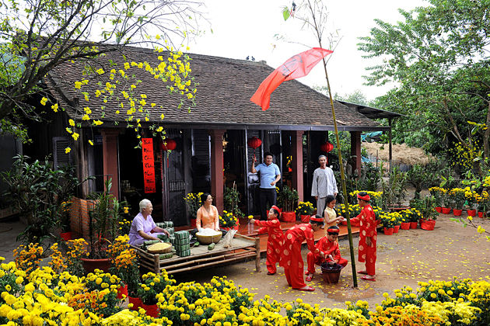
WARM-UP
LUNAR NEW YEAR / TET HOLIDAY

Slide 5
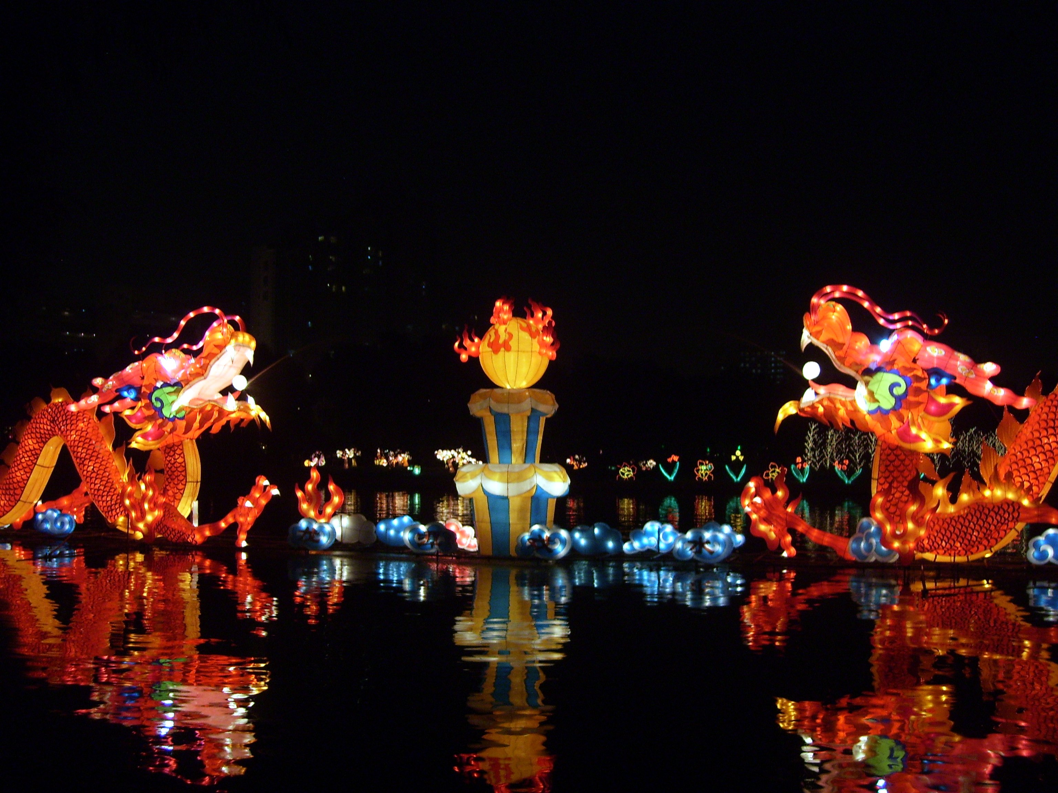
WARM-UP
FULL MOON FESTIVAL / MID-AUTUMN FESTIVAL

Slide 6
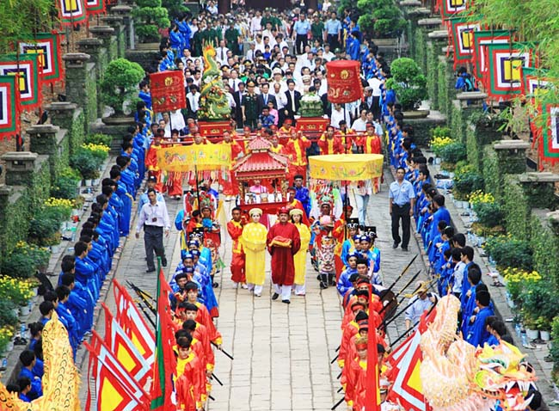
WARM-UP
HUNG KING TEMPLE FESTIVAL

Slide 7
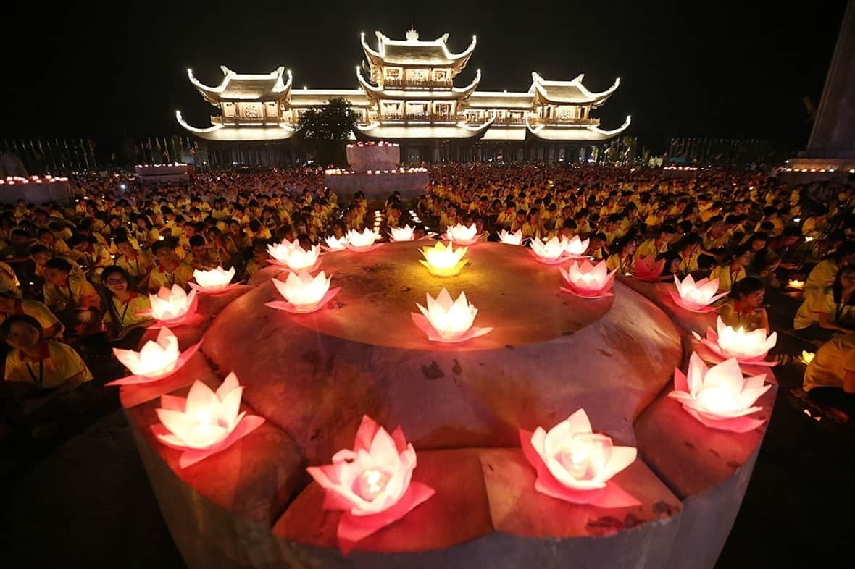
WARM-UP
BUDDHA’S BIRTHDAY

Slide 8
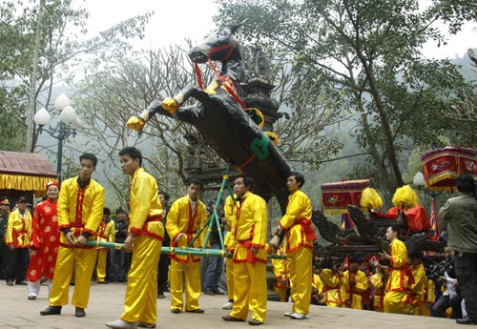
WARM-UP
GIONG FESTIVAL

Slide 9
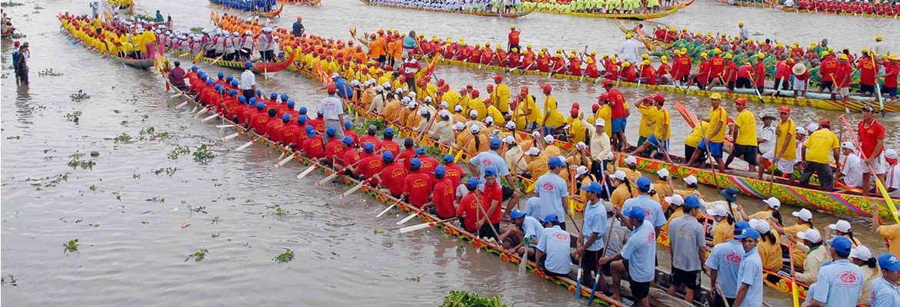
WARM-UP
OK OM BOK FESTIVAL

Slide 10

LISTENING
1
Work in pairs. Look at the picture and answer the following questions.
1. What can you see in the photos?
2. In which part of Viet Nam might the festival occur?

Slide 11

LISTENING
2
Listen to part of the programme “Charming Viet Nam”. Fill in each blank with no more than TWO words.
Ok Om Bok Festival
Purposes | - to thank the Moon God - to mark the (1) ______ of the Khmer year
Time | mid-October (lunar calendar)
Offerings | (2) ___________ and fruits
Activities | - singing and dancing - games and traditional (3) ______________ - Ngo Boat (4) ______
end
young rice
fashion shows
Race

Slide 12

LISTENING
3
Listen again and tick T (True) or F (False).
 | T | F
1. Ok Om Bok is the Moon Worshipping Festival.
2. On the night of the festival, the elders talk about their wishes.
3. There are lantern contests at the festival.
4. Tourists should wear informal clothes when attending the worshipping ceremony.

Slide 13
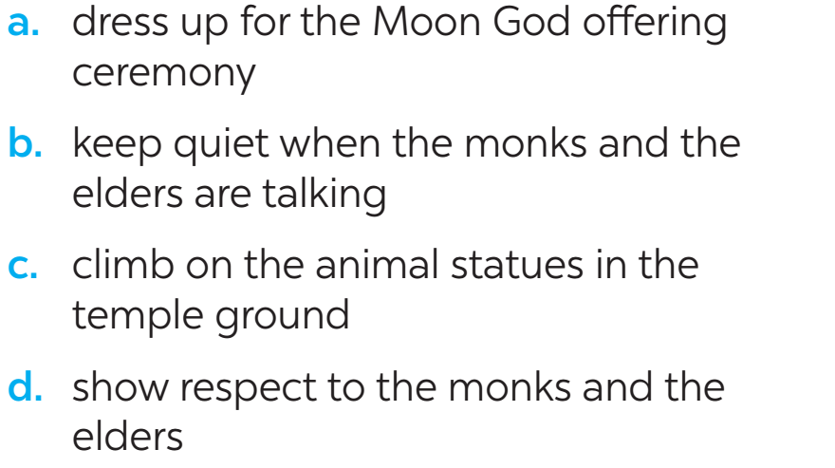
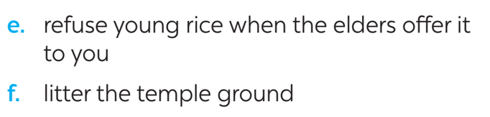
WRITING
4
Work in groups. Read the following pieces of advice for tourists at the Ok Om Bok Festival. Put them in the correct column.
Dos | Don’ts
a | f
b
c
d
e

Slide 14
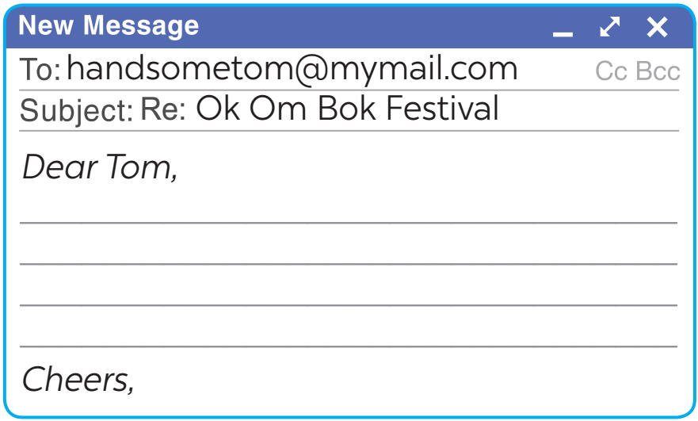
WRITING
5
Tom sent you an email. Read part of his email below.
“… Guess what! My dad is taking me with him to Soc Trang Province. We will be there during the Ok Om Bok Festival. What are some dos and don’ts at this festival? ...”
Write an email (80 - 100 words) to advise Tom about participating in the Ok Om Bok Festival.

Slide 15

CONSOLIDATION
1
Wrap-up
In this lesson, we have learnt to:
listen about a festival;
write an email to give advice on participating in a traditional festival.

Slide 16

CONSOLIDATION
2
Homework
Rewrite the passage on the notebook.
Prepare for Lesson 7 – Looking back & project.

Slide 17

Website: hoclieu.vn
Fanpage: facebook.com/www.tienganhglobalsuccess.vn/

