Slide 1

UNIT 4: INTERNATIONAL ORGANIZATIONS & CHARITIES
Lesson 1.2 – Grammar
Page 30

Slide 2


Lesson 1.2
LESSON OUTLINE
Wrap up

Slide 3

By the end of this lesson,
students will be able to …
practice and use The Present Simple and
The Present Continuous correctly.

Slide 4



Slide 5

Work in pairs.
Look around the classroom, describe what your classmates are doing. Try to make as many sentences as possible.
Example:
Mai and Linh are talking to each other.
Tam is looking out the window.
Hoang is writing something in his notebook.

Slide 6




Slide 7

Presentation
PRESENT SIMPLE
&
PRESENT CONTINUOUS

Slide 8
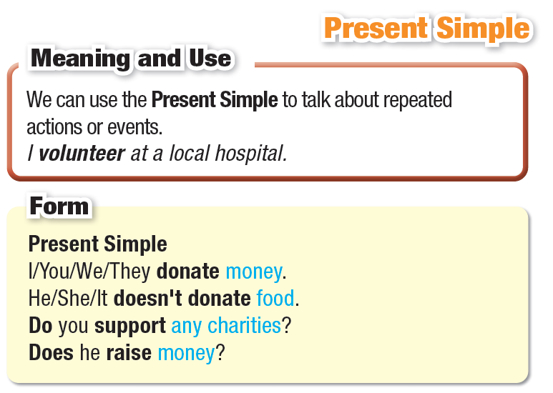

Slide 9

S1: I / you / we / they / plural nouns
S2: He / she / it / singular nouns
POSITIVE
S1 + V
S2 + V(s/es)
NEGATIVE
S1 + don’t + V (don’t = do not)
S2 + doesn’t + V (doesn’t = does not)
QUESTISONS
Do + S1 + + V?
Does + S2 + V?
Common adverbs: always, usually, often, sometimes, never, once/ twice/ three times a day/ a week/ a year, etc.

Slide 10
SPELLING OF –S AND –ES
To form a simple present verb in 3rd person, we usually add -s
dream → dreams
run → runs
see → sees
2. End of verb: -o, -sh, -ch, -ss, -x: add -es
do → does
wash → washes
teach → teaches
miss → misses
fix → fixes

Slide 11
3. End of verb: consonant + -y: change y to i, add -es
cry → cries
study → studies
4. End of verb: vowel + -y: add -s
pay → pays
buy → buys

Slide 12
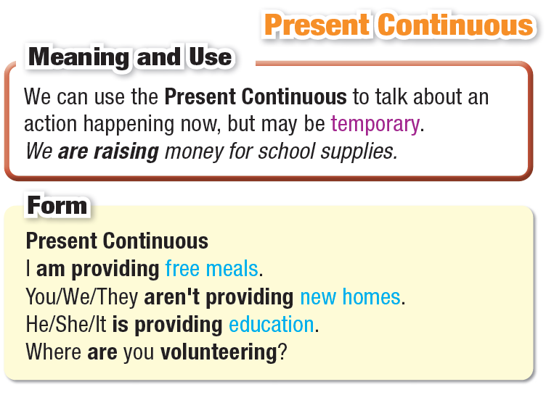

Slide 13

POSITIVE
S + am/ is/ are + V-ING
NEGATIVE
S + am/ is/ are + NOT + V-ING
QUESTIONS
Am/ Is/ Are + S + V-ING?
Common Adverbs: now, right now, at the moment,

Slide 14
SPELLING OF –ING
Most verbs: add -ing
dream → dreaming
stand → standing
2. End of verb: consonant + -e: drop –e and add -ing
smile → smiling
write → writing
(see → seeing)
3. End of verb: one vowel + one consonant: double the consonant, then add –ing run → running
sit → sitting
(rain → raining)

Slide 15
4. 2-syllable verbs ending in one consonant + one vowel + one consonant: double the last consonant if the last syllable is stressed
be’gin → beginning
for’get → forgetting
(‘open → opening)
5. End of verb -ie: change -ie to -y, add -ing
die → dying
lie → lying

Slide 16
Practice
PRESENT SIMPLE
&
PRESENT CONTINUOUS

Slide 17
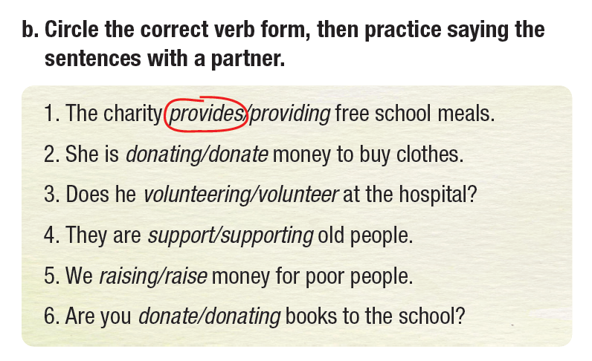

Slide 18
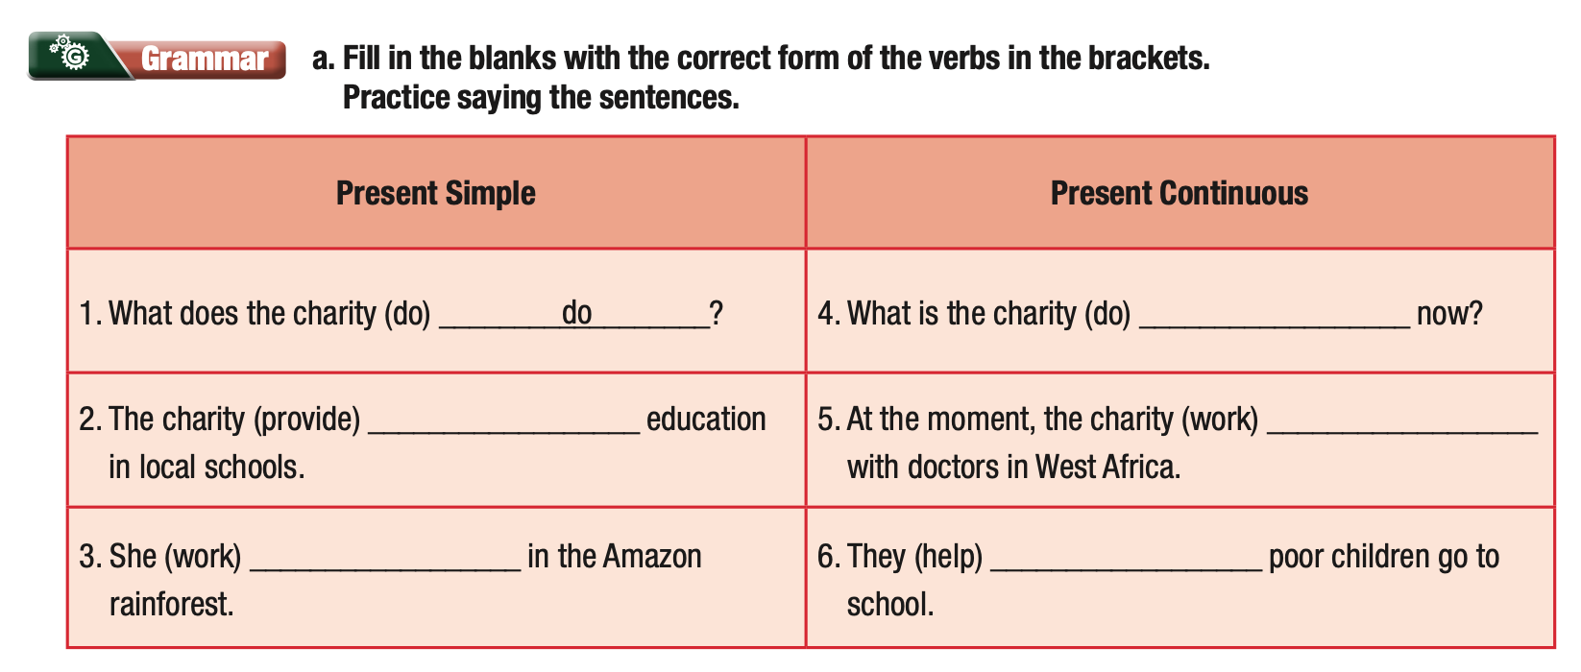
Extra Practice
WB, Page 21
is doing
provides
is providing
works
are helping

Slide 19
Extra Practice
WB, Page 21
Present Simple | Present Continuous
1. What does the charity (do) _________? | 4. What is the charity (do) __________________ now?
2. The charity (provide) ________ education in local schools. | 5. At the moment, the charity (work) __________________ with doctors in West Africa.
3. She (work) ______________ in the Amazon rainforest. | 6. They (help) ______________ poor children go to school.
do
provides
is doing
is providing
works
are helping

Slide 20
Extra Practice
WB, Page 21
b. Rewrite the Present Simple sentences in Present Continuous.
1. We build homes for people living in the mountains.
___________________________________________________
2. The charity works with volunteers to clean up beaches.
___________________________________________________
3. They donate clothes to Africa.
___________________________________________________
4. I teach children in poor countries.
___________________________________________________
5. He raises money for tigers and rhinos.
___________________________________________________________
We are building homes for people living in the mountains.
The charity is working with volunteers to clean up beaches.
They are donating clothes to Africa.
I am teaching children in poor countries.
He is raising money for tigers and rhinos.

Slide 21
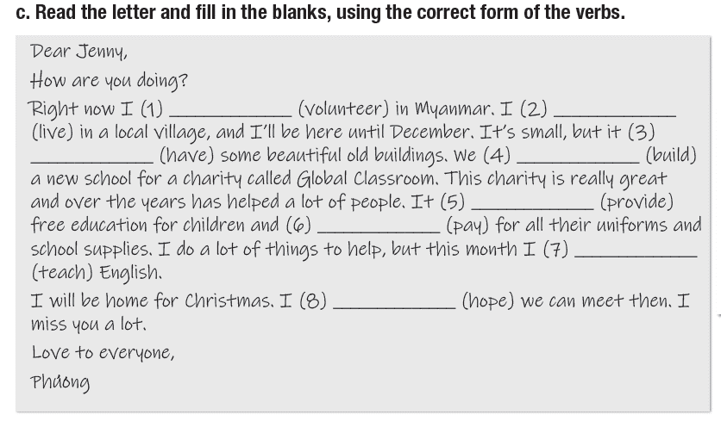

Slide 22
Dear Jenny,
How are you doing?
Right now I (1) an volunteering (volunteer) in Myanmar. I (2) ____ (live) in a local village, and I’ll be here until December. It’s small, but it (3) ___ (have) some beautiful old buildings. We (4) __________(build) a new school for a charity called Global Classroom. This charity is really great and over the years has helped a lot of people. It (5) _______ (provide) free education for children and (6) _____ (pay) for all their uniforms and school supplies. I do a lot of things to help, but this month I (7) ______________ (teach) English.
I will be home for Christmas. I (8) ______ (hope) we can meet then. I miss you a lot.
Love to everyone,
Phương
live
has
are building
provides
pays
am teaching
hope
hope

Slide 23
Production
PRESENT SIMPLE
&
PRESENT CONTINUOUS

Slide 24
Work in pairs.
Make sentences using the verbs in Task b. and exchange them with your partner.
Saigon Children Charity supports poor children.
We are collecting old books and donating them to schools in remote areas.

Slide 25

Consolidation

Slide 26
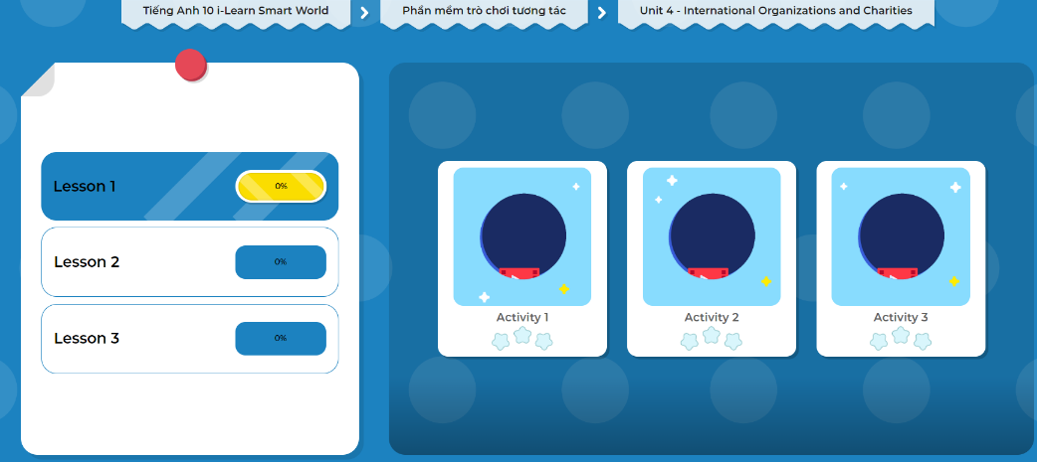
LET’S PLAY!
Click here to play the games.

Slide 27

WRAP-UP

Slide 28
Today’s lesson
Grammar Present Simple & Present Continuous
Spelling Adding -S/ -ES and -ING

Slide 29

Practice making sentences using the Simple Present and Present Continuous Tenses.
Do the exercises in WB on page 21 (Part 3 – Writing).
Complete the grammar notes in Tiếng Anh 10 i-Learn Smart World Notebook on page 21
Prepare the next lesson – Pronunciation and Speaking, page 32 in SB.
Play the consolidation games in Tiếng Anh 10 i-Learn Smart World DHA App on www.eduhome.com.vn

