Slide 1
Good morning class!!!
Liên hệ: 034.989.5579

Slide 2
* Warm up:
Game: Pelmanism
WRITE
LIVE
3
1
2
PLAY
GET
4
5
7
GOT
TOOK
WROTE
HAD
6
8
HAVE
PLAYED
11
12
9
10
LIVED
TAKE

Slide 3
Unit
3
COMMUNITY SERVICE
LESSON 3: A CLOSER LOOK 2
Unit

Slide 4
* GRAMMAR:

Slide 5
* GRAMMAR:
* Cách sử dụng thì quá khứ đơn
- Dùng để diễn tả một hành động đã xảy ra và kết thúc trong quá khứ.
Ví dụ: - They went to the concert last night.
* Dấu hiệu nhận biết thì quá khứ đơn
Trong câu có các trạng từ chỉ thời gian trong quá khứ:
- yesterday: hôm qua
- last night/ last week/ last month/ last year: tối qua/ tuần trước/ tháng trước/ năm ngoái
- ago: cách đây (two hours ago, two weeks ago, …)
- when: khi (trong câu kể)

Slide 6
* PRACTICE
1
1
Circle the correct answer A, B, or C to complete each sentence.

Slide 7
5
4
1
1. Green School ______ vegetables for an orphanage last spring.
3
2
a. is growing
b. grew
c. grows

Slide 8
5
2. Children ______ plastic bottles for recycling a month ago.
4
1
3
2
a. are collecting
b. collect
c. collected

Slide 9
5
4
1
3. We ______ English to children in a primary school last summer.
3
2
a. are teaching
b. taught
c. teach

Slide 10
5
4. Our school club ______ gloves for old people in nursing homes last winter.
4
1
3
2
a. made
b. is making
c. make

Slide 11
5
5. We ______ bottles to help the environment last month.
4
1
3
2
a. are reusing
b. reuse
c.reused

Slide 12
2
Complete the sentences the the past simple form of the given verbs.
took
1. Care for Animals (take) _______ care of thousands of homeless dogs and cats last year. 2. ___________ teenagers (join) ___________ Lending Hand in 2015? 3. We (help) ___________ the elderly in a village last summer. 4. Last year, we (send) ___________ textbooks to help children in a rural village. 5. Tom (volunteer) ______________ to teach English in our village last winter.
Did
join
helped
sent
volunteered

Slide 13
3
Complete the sentences with the correct forms of the verbs from the box.
plant read cook recycle pick up
1. The club members _____________ food for patients every Sunday. 2. ________ you _____________ those trees in the playground last month? 3. Nick and his friends _________________ rubbish on the beach now. 4. Tom ______________ the plastic bottles, and now he has some nice vases. 5. We often ____________ books to old people in a nursing home.
cook
Did
plant
are picking up
recycled
read

Slide 14
4
Write complete sentences from the prompts.
1. last year / our club / donate / books / children in rural areas. _____________________________________________________ 2. children / send / you thank-you cards / a week ago? _____________________________________________________ 3. I / teach / two children in grade 2 / last summer. _____________________________________________________ 4. Last spring / we / help / the elderly / nursing home. _____________________________________________________ 5. How / you / help / people / in flooded areas / last year? _____________________________________________________
Last year, our club donated books to children in rural areas.
Did children send you thank-you cards a week ago?
I taught two children in grade 2 last summer.
Last spring, we helped the elderly in a nursing home.
How did you help the people in flooded areas last year?

Slide 15
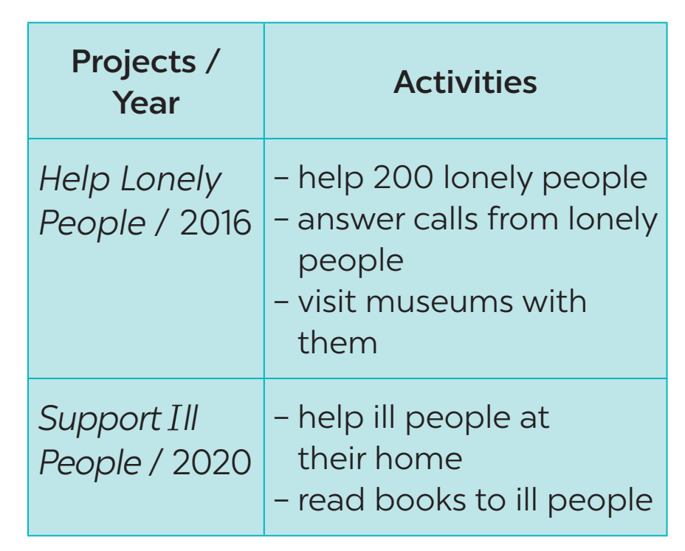
* PRODUCTION
5
Tom is from the Red Cross. Look at the fact sheet and ask Tom about his projects in 2016 and 2020.
The Red Cross in 2016 and 2020
Example: Tom: I’m from the Red Cross. I worked on the Help Lonely People project in 2016. Lan: What did you do? Tom: We helped 200 lonely people …
Lan: What else?
Tom: I also answered calls from lonely people and visited museums with them.

Slide 16
* PRODUCTION
5
The Red Cross in 2016 and 2020
Example: Nam : I’m from the Red Cross. I worked on the Support Ill People project in 2020. Nga: What did you do?
Tom: I and my friends helped ill people at their homes. ………………….

Slide 17
CONSOLIDATION
1
WRAP-UP

Slide 18
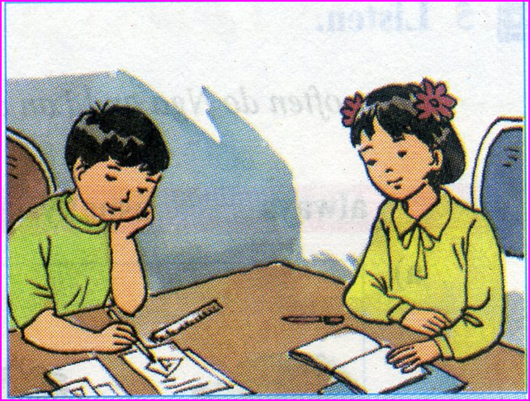
homework
- Complete exercises in the Workbook.
- Prepare lesson 4: Communication

Slide 19
Thank you!
Have a nice day!

