Slide 2



Unit
1
MY NEW SCHOOL
LESSON 7: LOOKING BACK & PROJECT
1

Slide 3
LESSON 7: LOOKING BACK & PROJECT
LESSON 1: GETTING STARTED
WARM-UP
Brainstorming: School things
Task 1: Write the correct words in the gaps.
Task 2: Match the words in A with the words/ phrases in B.
VOCABULARY REVIEW
Task 3: Complete the sentences with the present simple.
Task 4: Complete the text with the correct form of the verbs in brackets.
Task 5: Put the adverb in brackets in the correct place in each sentence.
GRAMMAR REVIEW
PROJECT
Your dream school
CONSOLIDATION
Wrap-up
Homework

Slide 4



WARM-UP
BRAINSTORMING
2 teams
Write as many school things as possible in 2 minutes.
Group with more correct answers

Slide 5
WARM-UP
BRAINSTORMING
pencil
compass
pencil sharpener
rubber
calculator
pen
school bag
subject
uniform

Slide 6

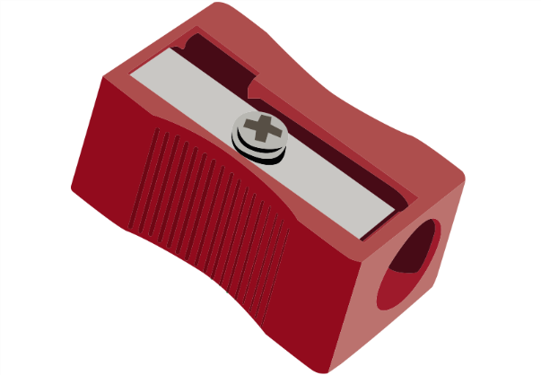

VOCABULARY
1
Look at the pictures. Write the correct words in the gaps.
1. Our new _________ is very nice.
2. I have a red _______________.
3. This is my ___________ for writing English words.
uniform
pencil sharpener
notebook

Slide 7
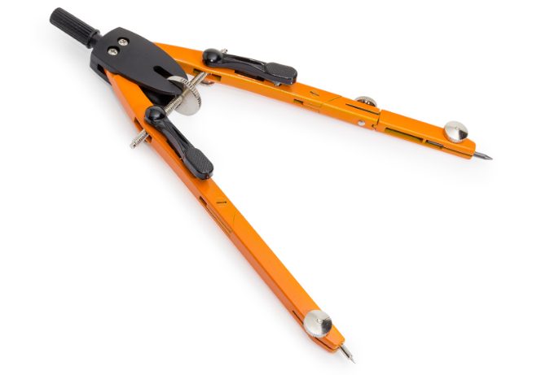
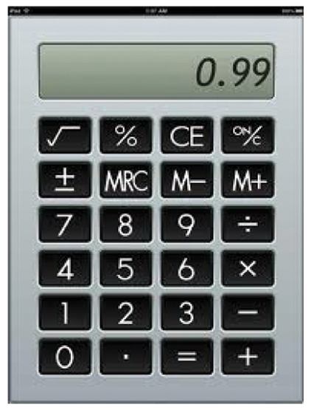
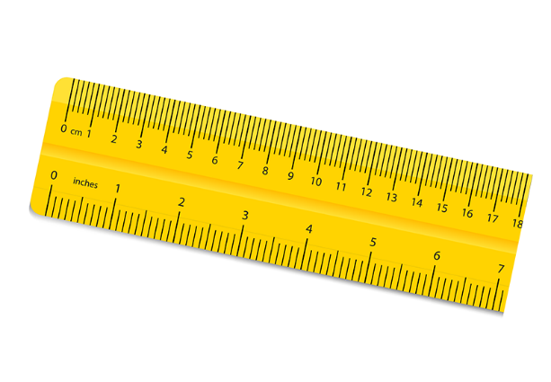
VOCABULARY
1
Look at the pictures. Write the correct words in the gaps.
4. We often use a _________ in a maths class.
5. Can you lend me your ___________ for a minute?
6. My new ______ is short.
compass
calculator
ruler

Slide 8

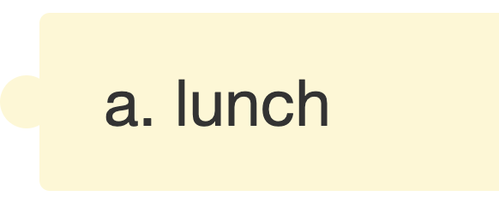

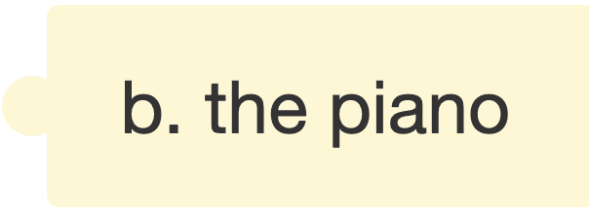
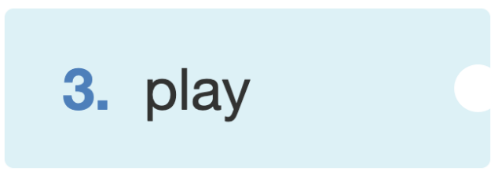
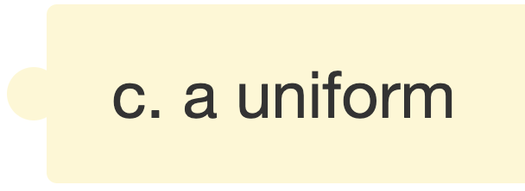

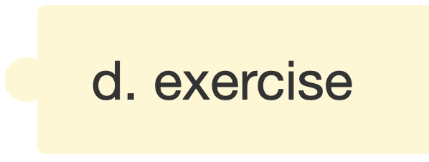

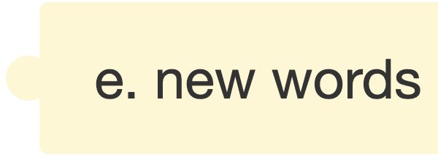
VOCABULARY
2
Match the words in A with the words/ phrases in B.
A
B

Slide 9
VOCABULARY
2
Match the words in A with the words/ phrases in B.
A
B

Slide 10
VOCABULARY
2
Match the words in A with the words/ phrases in B.
A
B

Slide 11
VOCABULARY
2
Match the words in A with the words/ phrases in B.
A
B

Slide 12
VOCABULARY
2
Match the words in A with the words/ phrases in B.
A
B

Slide 13
VOCABULARY
2
Match the words in A with the words/ phrases in B.
A
B

Slide 14
GRAMMAR
3
Complete the sentences with the present simple.
1. He (come) ______ from Da Nang.
2. − Do you learn Russian? − No, I (not do) _______.
3. She always (walk) _______ to school with her friends.
4. I often (do) _______ my homework after school.
5. Mr Nam (teach) _______ history at my school.
comes
don't
walks
do
teaches

Slide 15
GRAMMAR
4
Complete the text with the correct form of the verbs in brackets.
Hoang lives in a small house in the centre of his village. His house (1. be) ____ near his new school. Every day, he (2. have) ____ breakfast at 6 o'clock. Then he (3. walk) _____ to school with his friends. Hoang and his friends (4. study) _____ in grade 6 at An Son School. Hoang (5. like) _____ his new school.
is
has
walks
study
likes

Slide 16
GRAMMAR
4
Complete the text with the correct form of the verbs in brackets.
1. I remember to do my homework. (always)
→ I always remember to do my homework.
2. Nick gets good marks in exams. (usually)
→ Nick usually gets good marks in exams.
3. We do not see a rabbit in town. (often)
→ We do not often see a rabbit in town.

Slide 17
GRAMMAR
4
Complete the text with the correct form of the verbs in brackets.
4. I read in bed at night. (rarely)
→ I rarely read in bed at night.
5. Do you sing in the shower? (sometimes)
→ Do you sometimes sing in the shower?

Slide 18
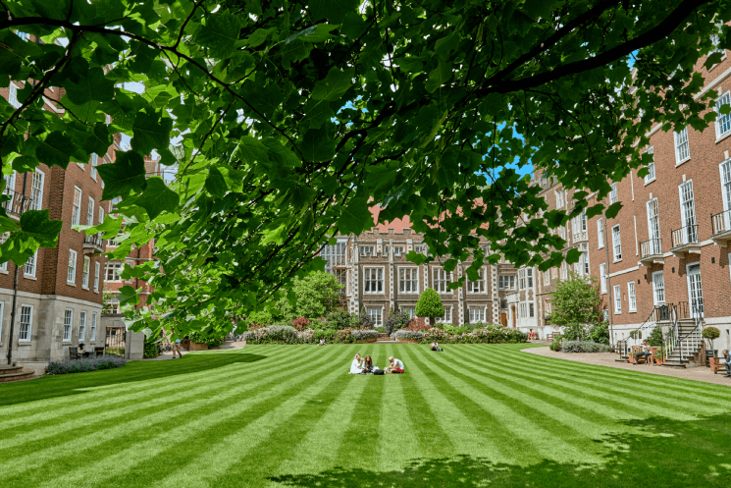

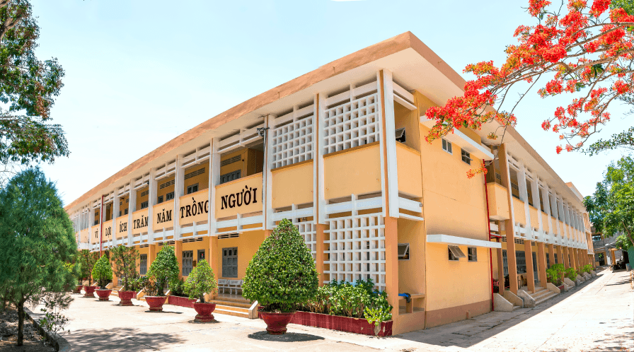

PROJECT

Slide 19

CONSOLIDATION
1
Wrap-up
What have we learnt in this lesson?
Review vocabulary related to school things and activities
Review present simple and adverbs of frequency
Do a project

Slide 20

CONSOLIDATION
2
Homework
Prepare for the next lesson:
Unit 2 – Lesson 1: Getting started

Slide 21






Website: hoclieu.vn
Fanpage: facebook.com/www.tienganhglobalsuccess.vn/

