Slide 4
I LIKE…
Notes:
PIC 1: COMPUTER- I LIKE COMPUTERS
PIC 2: PE- I LIKE PE

Slide 5
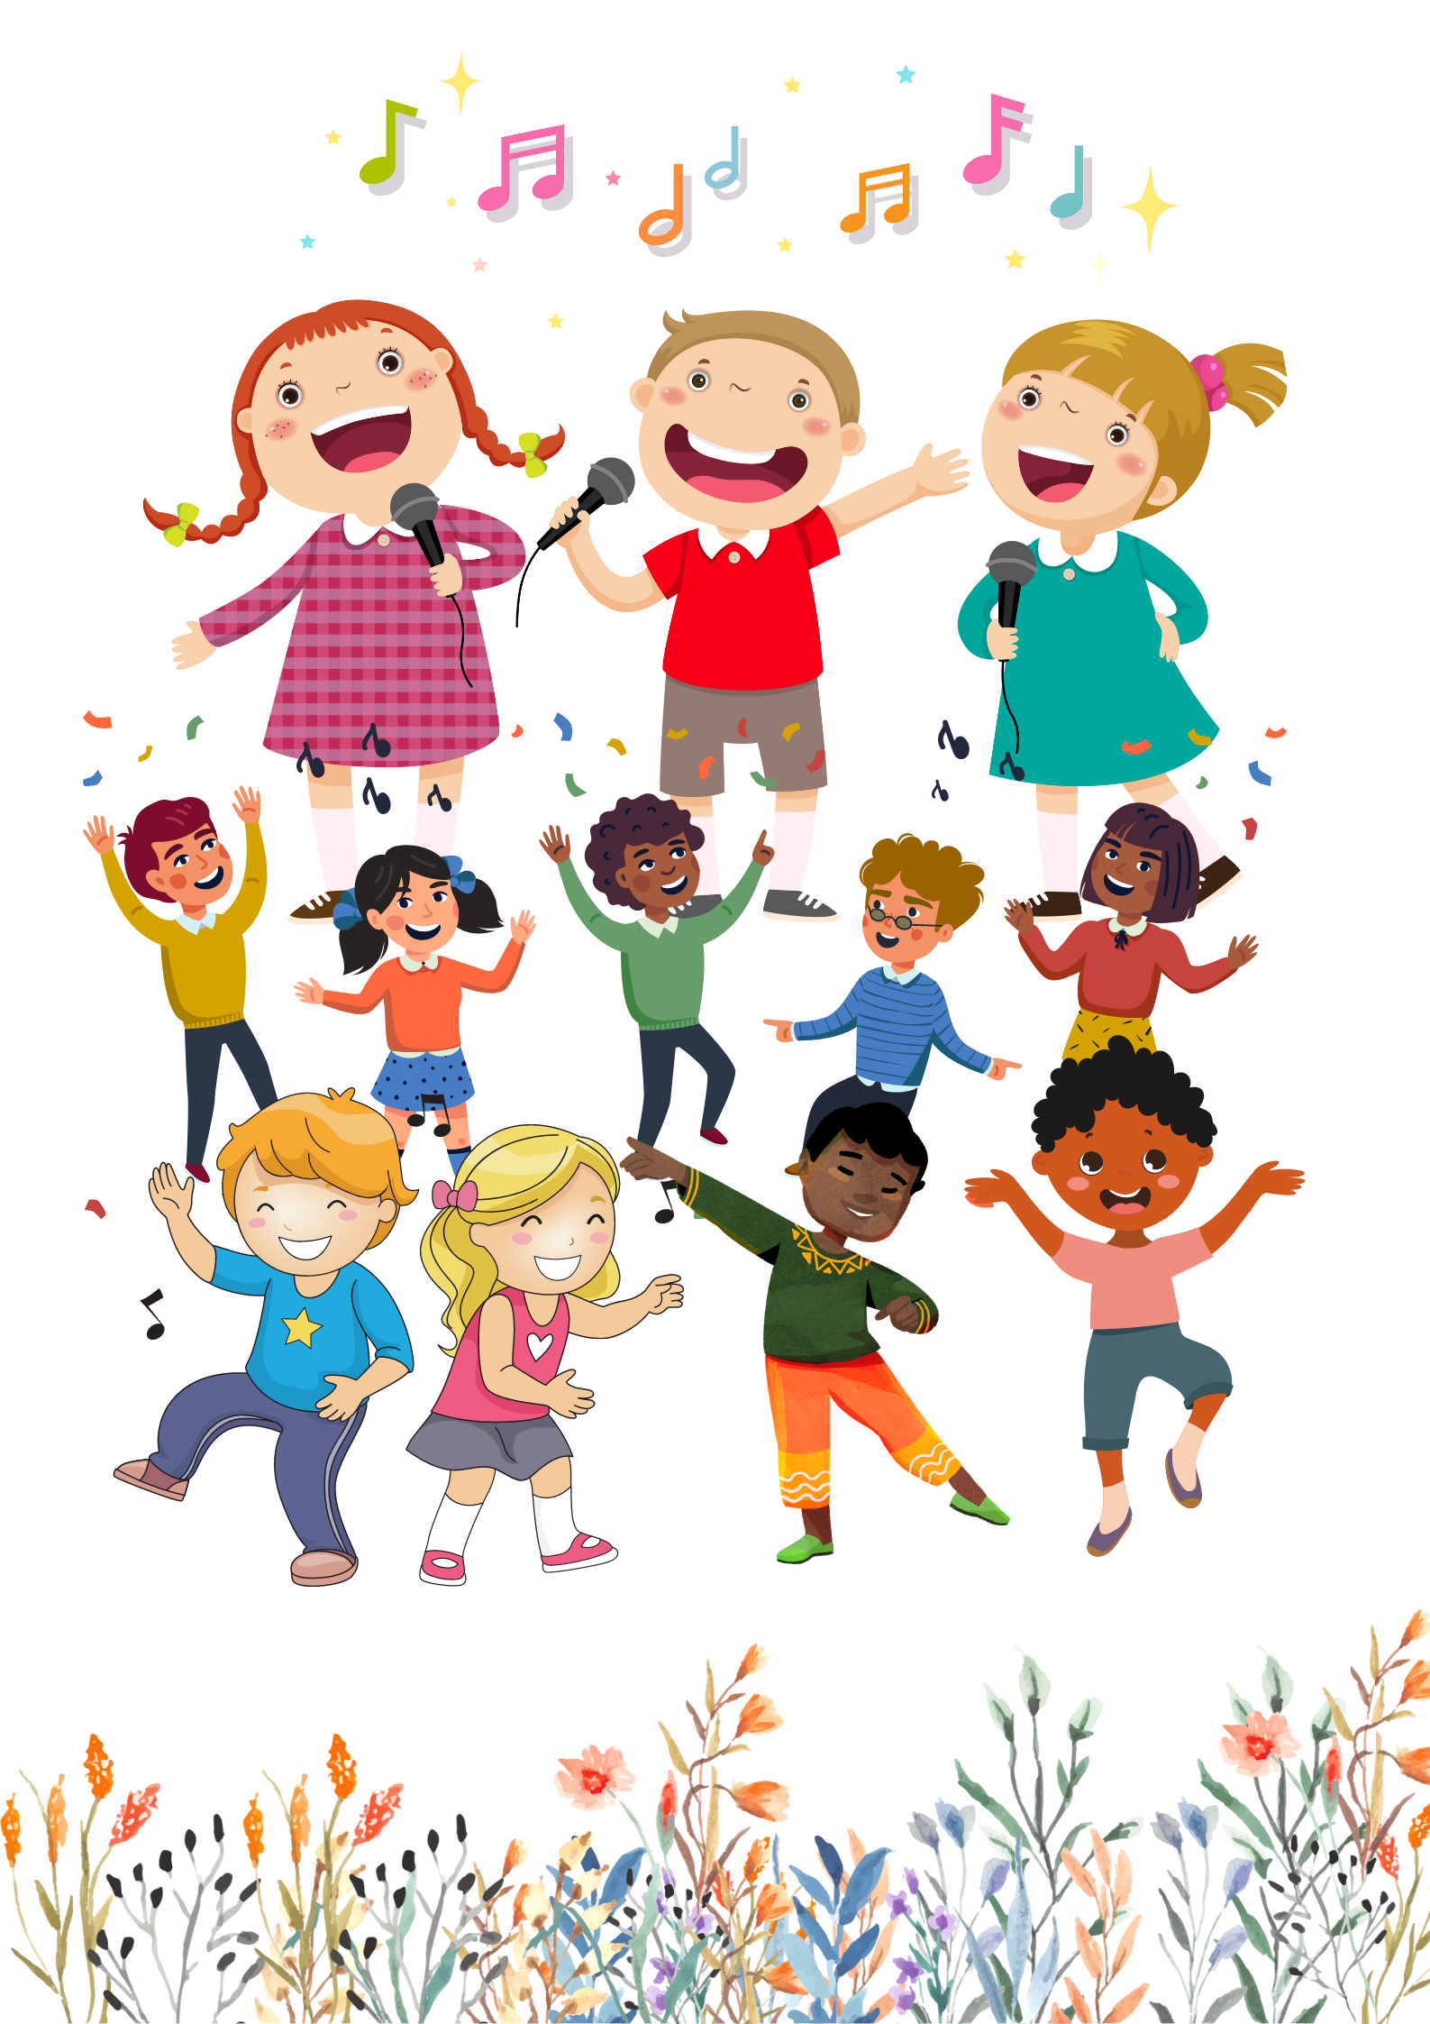
SINGING CONTEST
Notes:
PLAY THE SONG ONCE TO HELP PUPILS RECALL THE RYTHMS AND LYRICS
PLAY “I LIKE” PAUSE, MIMING AN ACTION, GUIDE PUPILS TO SING, SING WITH THEM
REPEAT SEVERAL ACTIONS
LET SOME GROUPS TO COMPETE IF POSSIBLE

Slide 7
Notes:
BDAC

Slide 8
Notes:
BDAC

Slide 10
Why
painter

Slide 11
subject
Because
music

Slide 12
Notes:
read out loud together, correct pronunciation if necessary

Slide 13
Notes:
let pupils think and give answer: music- singer; picture- painter- chalk- teacher- computer- IT teacher/ IT

Slide 14
Notes:
explain the rule
cover again to practice making sentences
use unit flashcards to FLASH randomly, reversely and repeatedly to practice making sentences

Slide 15
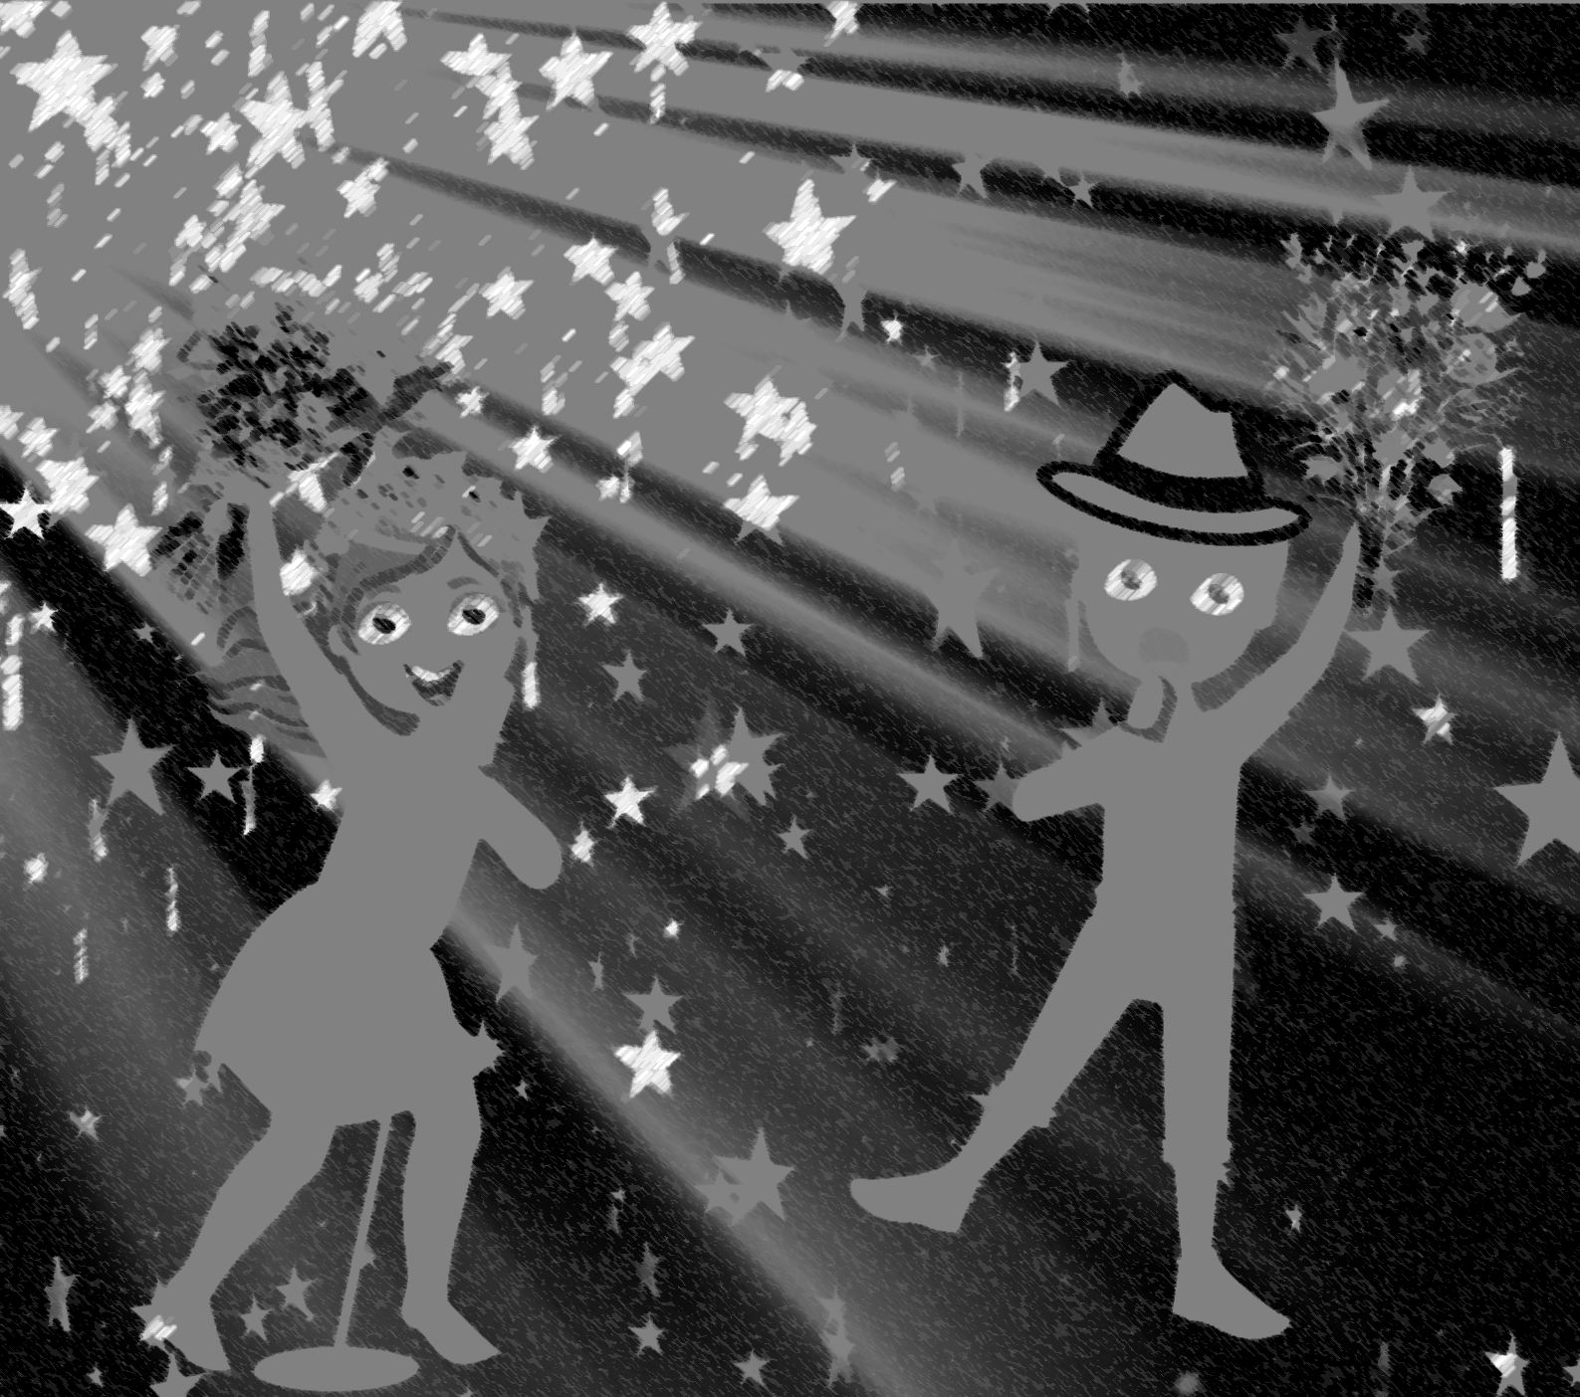
a maths teacher
Notes:
let pupils guess the job to practice saying “I ile music because I want to be a singer”

Slide 16
Notes:
music- singer
if time allowed, let pupils play the game to practice the structure
https://learnenglishkids.britishcouncil.org/word-games/jobs-1

