Slide 1

Unit 1: Free Time
Lesson 3.2: Speaking & Writing
Page 11

Slide 2




Lesson 3.2
LESSON OUTLINE
Consolidation

Slide 3

By the end of this lesson, students will be able to…
- use some adjectives to talk about extreme sports.
- invite a friend to join an activity.
- write an invitation email to ask a friend to join an activity.

Slide 4

WARM-UP

Slide 5

Work in pairs
Name the pictures.

Slide 6
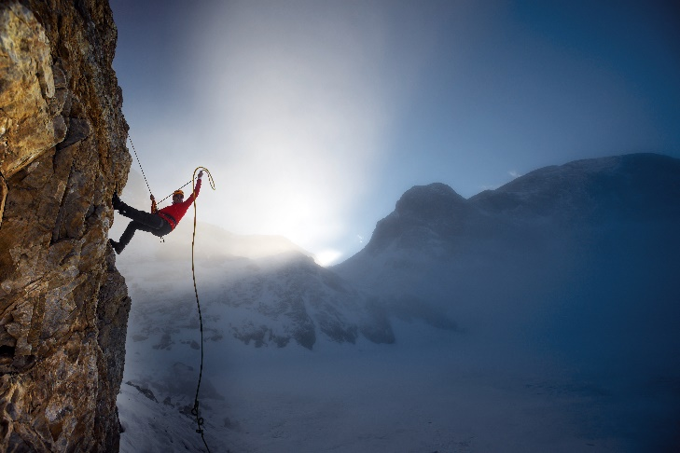
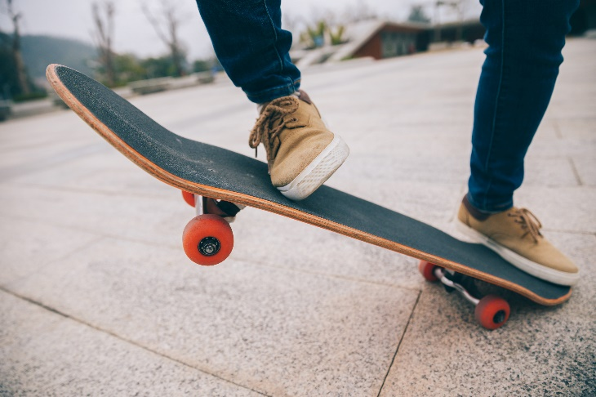
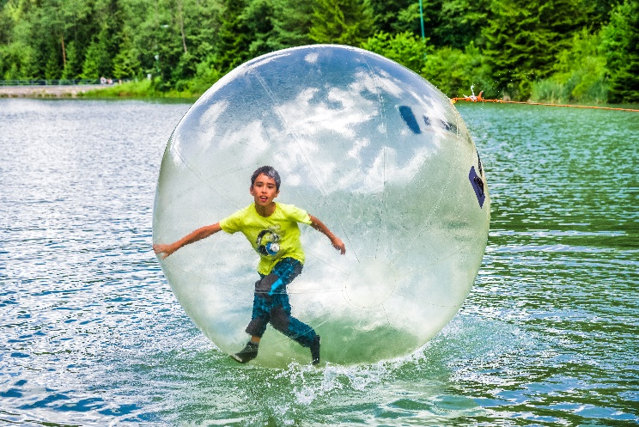
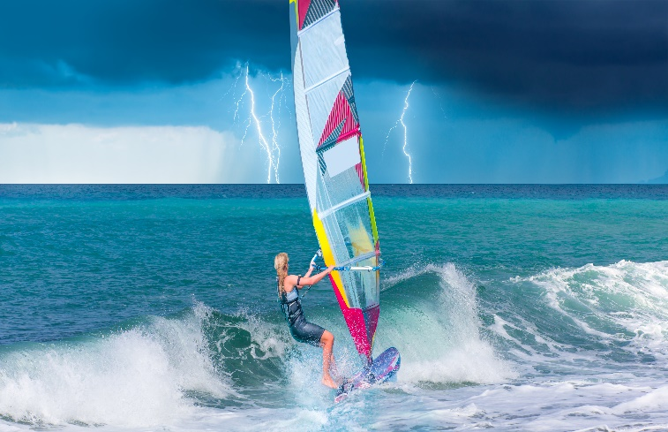
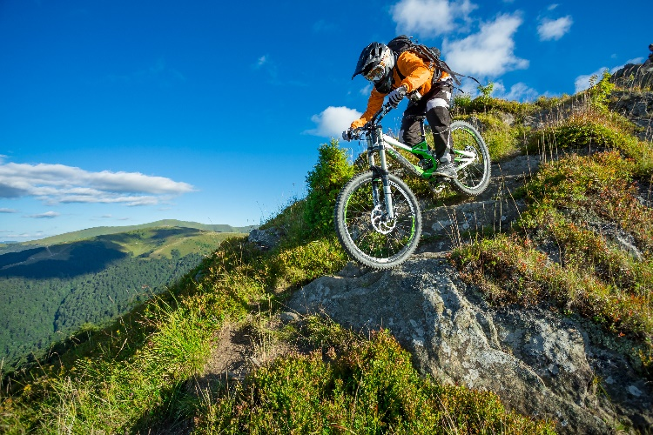
1. mountain climbing
2. skateboarding
3. zorbing
4. wind surfing
5. mountain biking

Slide 7


It’s writing time….
Writing

Slide 8
Pre - writing
a. Read the notes on writing invitation emails. Use the following sentences to replace some parts in Mark’s email on page 10.
1. Hey Ryan,
2. Speak to you soon.
3. I'm going surfing at Turtle Beach. Do you want to come?
4. Let me know if you want to come.

Slide 9
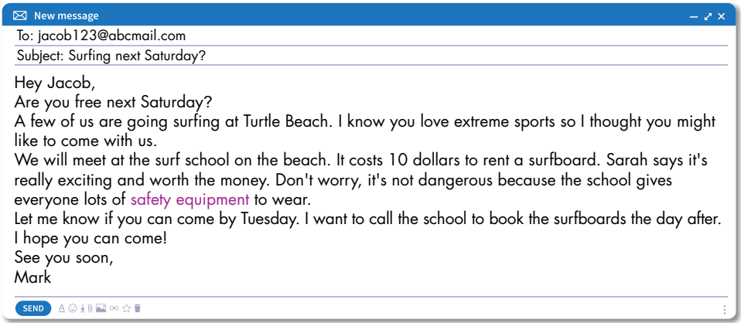
1
Hey Ryan,
I'm going surfing at Turtle Beach. Do you want to come?
3
4
Let me know if you want to come.
Speak to you soon.
2

Slide 10
Pre - writing
Elicit important elements of an email.
Subject line: the first thing the reader sees in their inbox
Greetings: a salutation to the recipient
Intro: the purpose of the email
Body: email text
Closing: a “see you” type phrase and your signature

Slide 11
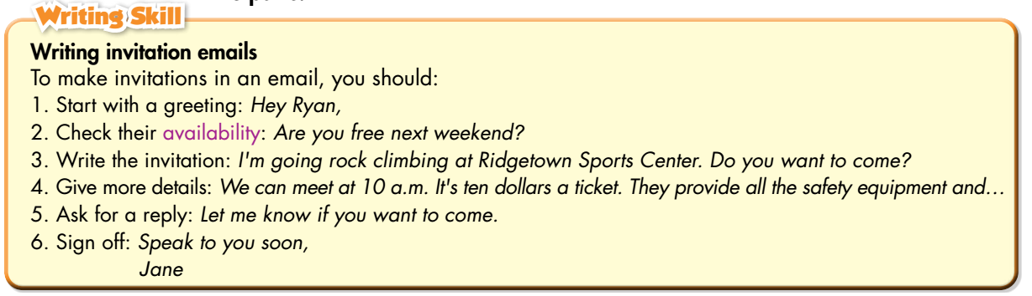
Pre - Writing
Read the notes on writing an invitation email again.

Slide 12
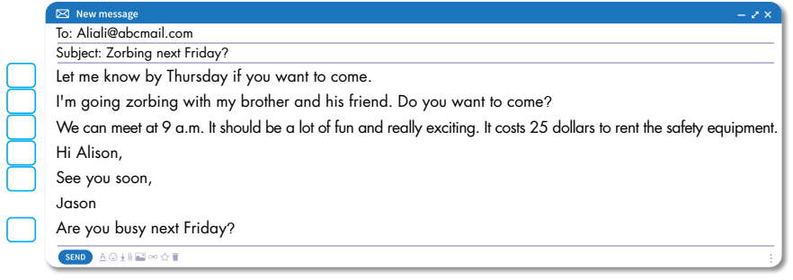
While - writing
b. Reorder the parts of the email. Use the skill box to help you.
5
3
4
1
6
2

Slide 13
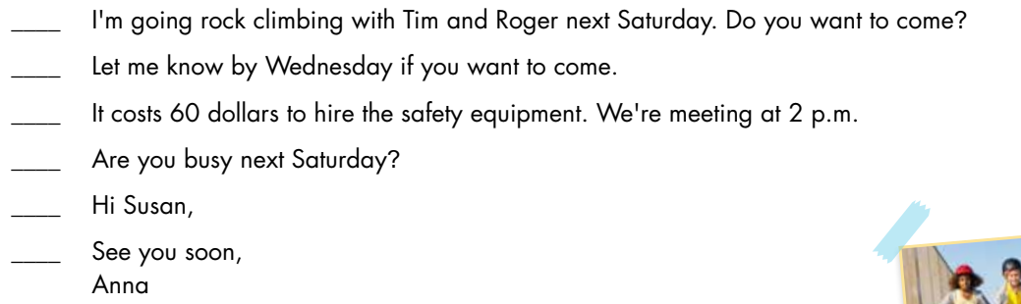
Extra Practice
WB, page 7
Reorder parts of the email (1–6).
3
5
4
2
1
6

Slide 14
While - writing
Complete the invitation email.
Hi Susan,
Are you busy next Saturday?
I'm going rock climbing with Tim and Roger next Saturday. Do you want to come?
It costs 60 dollars to hire the safety equipment. We're meeting at 2 p.m.
Let me know by Wednesday if you want to come.
See you soon,
Ann.

Slide 15
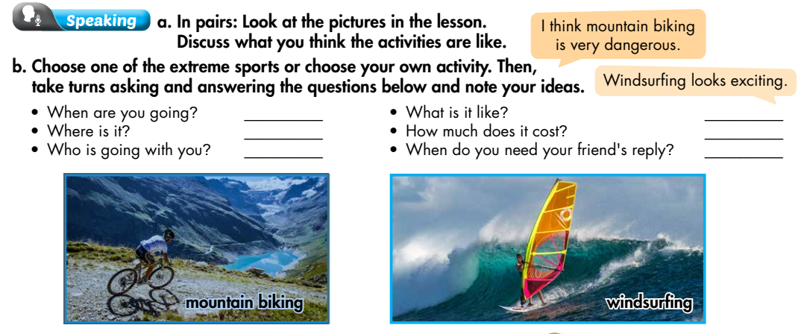
At the weekend.
It’s exciting.
At the mountain.
20 dollars.
Jack and Mike.
By Wednesday.

Slide 16
While - writing
Now, write an invitation email to ask a friend to join you for an
activity. Write 60 to 80 words.
To: richard@aczmail.com
Subject: Moutain biking at the weekends.
Hi Richard,
Are you busy at the weekend?
I'm going mountain biking at the mountain with Jack and Mike next Saturday. Do you want to join us?
It costs 20 dollars to hire the safety equipment. We're starting at 2 p.m.
Let me know by Wednesday if you want to join.
See you soon,
Scott.

Slide 17

CONSOLIDATION

Slide 18

Work in pairs.
Asking and answering about an extreme sport.

Slide 19

WRAP-UP

Slide 20
Today’s lesson
Adjectives to describe extreme sports: exciting, dangerous, fascinating, challenging, …
Format of an invitation email:
1. Start with a greeting
2. Check their availability
3. Write the invitation
4. Give more details
5. Ask for a reply
6. Sign off

Slide 21
Homework
Do the exercises on page 7 WB.
Complete the writing notes in Tiếng Anh 7 i-Learn Smart World Notebook on page 9.
Prepare Review Unit 1 (page 84 & 85 - SB).
Play the consolidation games in Tiếng Anh 7 i-Learn Smart World DHA App on www.eduhome.com.vn

Slide 22

Lesson 3
Stay positive and have a nice day!

