Slide 1

Unit 1: Free time
Lesson 1.1: Vocabulary & Reading
Page 4

Slide 2



LESSON OUTLINE
Consolidation

Slide 3

By the end of this lesson, students will be able to…
- talk about their hobbies.
- practice reading and understanding general and specific information about a teen’s hobby.

Slide 4

New words
collect soccer stickers
build models
bake cakes
make vlogs
read comics
play online games

Slide 5
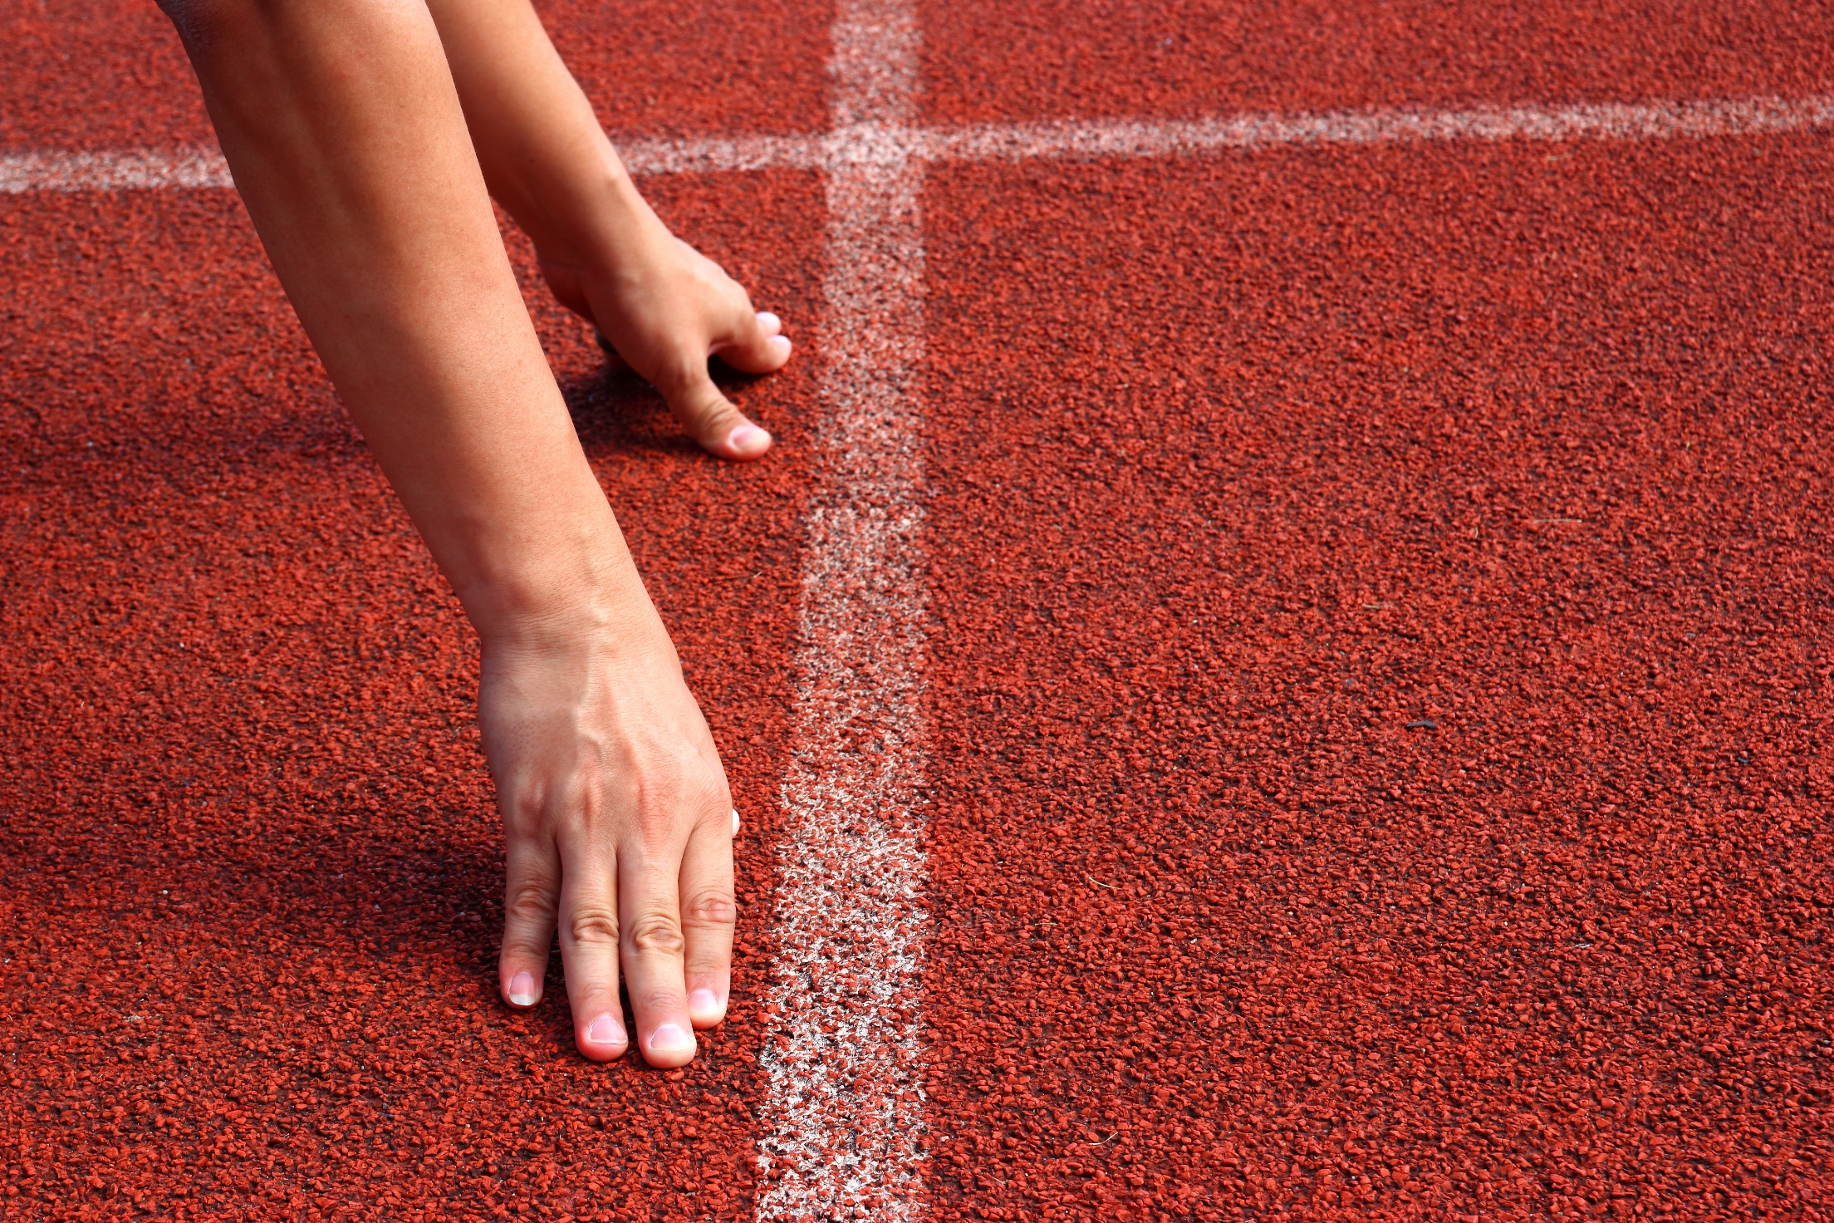
WARM-UP

Slide 6

Work in pairs
1. What do you often do in your free time?
2. How much time do you spend doing it?
3. Do you find it useful? Why?

Slide 7

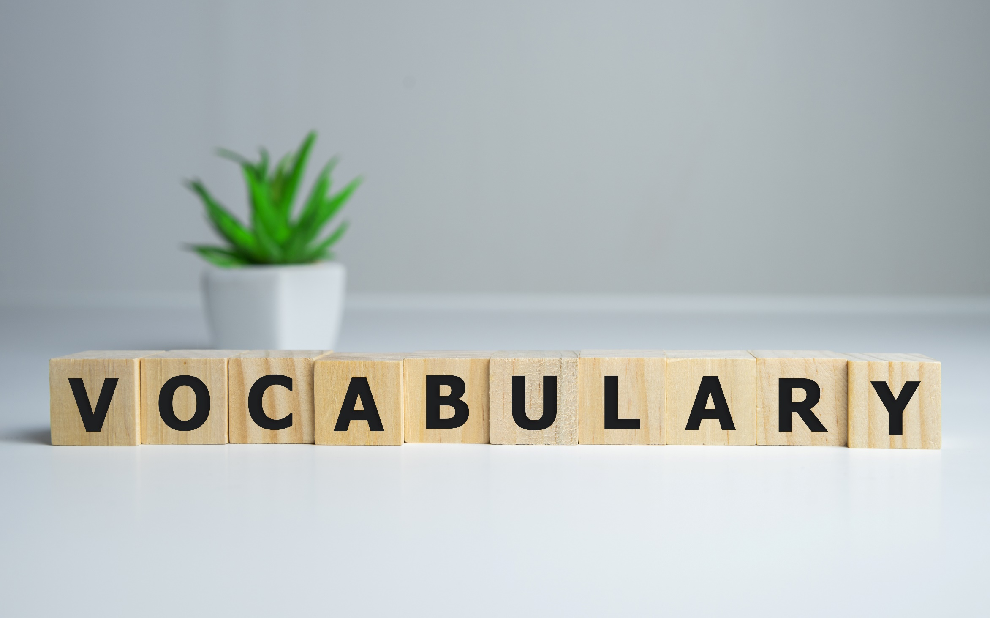

Slide 8

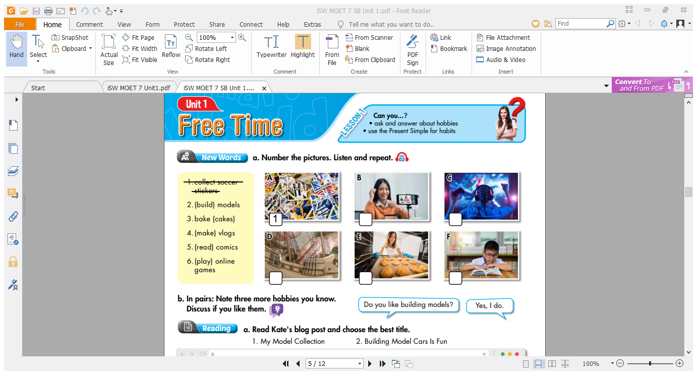
Work in pairs.
What does each person do in each picture?

Slide 9

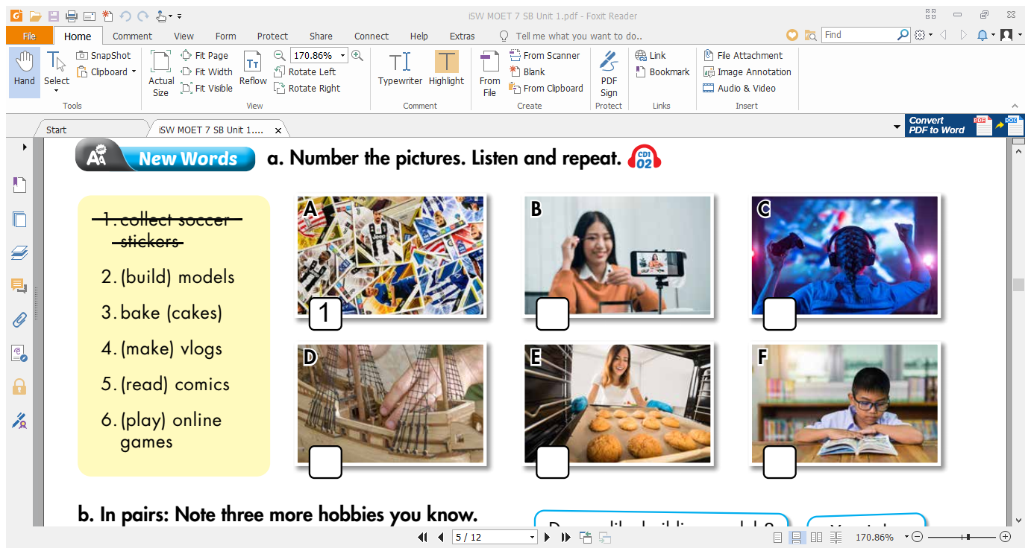
Work in pairs. a. Number the pictures.
4
6
2
3
5

Slide 10

Listen and repeat. Click each phrase to hear the sound.
collect soccer stickers (V. phr) /kəˈlekt sɑːkər ˈstɪkəz/
sưu tầm miếng dán cầu thủ bóng đá
build models (V. phr) /bɪld ˈmɑːdəlz/ lắp ghép mô hình
bake cakes (V. phr) /beɪk keɪks/ làm bánh
make vlogs (V. phr) /meɪk vlɑːɡz/ quay video dạng nhật ký ngắn
read comics (V. phr) /riːd ˈkɑːmɪks/ đọc truyện tranh
play online games (V. phr) /pleɪ ˈɑːnlaɪn ɡeɪmz/ chơi trò chơi trực tuyến

Slide 11
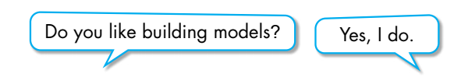

Work in pairs.
b. Note three more hobbies you know. Discuss if you like them.

Slide 12
Extra Practice
WB, page 2
Fill in the blanks with the words you have learned with correct form of verbs.
1. Frank likes stories with pictures and reads a lot.
His hobby is _____________.
2. Carol creates videos and posts them on the internet.
Her hobby is ___________.
3. James likes sports. He likes collecting things, too.
His hobby is _____________________.
reading comics
making vlogs
collecting soccer stickers

Slide 13
Extra Practice
WB, page 2
Fill in the blanks with the words you have learnt with correct form of verbs.
4. Tom likes cooking and he likes making sweet food.
His hobby is ___________.
5. Leo really likes making planes, trains, and boats.
His hobby is ______________.
6. Tina likes using different characters to compete against people on the internet.
Her hobby is __________________.
baking cakes
building models
playing online games

Slide 14

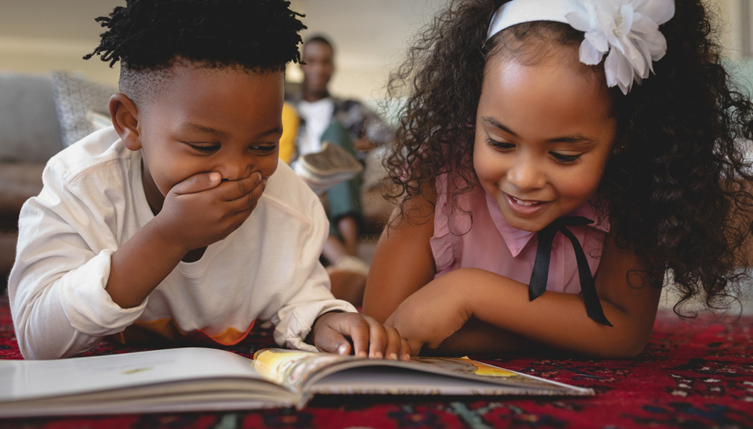
It’s reading time….

Slide 15
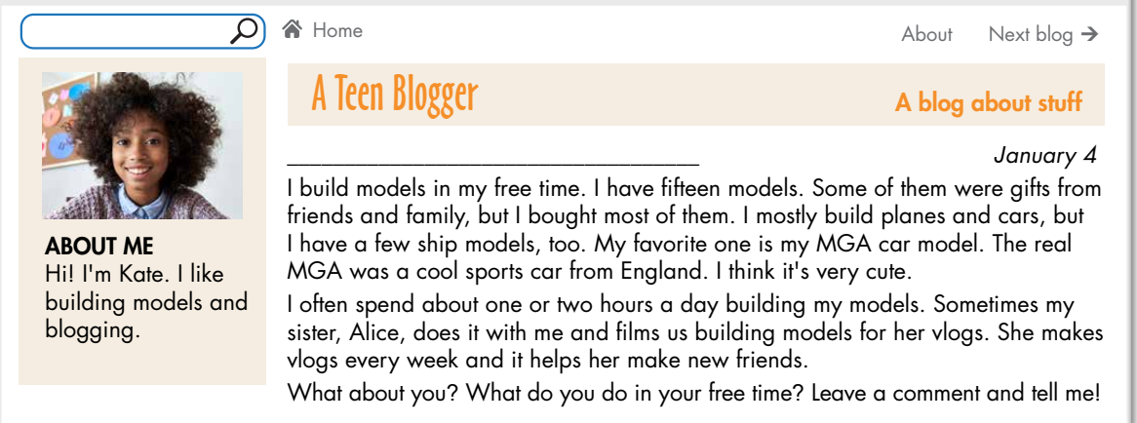
Pre-reading
What is the girl’s name?
→ Her name is Kate.

Slide 16
Pre-reading
What does she like doing?
She likes building models and blogging.

Slide 17
Pre-reading
What are you going to do?
→ Read Kate’s blog post.

Slide 18
Pre-reading
And then?
→ Choose the best title.

Slide 19
Pre-reading
Read the instruction quickly. Underline the key words. What are we going to do?
Read and choose the correct title.
1. My Model Collection
2. Building Model Cars Is Fun

Slide 20
While-reading
Read and choose the correct title.
1. My Model Collection
2. Building Model Cars Is Fun
cars, planes, ships
cars only

Slide 21
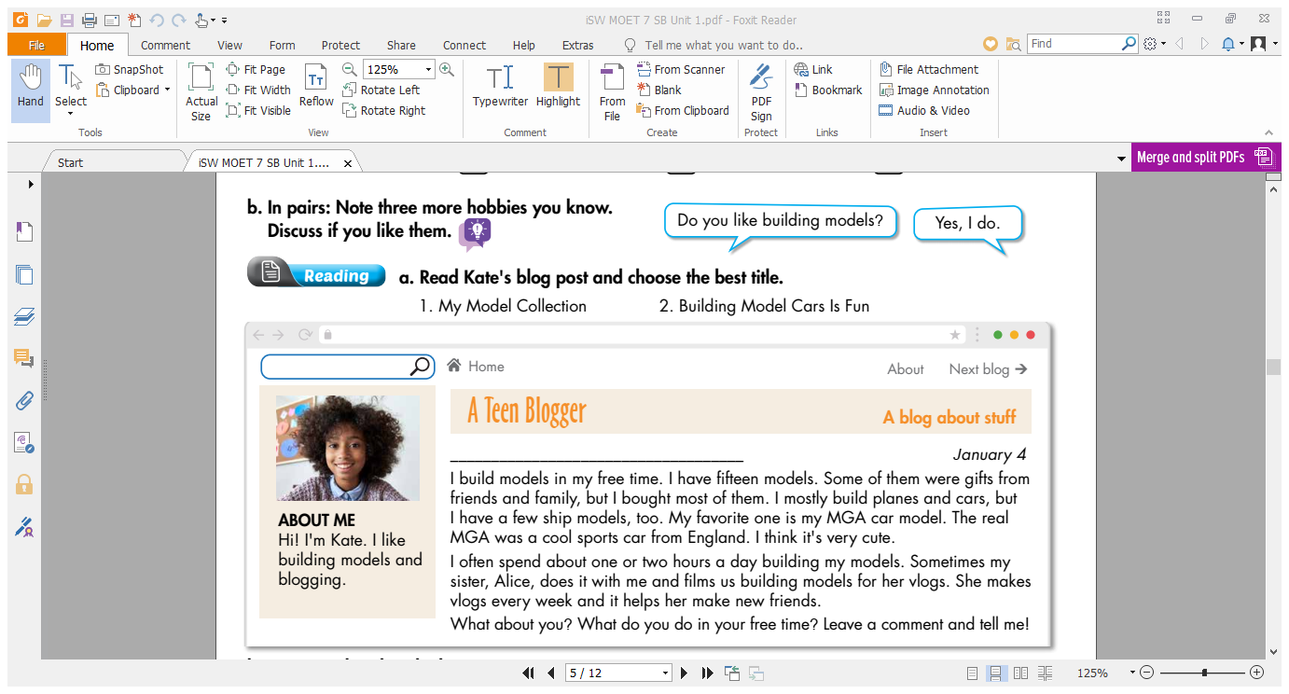
Look at the topic sentence and guess.
Building models

Slide 22
Skim the text. Underline the key words/phrases. Choose the best title.
2. My Model Collection

Slide 23
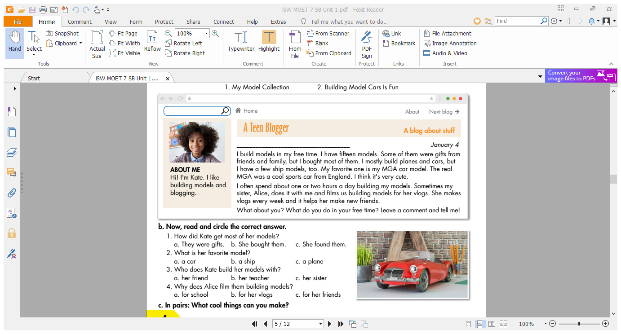
Pre-reading
What are you going to do with
exercise b?
→ Read the blog post again.
And then?
→ Circle the correct answer.

Slide 24
b. Read the questions. Underline the key words. Scan the text and choose the correct answer.
1. How did Kate get most of her models?
a. They were gifts. b. She bought them. c. She found them.
2. What is her favorite model?
a. a car b. a ship c. a plane
3. Who does Kate build her models with?
a. her friend b. her teacher c. her sister
4. Why does Alice film them building models?
a. for school b. for her vlogs c. for her friends

Slide 25
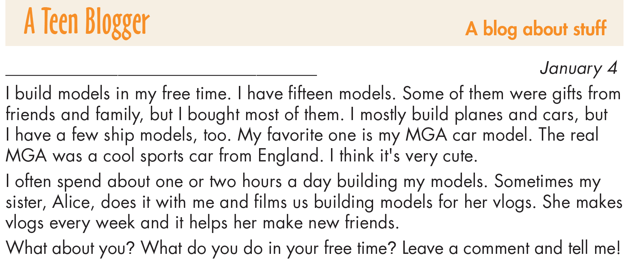
1. How did Kate get most of her models?
a. They were gifts. b. She bought them. c. She found them.
While-reading

Slide 26
2. What is her favorite model?
a. a car b. a ship c. a plane
While-reading

Slide 27
3. Who does Kate build her models with?
a. her friend b. her teacher c. her sister
While-reading

Slide 28
4. Why does Alice film them building models?
a. for school b. for her vlogs c. for her friends
While-reading

Slide 29

Post-reading
Work in pairs.
Talk about cool things you can make.

Slide 30

CONSOLIDATION

Slide 31
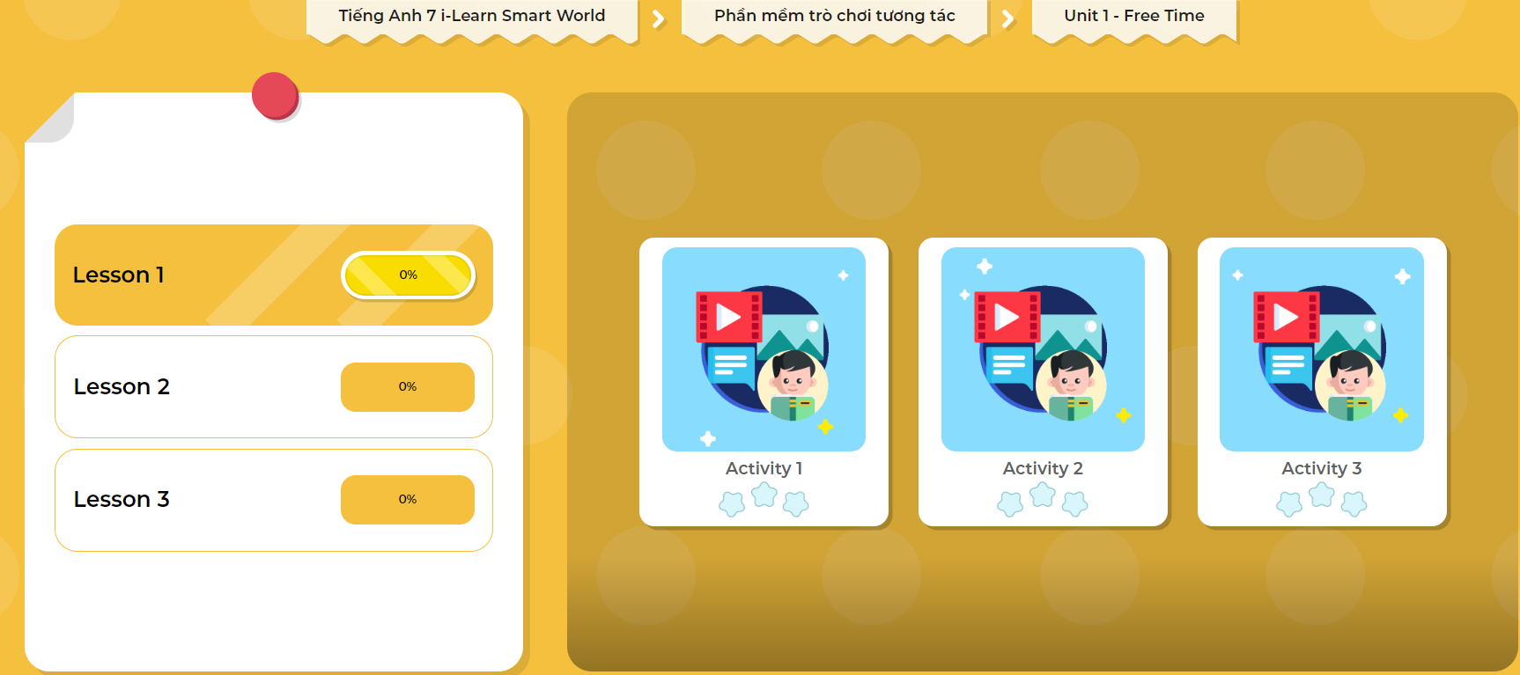
Extra Practice
DHA App
Let’s play!
Click here to play the game

Slide 32
Write about what activities you like doing in your free time and why you like doing them, using the words you learned today. (about 70 words)

Slide 33

WRAP-UP

Slide 34
Today’s lesson
Vocabularies
- collect soccer stickers
- build models
- bake cakes
- make vlogs
- read comics
- play online games

Slide 35
Today’s lesson
Reading:
- Understanding instructions.
Skimming and scanning for general and specific information.
Speaking:
- Talking about cool things you do in your free time.

Slide 36
Homework
Learn by heart the vocabularies and make sentences using them.
Do the Reading exercise on page 3 WB.
Do the exercises in Tiếng Anh 7 i-Learn Smart World Notebook on page 2.
Prepare the next lesson (page 5 SB).
Play the consolidation games in Tiếng Anh 7 i-Learn Smart World DHA App on www.eduhome.com.vn

Slide 37

Lesson 3
Stay positive and have a nice day!

