Slide 1


Slide 2
Unit
1
A long and healthy life
Unit
FAMILY LIFE
LESSON 5
LISTENING
Food and health

Slide 3
LESSON 5
LISTENING
WARM-UP
Quizizz
PRE-LISTENING
Task 1. Choose the correct meaning of the underlined word and phrase.
Task 2. Circle the topic of the show.
Task 3. Listen again and tick the food which is recommended in the talk.
Task 4. Complete the sentences. Use ONE word for each answer.
WHILE-LISTENING
POST-LISTENING
Make a healthy meal plan for one day
Wrap-up
Homework
CONSOLIDATION

Slide 4
WARM-UP
QUIZIZZ
- Use your electronic devices to access to the link on quizizz and join the game.
- The whole class complete to answer the questions.
- After the game, Ss with the highest point is the winner.

Slide 5

WARM-UP
https://quizizz.com/join?gc=182945

Slide 6
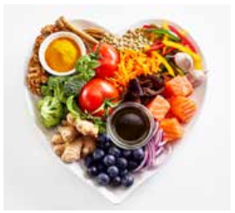
PRE-LISTENING
What is a balanced diet?
A diet that contains different kinds of foods in appropriate amounts to give our body the nutrients it needs

Slide 7
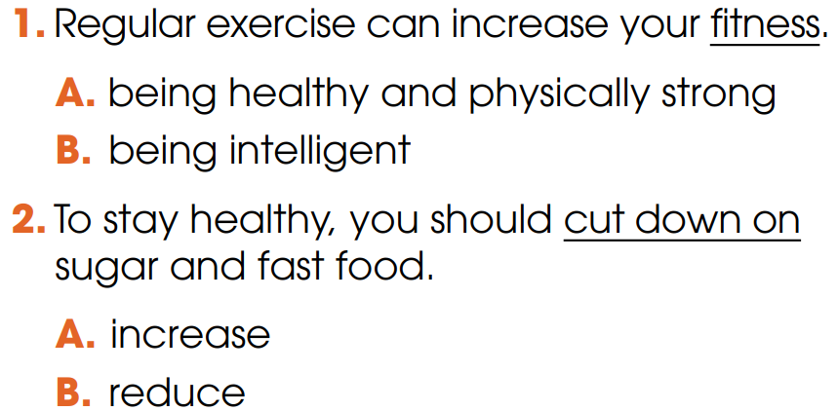
PRE-LISTENING
1
Choose the correct meaning of the underlined word and phrase

Slide 8
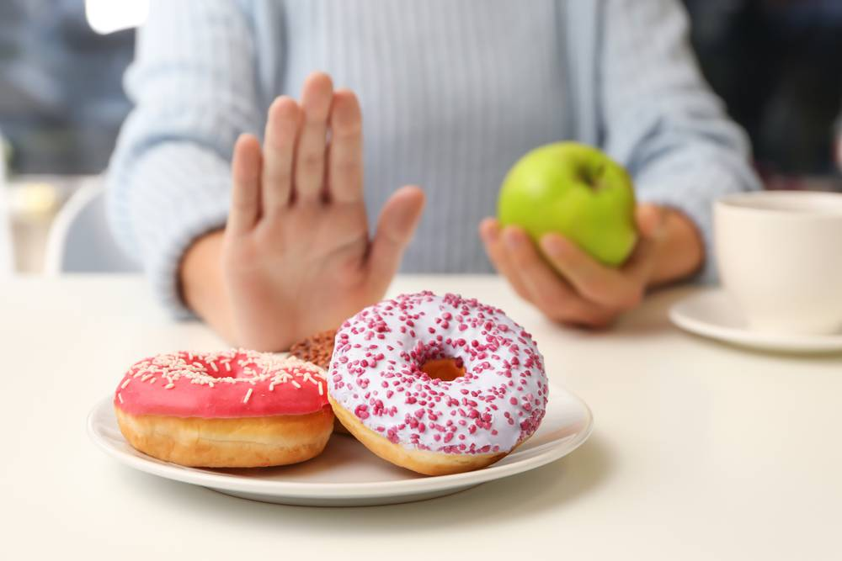

PRE-LISTENING
cut down on
/kʌt daʊn ɒn /
to reduce the size, amount or number of something
E.g. I will show you 5 tips to cut down on sugar.

Slide 9
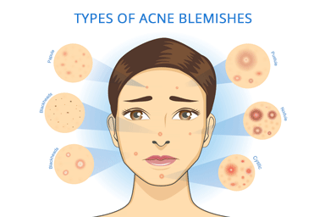
PRE-LISTENING
acne (n)
/ˈækni/
a skin condition, common among young people, that produces many pimples (= spots), especially on the face and neck

Slide 10

PRE-LISTENING
skincare (n)
/ˈskɪnkeə(r)/
the use of creams and special products to look after your skin

Slide 11
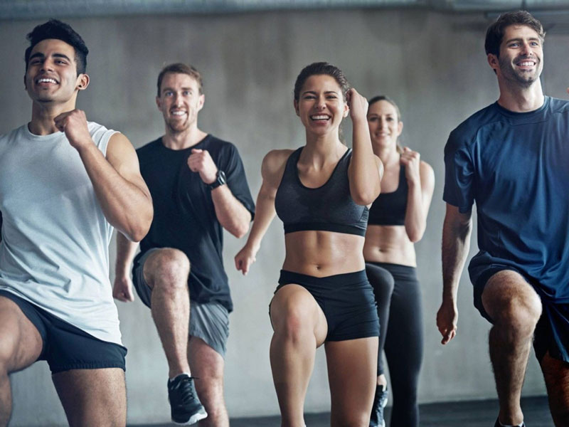
PRE-LISTENING
fitness (n)
/ˈfɪtnəs/
the state of being physically healthy and strong

Slide 12
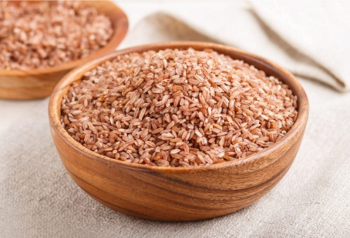
PRE-LISTENING
brown rice (n)
/ˌbraʊn ˈraɪs/
rice that is light brown because it has not had all of its outside part removed

Slide 13
PRE-LISTENING
Form | Pronunciation | Meaning
1. cut down on | /kʌt daʊn ɒn / | to reduce the size, amount or number of something
2. acne (n) | /ˈækni/ | a skin condition, common among young people, that produces many pimples (= spots), especially on the face and neck
3. skincare (n) | /ˈskɪnkeə(r)/ | the use of creams and special products to look after your skin
4. fitness (n) | /ˈfɪtnəs/ | the state of being physically healthy and strong
5. brown rice (n) | /ˌbraʊn ˈraɪs/ | ​rice that is light brown because it has not had all of its outside part removed

Slide 14
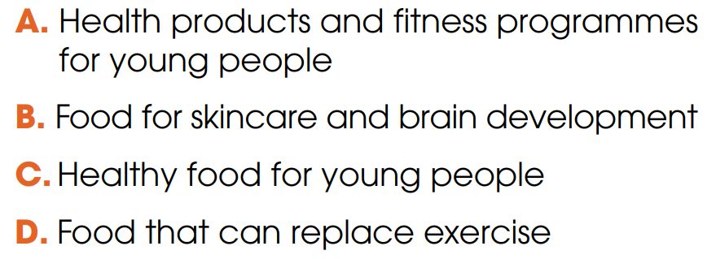
WHILE-LISTENING
2
Listen to a TV chat show about teen health. Circle the topic of the show.

Slide 15
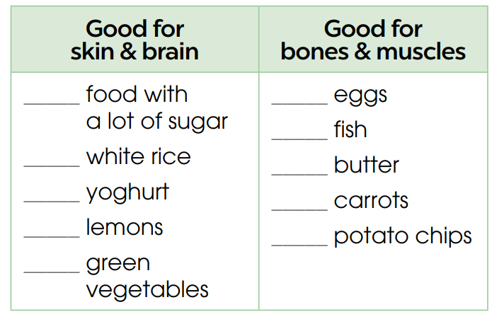

WHILE-LISTENING
3
Listen again and tick the food which is recommended in the talk.

Slide 16
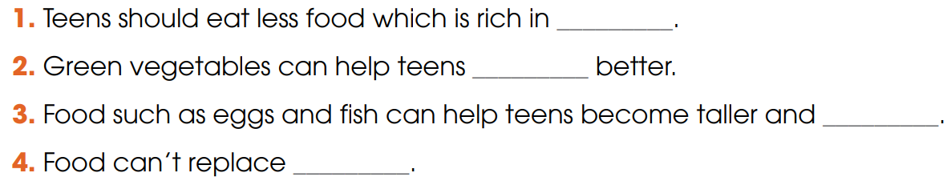
WHILE-LISTENING
4
Listen again and complete the sentences. Use ONE word for each answer.
sugar
concentrate
stronger
exercise

Slide 17
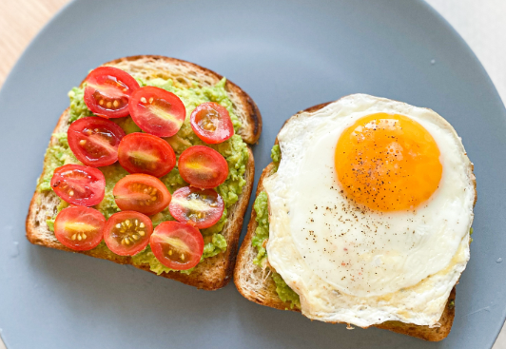
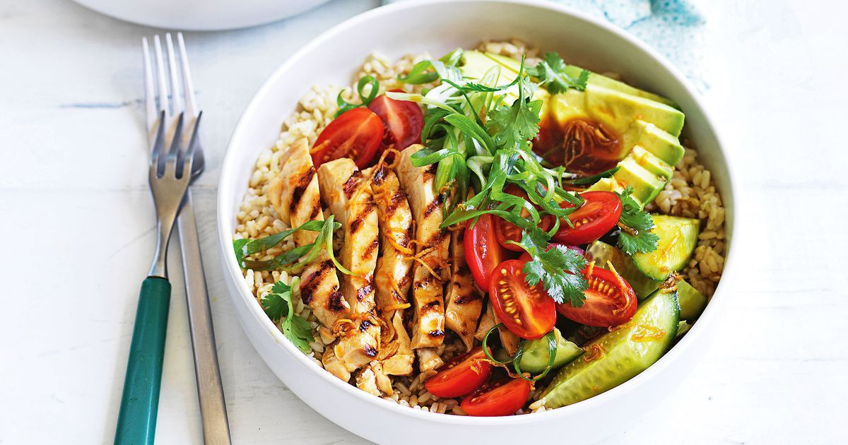
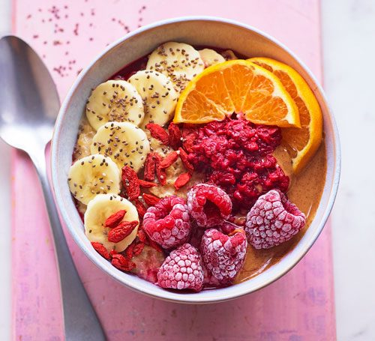
POST-LISTENING
5
Work in groups. Make a healthy meal plan for one day and explain why you have selected the food.

Slide 18
CONSOLIDATION
1
Wrap-up
What have you learnt today?
Healthy food for teenagers
Listening for main ideas and specific information

Slide 19
CONSOLIDATION
2
Homework
Do exercises in the workbook.
Prepare for Lesson 6 - Unit 1.

Slide 20

Website: hoclieu.vn
Fanpage: facebook.com/www.tienganhglobalsuccess.vn

