Slide 1
Unit 8: Traditions of
Ethnic Group in Vietnam
Lesson 1.2: Grammar
Pages 75 & 76

Slide 2
Lesson Outline
Warm-up
Grammar
Consolidation
Wrap-up

Slide 3
By the end of this lesson, students will be able to…
- practice and use the articles correctly.

Slide 4
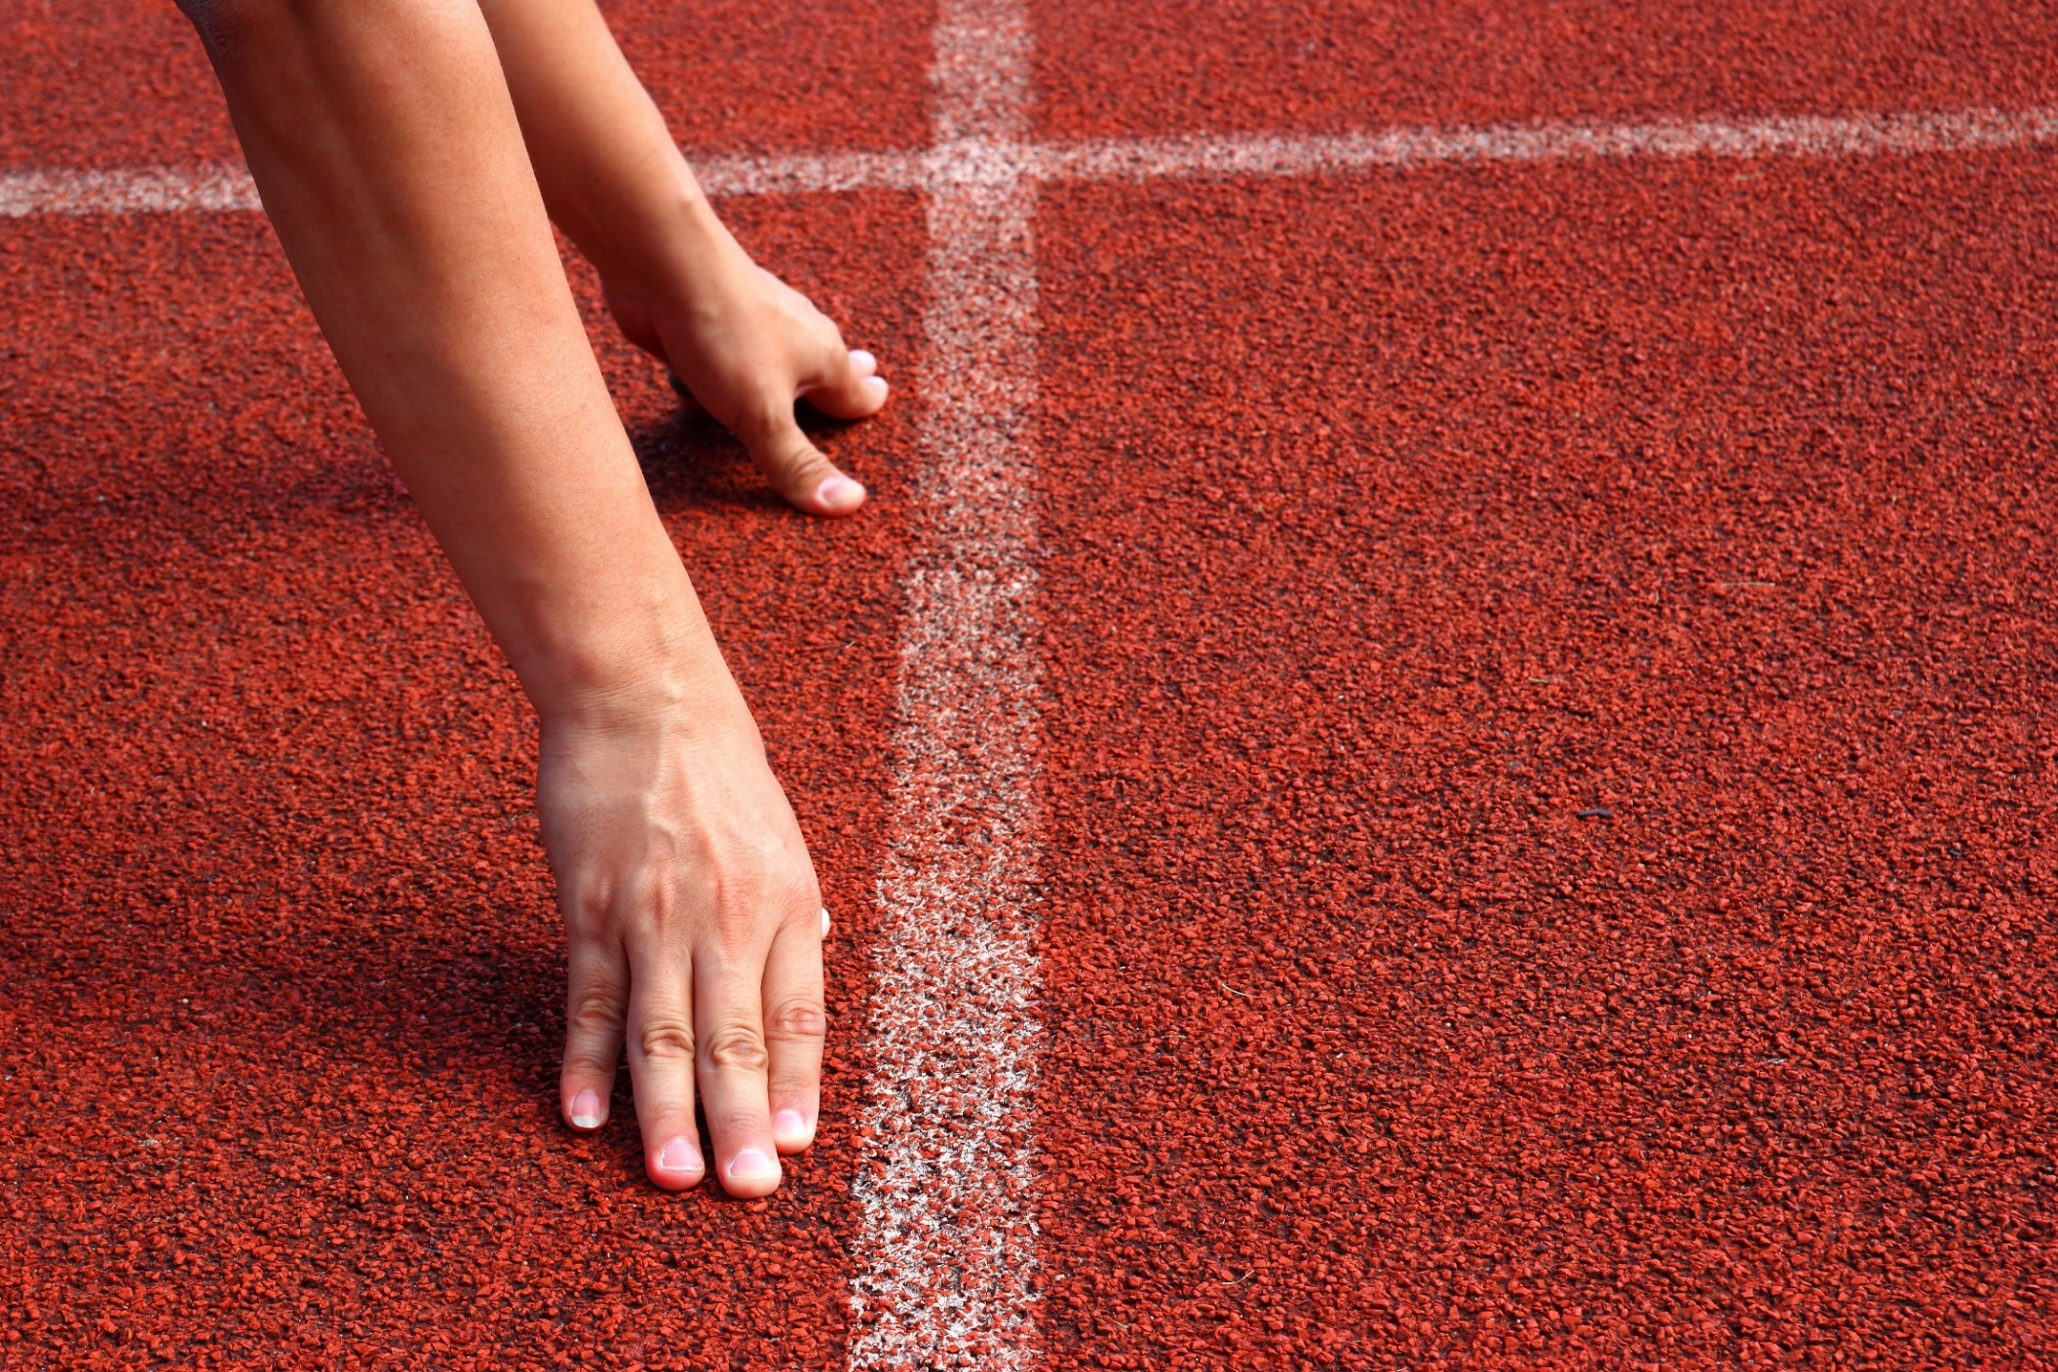
WARM UP

Slide 5
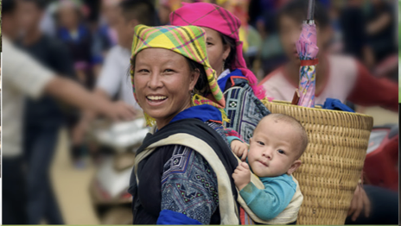
What can you see in the pictures?
ETHNIC GROUPS

Slide 6
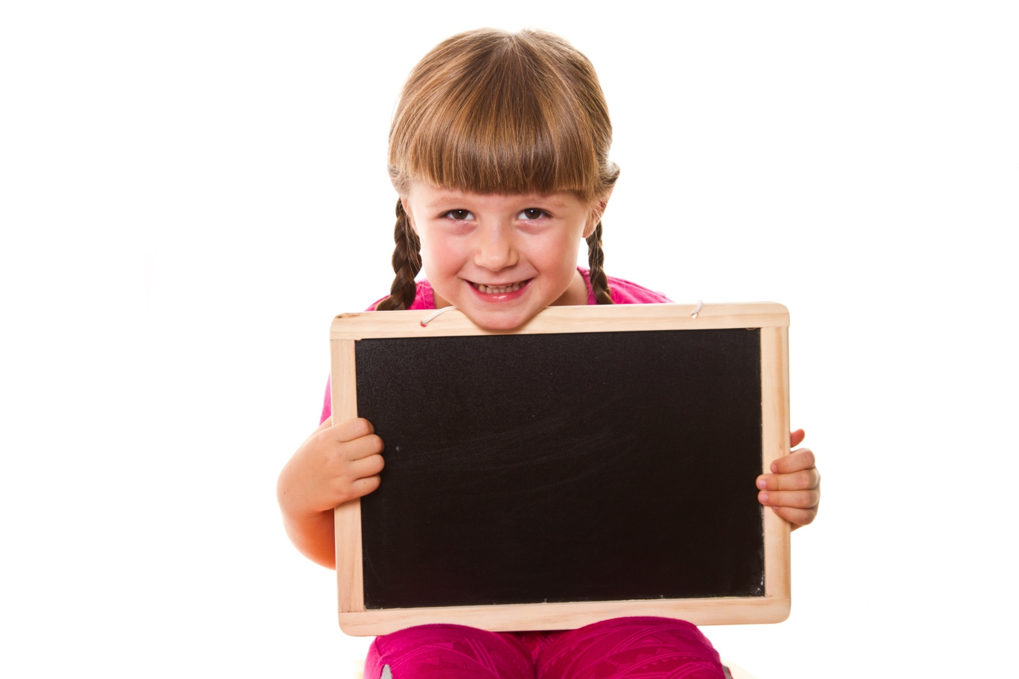
Presentation

Slide 7
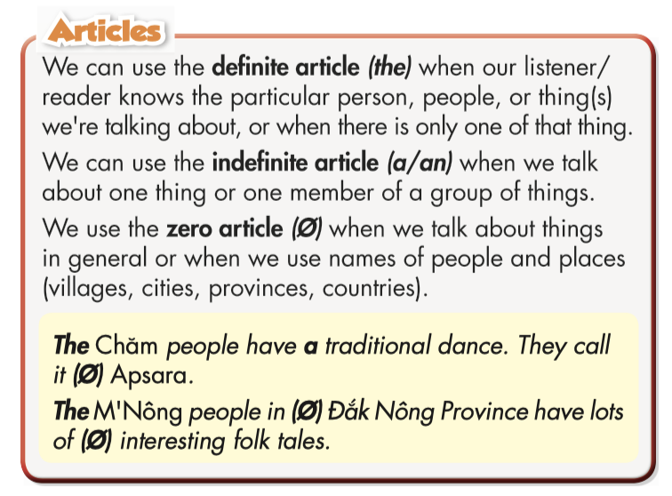
Grammar Meaning and Use

Slide 8
a. Read about articles and fill in the blanks.
Look at the pictures and answer the questions:
What ethnic group is the woman?
Where does she live?
What does she wear?
What food can you see?

Slide 9
a. Listen and check your answers. Listen again and repeat.
The Red Dao
Lào Cai

Slide 10
Grammar Form and Practice

Slide 11
Match the numbers with the letters to complete the rules.
1. We can use the indefinite article a / an when we talk about …
A. things in general or when we use names of people and places.
2. We can use the definite article the when we talk about …
B. one thing or one member of a group of things
C. know a person or thing(s) we’re talking about, or when there is only one of that thing.
3. We use zero article when we talk about …

Slide 12
Practice

Slide 13
Task a
Read the instruction and the words quickly:
For the beginning word: find the first Capital letter word.
For the ending word: find the word with punctuation marks.
Read the examples above and unscramble the sentences.

Slide 14
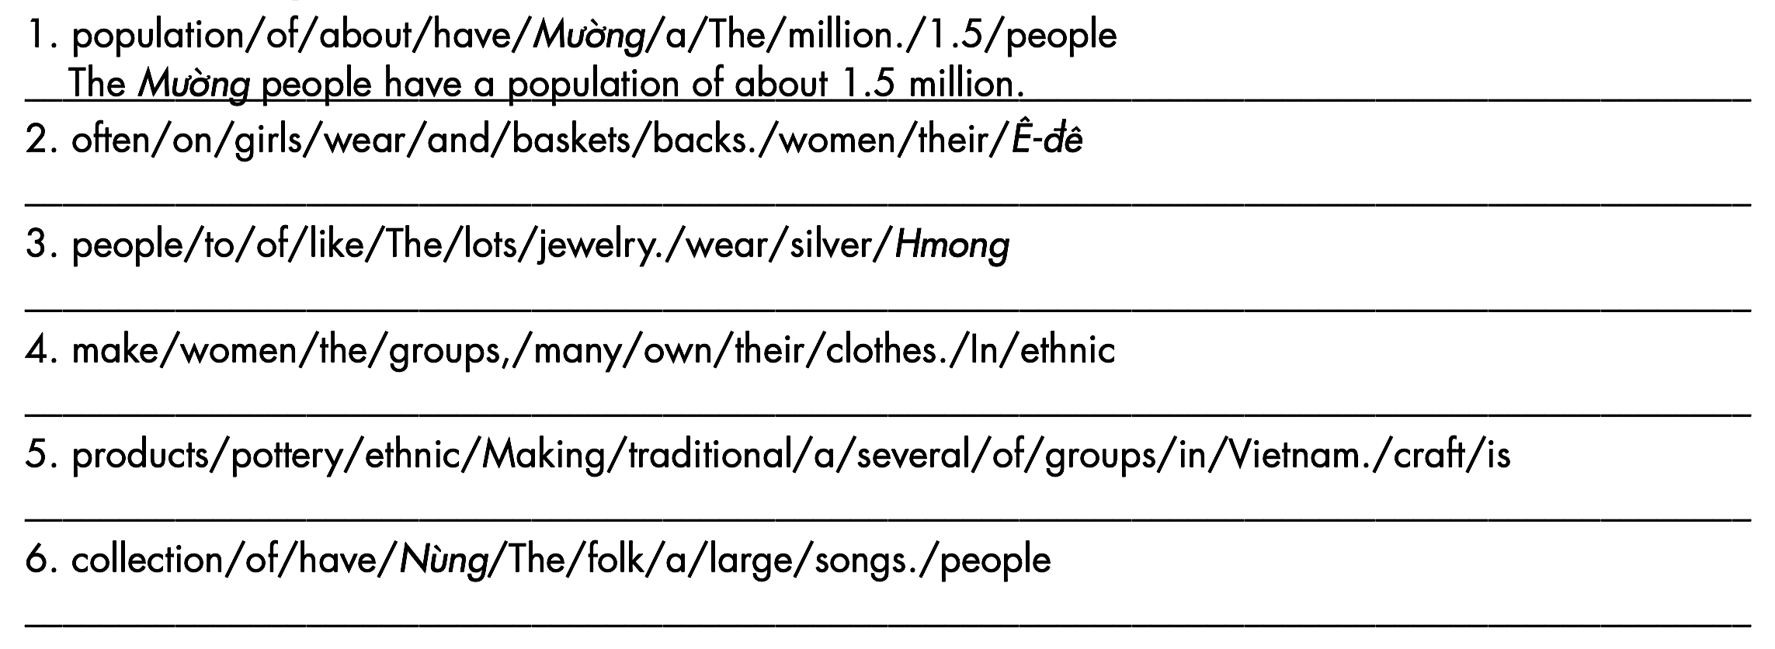
a. Read the examples above and unscramble the sentences.
Ê-đê girls and women often wear baskets on their backs.
The Hmong people like to wear lots of silver jewelry.
In many ethnic groups, the women make their own clothes.
Making pottery products is a traditional craft of several ethnic groups in Vietnam.
The Nùng people have a large collection of folk songs.

Slide 15
Task b
Read the instruction and the answers quickly:
Underline the key words.
What are we going to do?
Fill in the blanks with the correct articles.
b. Fill in the blanks with a, an, the, zero article (Ø)
People in general
Things in general

Slide 16
b. Fill in the blanks with a, an, the or zero article (Ø).
Ø
Ø
____ Hmong women wear headscarves and ____ clothes with beautiful embroidery.
____ Ê-đê people mainly live in ____ Đắk Lắk, ____ Phú Yên, and ____ Đắk Nông.
____ snails and ____ hearts are common patterns on Hmong clothes.
____ Chăm girls start learning how to make cloth from the age of 10-12.
Canh thụt is ____ traditional dish of the M’Nông.
The Khmer people celebrate their new year in April. It’s ____ important festival to them.
The
Ø
Ø
Ø
Ø
Ø
Ø
a
an

Slide 17
Workbook – Page 45
Underline the mistakes and write the correct words on the lines. Write “Ø” for zero article.
1. The Khmer people mainly live in the Cambodia. _________
2. The Nùng people have an large collection of folk songs. _________
3. A Red Dao man usually wears pants, a shirt, and the red headscarf. _________
4. After getting married, a men live with their wives’ families. _________
5. The men do a cooking on the first day of the new year. _________
Ø
a
a
the
the

Slide 18
Production

Slide 19
Task c
Work in pairs
Talk about traditional clothes, food, and customs of your ethnic group.
The Kinh people wear
áo dài. In Southern Vietnam, we eat a special cake at Tết. We call it bánh tét.

Slide 20
CONSOLIDATION

Slide 21
Ask your friends questions about his / her ethnic group.
Where do the (Thái) people live in Vietnam?
What are the traditional clothes of the (Thái) people?
What is the traditional food of the (Thái) people?
What are the customs of the (Thái) ethnic group?

Slide 22
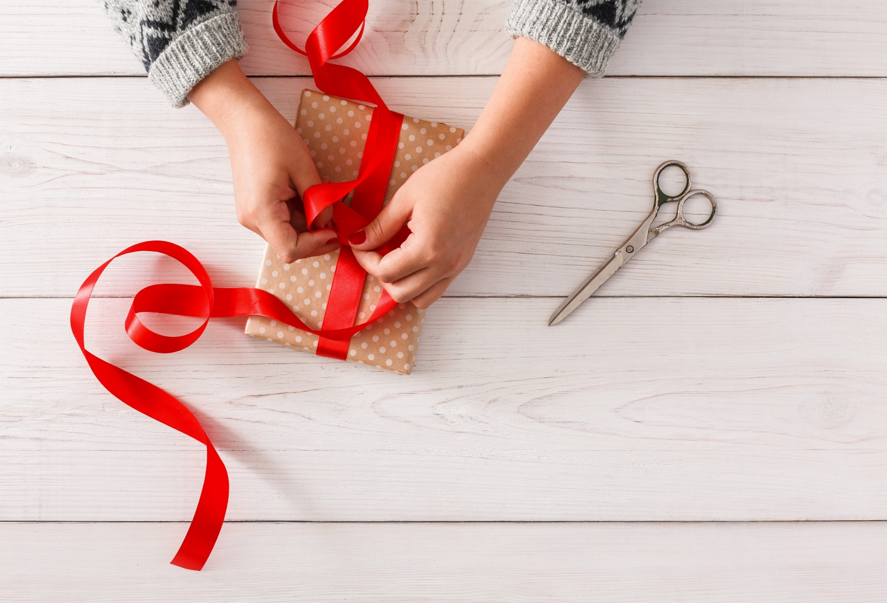
WRAP-UP

Slide 23
Today’s lesson
Grammar
Articles
Speaking
Talk about traditional clothes, food, and customs of your ethnic group.

Slide 24
Homework
Learn by hearts the grammar point and make sentences using it.
Do the grammar exercises on page 45 WB.
Do the exercises in Tiếng Anh 8 i-Learn Smart World Notebook on page 64.
Prepare the next lesson (pages 76 & 77 SB).
Play the consolidation games on www.eduhome.com.vn

Slide 25
Lesson 3
Stay positive and have a nice day!

