Slide 1


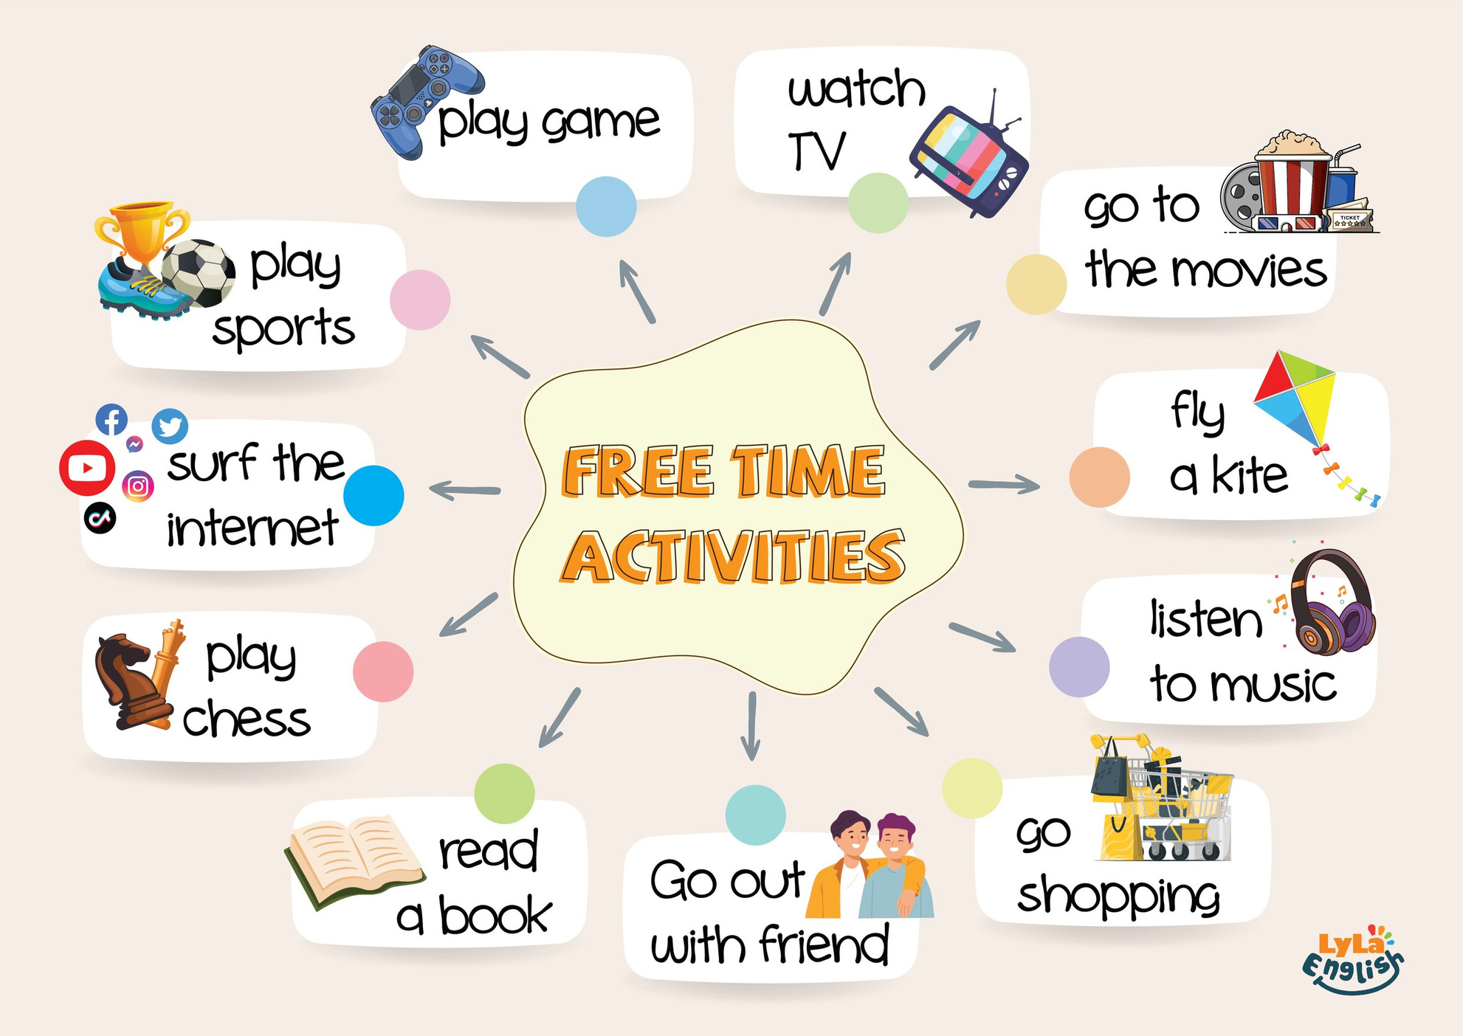

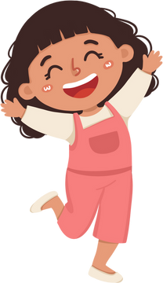

Slide 2




I. QUESTION
What do you do in your free time?
I ...
What book do you read?
It’s “...”.

Slide 3
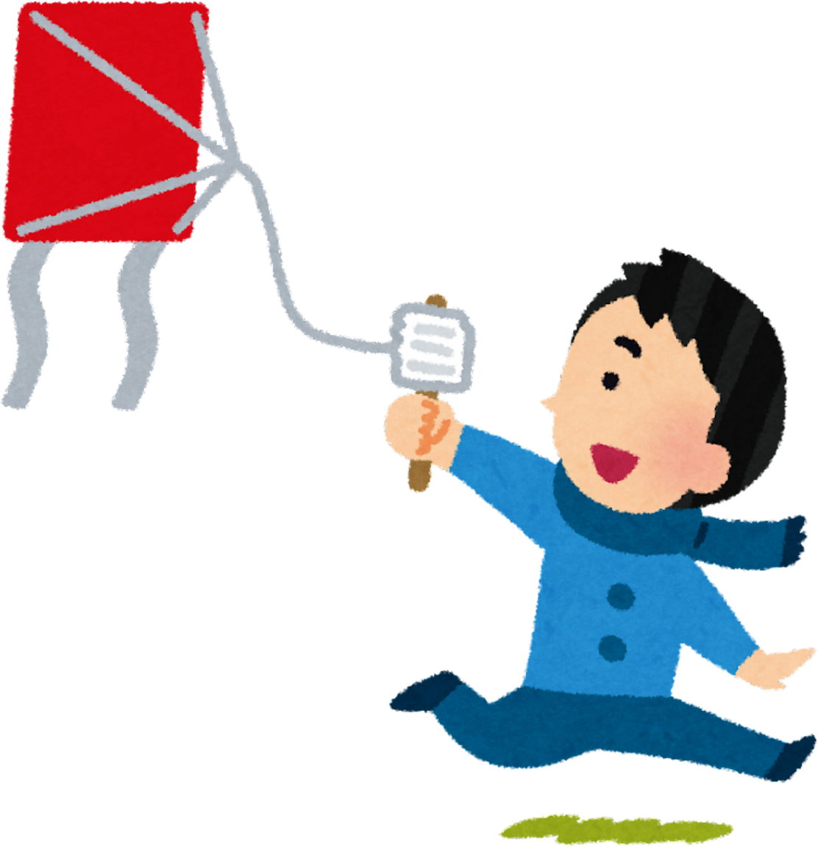
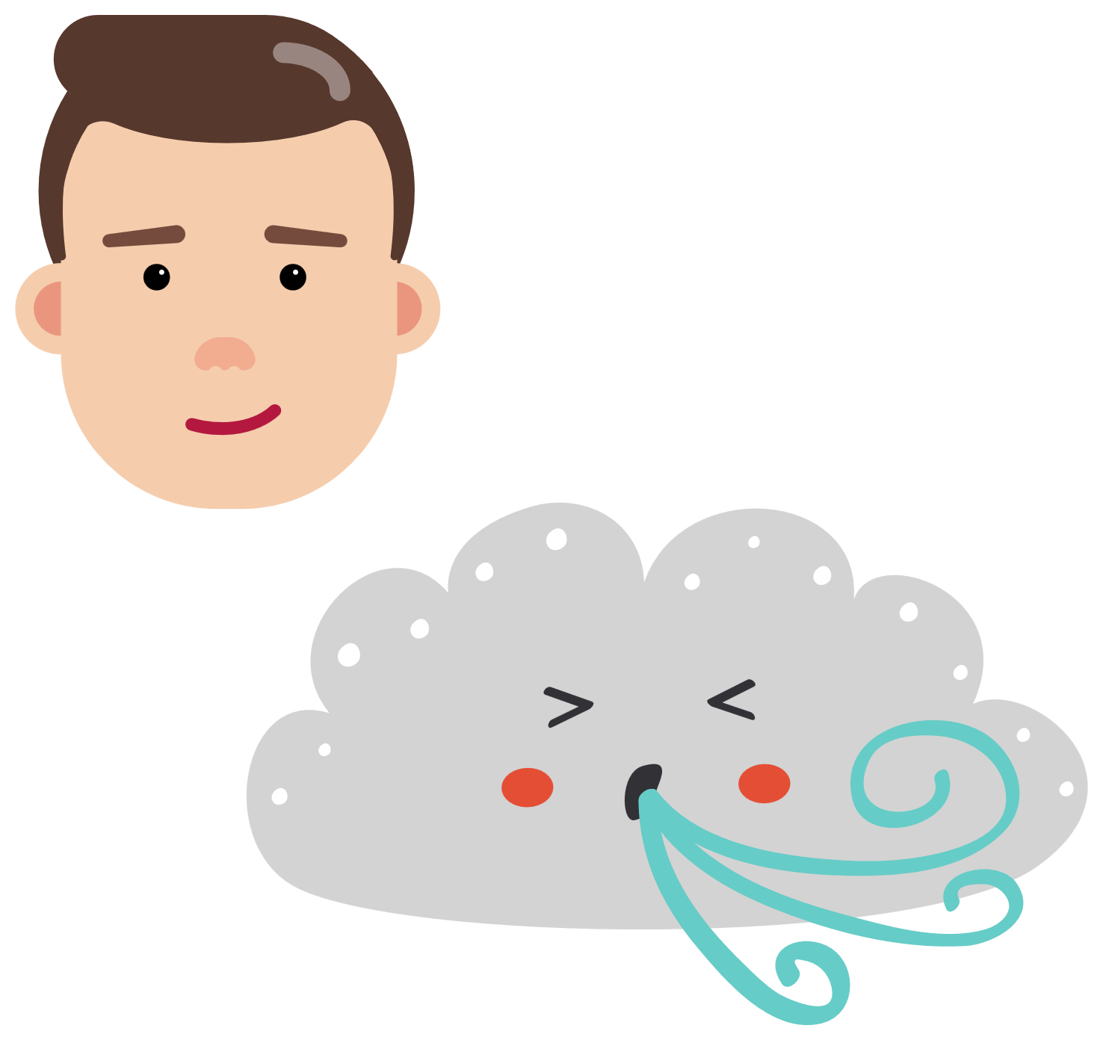
I. QUESTION
What do you do in your free time?
I...
What color is your kite?
It’s ...
What shape is it?’
It’s ...
Who bought it for you?
...
When do you fly a kite?
When it’s ...

Slide 4




I. QUESTION
What do you do in your free time? I...
When do you do exercise? In the ...

Slide 5
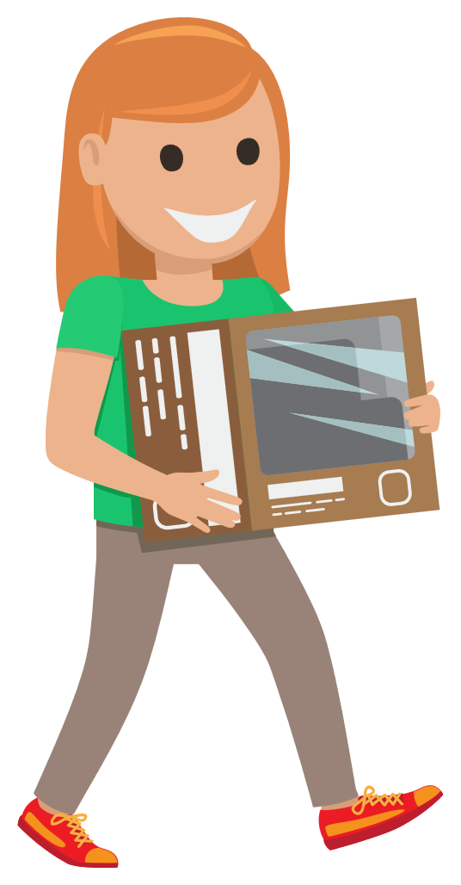
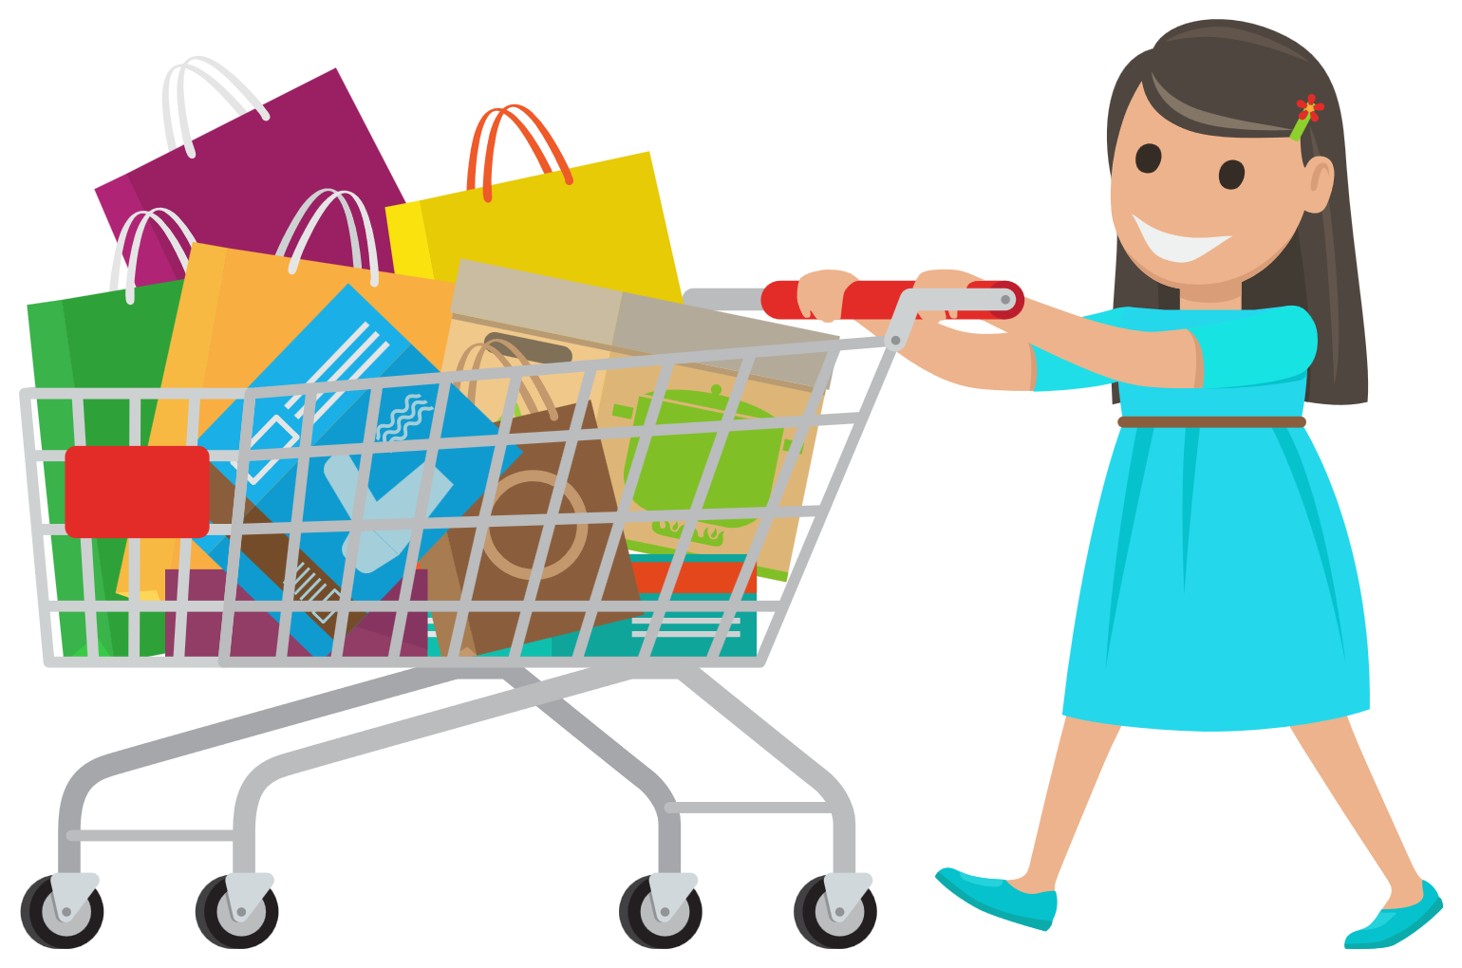
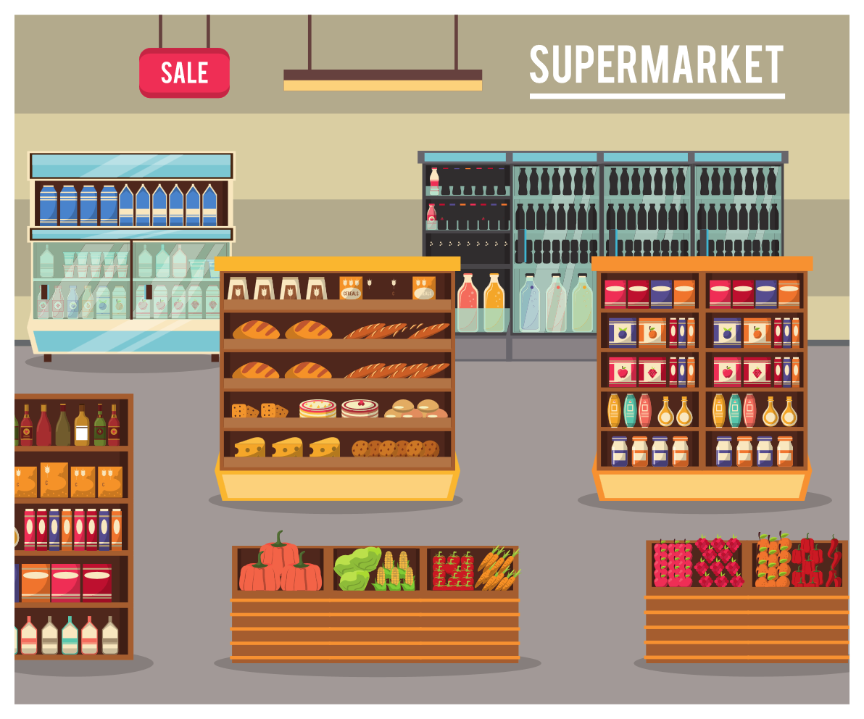




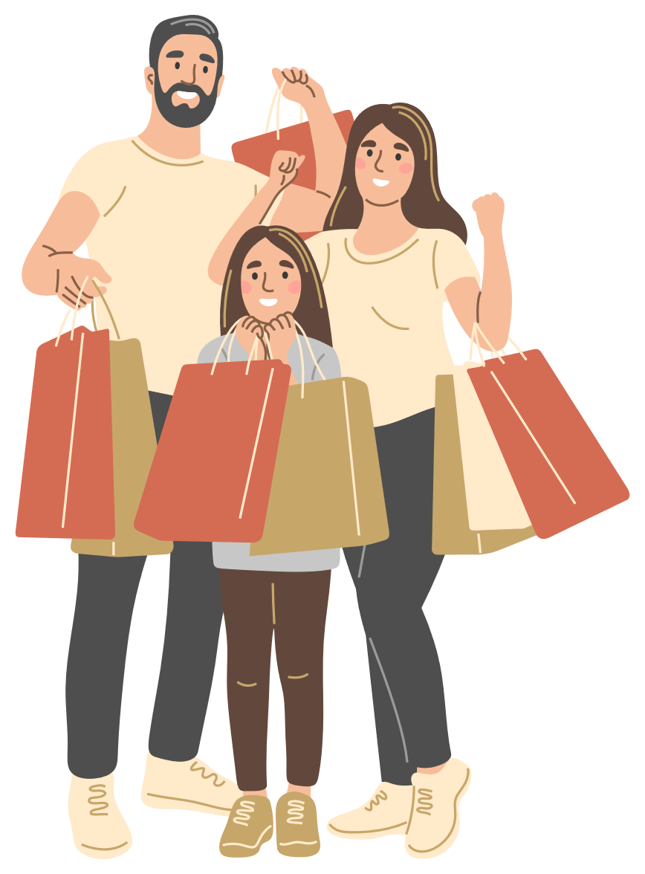
I. QUESTION
What do you do in your free time?
I...
Where do you go shopping?
I go to ...
Who take you go to there?
... and ...

Slide 6

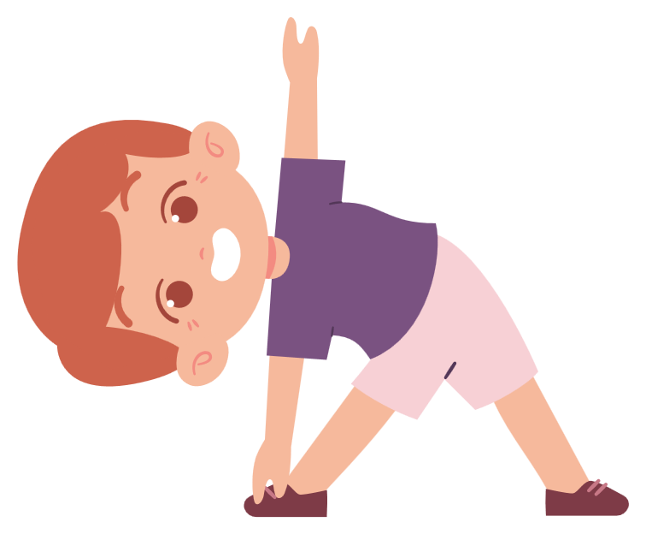
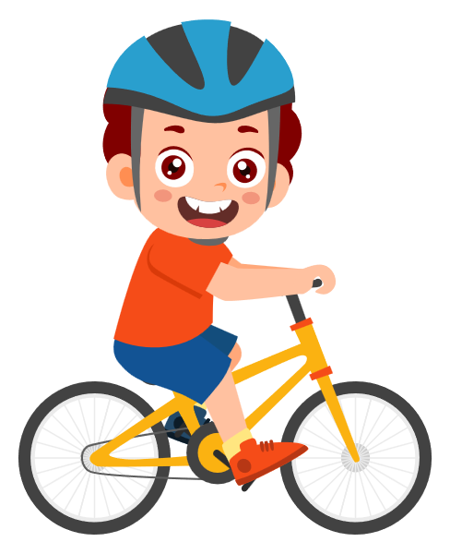
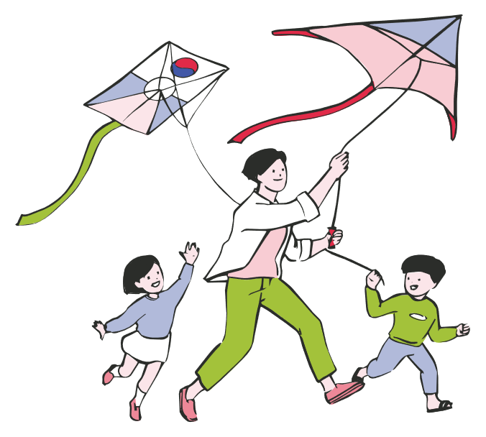

II. VOCABULARY
do exercise:...........................................................
ride a bike:.............................................................
fly a kite:...............................................................
read a book:.........................................................

Slide 7
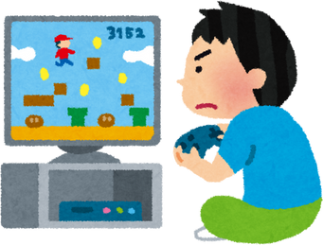
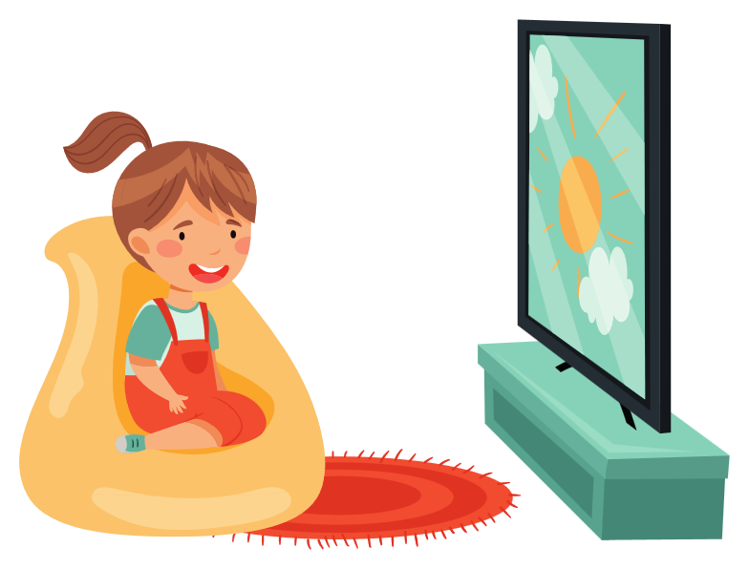
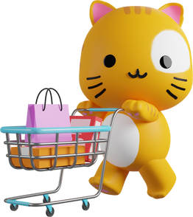
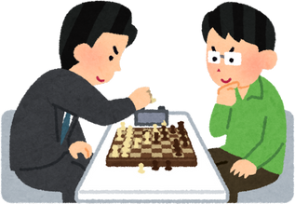
II. VOCABULARY
play game:...........................................................
watch TV:.............................................................
go shopping:.........................................................
play chess:............................................................

Slide 8


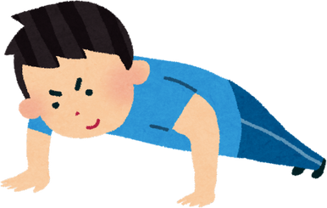
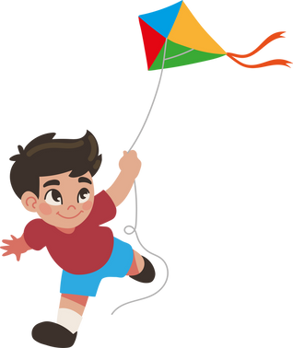
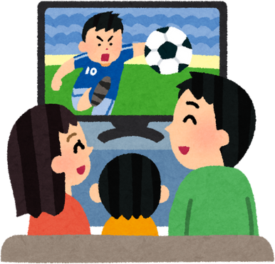
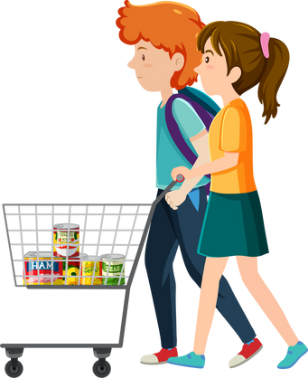
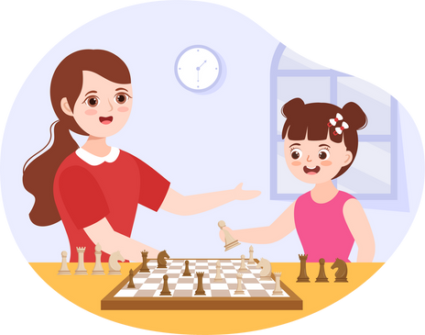
III. EXERCISE:
1. Look and match:
watch TV
go shopping
do exercise play chess
play game fly a kite

Slide 9
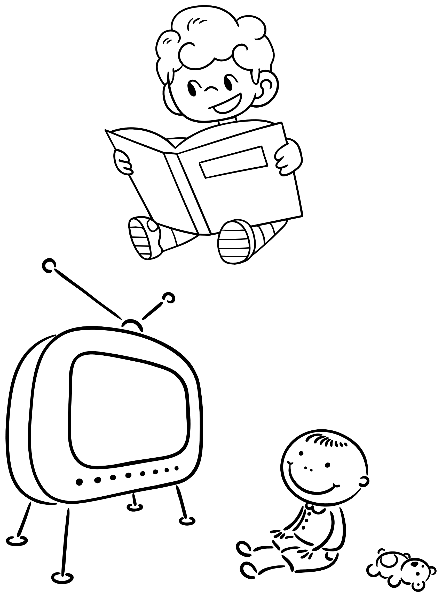
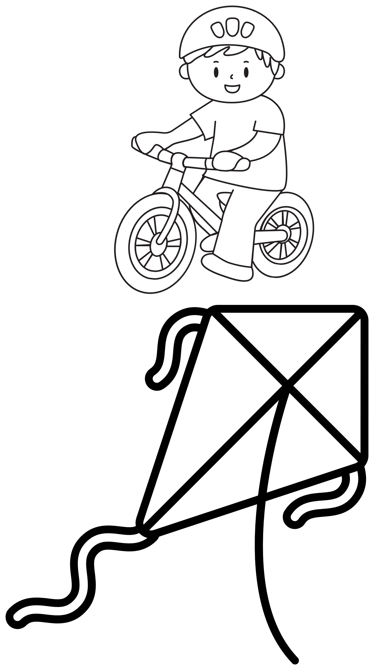
III. EXERCISE:
2. Read and color the activities:
I read a book
I ride a bike
I watch TV
I fly a kite

Slide 10
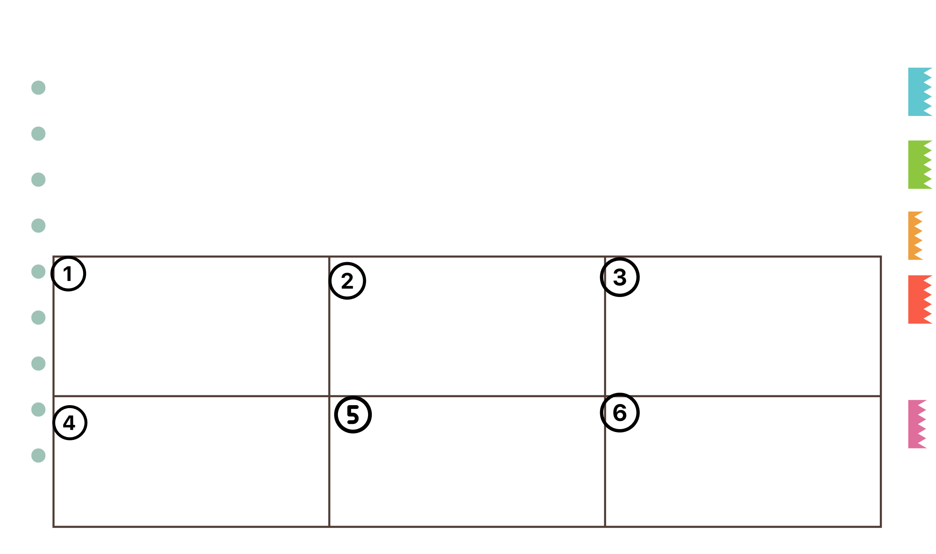
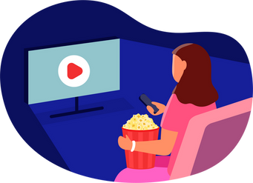
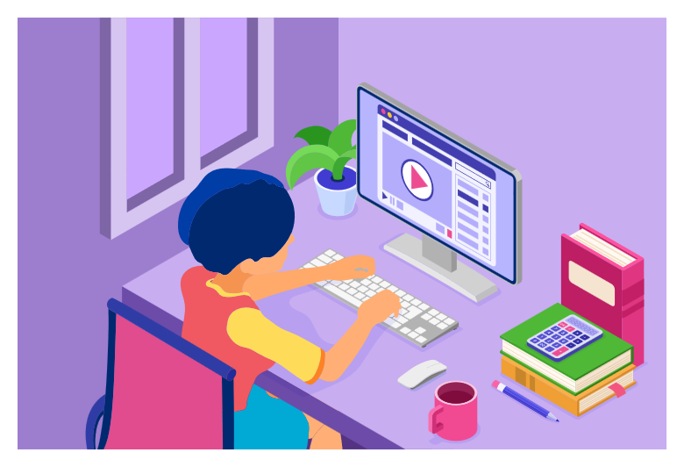


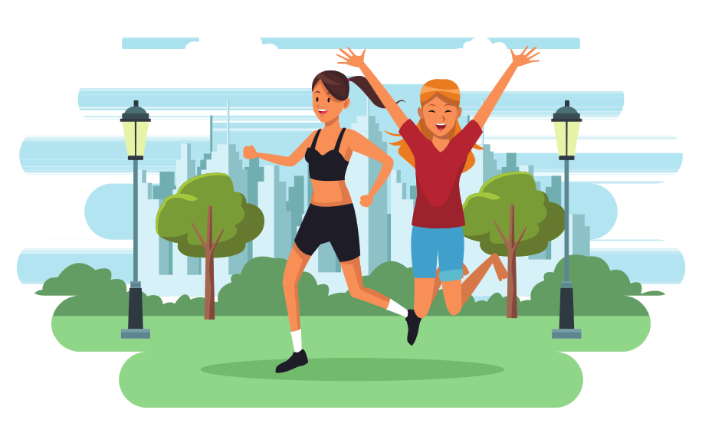
III. EXERCISES
3. Look at the pictures and write the words:
go shopping
watch the movie
do exercise
play game
listen to music
surf the web
.....
.....
.....
.....
.....
.....

Slide 11


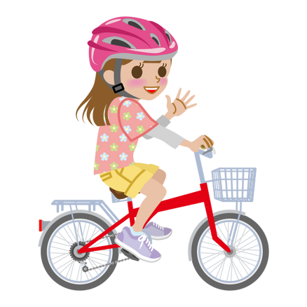
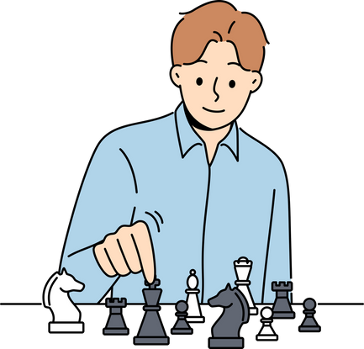
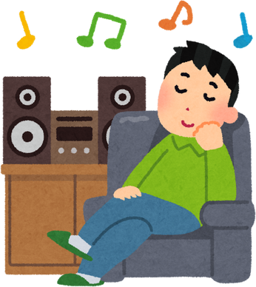
III. EXERCISE:
4. Fill the words:
_ _ _ _ a book
play c_ _ _ _
R_ _ _ a bike
Wat_ _ TV
Listen to m_ _ _ _

Slide 12


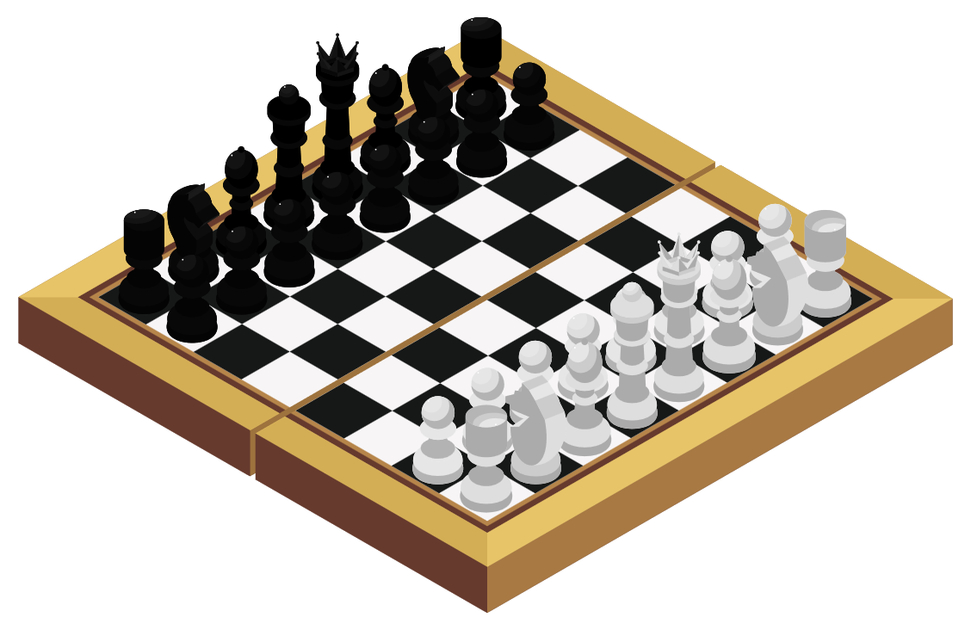
III. EXERCISE:
5. Draw lines to match:
read a book
listen to music
fly a kite
ride a bike
play chess

Slide 13
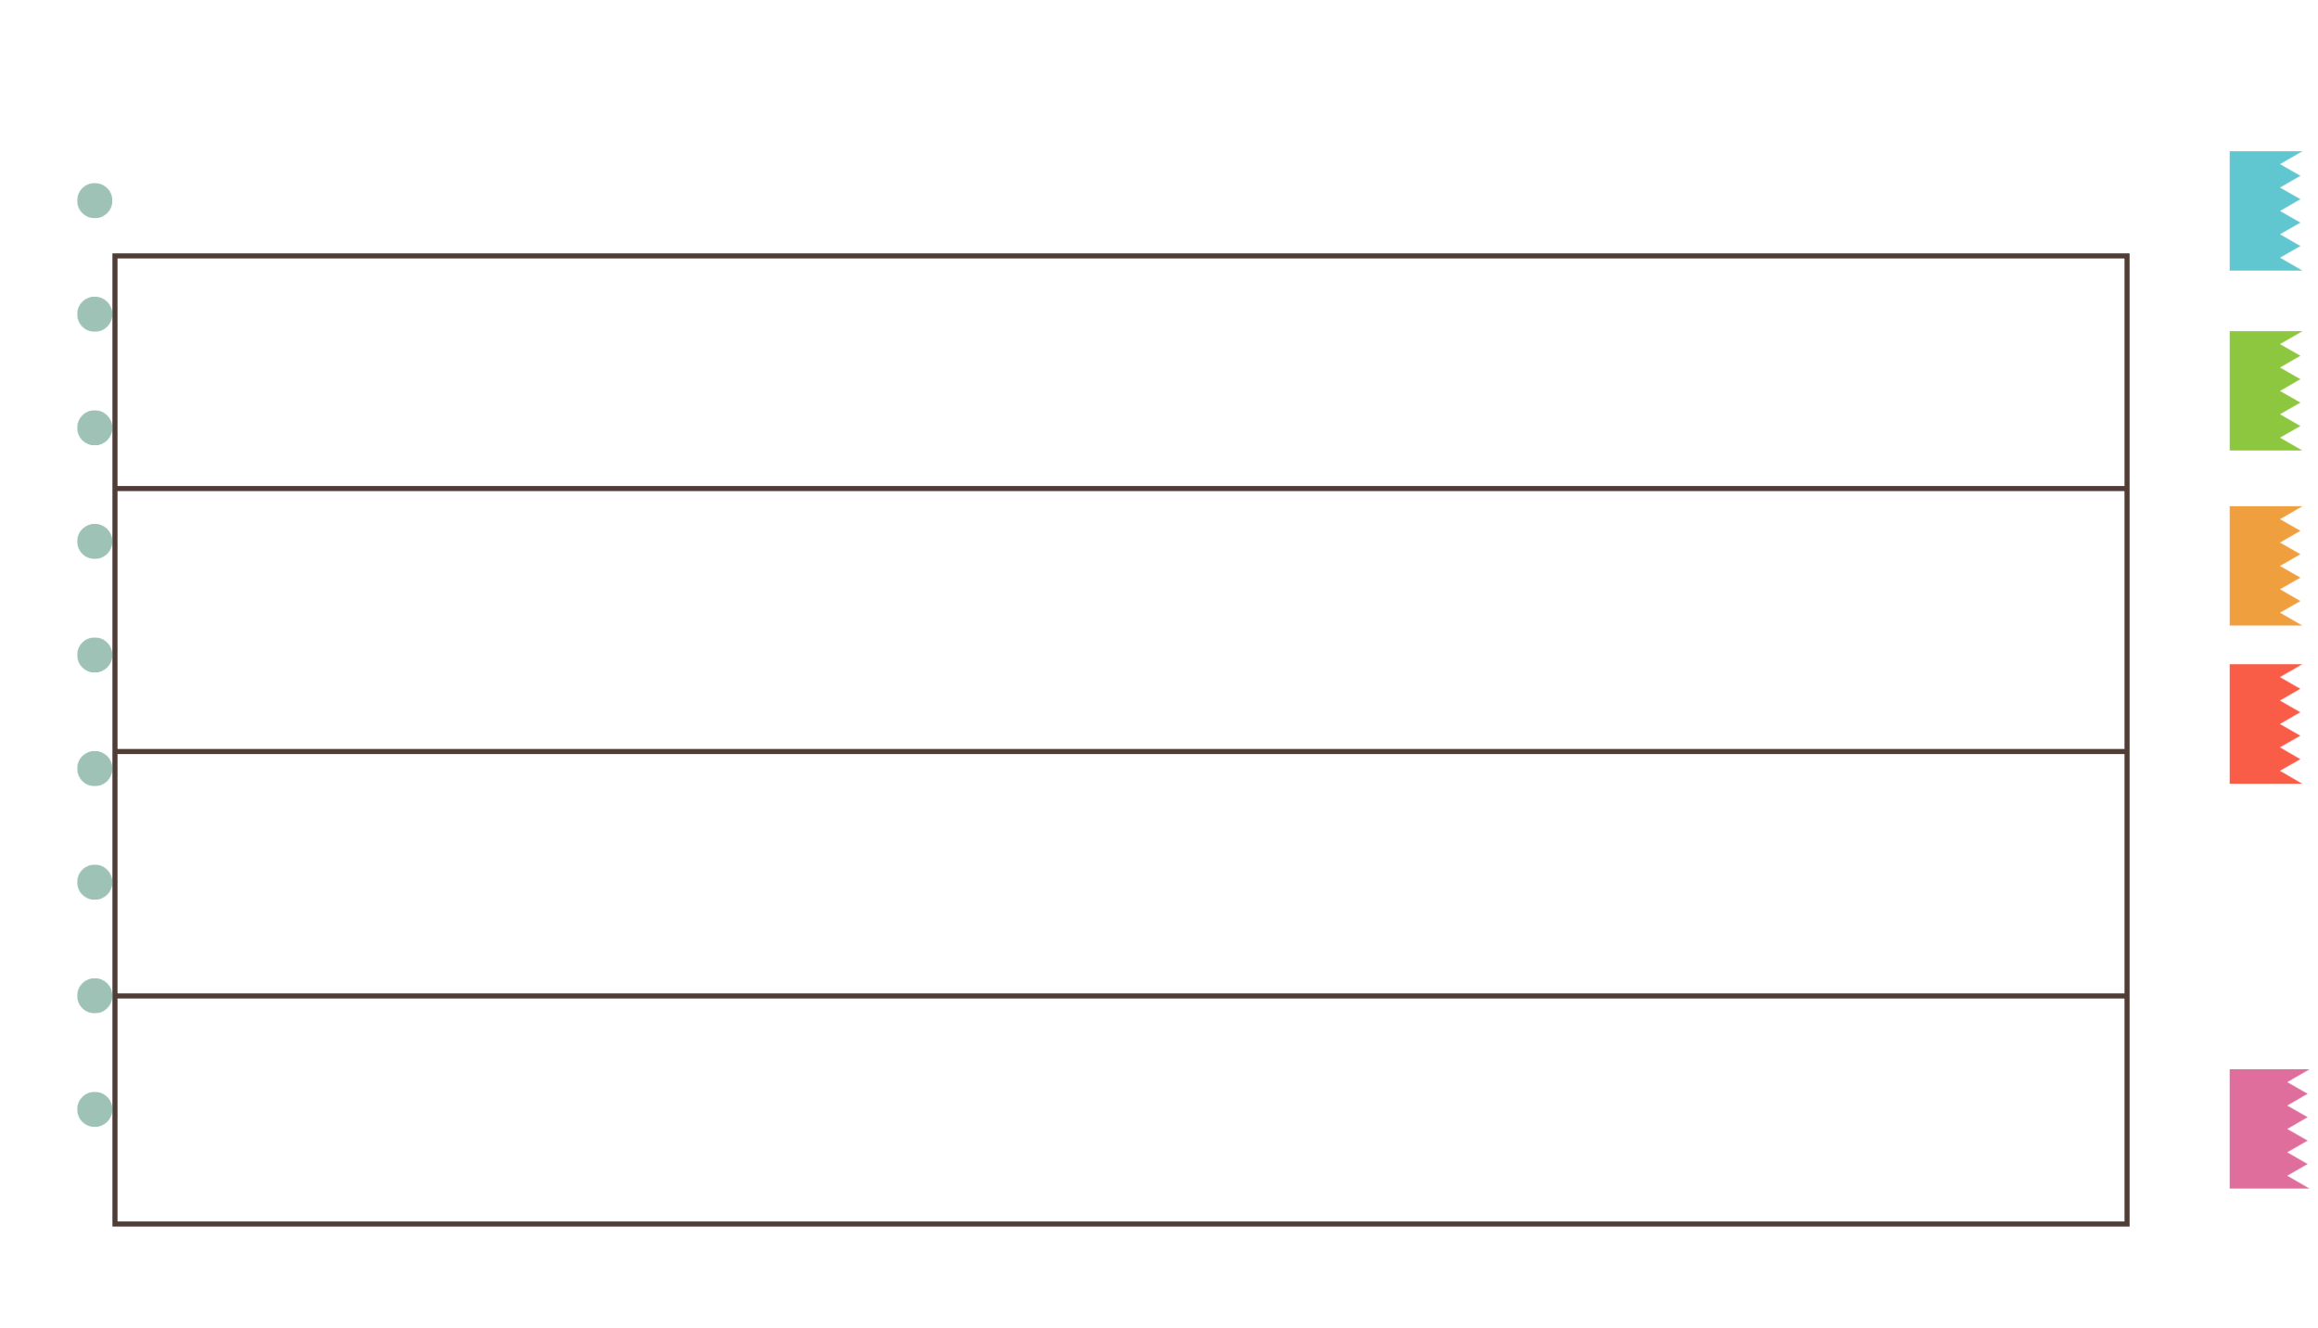
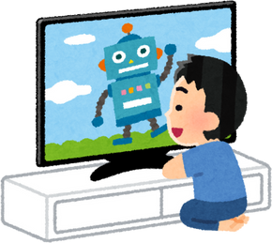
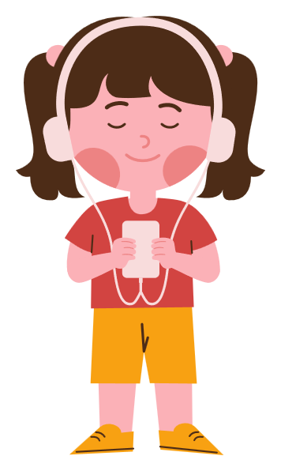
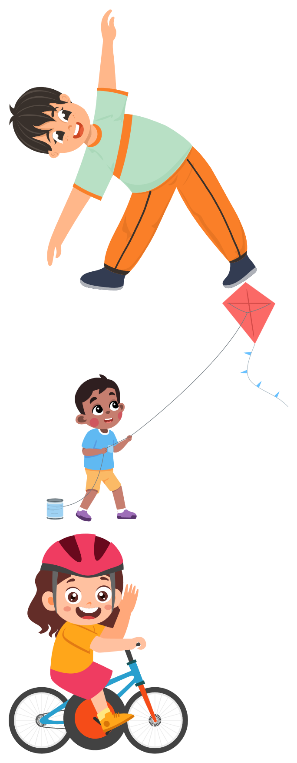
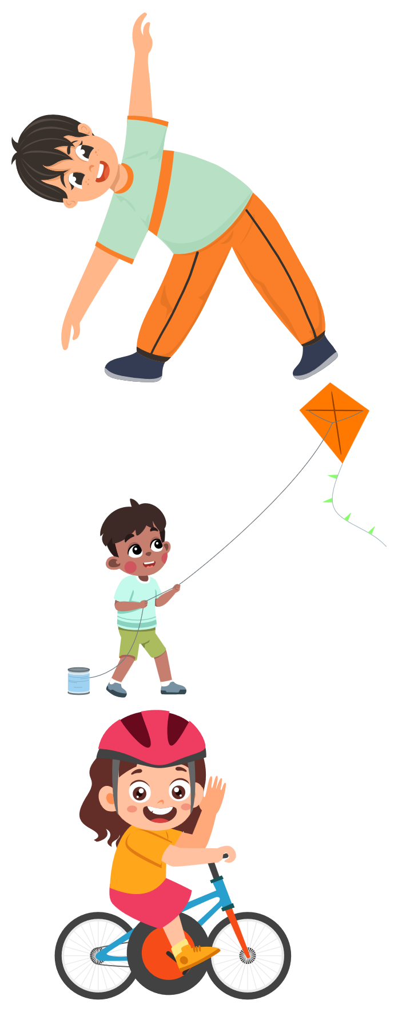
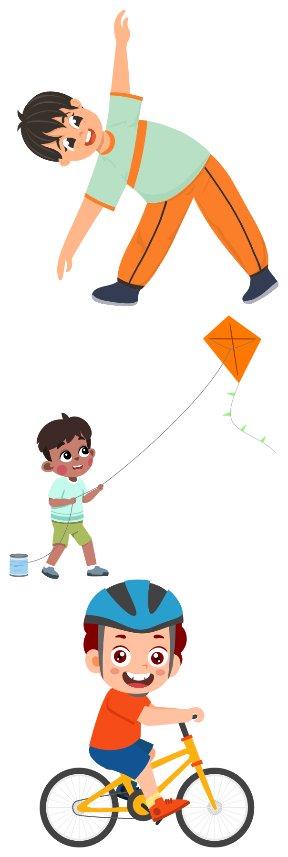
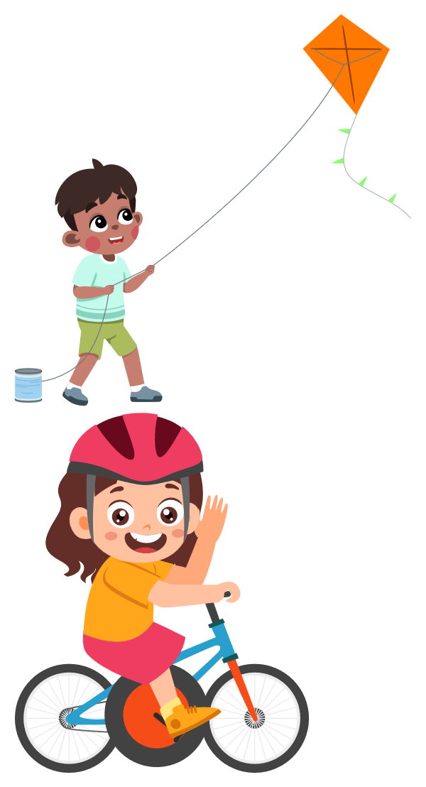
III. EXERCISES
6. Which is different?

Slide 14

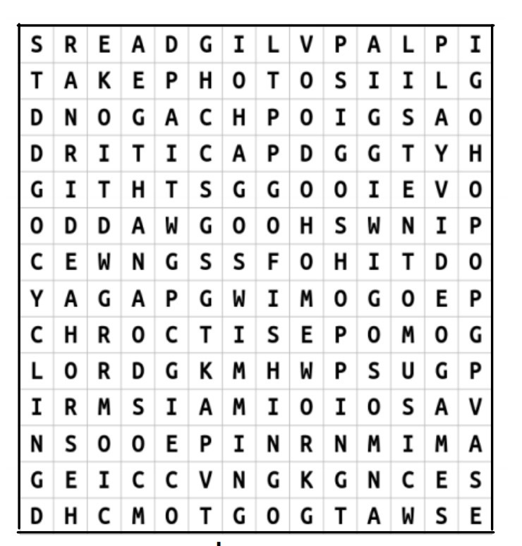
III. EXERCISES
7. Find the word:
watch TV
go shopping
play video games
listen to music

Slide 15
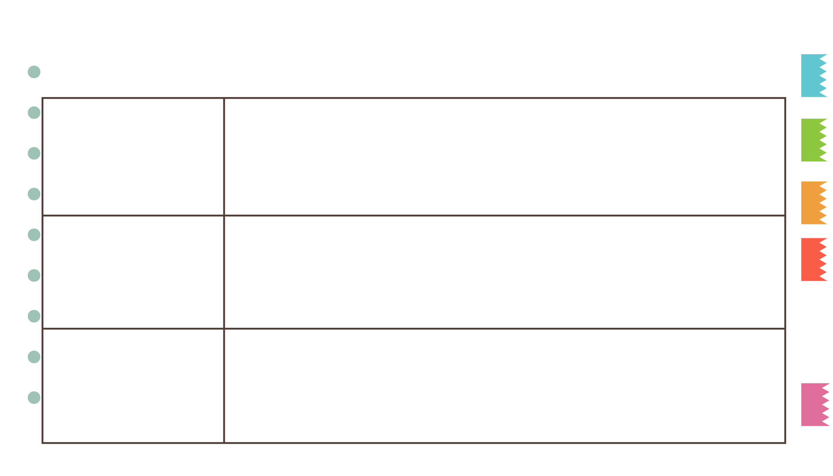
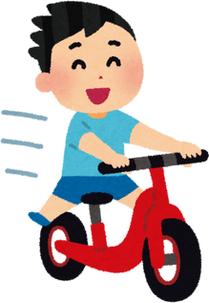
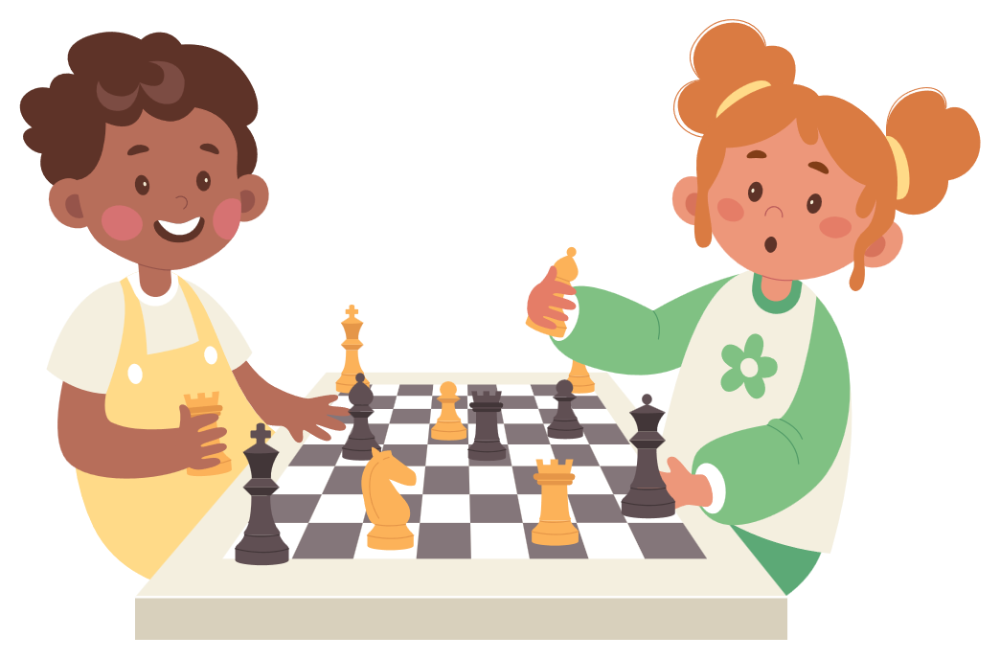

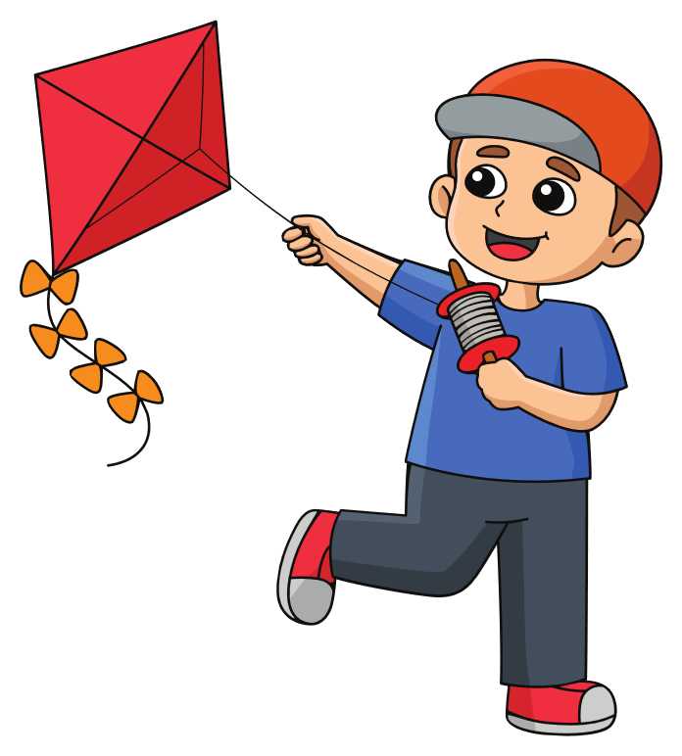
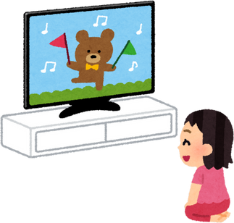

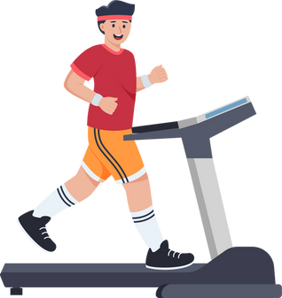
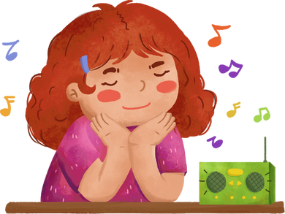
III. EXERCISES
8. Read and choose:
surf the web
watch TV
go shopping

