Slide 1

UNIT 4: INTERNATIONAL ORGANIZATIONS & CHARITIES
Lesson 1.1 – Vocabulary & Listening
Page 30

Slide 2



Lesson 1.1
LESSON OUTLINE
Conversation Skill

Slide 3

By the end of this lesson,
students will be able …
To practice and learn vocabulary for the work of charity.
To practice listening for purpose of the talk and specific information.
To practice functional English (Signaling the end of a conversation).

Slide 4
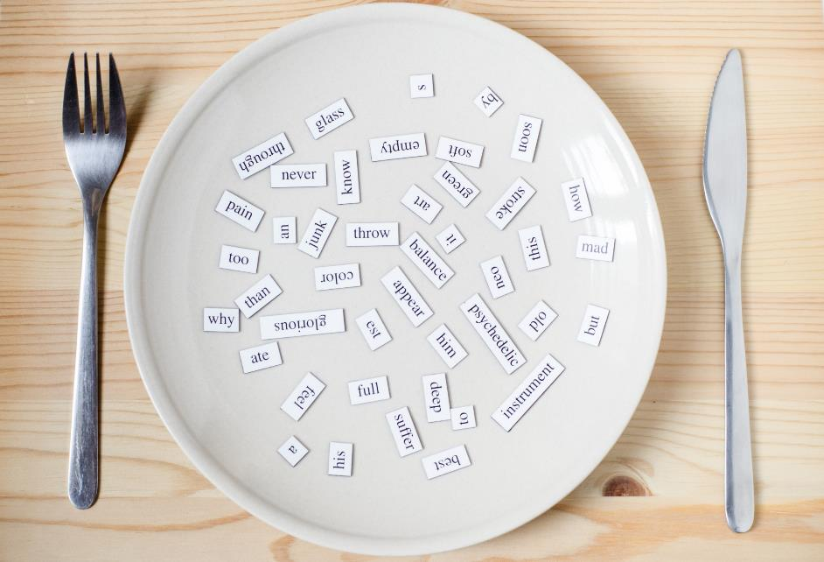
New words
charity
volunteer
donate
provide
raise
support

Slide 5



Slide 6

Work in pairs.
Have you ever given money to someone to help them? Why?
Yes, I have. …
No, I haven’t.

Slide 7



Slide 8

Listen and repeat. Click each phrase to hear the sound.
charity (n) /ˈtʃærəti/ˈ từ thiện, tổ chức từ thiện
volunteer (v) /ˌvɑːlənˈtɪr/ tình nguyện
donate (v) /doʊˈneɪt/ tặng, cho, biếu, quyên góp
provide (v) /prəˈvaɪd/ cung cấp
raise (n) /ˈreiz/ gây quỹ
support (n) /səˈpɔːrt/ ủng hộ, hỗ trợ
Notes:
GV click vào từng cụm nghe âm thanh

Slide 9
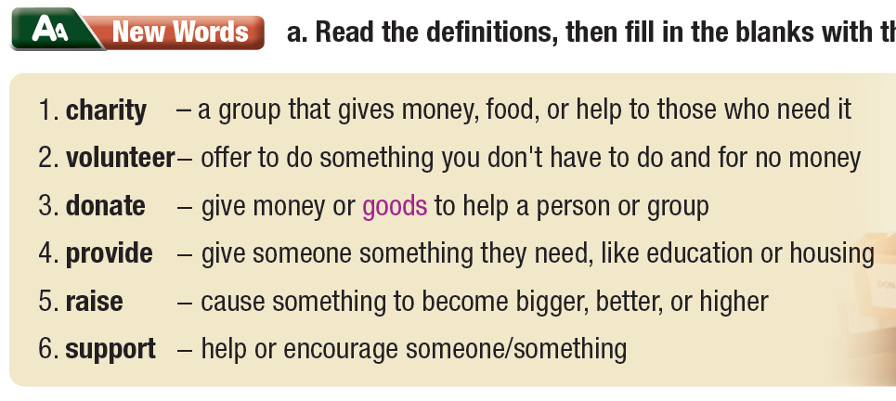
Read the definitions, then fill in the blanks with the new words.

Slide 10

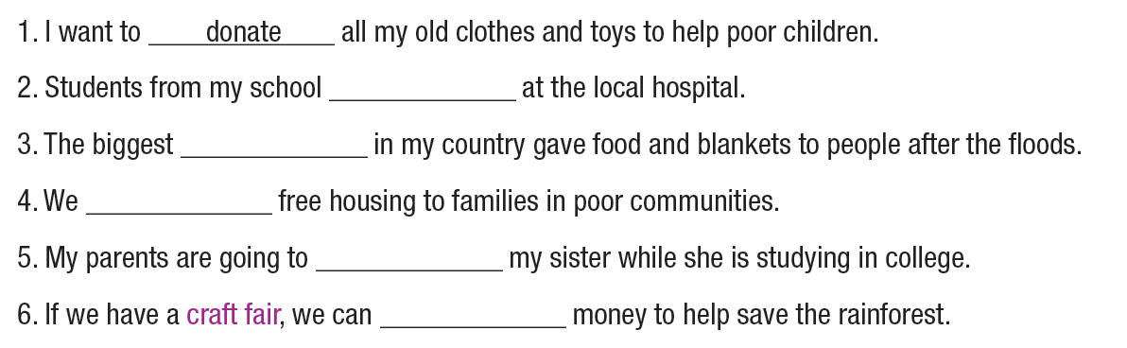
Fill in the blanks with the new words. Listen and repeat
Extra Practice
WB, page 20
volunteer
charity
provide
support
raise

Slide 11
Work in pairs.
Talk about charities in your country. How do they help people?
Saigon Children’s Charity helps poor children.

Slide 12



Slide 13
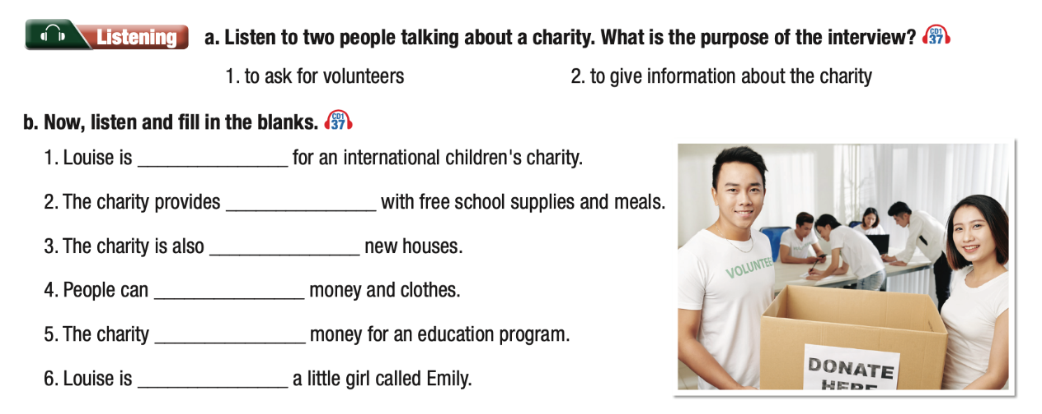

Slide 14


Pre - Listening
Look at the picture. What do you see?
Answer the questions below:
How many people are there?
Who are they?
What does the sign on the box say?
What are the two people writing for?
In your opinion, what do people often donate to support charities?
Notes:
Taken from TA 10 i-Learn Smart World WB, page 2

Slide 15
Pre - Listening
Answers:
How many people are there?
Six people
Who are they? They are volunteers.
What does the sign on the box say?
It says “Donate here”
What are the two people writing for?
They want to sign in/ register to be volunteers.
In your opinion, what do people often donate to support charities?
Food, books and stationaries, clothes, money, toiletries, etc.
Notes:
Taken from TA 10 i-Learn Smart World WB, page 2

Slide 16
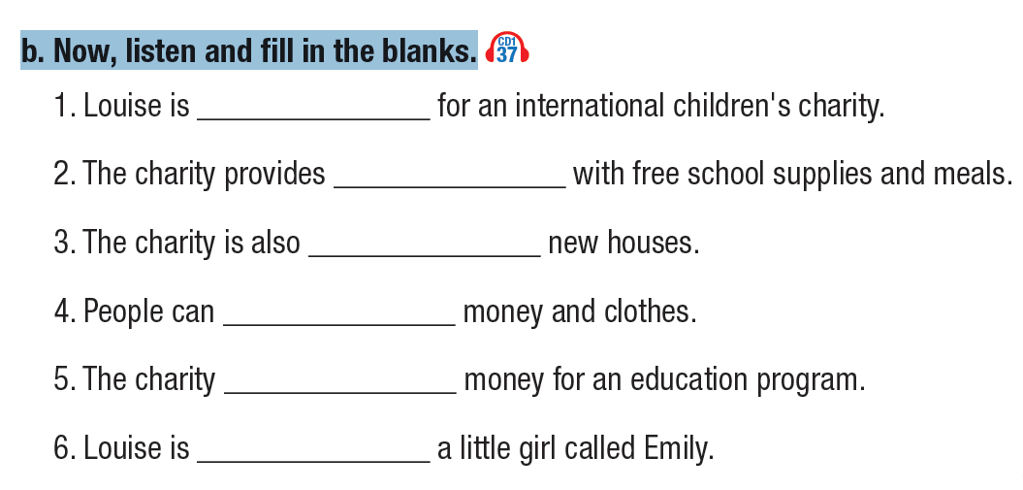
b. Now, listen and fill in the blanks.
Guess if the answer is a noun, a verb, an adjective, or an adverb.
Adj / V-ing
noun
V-ing
Verb
Verb w. s
V-ing
Notes:
Taken from TA 10 i-Learn Smart World WB, page 2

Slide 17
While - Listening
a. Listen to two people talking about a charity.
What is the purpose of the interview?
to ask for volunteers
to give information about the charity
Notes:
Taken from TA 10 i-Learn Smart World WB, page 2

Slide 18
b. Now, listen and fill in the blanks.
volunteering
every student
providing
donate
raises
supporting
Notes:
Taken from TA 10 i-Learn Smart World WB, page 2

Slide 19

Scripts
Henry: Hi, welcome to Teen Chat. I'm talking to Louise Metcalf. She's a student living overseas.
Louise: Hello. It's great to be here.
Henry: So, Louise, you're volunteering for an international
children's charity.
Louise: That's right.
Henry: And where are you exactly?
Louise: I'm living in a small village in Nicaragua.
Henry: Wow! What's that like?
Louise: It's lovely. It's a wonderful experience.
Henry: So, how are you helping?
Louise: I'm volunteering at the village school. I teach English there. The charity provides every student with free school books and meals.

Slide 20
Scripts
Henry: Fantastic! And how many children do you teach?
Louise: A lot! I have over fifty students.
Henry: And the charity is providing new houses, too. Is that right?
Louise: Yes, because many of the villagers lost their homes in the floods last year.
Henry: That's terrible. So, how can our listeners help?
Louise: Well, they can donate money and clothes. We always need things like that.
Henry: Is there anything else we can do?
Louise: Yes, the charity raises money for an education program.
Henry: Tell me more.
Louise: For fifty-nine dollars, you can buy all their school things for one year. I’m supporting a little girl called Emily.
Henry: Awesome. It was great talking to you, Louise.
Louise: Thank you, Henry.
Henry: Now, let’s listen to some...

Slide 21
Post - Listening
Listen to the conversation. Try to copy the intonation and pronunciation.
Look at the script and act out a conversation with your partner. Replace some information with your own ideas.
Notes:
Taken from TA 10 i-Learn Smart World WB, page 2

Slide 23

Work in pairs.
If you volunteer for a charity, what kind of charity will you work for? Why?
If I volunteer for a charity, I will work for …
Why?

Slide 24

Consolidation

Slide 25
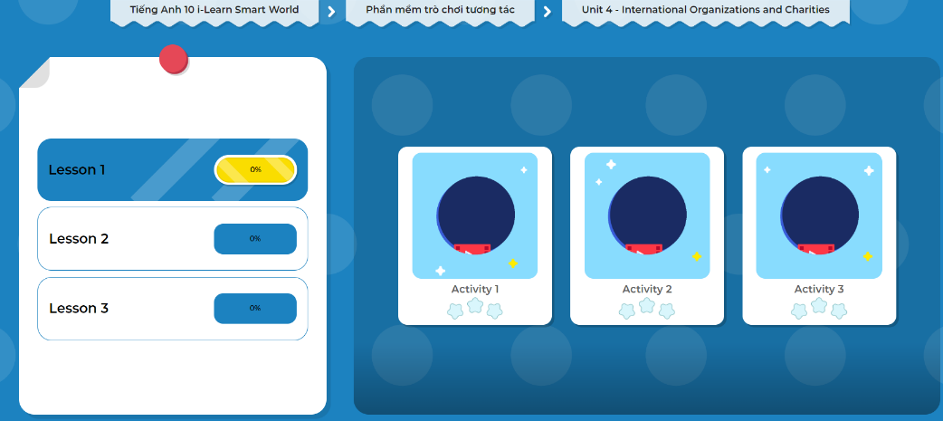
LET’S PLAY!
Click here to play the games.

Slide 26

WRAP-UP

Slide 27
Today’s lesson
Vocabulary: Charity
Listening: for purpose of the talk and specific information
Conversation Skill: Signaling the end of a conversation

Slide 28

Learn by heart vocabulary and make sentences using them.
Learn by heart how to signal the end of a conversation.
Do the exercises in WB on page 20.
Do the exercises in Tiếng Anh 10 i-Learn Smart World Notebook on page 20.
Prepare the next lesson - Grammar on page 21 in SB.

