Slide 1

UNIT 6: COMMUNITY LIFE
Lesson 2.2 – Grammar
Page 52

Slide 2


LESSON OUTLINE
Consolidation

Slide 3

By the end of this lesson,
students will be able to …
practice and use Modals with passive voice correctly.

Slide 4



Slide 5
Work in pairs.
Sort the verbs into the correct columns
am dance can are fly will should were
must return increase may was belong
To Be | Main Verbs | Modal Verbs
am
are
were
was
dance
fly
return
Increase
belong
can
will
should
Must
may

Slide 6

Presentation
Modals with passive voice

Slide 7
Lead in:
Identify the function of underlined words
Students must wear uniform in school.
Active
S
Modal verb
Main verb
O
Passive
S
must
be + V-ed/V3
by + O
Uniform must be worn (by students).
Modals with Passive Voice

Slide 8

Modals with Passive Voice
Modals like can, may, should, and must can be used with the passive voice to describe rules and recommendations when it is clear who they are for (e.g. School rules are for students.)

Slide 9
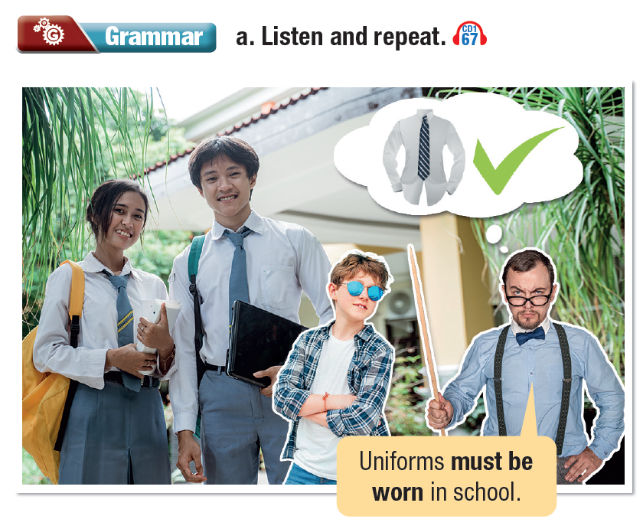


Slide 10
Modals with Passive Voice
• We use must for rules which everyone has to follow.
Swimming caps must be worn in the pool.
• We use should for advice and recommendations.
People can follow them if they choose to.
Money should be kept in the lockers.

Slide 11
Modals with Passive Voice
• We use can and may to express possibility and choice. May is more formal and polite than can.
Tennis equipment can be rented from the front desk

Slide 12

Modals with Passive Voice
Lockers must be used.
Tennis courts can't be rented by guests.
Can equipment be rented by members?

Slide 13

Practice

Slide 14
b. Decide if the sentences express necessity or possibility, then fill in the blanks.
1. Members' cards _______________ (show) at the front desk when entering the gym.
2. Swimming caps _______________ (wear) at all times in the pool by all members.
3. The pool _______________ (book) for parties. Members should book at least one week before the event.
must
be shown
must/should
be worn
can/may
be booked

Slide 15
4. Members can use their own balls and rackets on the tennis courts. Also, balls and rackets _______________ (rent) at the front desk.
5. Members must not bring their bags into the exercise area. Bags _______________ (keep) in the lockers at all times.
6. Rented equipment _______________ (return) to the front desk before the Center closes. Members have to pay for rented equipment that is not returned in time.
can/may
be rented
must/should
be kept
must/should
be returned

Slide 16
c. Write passive sentences. Use the prompts.
1. Member cards/must/show/borrow/books.
_________________________________________________2. Tennis equipment/can/rent/front desk.
_________________________________________________3. Swimming caps/must/wear/swimming pool/all times.
_________________________________________________
Member cards must be shown to borrow books.
Tennis equipment can be rented from the front desk.
Swimming caps must be worn in the swimming pool at all times.

Slide 17
4. Lockers/should/use/keep/money/safe.
________________________________________________
5. Books/should/return/front desk/library members.
________________________________________________
6. Can/swimming pool/book/children’s parties?
________________________________________________
Lockers should be used to keep money safe.
Books should be returned to the front desk by library members.
Can the swimming pool be booked for children’s parties?

Slide 18
Extra Practice
WB, page 35
a. Fill in the blanks using the passive voice.
Mai must pay the bill.
The bill _____________________ by Mai.
2. The children can read these books.
These books _____________________ by the children.
3. She must open the window.
The window _____________________.
must be paid
can be read
must be opened

Slide 19
4. The students must answer a lot of questions.
A lot of questions _____________________ by the students.
5. You shouldn't wear shoes by the pool.
Shoes _____________________ by the pool.
6. Phong may win the competition.
The competition _____________________ by Phong.
7. They can repair my car.
My car _____________________.
must be answered
shouldn’t be worn
may be won
can be repaired

Slide 20

Production

Slide 21
b. Rewrite the sentences in the passive voice.
Extra Practice
WB, page 35
1. You must follow the rules.
_________________________________________________
2. You must return books to their place before you leave the library.
_________________________________________________
3. You can book the ﬂight tickets one year in advance.
_________________________________________________
The rules must be followed.
Books must be returned to their place before you leave the library.
The ﬂight tickets can be booked one year in advance

Slide 22
4. You should put your personal belongings in a locker.
__________________________________________________
5. They must follow the traffic rules.
__________________________________________________
6. They should cancel the game because of the heavy snow.
__________________________________________________
7. Students must show their member cards at the library.
__________________________________________________
Your personal belongings should be put in a locker.
The traffic rules must be followed.
The game should be canceled because of the heavy snow.
Member cards must be shown at the library by students.

Slide 23

Consolidation

Slide 24
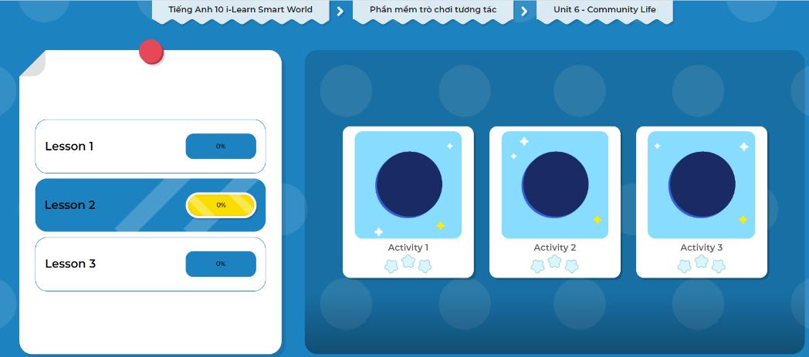
Extra Practice
DHA on Eduhome
Let’s Play!
Click here to play the games.

Slide 25

Work in pairs.
d. Talk about rules and things you can or can't do at your school.
Use the grammar point: Modals with passive voice
In my school, uniforms must be worn.
Mobile phones can't be used in class.

Slide 26

WRAP-UP

Slide 27
Today’s lesson
Grammar: Modals with passive voice
Speaking: talking about rules at school

Slide 28

Practice making sentences using Modals with passive voice.
Do the exercises in WB on page 35 (Writing).
Complete the grammar notes in Tiếng Anh 10 i-Learn Smart World Notebook on page 35.
Prepare the next lesson on page 53 in SB.
Play the consolidation games in Tiếng Anh 10 i-Learn Smart World DHA App on www.eduhome.com.vn

