Slide 1

UNIT 9: TRAVEL AND TOURISM
Lesson 3.2 – Writing
Page 81

Slide 2



Lesson 3.2
LESSSON OUTLINE
Pre writing

Slide 3

By the end of this lesson,
students will be able to:
write a description of an eco resort, using pronouns and determiners to make the text more personal.
make progress in writing skill.

Slide 4



Slide 5

Work in pairs – Discuss.
What are the ideas should you include in the Eco resort’s description?
Name of the resort
Location
What the room/ restaurant like
Activities guests can do
Reasons guests should stay there
It’s special things

Slide 6

Pre writing

Slide 7
Pre writing
a. Read about using pronouns and possessives to make texts more personal
Using pronouns and possessives to make texts more personal
To make ad information seem more personal, you can use pronouns (you, we, it) and possessives (your, our).
For example:
Guests can enjoy delicious food from the resort's five-star restaurant.
→ You can enjoy delicious food from our five-star restaurant.
This makes the information seem personal, and the readers feel that the writer is talking to them. The readers can imagine being at the resort, and this can help convince them to make a booking.

Slide 8
Read the description of the Yên Vân Eco Park Resort again and underline the pronouns and possessives.
Yên Vân Eco Park is a new five-star resort on the Vietnamese island of Phú Quốc, a large island with an area of 544 square kilometers. We make all our private bungalows from bamboo and each comes with its own saltwater swimming pool. All rooms have a king-sized double bed, silk mosquito nets, and a view of the beach. We have three restaurants ready to serve you delicious Vietnamese food made from fresh local ingredients. Each morning you can enjoy our buffet breakfast or have your food on your bungalow’s terrace while listening to the birdsong in the nearby forest. When not relaxing in our spa, why not take a walk along our private beach? We also have daily boat trips around the island for our guests. You can try spear fishing in the sea if you would like to catch your own dinner. Children will love the water slide. It’s 800 meters long and runs down the side of a hill. There is something for everyone at our resort. Why don’t you book your next vacation with us today?

Slide 9
Pre writing
b. You are the hotel staff. Rewrite the sentences by replacing the underlined words with pronouns or possessives.
The resort is located next to the beach.
Our resort is located next to the beach./ It is located next to the beach.
2. The guest's bungalow has a private pool. ___________________________________________________
3. The guests can enjoy many great activities. ___________________________________________________
4. The hotel staff will take care of ___________________________________________________
5. The guest can enjoy delicious food in
__________________________________________________
Your bungalow has a private pool
You can enjoy many great activities.
We will take care of you.
You can enjoy delicious food in our restaurant

Slide 10

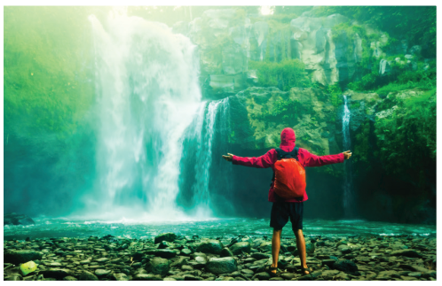
Pre writing
You're opening a new eco resort and want to write about it on your resort's website. In pairs: Discuss the following points.
• What your resort is called
• Where your resort is located
• What the rooms are like
• What the restaurants are like
• What kind of activities your guests can do
• Why people should stay at your resort
• What will make it special?

Slide 11
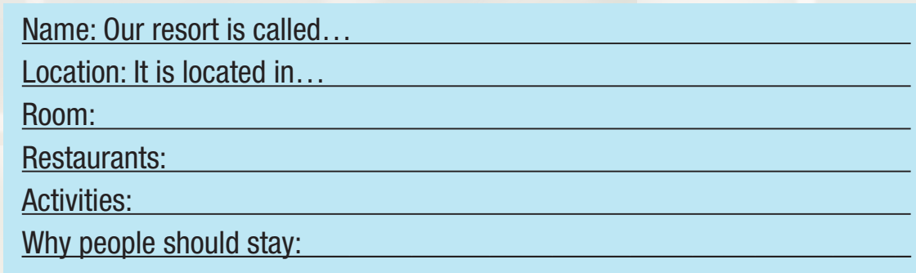
Pre writing
b. Note your ideas down using pronouns and possessives.

Slide 12


Slide 13
Now, write a description of your resort. Use the Feedback form to help you. Write 120 to 150 words.

Slide 14
Sample answer:
Eco Star Resort is a new five-star resort in Đà Nẵng, Vietnam. It is located next to a big private beach. All our bungalows are made from bamboo. Each bungalow has a private swimming pool, king-sized double bed, and a view of the beach.
We have two restaurants serving delicious Vietnamese food made from local ingredients. You can eat a buffet breakfast in the morning while listening to the sound of the sea. You can try fishing in the sea if you would like to catch your own
lunch. When you are not relaxing on the beach, why not go on a boat trip to a nearby island? We also have daily trips to the waterfalls by bicycles for our guests.
Families will love the water park and amusement park. There are lots of exciting rides. So why don't you book your next vacation with us?

Slide 15

The description follows the model and uses pronouns and possessives   
It is interesting.(Suggest ideas, if not.)   
I can understand everything   
(Underline anything you don’t understand)

Slide 16

Consolidation

Slide 17
Wrap-up
Today’s lesson
A description essay of an eco resort:
Name of the resort
Location
What the room/ restaurant like
Activities guests can do
Reasons guests should stay there
Special things about the resort

Slide 18

Rewrite your “description of an eco resort” after getting feedback
Do the exercise in Workbook (page 55).
Complete the writing notes in Tiếng Anh 10 i-Learn Smart World Notebook (page 55).
Play the consolidation games in Tiếng Anh 10 i-Learn Smart World DHA App on www.eduhome.com.vn
Prepare the next lesson: Unit 10, Lesson 1.1 – Vocab & Reading, (page 82).

