Slide 1
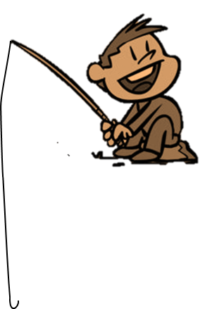
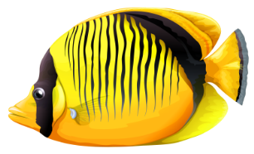
FISHING GAME
GO

Slide 2
Question 1?
C.right
A.wrong
D.wrong
C.right
B.wrong

Slide 3
Question 2?
D.right
A.wrong
B.wrong
C.wrong
D.right

Slide 4
Question 3?
A.right
A.right
D.wrong
C.wrong
B.wrong

Slide 5
Question 4?
D.right
A.wrong
B.wrong
C.wrong
D.right

Slide 6
Question 5?
C.right
A.wrong
D.wrong
C.right
B.wrong

Slide 7
Question 6?
A.right
A.right
D.wrong
C.wrong
B.wrong

Slide 8
Question 7?
D.right
A.wrong
B.wrong
C.wrong
D.right

Slide 9
Question 8?
A.right
A.right
D.wrong
B.wrong
C.wrong

Slide 10
Question 9?
B.right
B.right
A.wrong
D.wrong
C.wrong

Slide 11
Question 10?
C.right
A.wrong
D.wrong
C.right
B.wrong

