Slide 1



Review Unit 3
Test

Slide 2

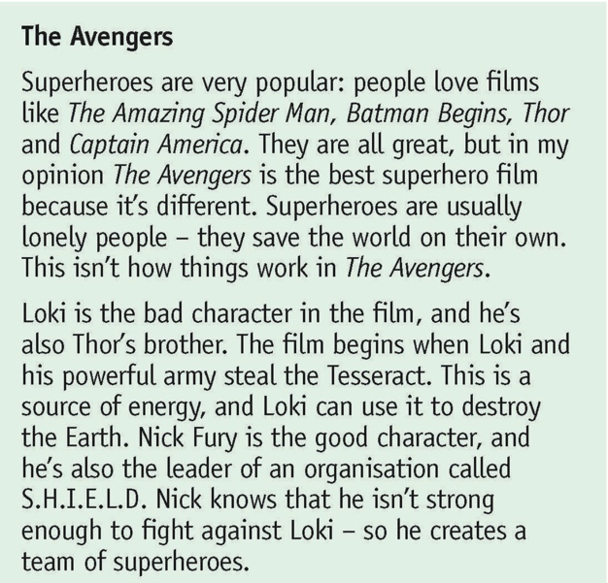

Reading:
What makes The Avengers different form the other superhero films is its clever script.
Answer: False
The superhero in the Avengers are the most powerful
Answer: DS
Tesseract, a weapon stolen by Loki’s team can be used to destroy the Earth
Answer: True
www.phuongnam.edu.vn

Slide 3
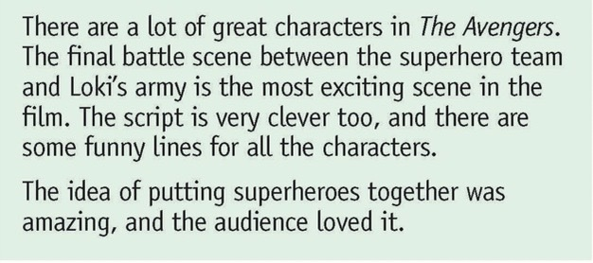
Reading:
There are a lot of battle scenes in The Avengers
Answer: DS
Some lines in the script make the audience laugh
Answer: True
The audience enjoys watching superheroes cooperate in an effort to save the world
Answer: True
www.phuongnam.edu.vn

Slide 4
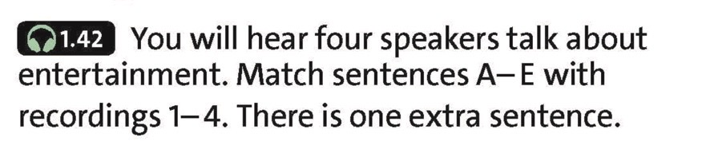


Listening:
We learn about somebody’s life.
The speaker is making an appointment to competitors.
The speaker is still studying at school.
We learn about the history of some popularn stories.
The speaker is describing a festival.
2
1
4
3
www.phuongnam.edu.vn

Slide 5
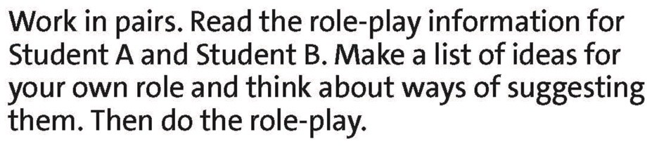
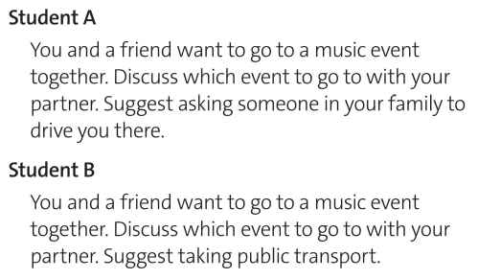
Speaking:
HINT:
- Make a list of ideas for your own role
+ Music event’s name: …
+ Where and when to meet?
+ Transportation: …
- Use appropriate language for making suggestions
www.phuongnam.edu.vn

Slide 6


Writing:
HINT:
- Describe the film
    + Who stars in the movie?
- Give your opinion of the film
+ How was the acting?
+ How was the CGI?
- Make a suggestion to your friend
www.phuongnam.edu.vn

Slide 7

www.phuongnam.edu.vn

Slide 8



Thank you!
CTCP ĐẦU TƯ VÀ PHÁT TRIỂN GIÁO DỤC PHƯƠNG NAM

