Slide 1

Unit 2: Family
Lesson 3.3
Page 32

Slide 2
Lesson Outline
Warm-up
Practice
Speaking
Consolidation
Wrap-up

Slide 3
Objectives
By the end of this lesson, students will be able to follow simple instructions, using ….
Vocabulary:
do your homework, clean your room, wake up, go to bed
Structure:
Stand up!

Slide 4

WARM UP

Slide 5
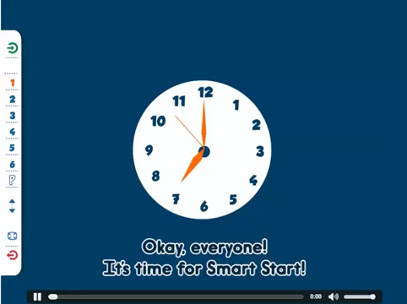
Let’s sing!

Slide 6

do your homework
Answer

Slide 7
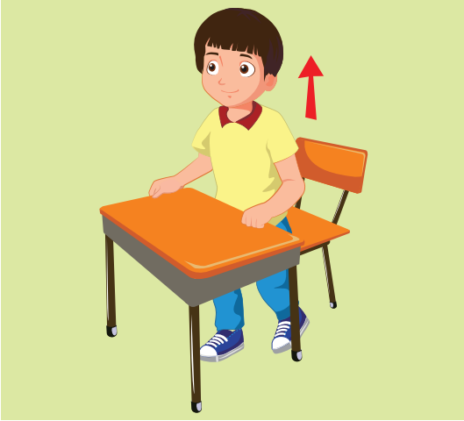
stand up
Answer

Slide 8
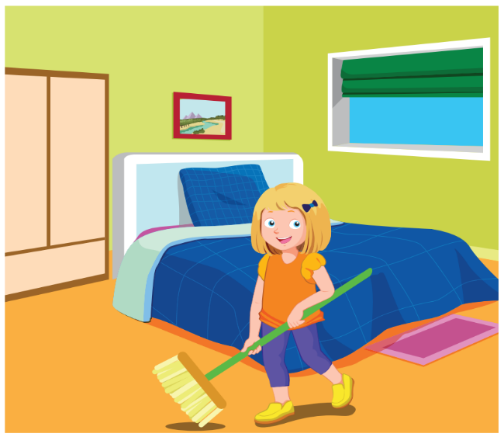
clean your room
Answer

Slide 9
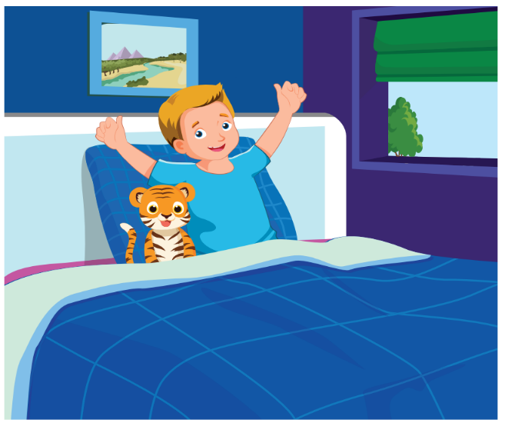
wake up
Answer

Slide 10
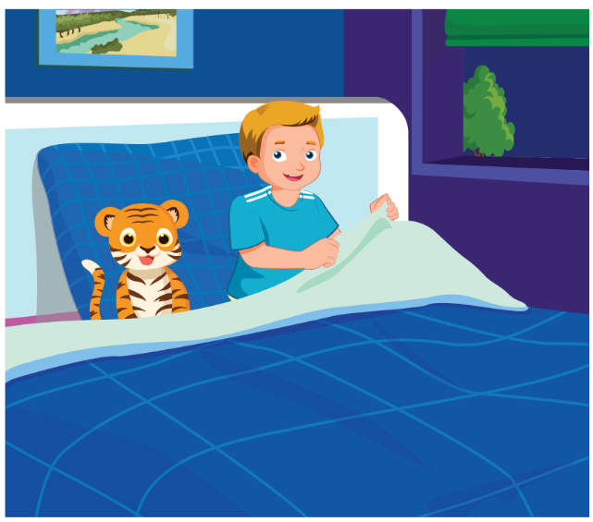
go to bed
Answer

Slide 11

It’s time to learn …

Slide 12

Practice

Slide 13
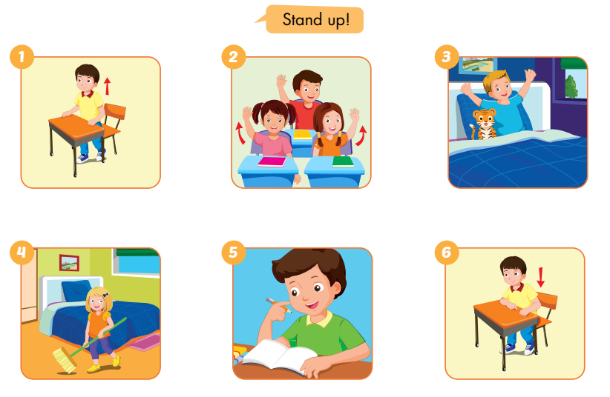
E
Point and say.
Notes:
E. Point and say.
Divide the class into two pairs.
Demonstrate the activity using the speech bubbles.
Have the student A point, have the student B say.
Swap roles and repeat.
Afterwards, have some pairs demonstrate the activity in front of the class.

Slide 14

Speaking

Slide 15
E
2. Role-play.
Example:
Tina: This is my brother, Ben.
Mark: Hello, Ben. I’m Mark.
Ben: Hello, Mark.
Notes:
2. Role-play.
Divide the class into groups of three.
Demonstrate the activity using the example.
Ask them to role-play the activity.
Swap roles and repeat.
Afterwards, have some pairs demonstrate the activity in front of the class.

Slide 16
Practice

Slide 17
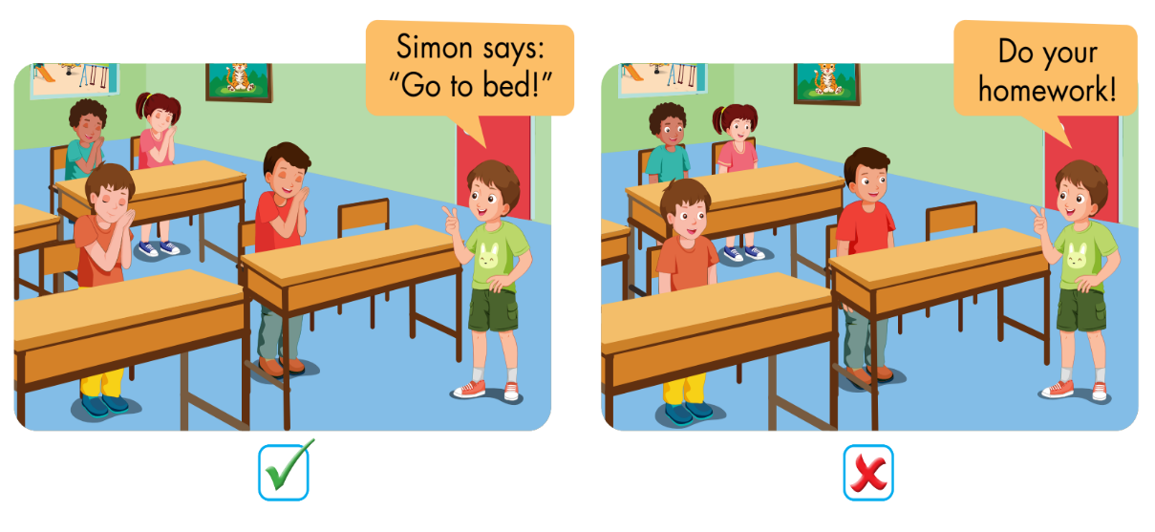
F
Play Simon says.
Notes:
F. Play Simon says.
Have students time to look and read at the examples.
Tell them they must only follow commands that start with “Simon says…”.
Model the activity in front of the class.
Demonstrate the game by giving the students different commands. If the command starts with “Simon says…”, students must do the action. If it doesn’t start with “Simon says”, students who do the action must sit down.
Invite one student to come to the front of the class to be “Simon”.
Ask them to swap roles and repeat with a new “Simon”.

Slide 18
Speaking

Slide 19
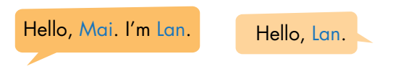
F
2. Role-play.
Example:
Lily: This is my sister, Mary.
Sam: Hello, Mary. I’m Sam.
Mary: Hello, Sam.
Notes:
2. Role-play.
Divide the class into groups of three.
Demonstrate the activity using the example.
Ask them to role-play the activity.
Swap roles and repeat.
Afterwards, have some pairs demonstrate the activity in front of the class.

Slide 20

CONSOLIDATION

Slide 21


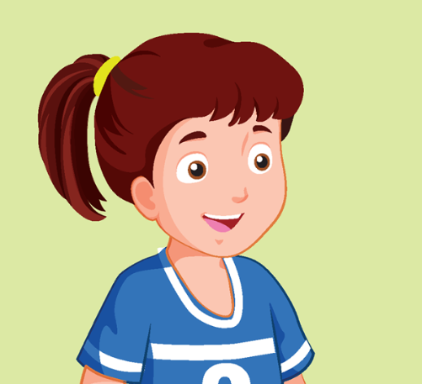
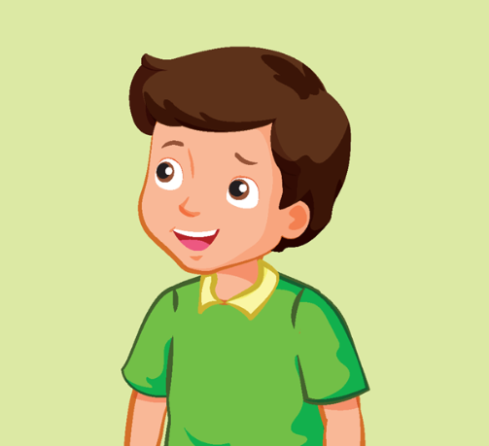
Look and say.
This is my… .
Notes:
Look and say.
Demonstrate the activity in front of the class.
Ask the class to look at the flashcards.
Have them use the structure: “This is my… .” to introduce family members.
Help them with their pronunciation and grammar (if any).

Slide 22

WRAP-UP

Slide 23
Today’s lesson
Vocabularies
grandfather grandmother
uncle
aunt
cousin
Structures/ Sentence patterns
Who’s he?
He’s my grandfather.
What’s his name?
His name’s Dan.

Slide 24
Homework
Practice the vocabularies and structures; and make sentences using them.
Do the exercises in Tiếng Anh 3 i-Learn Smart Start Notebook on page 18.
Prepare the next lesson: Unit 2 – Culture Lesson – Page 33.
Play the consolidation games in Tiếng Anh 3 i-Learn Smart Start DHA App on www.eduhome.com.vn

Slide 25

Enjoy your day!

