Slide 1

Unit 1: My World
Lesson 1d: Everyday English
Page 19

Slide 2
Lesson Outline
Warm-up
Everyday Eng.
Pronunciation
Consolidation
Wrap-up

Slide 3
Objectives
By the end of this lesson, students will be able to…
- act out a dialogue, describing a person.
- learn and practise sentence stress.

Slide 4

WARM-UP

Slide 5
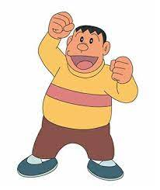
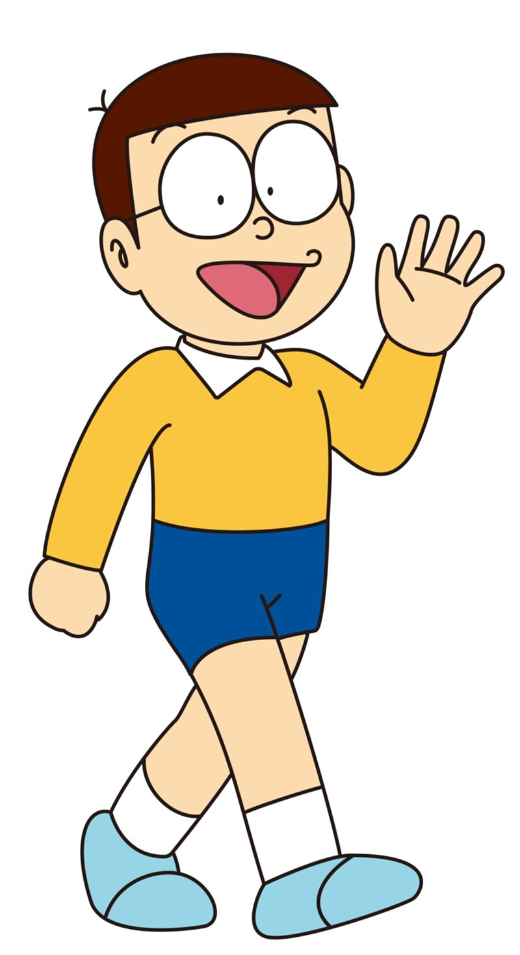
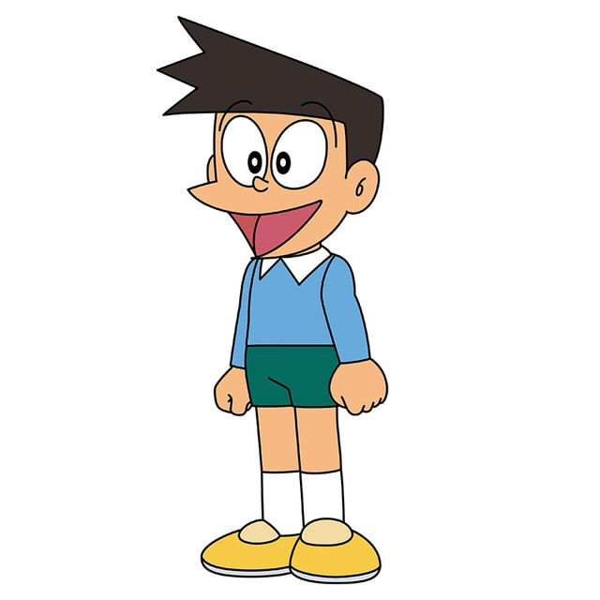
Read the descriptions. Who is he?
He is tall and chubby. He’s got short black hair. He’s a bossy person. He always bullies his friends.
Nobita
Jaian
Suneo

Slide 6
Choose the word whose underlined part is pronounced differently from that of the others.
A. kisses B. watches C. goes D. mixes
2. A. bossy B. worried C. honest D. modern
3. A. books B. sports C. shops D. songs
/ˈkɪsiz/
/ˈwɒtʃiz/
/ɡəʊz/
/ˈmɪksiz/
/ˈbɒsi/
/ˈwʌrid/
/ˈɒnɪst/
/ˈmɒdən/
/bʊks/
/spɔːts/
/ʃɒps/
/sɒŋz/

Slide 7
Choose the word whose main stress is placed differently from that of the others.
1. A. popular B. talkative C. impatient D. generous
2. A. cheerful B. bossy C. selfish D. polite
3. A. difference B. importance C. indigo D. restaurant
/ˈpɒpjələr/
/ˈtɔːkətɪv/
/ɪmˈpeɪʃənt/
/ˈdʒenərəs/
/ˈtʃɪəfəl/
/ˈbɒsi/
/ˈselfɪʃ/
/pəˈlaɪt/
/ˈdɪfərəns/
/ɪmˈpɔːtəns/
/ˈɪndɪɡəʊ/
/ˈrestrɒnt/

Slide 8

It’s time to learn …

Slide 9
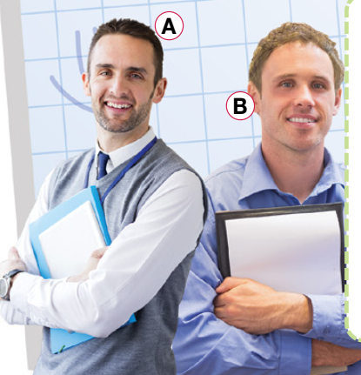
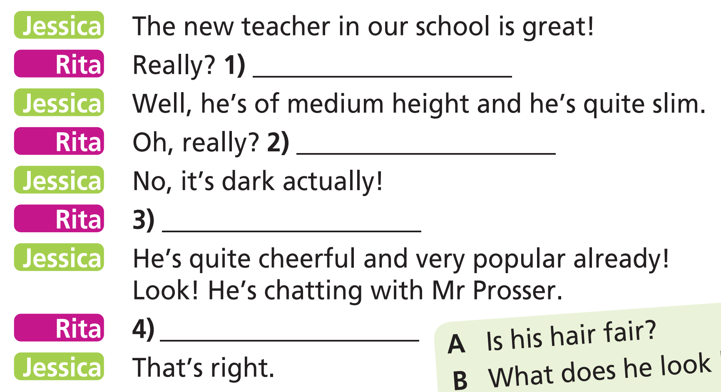
1 a) Read the dialogue. Which teacher (A or B) are Jessica and Rita talking about?
Pre-speaking
The answer is teacher A.

Slide 10

1 b) Complete the dialogue. Use the sentences in the list. One sentence is extra. Is the dialogue formal or informal?
A Is his hair fair?
B What does he look like?
C How old is he?
D What’s he like?
E Is he the one with a short
beard and a moustache?

Slide 11

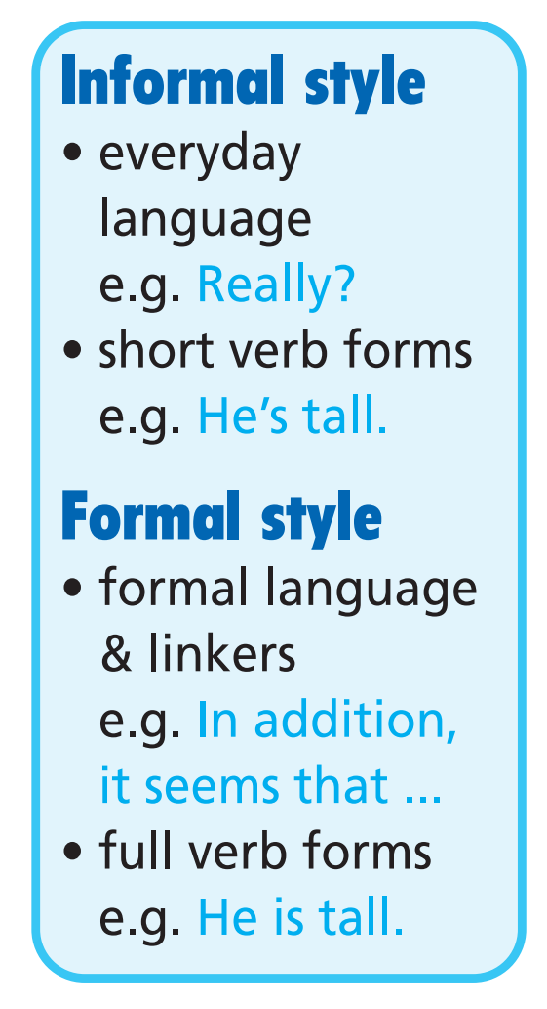

Slide 12

2 Listen, read and check.
It’s informal style!
A Is his hair fair?
B What does he look like?
C How old is he?
D What’s he like?
E Is he the one with a short
beard and a moustache?

Slide 13
While -speaking
3 Take roles and read the dialogue in Exercise 1 aloud. What does the new teacher look like? What is he like?
What does he look like?
The new teacher is of medium height and quite slim. He’s got dark hair, a short beard and a moustache. He’s cheerful and very popular.
Is his hair fair?
What’s he like?
Is he the one with a short beard and a moustache?

Slide 14

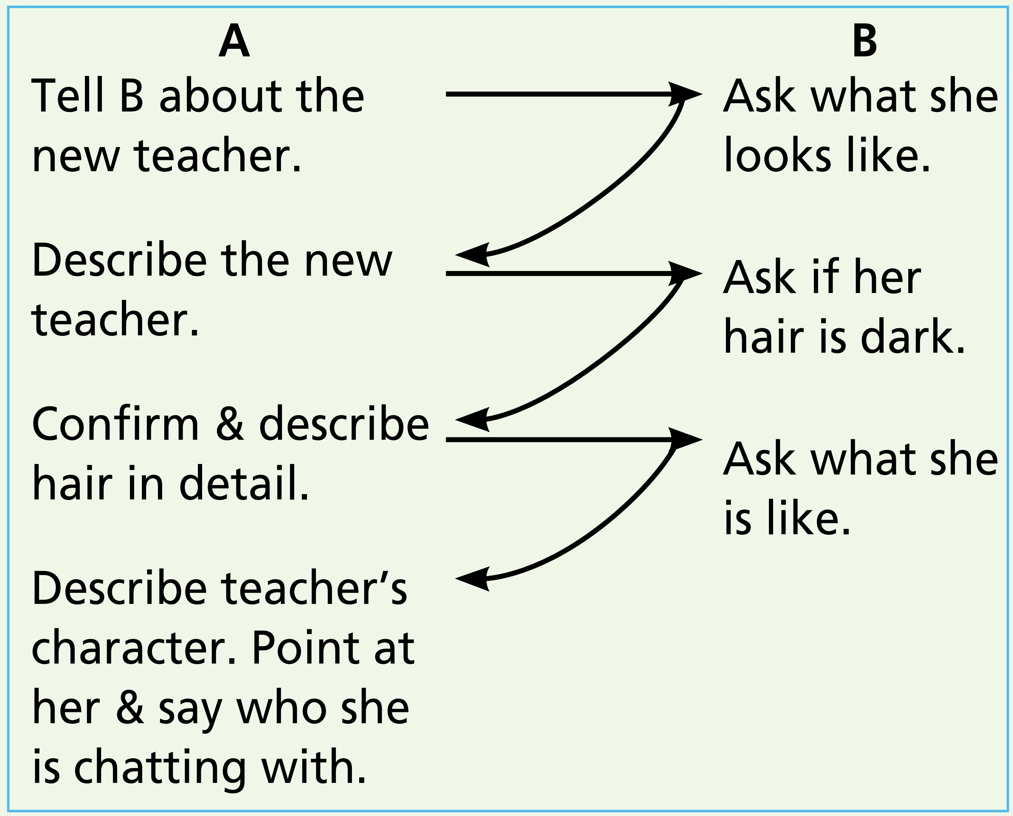
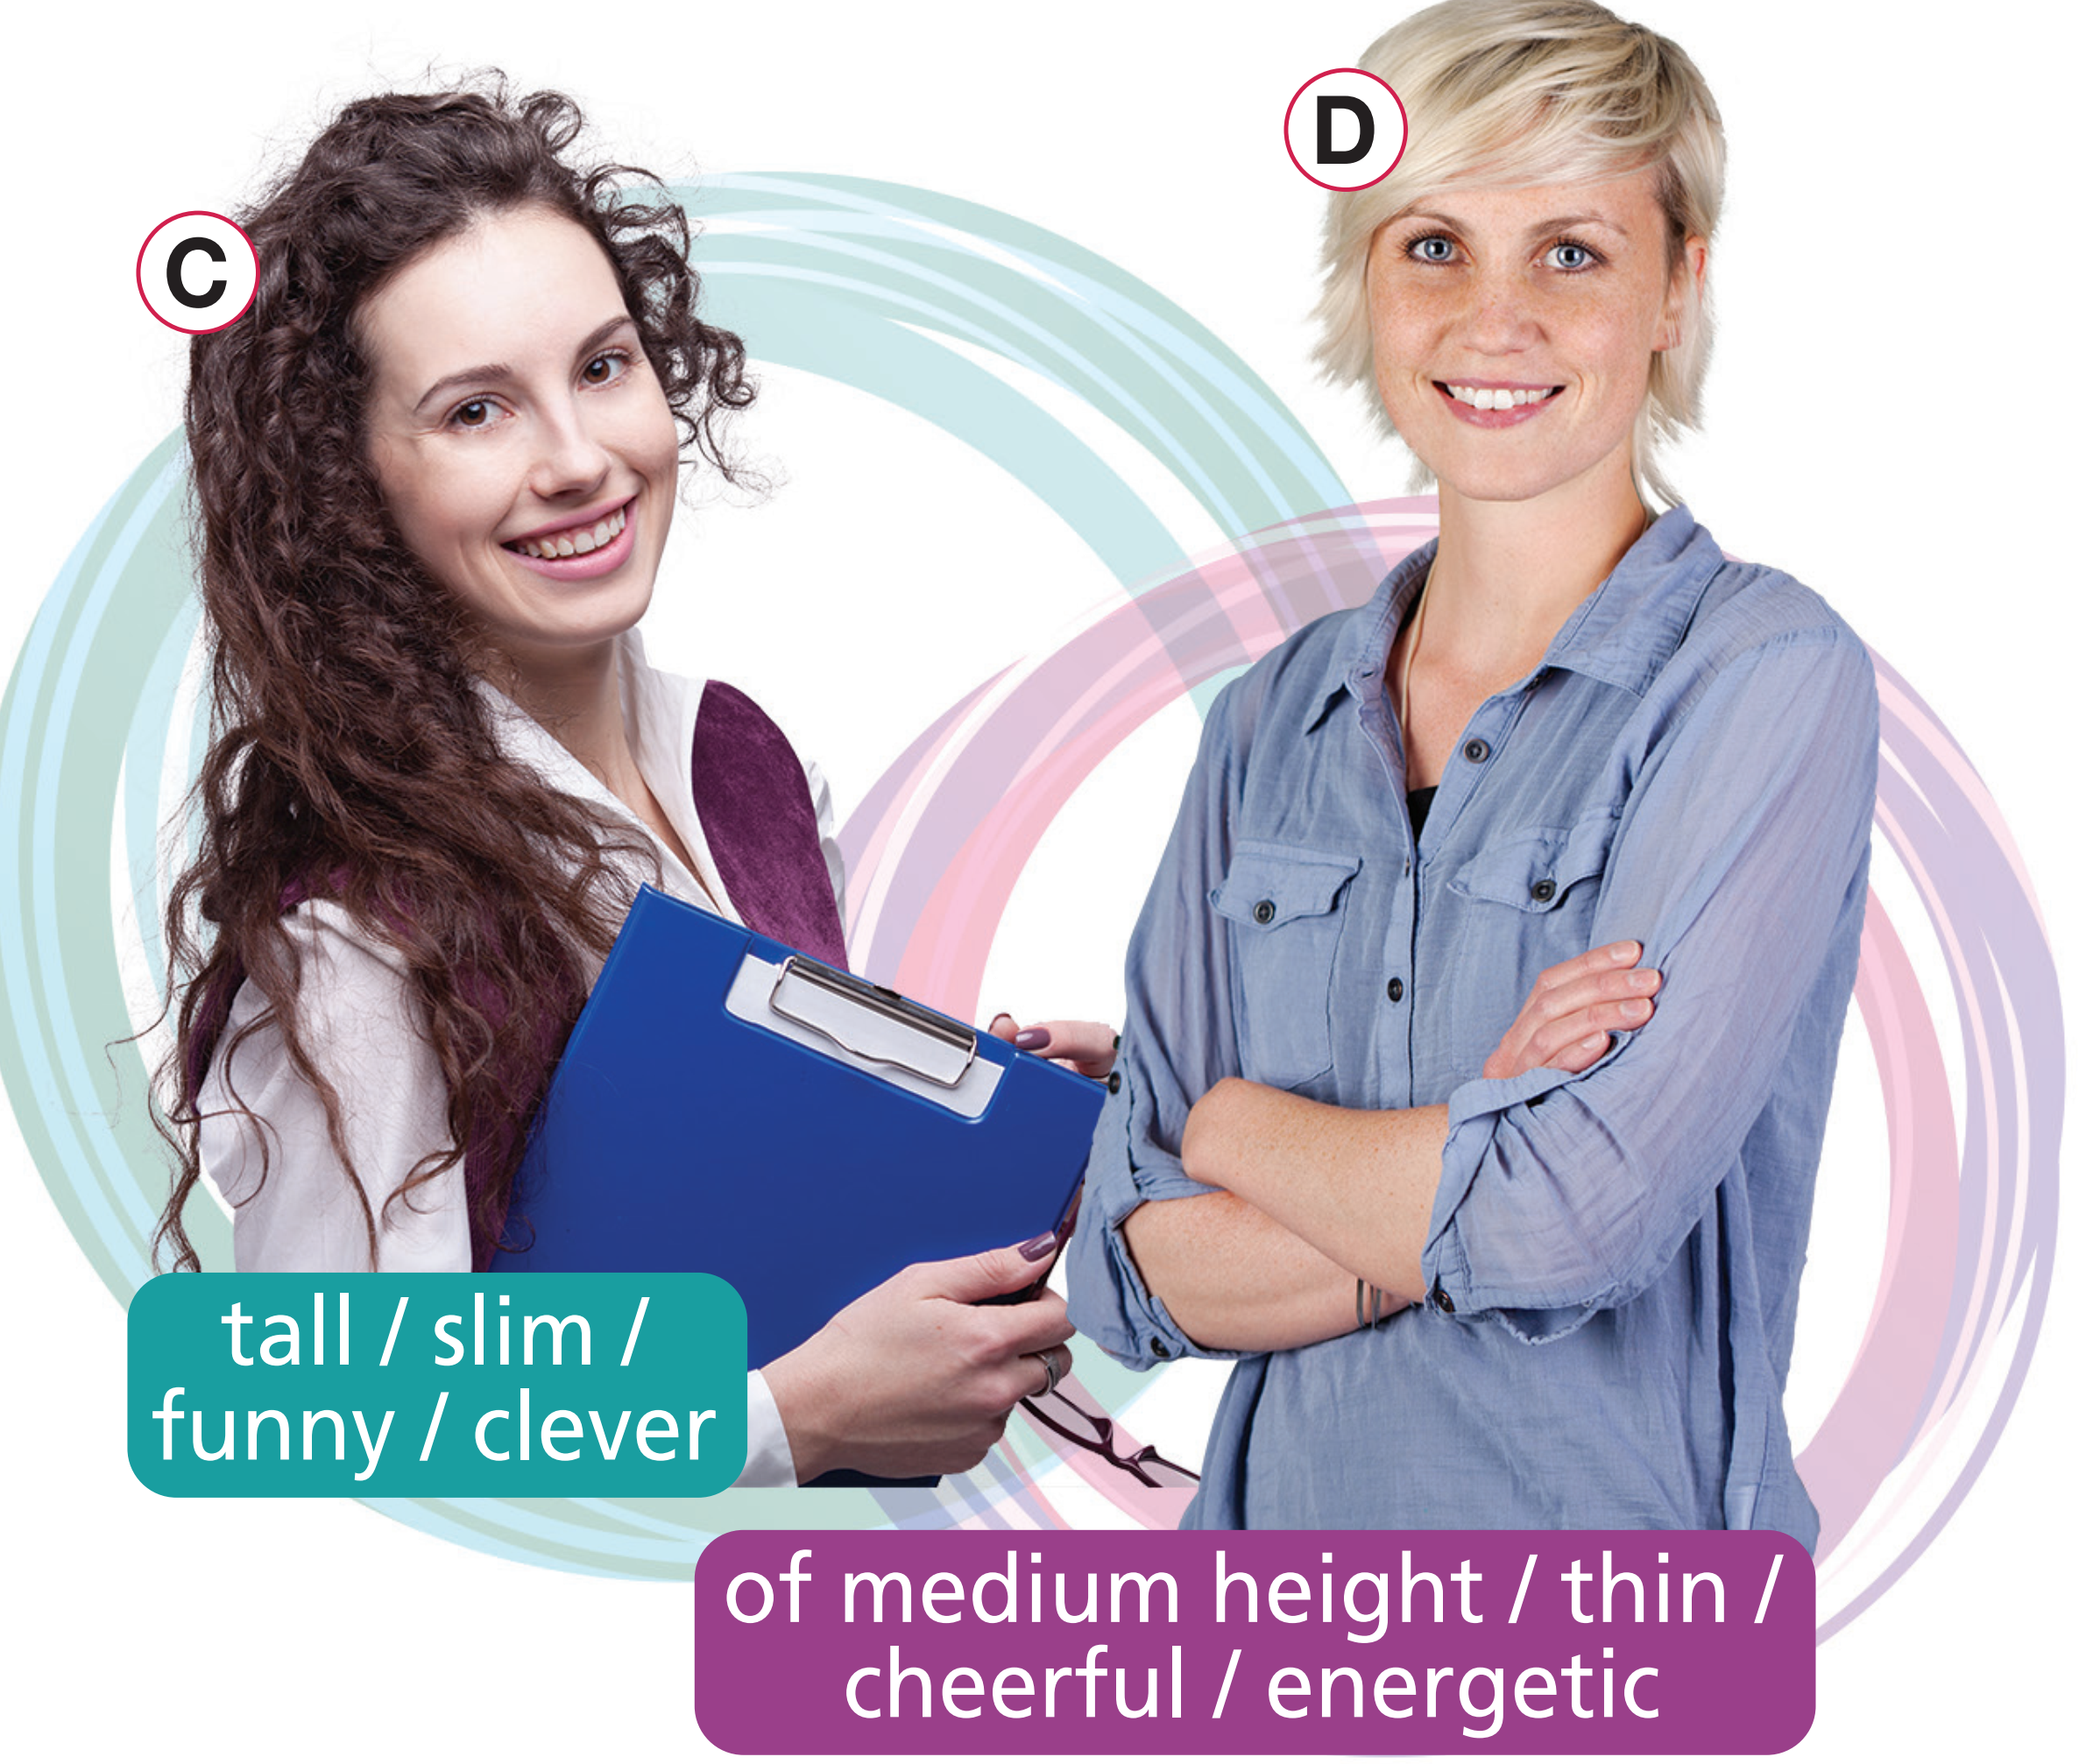
Act out a similar dialogue. Describe teacher C or D using the dialogue in Exercise 1 as a model

Slide 15
Post-speaking
Write a paragraph to describe one of two teachers in Exercise 4.

Slide 16

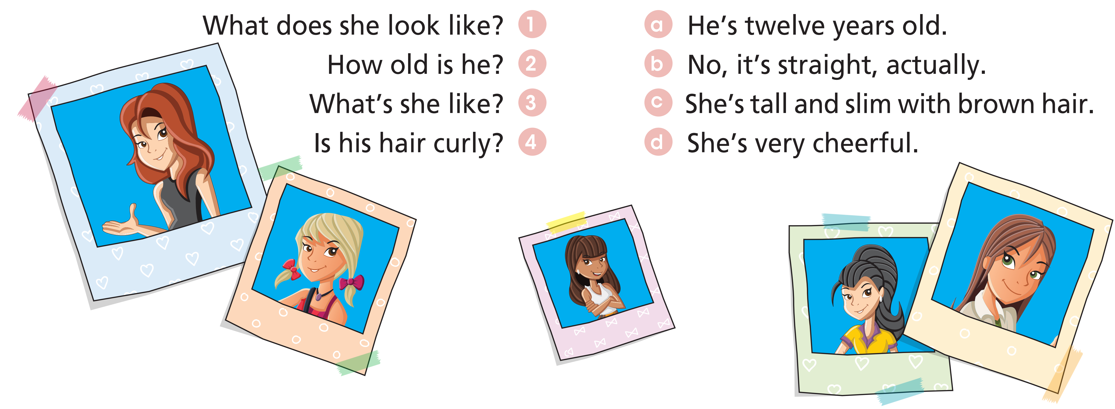
Extra Practice
WB, page 13

Slide 17
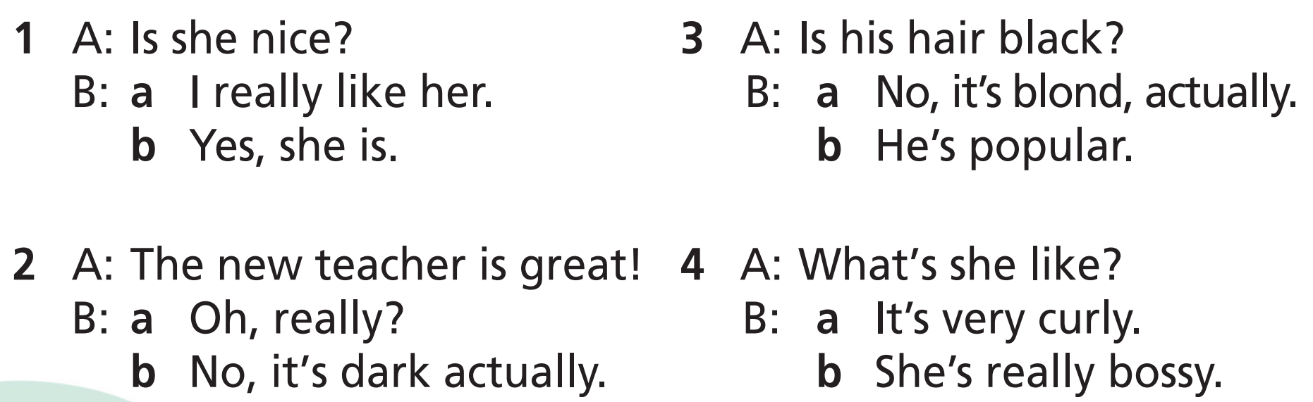
Extra Practice
WB, page 13
Choose the correct response. Read the exchanges aloud. Which words are stressed in each sentence?

Slide 18

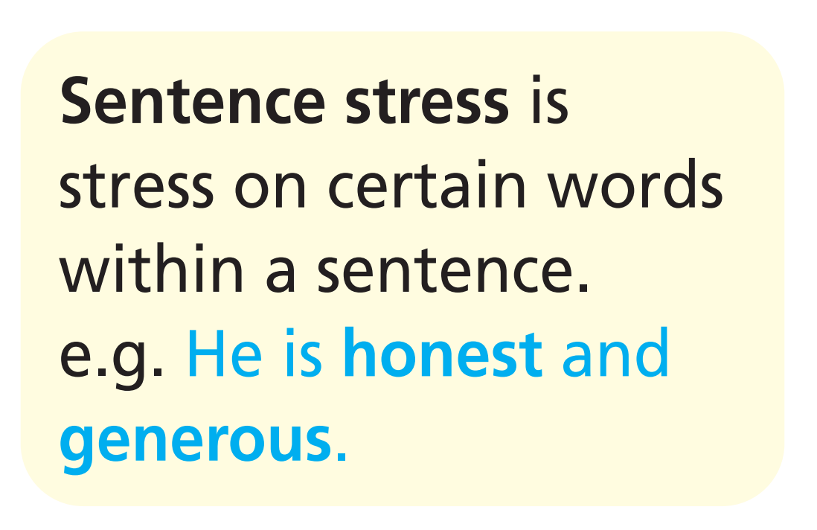
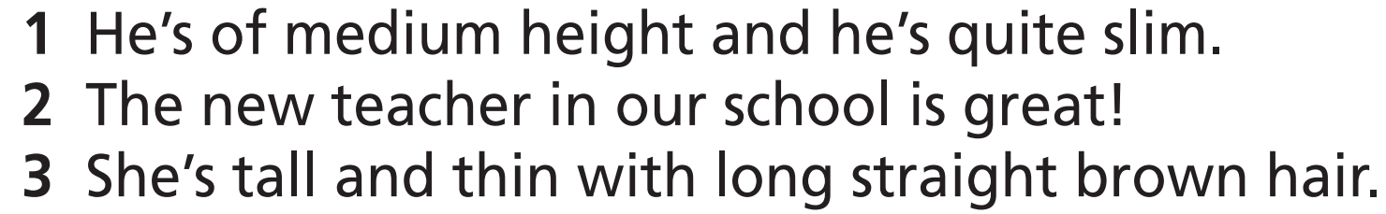

Slide 19

CONSOLIDATION

Slide 20
Write a paragraph (60-80 words) to describe your favourite teacher, using vocabulary and structures in the lesson.

Slide 21

WRAP-UP

Slide 22
Today’s lesson
Vocabularies
Words to describe a person
Structures/ Sentence patterns
Sentences to describe a person

Slide 23
Homework
Practise the vocabularies and structure and make sentences using them.
Do the exercises in TA 7 Right on WB (page 13)
Prepare the next lesson (page 20 SB)

Slide 24
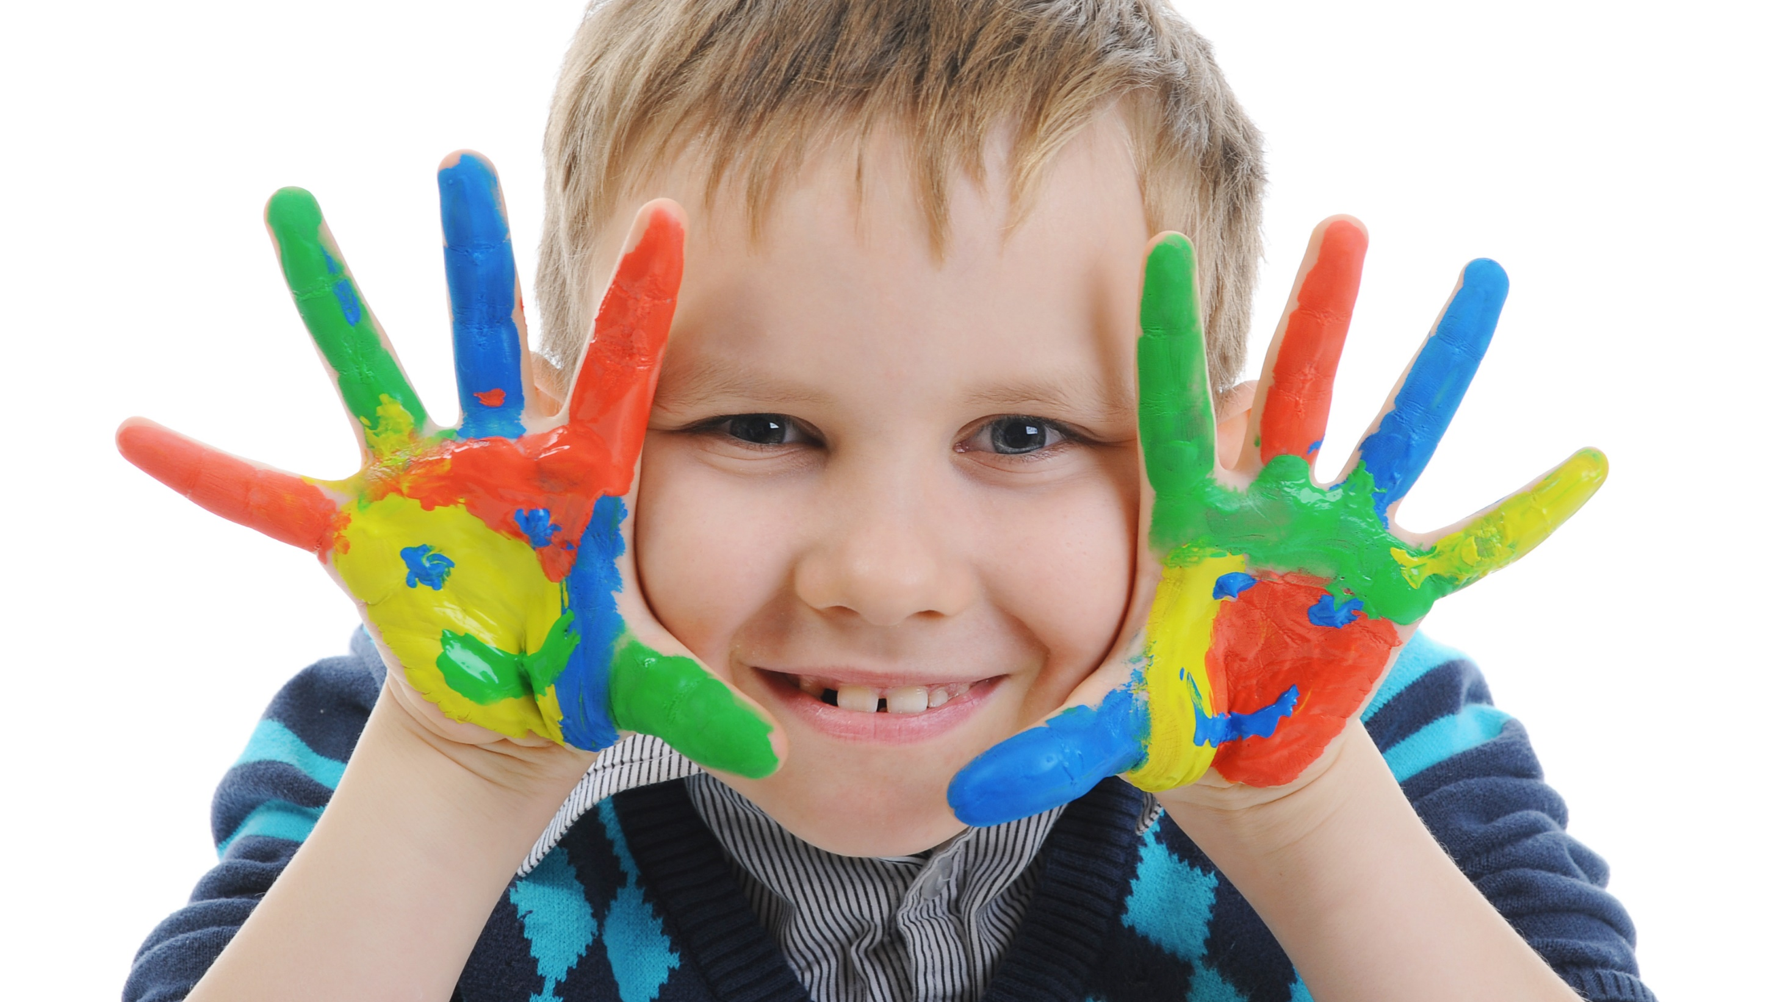
Enjoy your day!

