Slide 1


Unit 5: INVENTIONS
Lesson 8: Looking Back And Project

Slide 2

Unit
1
1
FAMILY LIFE
Family Life
Unit
OBJECTIVES
Review the vocabulary, pronunciation and grammar of Unit 5;
Apply what students have learnt into practice through a project.

Slide 3
Table of contents
01
02
03
Warm-up
Looking back
Project
04
Consolidation

Slide 4
Warm-up
01
Brainstorming

Slide 5

BRAINSTORMING
Brainstorm three-syllable nouns about topic Inventions
Camera
Inventor
Submarine
Invention
Telegraph
Computer
Telescope
Telephone
Beverage
Typewriter

Slide 6
Looking back
02

Slide 7
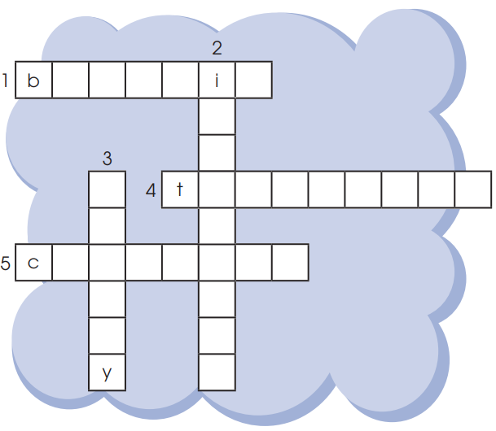
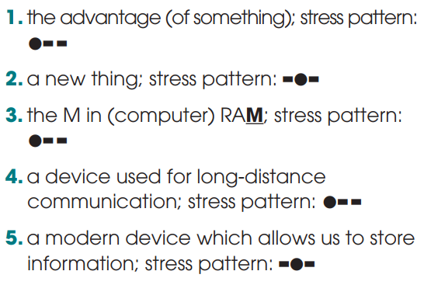
PRONUNCIATION & VOCABULARY
Solve the crossword.

Slide 8
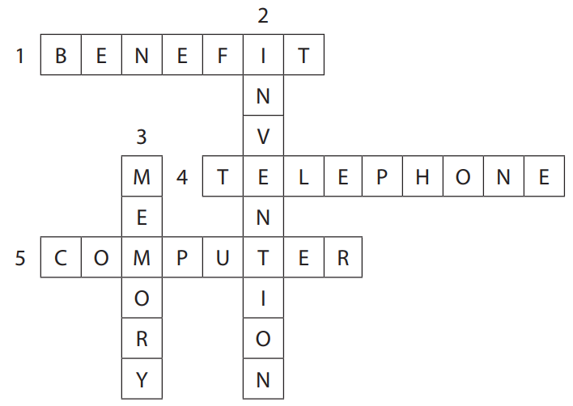
PRONUNCIATION & VOCABULARY
Solve the crossword.
benefit
invention
memory
telephone
computer

Slide 9


Slide 10


Grammar Time

Slide 11


They .................... some interesting software on the school computers.
have just installed
GREAT
have just installed
just installed

Slide 12

The programs are working very well and everyone enjoys ………… them.
using
GREAT
to use
using

Slide 13
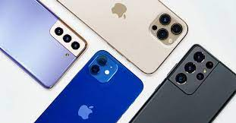
Smartphones allow people ………………information over long distances.
to send
GREAT
to send
sending

Slide 14
………………. with a smartphone is fun as well.
To learn
GREAT
To learn
Learn

Slide 15
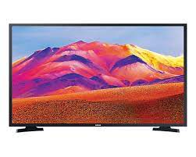
Since television was …………………, TV designs have changed a lot.
invented
GREAT
has been invented
invented

Slide 16
Project
03

Slide 17
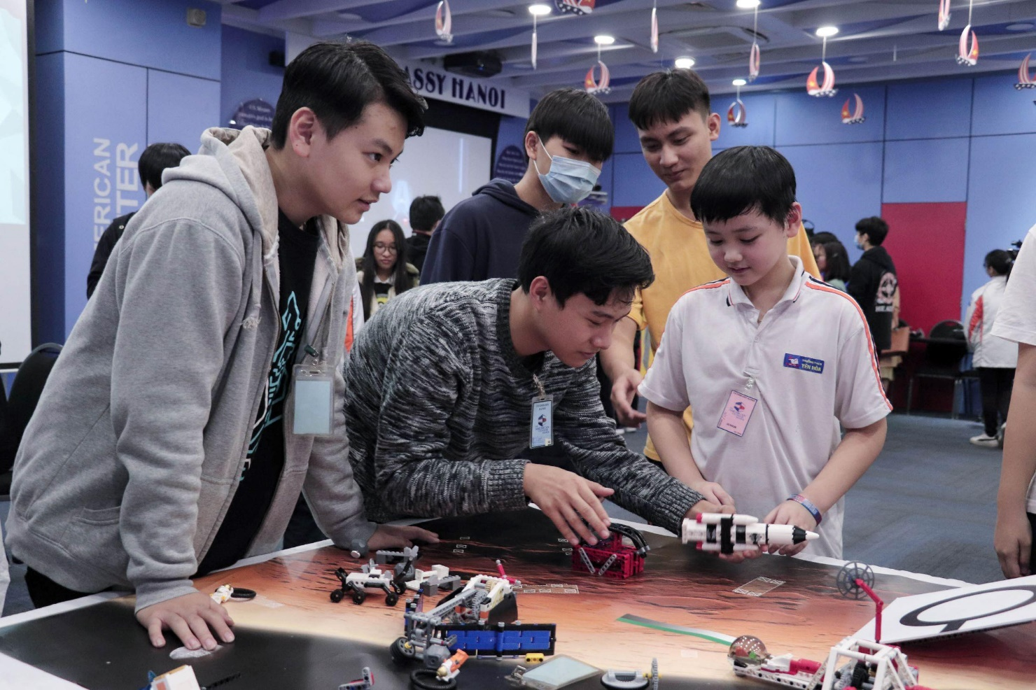
PROJECT
Inventions for the classroom

Slide 18
Consolidation
04

Slide 19
CONSOLIDATION
1
Wrap-up
Review the vocabulary, pronunciation and grammar of Unit 5;
Apply what students have learnt into practice through a project.

Slide 20
CONSOLIDATION
2
Homework
Prepare for the next lesson: Unit 6_Getting started
Do exercises in the workbook

Slide 21
SEE YOU NEXT TIME !!

