Slide 2
Unit 8
  WILDLIFE CONSERVATION
LESSON 7
COMMUNICATION AND CULTURE

Slide 3
LESSON 7
COMMUNICATION AND CULTURE
WARM-UP
If I were in charge
Task 1: Listen and complete the conversation.
Task 2: Make similar conversations
EVERYDAY ENGLISH
CLIL
Task 1: Read the text and put a tick and a cross
Task 2: Name some endangered animals in VN
CONSOLIDATION
Wrap-up
Homework

Slide 4

WARM-UP
GAME

Slide 5

EVERYDAY ENGLISH
1
Listen and complete the conversations with the expressions in the box. Then practice them in pairs.
A. Has something happened? B. Is there something wrong?
C. Is there anything I can do to help? D. Do you feel better now?
1.
Nam: Hi, Linda. Why didn’t you come to Cuc Phuong National Park with us yesterday? We were worried about you. (1) _________
Linda: I had a stomach ache, so I had to stay at home and rest.
Nam: Sorry to hear that. (2) _________
Linda: I’m fine now. Thanks for asking.
A
D

Slide 6
EVERYDAY ENGLISH
1
Listen and complete the conversations with the expressions in the box. Then practice them in pairs.
A. Has something happened? B. Is there something wrong?
C. Is there anything I can do to help? D. Do you feel better now?
2
Mai: You look worried. (3) _________
Nam: No, I’m just a bit nervous about my presentation on wildlife protection tomorrow.
Mai: (4) _________
Nam: If you could look at my slides, it would be great. Thanks so much in advance, Mai.
B
C

Slide 7
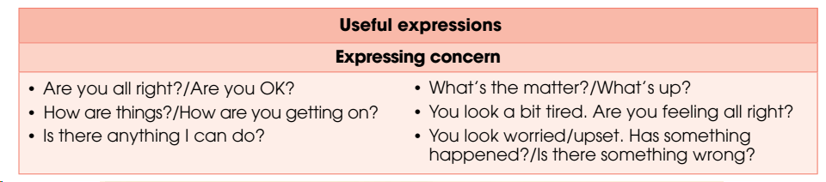
EVERYDAY ENGLISH
2
Work in pairs. Use the models in 1 to make similar conversations for these situations. One of you is A, the other is B. Use the expressions on page 109 to help you.

Slide 8
EVERYDAY ENGLISH
2
Work in pairs. Use the models in 1 to make similar conversations for these situations. One of you is A, the other is B. Use the expressions on page 109 to help you.
A looks worried because he/she hasn’t collected enough
information about endangered species for his/her biology project.
B expresses concern about him/her.
B didn’t join a school field trip to the Endangered Species Rescue Centre.
A expresses concern about him/her.

Slide 9
EVERYDAY ENGLISH
2
Work in pairs. Use the models in 1 to make similar conversations for these situations. One of you is A, the other is B. Use the expressions on page 109 to help you.
Sample conversation 1:
Mai: You look so worried. What’s the matter with you?
Mark: I haven’t collected enough information about endangered species for my biology project.
Mai: Oh. I see. Is there anything I can do to help?
Mark: Thank you. I’ll try to manage. I’ll call you if I need any help.

Slide 10
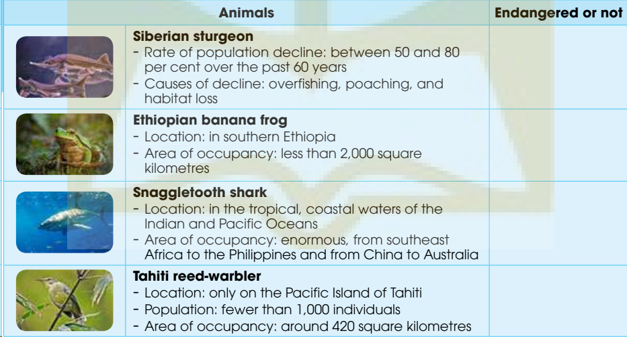
CULTURE
1
Read the following text. Put a tick (✓) if the animals in the table are classified as endangered and a cross (✗) if they are not.
✓
✗
✗
✓

Slide 11
CULTURE
2
Work in groups. Name some endangered animals in Viet Nam. Share what you know about them.
Example:
I think Saola is one of the most endangered animals in Viet Nam because it is rare and its population is so small.

Slide 12
CONSOLIDATION
1
Wrap-up
What have you learnt today?
How to express concerns
How animals are classified as endangered.

Slide 13
CONSOLIDATION
2
Homework
Do exercises in the workbook.
Prepare for Lesson 8 – Looking back and project

Slide 14
Website: hoclieu.vn
Fanpage: facebook.com/www.tienganhglobalsuccess.vn

