Slide 1
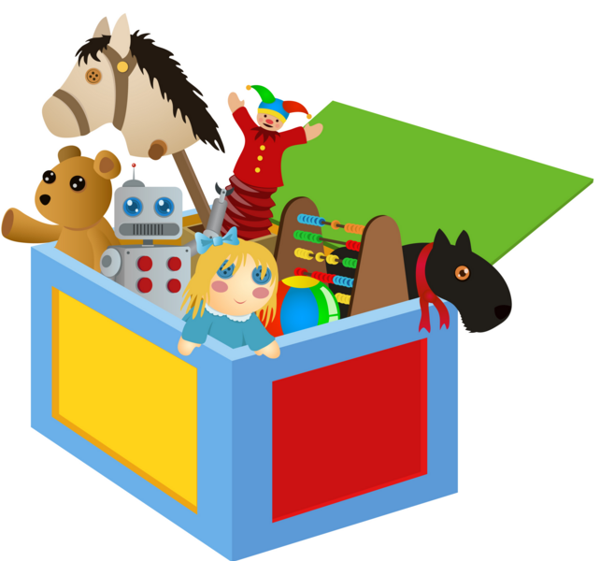
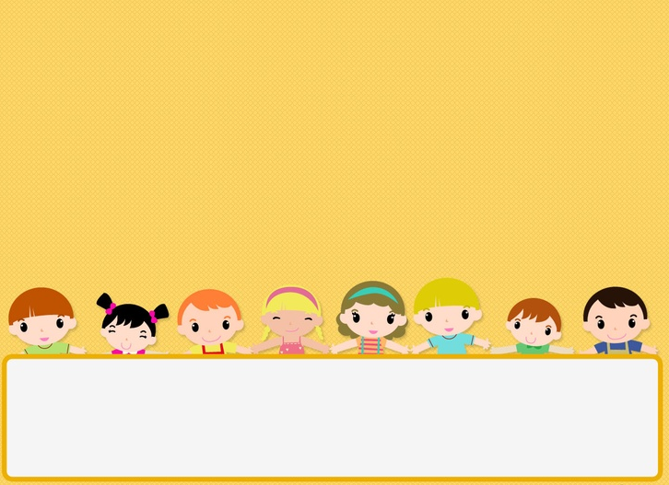
TOYS

Slide 2
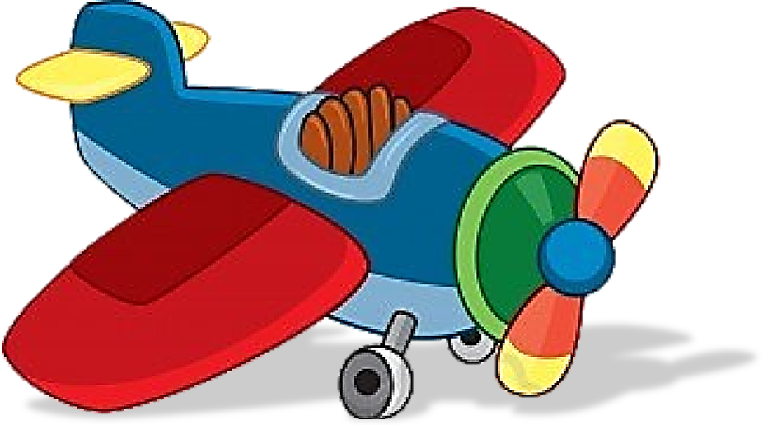
Aeroplane

Slide 3
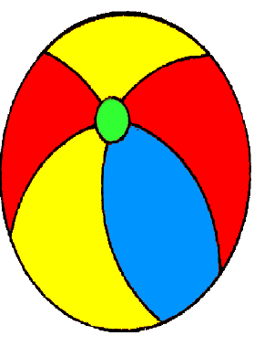
Ball

Slide 4
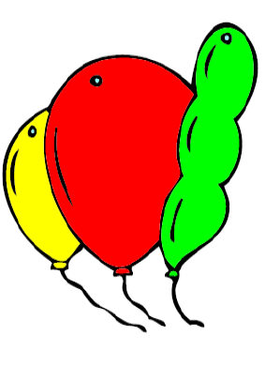
Balloons

Slide 5
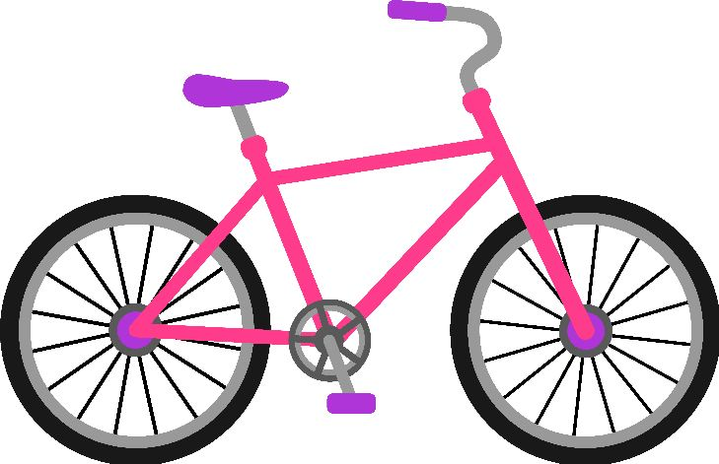
Bike

Slide 6
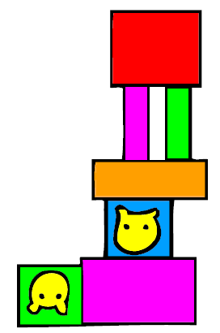
Building blocks

Slide 7
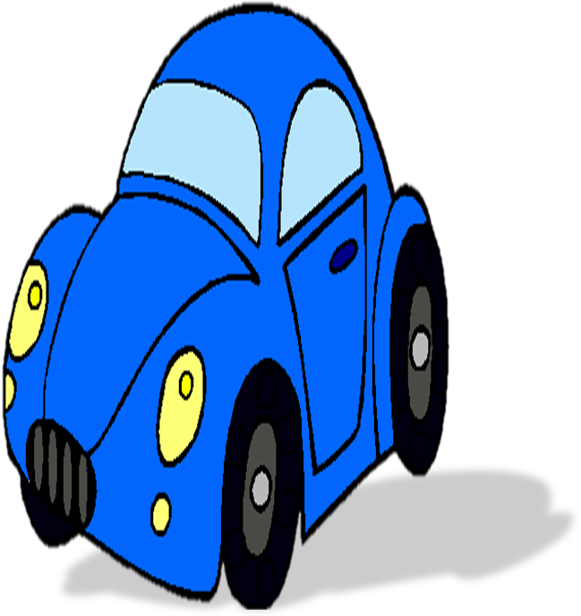
Car

Slide 8
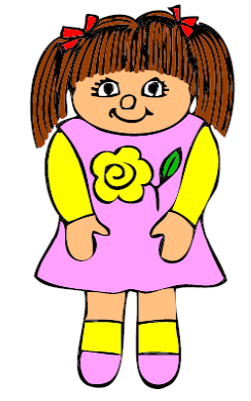
Doll

Slide 9
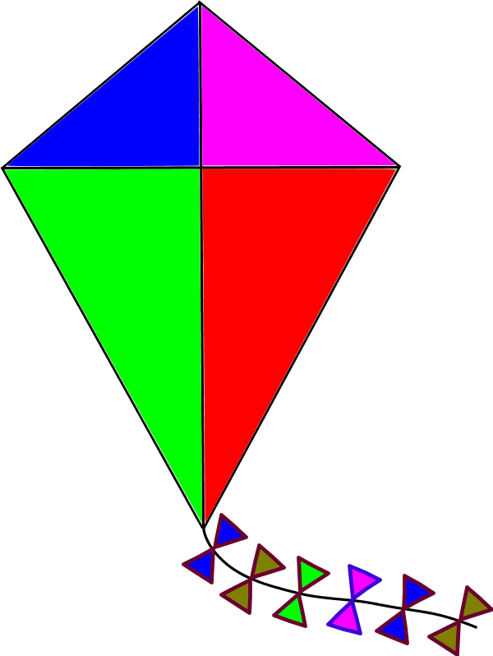
Kite

Slide 10
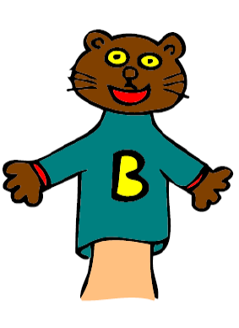
Puppet

Slide 11
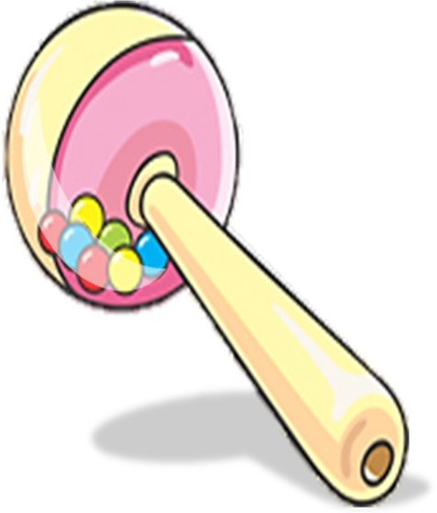
Rattle

Slide 12
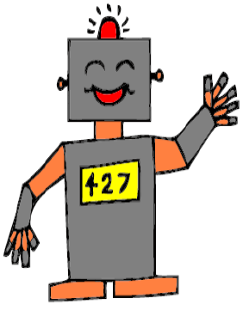
Robot

Slide 13
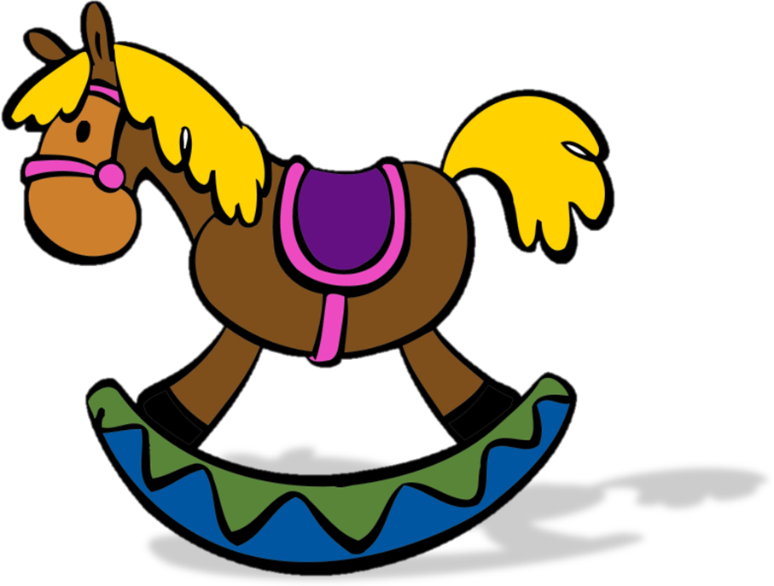
Rocking horse

Slide 14
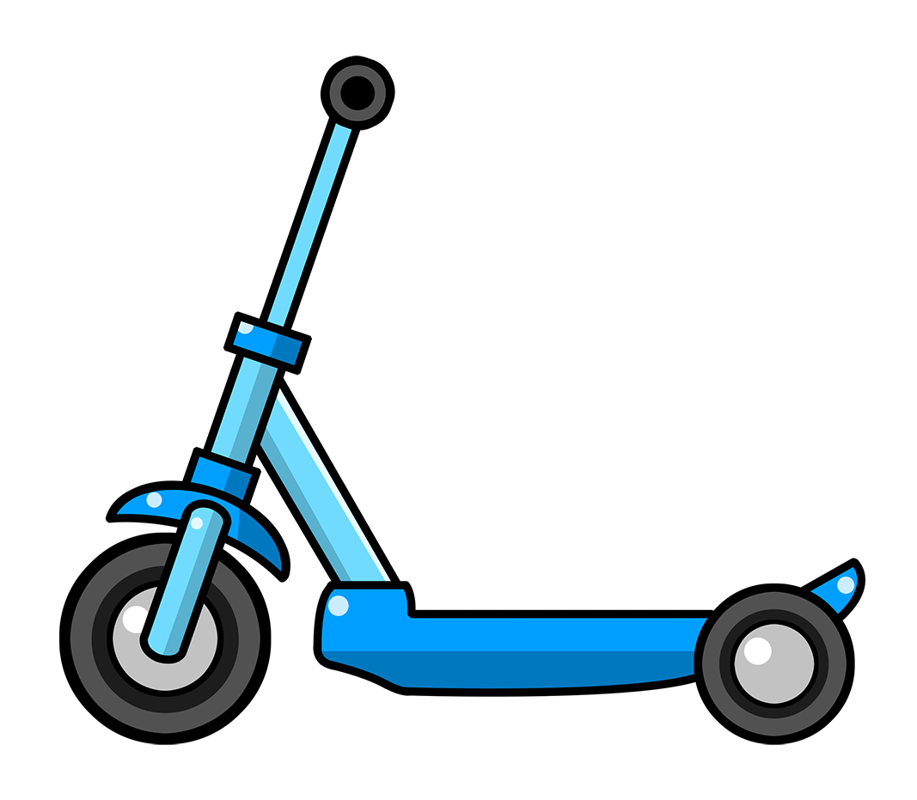
Scooter

Slide 15
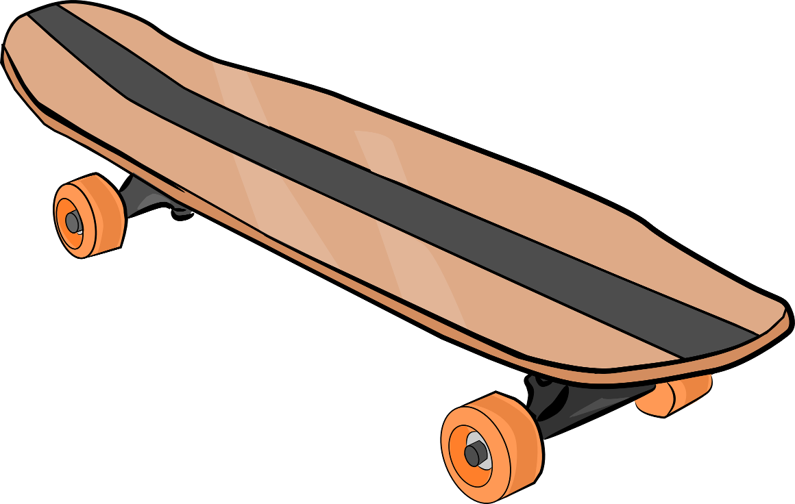
Skateboard

Slide 16
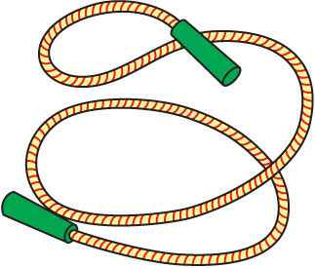
Skipping rope

Slide 17
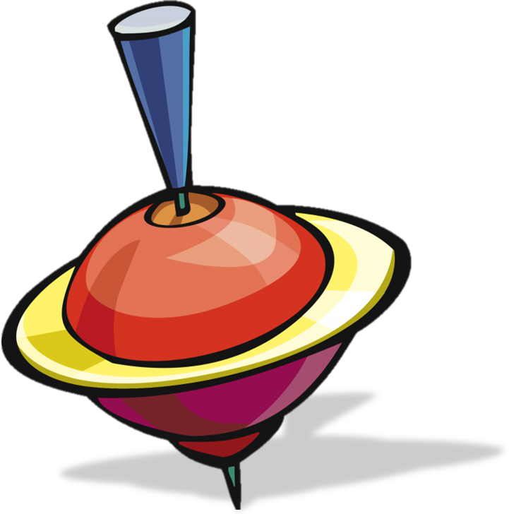
Spinning top

Slide 18
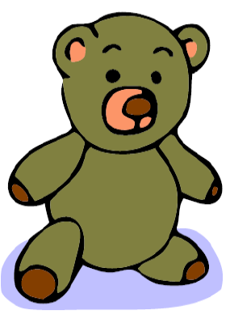
Teddy bear

Slide 19
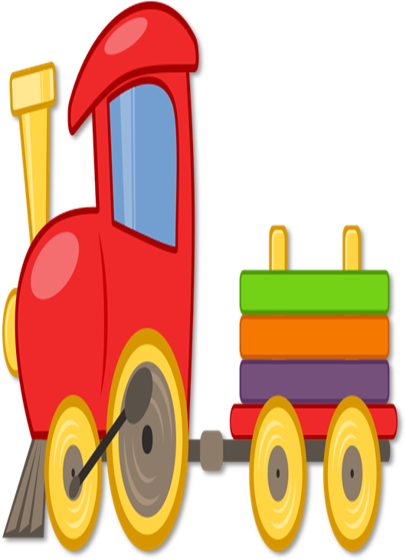
Train

Slide 20
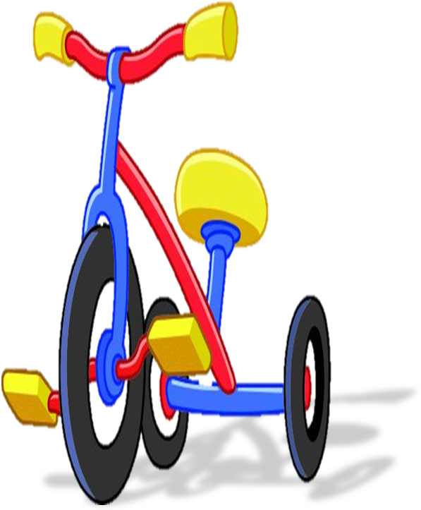
Tricycle

Slide 21
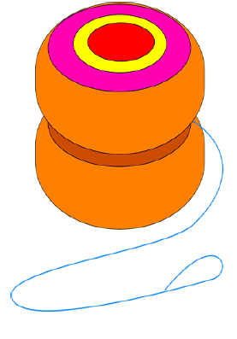
Yo-yo

Slide 22

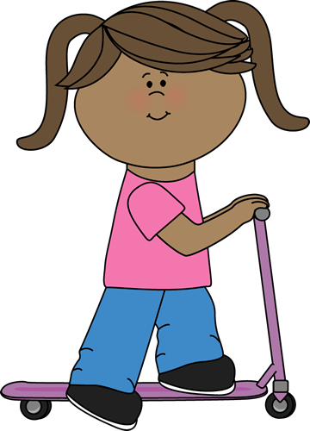
I’ve got
a scooter.
It’s new.

Slide 23
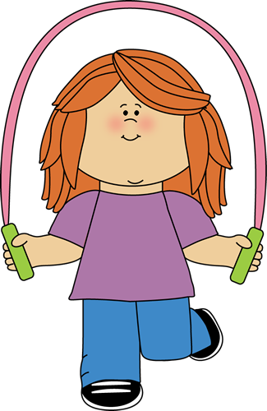
I’ve got
a skipping rope.
It’s old.

Slide 24
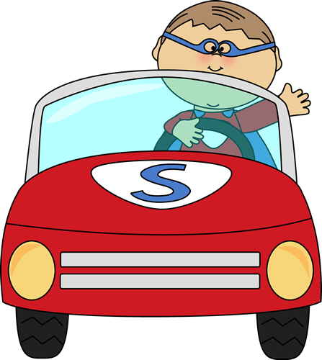
I’ve got
a car.
It’s big.

Slide 25
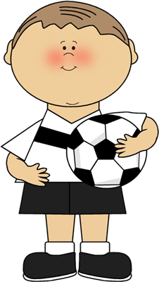
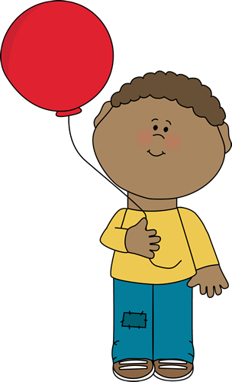
I’ve got
a ball.
It’s big.

Slide 26
I’ve got
a balloon.
It’s red.

Slide 27
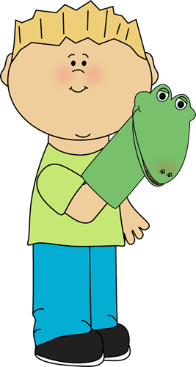
I’ve got
a puppet.
It’s green.

Slide 28
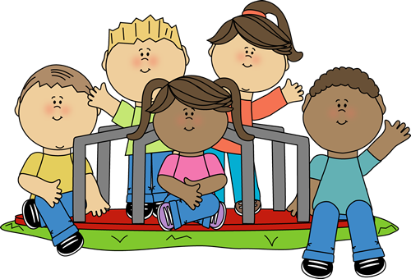
What have you got?

Slide 29

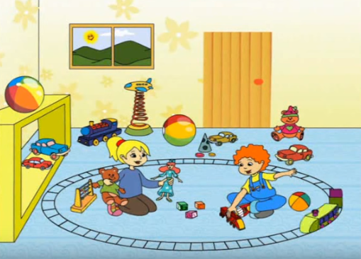
SONG:
My toys

Slide 30

SƯU TẦM: ĐOÀN VĂN DOANH, NAM TRỰC, NAM ĐỊNH
LINK NHÓM DÀNH CHO GV BỘ MÔN VẬT LÝ TRAO ĐỔI TÀI LIỆU VÀ CHUYÊN MÔN CT 2018
https://www.facebook.com/groups/299257004355186

