Slide 2
Table of contents
01
02
Activity 3
Warm up
Read and match
03
Activity 4
04
Activity 5
Red and complete
Let’s write
05
Fun time
Game

Slide 3
Warm up
01
Sing a song

Slide 4
Bad
Luck
Billy

Slide 5
This is Billy.
He has bad luck.

Slide 6
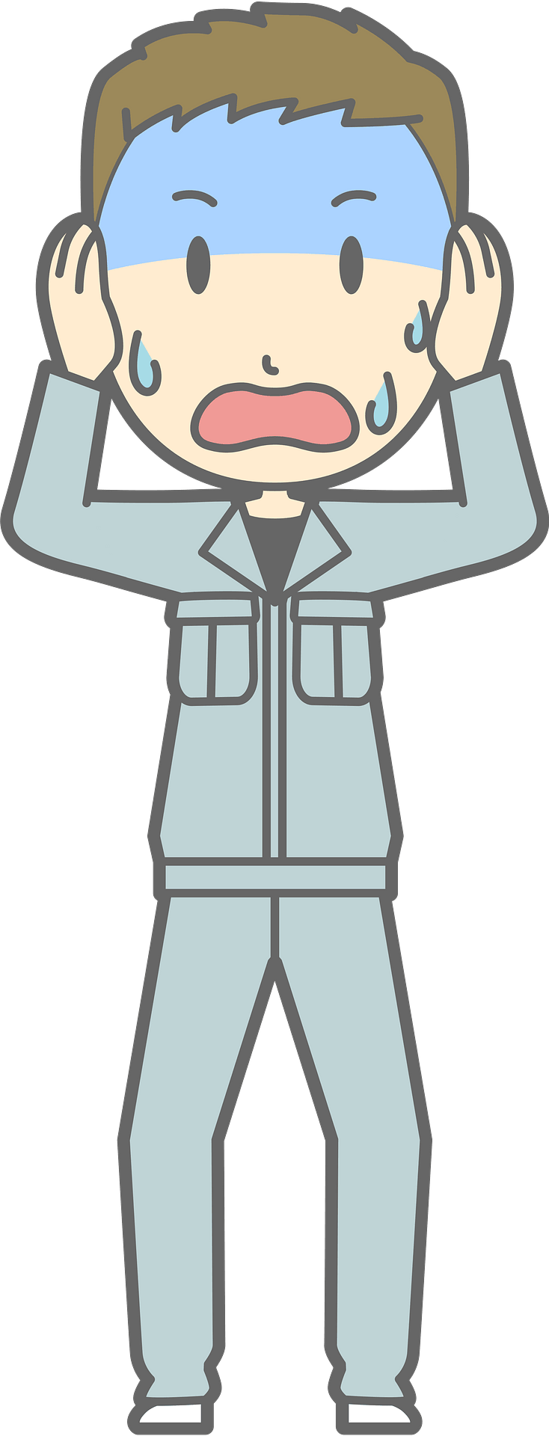
Dark clouds like to follow him…

Slide 7
…and strike him with lightning!
Notes:
Skeleton image designed by creazilla.com

Slide 8
Don’t worry,
Billy is okay…

Slide 9
…but, don’t have
bad luck like Billy.

Slide 10
How to Play
Everyone stands up.
One person reads the word or sentence on the screen.
Then, the next person goes.
If Billy is struck by lightning when you’re reading, you’re out (sit down).
The last person standing is the winner!
Notes:
TEACHER NOTES:
When I say ”Then, the next person goes.” I mean the next person reads the same word/sentence on the screen. The order of students reading is up to you and what makes the most sense for your class.
Feel free to adjust the instructions as needed for your class.
Skeleton image designed by creazilla.com

Slide 11
Where do you live?
Ready?
Notes:
TEACHER NOTES:
Replace the text in the box with your key vocabulary/sentences.
OR if you want to make it into a speaking activity, delete the text and put an image in the box.
When playing the game, click/press the spacebar to send in the dark clouds.
Students start reading the text in the box after the dark cloud music stops.
Lightning will strike automatically after the dark clouds appear, no need to click again. The time when it strikes is different on each slide (view the animation pane to view or change the timing).
After the lightning strikes Billy and the student reading sits down, click/press the spacebar to go to the next slide.
Currently, there are 30 game slides in total (meant for 31 students). However, feel free to add or delete slides as needed for the number of students in your class.
If you want to adjust the time of when the lightning strikes, go to the “Animations” tab and open the ”Animation Pane.” Then, click on the “Lightning Strike” animation and adjust the delay time in the timing window.
If using the game more than once with the same class and are worried students will remember the lightning strike timing on each slide, no need to adjust the times of each lightning strike animation, just reorder the slides to save time and make the game feel fresh.
Skeleton image designed by creazilla.com

Slide 12
What’s the city like?
Ready?
Notes:
TEACHER NOTES:
Replace the text in the box with your key vocabulary/sentences.
OR if you want to make it into a speaking activity, delete the text and put an image in the box.
When playing the game, click/press the spacebar to send in the dark clouds.
Students start reading the text in the box after the dark cloud music stops.
Lightning will strike automatically after the dark clouds appear, no need to click again. The time when it strikes is different on each slide (view the animation pane to view or change the timing).
After the lightning strikes Billy and the student reading sits down, click/press the spacebar to go to the next slide.
Currently, there are 30 game slides in total (meant for 31 students). However, feel free to add or delete slides as needed for the number of students in your class.
If you want to adjust the time of when the lightning strikes, go to the “Animations” tab and open the ”Animation Pane.” Then, click on the “Lightning Strike” animation and adjust the delay time in the timing window.
If using the game more than once with the same class and are worried students will remember the lightning strike timing on each slide, no need to adjust the times of each lightning strike animation, just reorder the slides to save time and make the game feel fresh.
Skeleton image designed by creazilla.com

Slide 13
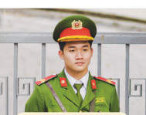
What does he do?
Ready?
Notes:
TEACHER NOTES:
Replace the text in the box with your key vocabulary/sentences.
OR if you want to make it into a speaking activity, delete the text and put an image in the box.
When playing the game, click/press the spacebar to send in the dark clouds.
Students start reading the text in the box after the dark cloud music stops.
Lightning will strike automatically after the dark clouds appear, no need to click again. The time when it strikes is different on each slide (view the animation pane to view or change the timing).
After the lightning strikes Billy and the student reading sits down, click/press the spacebar to go to the next slide.
Currently, there are 30 game slides in total (meant for 31 students). However, feel free to add or delete slides as needed for the number of students in your class.
If you want to adjust the time of when the lightning strikes, go to the “Animations” tab and open the ”Animation Pane.” Then, click on the “Lightning Strike” animation and adjust the delay time in the timing window.
If using the game more than once with the same class and are worried students will remember the lightning strike timing on each slide, no need to adjust the times of each lightning strike animation, just reorder the slides to save time and make the game feel fresh.
Skeleton image designed by creazilla.com

Slide 14
Where does she work?
Ready?
Notes:
TEACHER NOTES:
Replace the text in the box with your key vocabulary/sentences.
OR if you want to make it into a speaking activity, delete the text and put an image in the box.
When playing the game, click/press the spacebar to send in the dark clouds.
Students start reading the text in the box after the dark cloud music stops.
Lightning will strike automatically after the dark clouds appear, no need to click again. The time when it strikes is different on each slide (view the animation pane to view or change the timing).
After the lightning strikes Billy and the student reading sits down, click/press the spacebar to go to the next slide.
Currently, there are 30 game slides in total (meant for 31 students). However, feel free to add or delete slides as needed for the number of students in your class.
If you want to adjust the time of when the lightning strikes, go to the “Animations” tab and open the ”Animation Pane.” Then, click on the “Lightning Strike” animation and adjust the delay time in the timing window.
If using the game more than once with the same class and are worried students will remember the lightning strike timing on each slide, no need to adjust the times of each lightning strike animation, just reorder the slides to save time and make the game feel fresh.
Skeleton image designed by creazilla.com

Slide 15
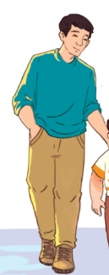
What does he look like?
Ready?
Notes:
TEACHER NOTES:
Replace the text in the box with your key vocabulary/sentences.
OR if you want to make it into a speaking activity, delete the text and put an image in the box.
When playing the game, click/press the spacebar to send in the dark clouds.
Students start reading the text in the box after the dark cloud music stops.
Lightning will strike automatically after the dark clouds appear, no need to click again. The time when it strikes is different on each slide (view the animation pane to view or change the timing).
After the lightning strikes Billy and the student reading sits down, click/press the spacebar to go to the next slide.
Currently, there are 30 game slides in total (meant for 31 students). However, feel free to add or delete slides as needed for the number of students in your class.
If you want to adjust the time of when the lightning strikes, go to the “Animations” tab and open the ”Animation Pane.” Then, click on the “Lightning Strike” animation and adjust the delay time in the timing window.
If using the game more than once with the same class and are worried students will remember the lightning strike timing on each slide, no need to adjust the times of each lightning strike animation, just reorder the slides to save time and make the game feel fresh.
Skeleton image designed by creazilla.com

Slide 16
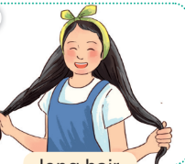
What does she look like?
Ready?
Notes:
TEACHER NOTES:
Replace the text in the box with your key vocabulary/sentences.
OR if you want to make it into a speaking activity, delete the text and put an image in the box.
When playing the game, click/press the spacebar to send in the dark clouds.
Students start reading the text in the box after the dark cloud music stops.
Lightning will strike automatically after the dark clouds appear, no need to click again. The time when it strikes is different on each slide (view the animation pane to view or change the timing).
After the lightning strikes Billy and the student reading sits down, click/press the spacebar to go to the next slide.
Currently, there are 30 game slides in total (meant for 31 students). However, feel free to add or delete slides as needed for the number of students in your class.
If you want to adjust the time of when the lightning strikes, go to the “Animations” tab and open the ”Animation Pane.” Then, click on the “Lightning Strike” animation and adjust the delay time in the timing window.
If using the game more than once with the same class and are worried students will remember the lightning strike timing on each slide, no need to adjust the times of each lightning strike animation, just reorder the slides to save time and make the game feel fresh.
Skeleton image designed by creazilla.com

Slide 17
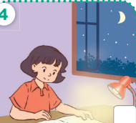
When do you do homework?
Ready?
Notes:
TEACHER NOTES:
Replace the text in the box with your key vocabulary/sentences.
OR if you want to make it into a speaking activity, delete the text and put an image in the box.
When playing the game, click/press the spacebar to send in the dark clouds.
Students start reading the text in the box after the dark cloud music stops.
Lightning will strike automatically after the dark clouds appear, no need to click again. The time when it strikes is different on each slide (view the animation pane to view or change the timing).
After the lightning strikes Billy and the student reading sits down, click/press the spacebar to go to the next slide.
Currently, there are 30 game slides in total (meant for 31 students). However, feel free to add or delete slides as needed for the number of students in your class.
If you want to adjust the time of when the lightning strikes, go to the “Animations” tab and open the ”Animation Pane.” Then, click on the “Lightning Strike” animation and adjust the delay time in the timing window.
If using the game more than once with the same class and are worried students will remember the lightning strike timing on each slide, no need to adjust the times of each lightning strike animation, just reorder the slides to save time and make the game feel fresh.
Skeleton image designed by creazilla.com

Slide 18
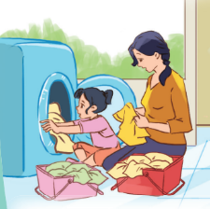
What do you do on Sunday?
Ready?
Notes:
TEACHER NOTES:
Replace the text in the box with your key vocabulary/sentences.
OR if you want to make it into a speaking activity, delete the text and put an image in the box.
When playing the game, click/press the spacebar to send in the dark clouds.
Students start reading the text in the box after the dark cloud music stops.
Lightning will strike automatically after the dark clouds appear, no need to click again. The time when it strikes is different on each slide (view the animation pane to view or change the timing).
After the lightning strikes Billy and the student reading sits down, click/press the spacebar to go to the next slide.
Currently, there are 30 game slides in total (meant for 31 students). However, feel free to add or delete slides as needed for the number of students in your class.
If you want to adjust the time of when the lightning strikes, go to the “Animations” tab and open the ”Animation Pane.” Then, click on the “Lightning Strike” animation and adjust the delay time in the timing window.
If using the game more than once with the same class and are worried students will remember the lightning strike timing on each slide, no need to adjust the times of each lightning strike animation, just reorder the slides to save time and make the game feel fresh.
Skeleton image designed by creazilla.com

Slide 19
Activity 3
02
Read and match

Slide 20
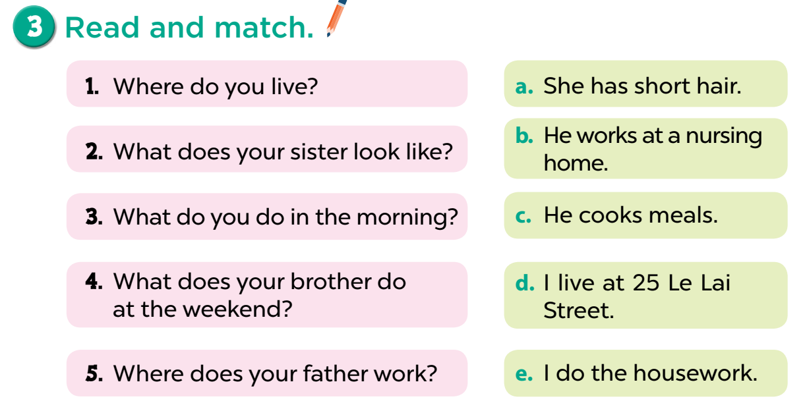

Slide 21
Activity 4
03
Read and complete

Slide 22
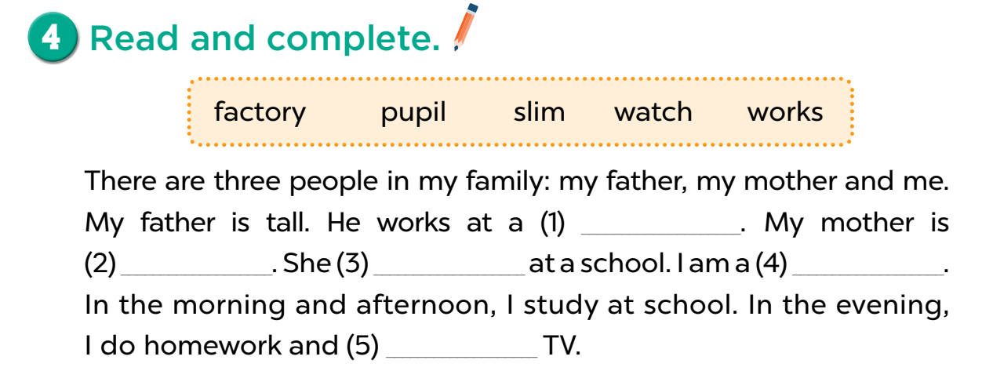
factory
slim
works
pupil
watch

Slide 23
Activity 5
04
Let’s write

Slide 24
cooks meals
clean the
floor
washes the
dishes
clean the table

Slide 25
Fun time
05
Play a game

Slide 26
CLICK TO SPIN
Where do you live? – I live ____. What’s the ____ like? – It’s ____. What does he / she do? – He’s / She’s ____. Where does he / she work? – He / She works ____. What does he / she look like? – He’s / She’s ____. What does he / she look like? – He / She has ____. When do you watch TV? – I watch TV ____. What do you do in the morning? – I ____. Where does he / she go on Saturdays? – He / She goes to the ____. What does he / she do on Sundays? – He / She ____.
7 stars
1 star
2 stars
5 stars
10 stars
- 5 stars

Slide 27
THANK YOU

