Slide 1


Slide 2

Unit
8
1
Unit
FAMILY LIFE
NEW WAYS TO LEARN
LESSON 8
LOOKING BACK AND PROJECT

Slide 3

Unit
1
1
FAMILY LIFE
Family Life
OBJECTIVES
Unit
1. Knowledge
- Review the vocabulary and grammar of Unit 8
- Apply what they have learnt (vocabulary and grammar) into practice through a project
2. Core competence
- Develop communication skills and creativity
- Develop presentation skills
- Develop critical thinking skills
- Be collaborative and supportive in pair work and team work
- Actively join in class activities
3. Personal qualities
- Be more creative when doing the project
- Develop self-study skills

Slide 4
LESSON 8
LOOKING BACK AND PROJECT
Unit
GETTING STARTED
WARM-UP
Brainstorming
Activity 1: Pronunciation
Activity 2: Vocabulary
Activity 3: Grammar
LOOKING BACK
PROJECT
Presentation: Technology for learning
CONSOLIDATION
Wrap-up
Homework

Slide 5
LESSON 8
LOOKING BACK AND PROJECT
Unit
GETTING STARTED
WARM-UP
Brainstorming

Slide 6


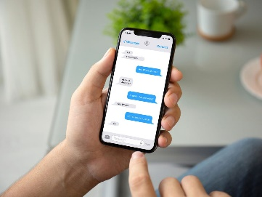
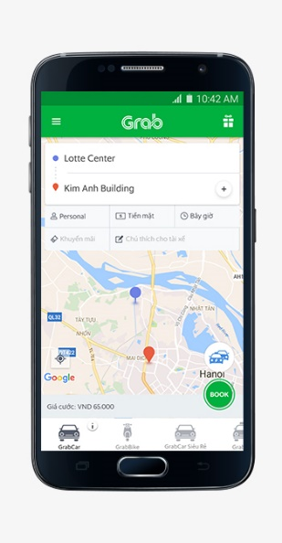
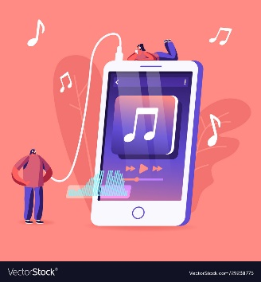

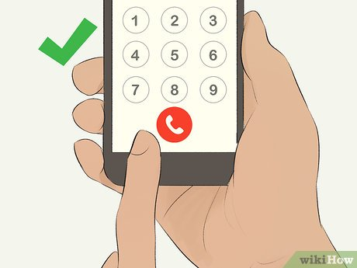
WARM-UP
WHAT DO YOU USE ELECTRONIC DEVICES FOR?

Slide 7
LESSON 8
LOOKING BACK AND PROJECT
Unit
GETTING STARTED
WARM-UP
Brainstorming
Activity 1: Pronunciation
Activity 2: Vocabulary
Activity 3: Grammar
LOOKING BACK

Slide 8
LOOKING BACK
unstressed
stressed
Content words
Nouns
Verbs
Adjectives
Structure words
Determiners
Articles
Prepositions
Adverbs
Pronouns
Auxiliary verbs
Conjunctions

Slide 9

LOOKING BACK
1
Listen and underline the stressed words in the sentences. Then practice reading them.
1. Many students bring smartphones to school nowadays.
2. You can download the app to study English.
3. Thanks to technology, students can learn anywhere.
4. My sister is looking for information for her presentation tomorrow.

Slide 10
LOOKING BACK
2
Complete the sentences using the words in the box.
blended connection traditional
teamwork online
1. I don’t like __________ learning because it’s hard to make friends with my classmates.
2. ____________ schools may not prepare us for the jobs of the future.
3. I’m taking an online course so I need a faster Internet ____________.
4. With __________ learning, students are still able to attend face-to-face classes.
5. Projects help us improve our __________ skills.
online
Traditional
connection
blended
teamwork

Slide 11
LOOKING BACK
3
Complete the sentences with who, which, that or whose. You may use more than one relative pronouns in some sentences.
who/that
1. That is the teacher _________ has received an award for excellent teaching.
2. We were invited to attend a talk show ___________ is popular with teenagers.
3. Their school, _______ offers both face-to-face and online classes, is the best in the city.
4. The students ________ names are on the list will join the field trip.
5. Have you finished the project ___________ was given by our art teacher?
6. My cousin John, ______ lives in Da Nang, is coming to visit me this weekend.
which/that
which
whose
which/that
who

Slide 12
LESSON 8
LOOKING BACK AND PROJECT
Unit
GETTING STARTED
WARM-UP
Brainstorming
Activity 1: Pronunciation
Activity 2: Vocabulary
Activity 3: Grammar
LOOKING BACK
PROJECT
Presentation: Technology for learning

Slide 13

PROJECT
Technology for learning

Slide 14

PROJECT
Presentation: Technology for learning

Slide 15
LESSON 8
LOOKING BACK AND PROJECT
Unit
GETTING STARTED
WARM-UP
Brainstorming
Activity 1: Pronunciation
Activity 2: Vocabulary
Activity 3: Grammar
LOOKING BACK
PROJECT
Presentation: Technology for learning
CONSOLIDATION
Wrap-up
Homework

Slide 16

CONSOLIDATION
1
Wrap-up
Review sentence stress, relative pronouns and vocabulary of different ways of learning
Make a presentation about technology for learning

Slide 17

CONSOLIDATION
2
Homework
Do exercises in the workbook
Prepare for Unit 9 – Lesson 1

Slide 18

Website: sachmem.vn
Fanpage: facebook.com/sachmem.vn/

