Slide 2
Unit 2
A multicultural world
LESSON 4
SPEAKING
Planning a Cultural Diversity Day

Slide 3
LESSON 4
SPEAKING
WARM-UP
Guessing game
- Task 1: Discuss and complete the table.
- Vocabulary
- Task 2: Discuss the plans for the event.
CONTROLLED PRACTICE
LESS-CONTROLLED PRACTICE
- Task 3: Report the discussion.
CONSOLIDATION
- Wrap-up
- Homework

Slide 4
WARM-UP
Guessing game
- Work as two groups.
- There are four questions, the answers of which provide four clues for the keyword.
- Choose and answer the question.
- If you have a correct answer ➔ one point.
- If a team can guess the keyword ➔ 5 points.
- The team with more points is the winner.

Slide 5
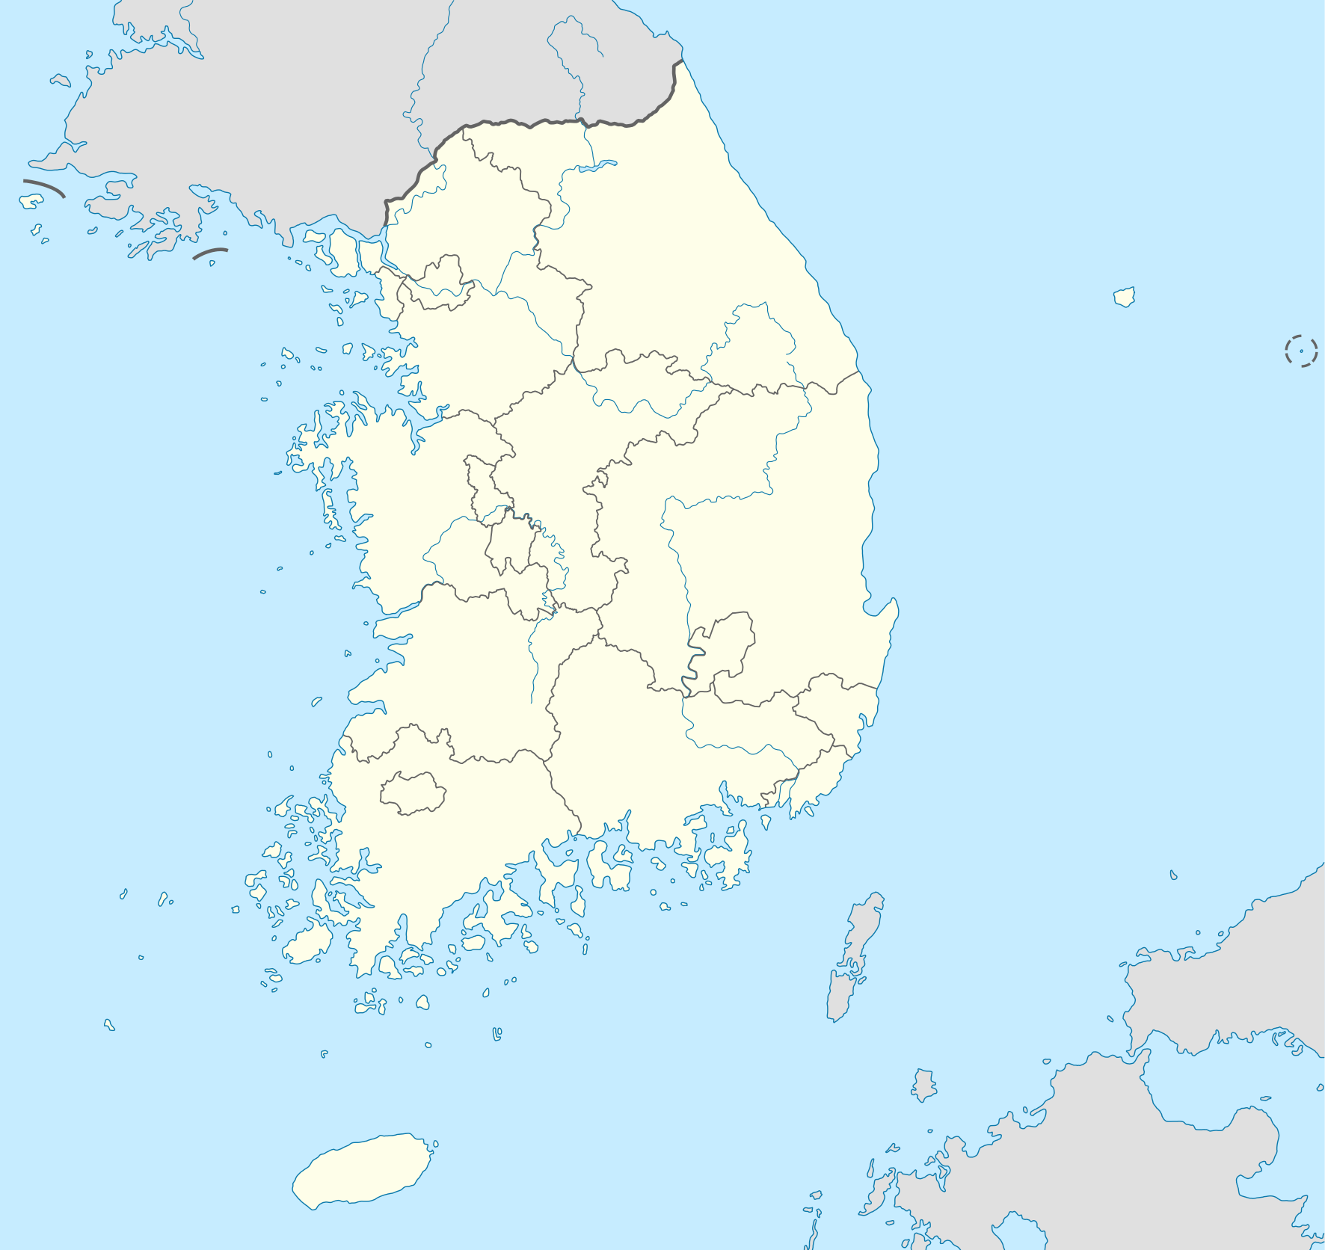
WARM-UP
WARM-UP
Answer the question in each puzzle.
1
2
3
4

Slide 6
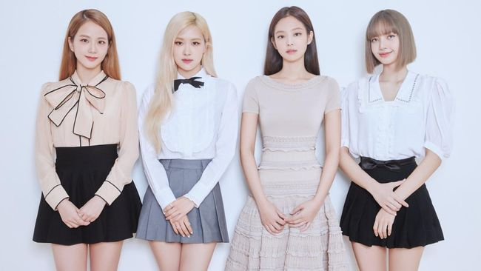
WARM-UP
WARM-UP
Question 1
What is the name of this music band?
➔ Blackpink
BACK

Slide 7
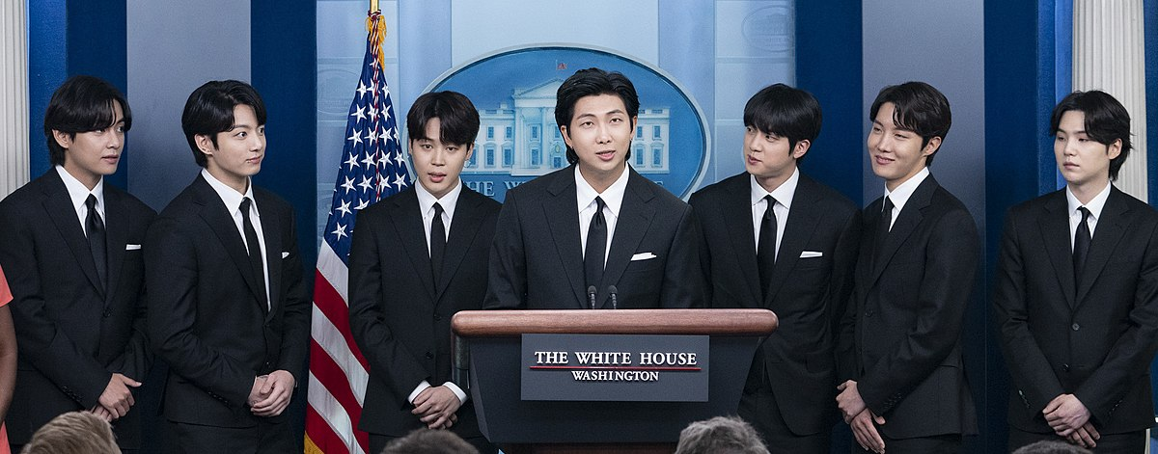
WARM-UP
WARM-UP
Question 2
Who are they?
➔ BTS
BACK

Slide 8
WARM-UP
WARM-UP
Question 3
Fill in the blank:
They’re going to organise a ______ Diversity Day next weekend.
➔ Cultural
BACK

Slide 9
WARM-UP
WARM-UP
Question 4
What is the name of a spicy food which is mainly made from Chinese cabbage?
➔ kimchi
BACK

Slide 10
WARM-UP
WARM-UP
KEY WORD: SOUTH KOREA

Slide 11
CONTROLLED PRACTICE
1
Work in pairs. Discuss the differences between Vietnamese culture and some other cultures you know about. Use the ideas in Getting Started and Reading, and the table and examples below to help you.
Country | Viet Nam | South Korea | …
Cuisine | e.g. pho, bun cha, spring rolls | e.g. kimchi, tteokbokki
Music
Fashion/ Clothing

Slide 12
CONTROLLED PRACTICE
1
Work in pairs. discuss the differences between Vietnamese culture and some other cultures you know about. Use the ideas in getting Started and Reading, and the table and examples below to help you.
Example:
A: | South Koreans seem to eat a lot of spicy food, such as kimchi and tteokbokki, while our traditional dishes, like bun cha and pho, are not very spicy in general.
B: | I agree. How about music? I think in both countries, young people like to listen to pop music, but K-pop focuses mainly on dance groups while our pop music is usually produced by solo artists.

Slide 13
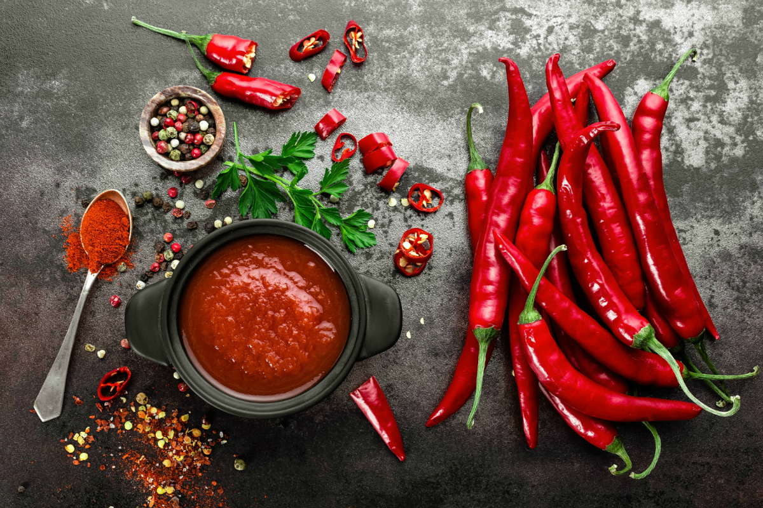

VOCABULARY
spicy (adj)
/ˈspaɪsi/
(of food) having a strong taste because spices have been added to it

Slide 14

VOCABULARY
focus on (v)
/ˈfəʊkəs ɒn/
to give attention, effort, etc. to one particular subject, situation or person rather than another

Slide 15

VOCABULARY
professional (adj)
/prəˈfeʃənl/
doing something as a paid job rather than as a hobby

Slide 16
VOCABULARY
Form | Pronunciation | Meaning | Vietnamese equivalent
1. spicy (adj) | /ˈspaɪsi/ | (of food) having a strong taste because spices have been added to it | cay
2. focus on (v) | /ˈfəʊkəs ɒn/ | to give attention, effort, etc. to one particular subject, situation or person rather than another | tập trung vào
3. professional (adj) | /prəˈfeʃənl/ | doing something as a paid job rather than as a hobby | chuyên nghiệp

Slide 17


CONTROLLED PRACTICE
2
Work in groups. Your school is organising a Cultural diversity day. discuss what the event should include. Use the ideas in 1 to create the event programme.
Example:
A: We’ve decided to organise a Cultural Diversity Day in our school. Let’s discuss what activities to include.
B: First, we should set up some food stalls offering traditional dishes from different cultures.
C: That sounds fun! We can call them ‘Taste the World’. We can also show visitors how to cook these dishes.
D: I like your idea, but we don’t have any cooking experience.
We may need to involve professional cooks.

Slide 18

LESS-CONTROLLED PRACTICE
3
Report your group’s ideas to the whole class. Vote for the best Cultural diversity day programme.

Slide 19
CONSOLIDATION
1
Wrap-up
What have you learnt today?
An overview about cultural diversity;
Vocabulary to talk about how to organise a Cultural Diversity Day.

Slide 20
CONSOLIDATION
2
Homework
Write a paragraph about the similarities and differences in Vietnamese and Korean cultures.
Do exercises in the workbook.
Prepare for the next lesson – Listening.

Slide 21
Website: hoclieu.vn
Fanpage: facebook.com/www.tienganhglobalsuccess.vn

