Slide 1

Unit 6: Entertainment
Lesson 6b: Grammar
Page 106

Slide 2
Lesson Outline
Warm-up
Grammar
Consolidation
Wrap-up

Slide 3
Objectives
By the end of this lesson, students will be able to…
learn the grammar points: will & be going to.
practise asking and answering the questions, using the new grammar points.

Slide 4

WARM-UP

Slide 5
Choose the word whose underlined part is pronounced differently from that of the others.
1. A. football B. sample C. market D. bargain
/ˈfʊtbɔːl/ /ˈsɑːmpəl/ /ˈmɑːkɪt/ /ˈbɑːɡɪn/
2. A. bend B. email C. send D. end
/bend/ /ˈiːmeɪl/ /send/ /end/
3. A. circus B. river C. ticket D. music
/ˈsɜːkəs/ /ˈrɪvə/ /ˈtɪkɪt/ /ˈmjuːzɪk/

Slide 6
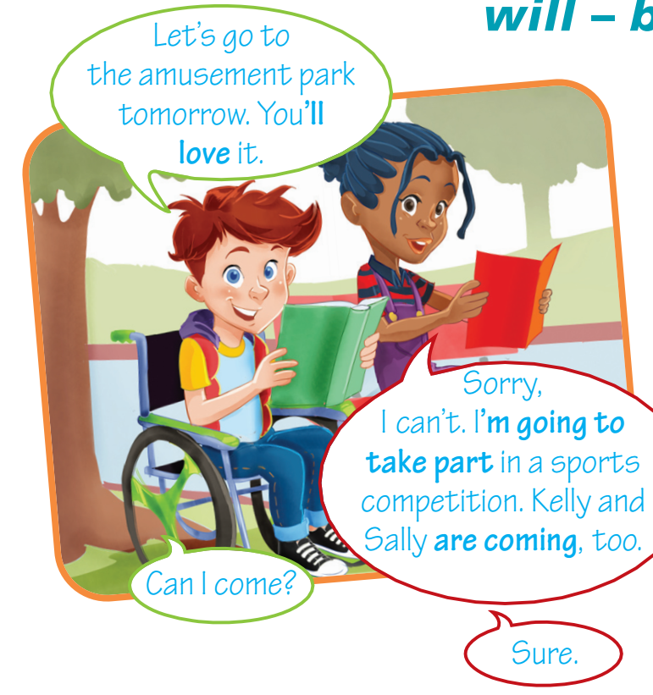
Look at the dialogue. Pay attention to the words in bold and answer the questions.
When does the boy go to the amusement park?
A. in the past B. at the present C. in the future
When does the girl take part in a sports competition?
A. in the past B. at the present C. in the future
When do Kelly and Sally come?
A. in the past B. at the present C. in the future

Slide 7

It’s time to learn …

Slide 8

Presentation

Slide 9
We use will for:
• on-the-spot decisions. I’m too tired. I won’t go out tonight.
• predictions based on what we think, believe or imagine with the verbs think, believe, hope, know. I think forests will disappear in 50 years’ time.
• promises. I’ll be back in an hour. Don’t worry.
• offers. I’ll help you with your project.
We use be going to for:
• future predictions based on what we know or see. Look at the sky! It’s not going to rain today.
• future plans & intentions. Are you going to buy a new laptop now that you have the money? No, I’m not. I’m going to buy a new smartphone, instead.
Time expressions: tomorrow, next week/month/year, soon, etc.

Slide 10

Practice

Slide 11
1 Complete the gaps. Use will or won’t and the verbs in the list.
• rise • join • be • go • rain
1 A: Look outside – it’s raining heavily. We can’t go to the park.
B: That’s OK. We _______________ to Paul’s house to play computer games, then.
2 A: It’s so cold at the moment!
B: You’re right, but I believe that the temperatures ______________ later in the week.
3 A: I hope that the weather _______________ nice while we’re on holiday.
B: Don’t worry! I’m sure it _______________.
4 A: Ted ____________ us at the cinema. He has to work late.
B: Oh no!
will go
will rise
will be
won’t rain
won’t join

Slide 12

2 Ask and answer using the prompts and will or won’t.
1 newspapers/exist/in the future?
A: Will newspapers exist in the future?
B: Yes, they will. / No, they won’t.
2 everyone/speak/same language/in 100 years?
3 people/travel in flying cars/in the future?
4 robots/do our housework/in the future?
5 people/go on holidays/to other planets/in 50 years?
6 students/learn in virtual classrooms/in the future?

Slide 13
2 Ask and answer using the prompts and will or won’t.
1 newspapers/exist/in the future?
A: Will newspapers exist in the future?
B: Yes, they will. / No, they won’t.
2 everyone/speak/same language/in 100 years?
A: Will everyone speak the same language in 100 years?
B: Yes, they will. / No, they won’t.
3 people/travel in flying cars/in the future?
A: Will people travel in flying cars in the future?
B: Yes, they will. / No, they won’t.

Slide 14
2 Ask and answer using the prompts and will or won’t.
4 robots/do our housework/in the future?
A: Will robots do our housework in the future?
B: Yes, they will. / No, they won’t.
5 people/go on holidays/to other planets/in 50 years?
A: Will people go on holidays to other planets in 50 years?
B: Yes, they will. / No, they won’t.
6 students/learn in virtual classrooms/in the future?
A: Will students learn in virtual classrooms in the future?
B: Yes, they will. / No, they won’t.

Slide 15
Further practice
Underline the correct item.
future plan
1 This Sunday, we will/are going to attend a performance. We booked our tickets yesterday.
2 I believe we are going to/will have our own robot assistant in the future.
3 Daisy will/is going to go to Borough Market later because she wants some new shoes.
4 OK. I’m going to/’ll pick up the kids before I get home.
5 I suddenly feel really tired. I won’t/am not going to come to the amusement park with you.
6 Look at that player go! He looks like he ’ll/’s going to score.
predictions based on what we believe
intention
promise
on-the-spot decisions
predictions based on what we know or see

Slide 16

Production

Slide 17
3 What are your predictions about life in the future? Think about housing, transport, food and lifestyle. Write sentences. Tell the class.
Sample
Housing: People will live in underwater cities.
Transport: There will be flying cars.
Food: People will eat 3D-printed meals.
Lifestyle: People will do all their shopping online. They will have robot assistants. etc.

Slide 18

CONSOLIDATION

Slide 19
Write a paragraph (60 words) about your plan in the future.

Slide 20

WRAP-UP

Slide 21
Today’s lesson
Grammar
- will
- be going to

Slide 22
Homework
Practise the grammar points and make sentences using them.
Do the exercises in TA 6 Right on WB (p. 55).
Complete the grammar notes in TA 6 Right on Notebook (p. 56).
Prepare the next lesson (p. 107 SB).

Slide 23
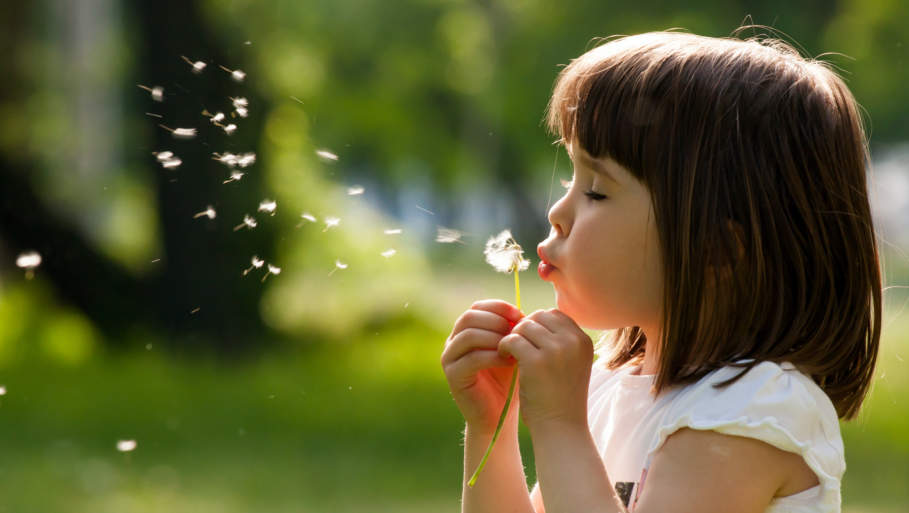
Enjoy your day!

