Slide 2
Unit 2
A multicultural world
LESSON 7
COMMUNICATION & CULTURE / CLIL

Slide 3
LESSON 7
COMMUNICATION & CULTURE / CLIL
WARM-UP
Board race
- Task 1: Listen and complete the conversations. Then practice in pairs.
- Useful expressions
- Task 2: Work in groups of three. Use the models in Task 1 to make similar conversations.
EVERYDAY ENGLISH
CULTURE
- Task 1: Read the following text and put a tick (✓) or cross (✗) in the box next to the pictures
- Task 2: Work in groups. Discuss the questions.
CONSOLIDATION
- Wrap-up
- Homework

Slide 4
WARM-UP
Board race
- Work as four teams.
- Come to the board one by one to write down a name of a festival
- Time allowed: 2 mins
- If the answer is correct ➔ one point for their team.
- The team with higher score is the winner.

Slide 5

WARM-UP
WARM-UP

Slide 6

EVERYDAY ENGLISH
1
Listen and complete the conversations with the expressions in the box. Then practise them in pairs.
1
Ms Hoa: Good morning, class. (1) ___________________ Mr Paul Smith. He’s a culture specialist. Today, he’ll talk about cultural diversity in the UK.
Ms Hoa: Hello, everyone. (2) _______________________.
Class: Good morning, Mr Smith. It’s nice to meet you too!
B. I’d like you to meet
A. It’s nice to meet you all

Slide 7
EVERYDAY ENGLISH
1
Listen and complete the conversations with the expressions in the box. Then practise them in pairs.
2
Mai: Nam, (3) _________ Alan Samson, our new classmate from Australia ... Alan, this is my friend, Nam.
Nam: (4) _____________________, Alan.
Alan: Pleased to meet you too.
C. this is
D. Pleased to meet you

Slide 8

EVERYDAY ENGLISH
2
Work in groups of three. Use the models in 1 to make similar conversations for these situations. One of you is a, the others are B and C. Use the expressions below to help you.
Situations:
1. A is a teacher, B is an exchange student from America, and C represents the class. A introduces B to the whole class. B and C respond to the introduction.
2. A is a member and B is the president of ASEAN culture club. C is a new member. B introduces C to A. A and C respond to the introduction.

Slide 9
EVERYDAY ENGLISH
Sample conversations:
1.
Student A: Hello class. I would like to introduce Nam – a new member of our class. He has just moved from Nam Dinh High school. Please welcome him.
Student B: Hello, everyone. My name is Nam. It’s nice to meet you.
Student C: Hi, Nam. Nice to meet you, too. Welcome to our class
2.
Student B: Hey, Long. Have you met Pit? He has joined our football club this week.
Student A: Not yet. Hi, happy to meet you, Pit. I’m Long.
Student C: Hi Long, great to meet you, too.

Slide 10
EVERYDAY ENGLISH
Useful expressions
Introducing people | Responding
Formal/ Semi-formal • I’d like you to meet ... • I’d like to introduce/ present ... • It’s a pleasure to introduce ... • May I introduce/ present ...? | Formal/ Semi-formal • It’s nice to meet you. • How nice to meet you. • It’s a pleasure to meet you. • How do you do?
informal • This is ... • I want you to meet ... • Let me introduce you to ... • Please meet ... • Have you met ...? | informal • Hi, great/ nice to meet you. • Pleased/ Happy to meet you.

Slide 11
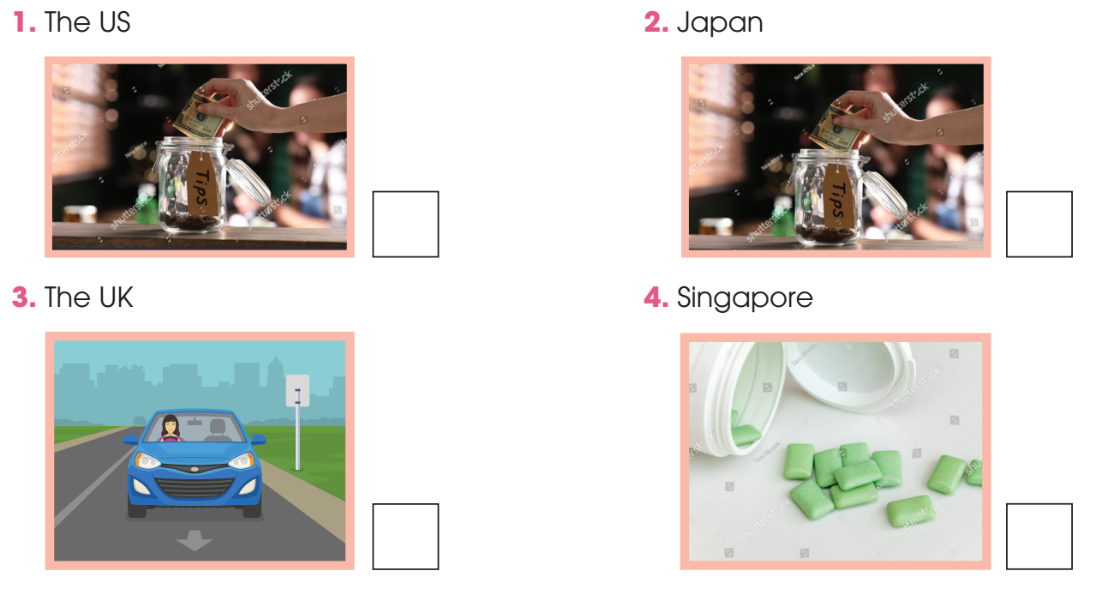
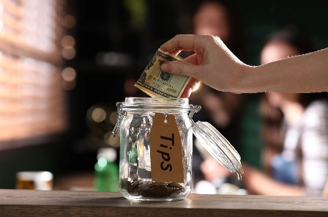


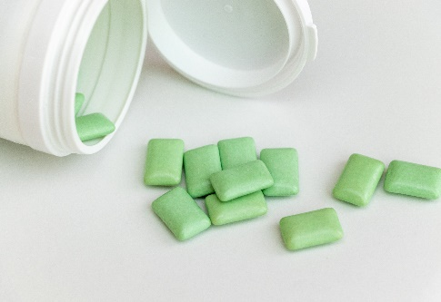
CULTURE
1
Read the text and put a tick (✓) or cross (✗) in the box next to the pictures to show the appropriate behaviour in different cultures.

Slide 12
CULTURE
2
Work in groups. Discuss the questions.
What kind of culture shock do you think foreigners may experience in Viet Nam? What will you do to help them overcome it?
Suggested answers:
Visitors may experience different kinds of culture shock when they come to Viet Nam. For example, they may not be used to using chopsticks when eating or enjoying many dishes in streets. Some may find Vietnamese people in different regions (the North, Middle and the South) have different dialects.
To help these visitors, we can make friends with them and guide them when they want to explore the city or culture. Moreover, we can design some clips or leafleat to introduce special features of Vietnamese culture and some taboo topics they should avoid.

Slide 13
CONSOLIDATION
1
Wrap-up
What have you learnt today?
Gain knowledge about culture shock;
Review expressions for making introductions and responding;
Talk about culture shock that foreign visitors may experience in Viet Nam.

Slide 14
CONSOLIDATION
2
Homework
- Do exercises in the workbook.
- Prepare for the next lesson
- Looking back and Project.

Slide 15
Website: hoclieu.vn
Fanpage: facebook.com/www.tienganhglobalsuccess.vn

