Slide 1


Slide 2

Unit
9
1
Unit
FAMILY LIFE
Protecting The Environment
LESSON 1
GETTING STARTED
A Presentation on the Environment

Slide 3

Unit
1
1
FAMILY LIFE
Family Life
Unit
OBJECTIVES
Gain an overview about the topic Protecting the environment
Build vocabulary about the environment and identify the reported speech with statements and questions

Slide 4
LESSON 1
GETTING STARTED
Unit
WARM-UP
Crossword puzzle
PRESENTATION
Vocabulary
Task 1: Listen and read.
Task 2: Read the conversation again and answer the questions.
Task 3: Match the words in A with the words in B to form phrases.
Task 4: Complete the sentences.
Task 5: Role play
PRACTICE
CONSOLIDATION
Wrap-up
Home work

Slide 5
LESSON 1
GETTING STARTED
Unit
Crossword
1
WARM-UP
E | A | R | T | H
2
P | O | L | L | U | T | I | O | N
3
R | I | V | E | R
4
A | C | I | D | R | A | I | N
5
A | I | R
6
S | O | I | L
7
G | R | E | E | N | H | O | U | S | E
8
E | M | I | S | S | I | O | N
9
E | C | O | S | Y | S | T | E | M
10
D | E | F | O | R | E | S | T | A | T | I | O | N
11
H | A | B | I | T | A | T
12
Q11. The type of place that a particular animal usually lives in or a particular plant usually grows in
Q1. The planet on which we live
Q2. The process of damaging the air, water, or land with chemicals or other substances
Q3. A large area of water that flows towards the sea
Q4. Rain containing a high level of acid that can damage the environment.
Q5. The mixture of gases surrounding the Earth that we breathe
Q6. The substance on the surface of the Earth in which plants grow
Q7. A building made of glass that is used for growing plants that need protection from the weather
Q8. A substance, especially a gas, that goes into the air
Q9. All the plants and animals in a particular area, considered as a system with parts that depend on one another
Q10. The process of cutting down all the trees from an area of land

Slide 6
LESSON 1
GETTING STARTED
Unit
WARM-UP
THE CROSSWORD PUZZLE
ENVIRONMENT

Slide 7
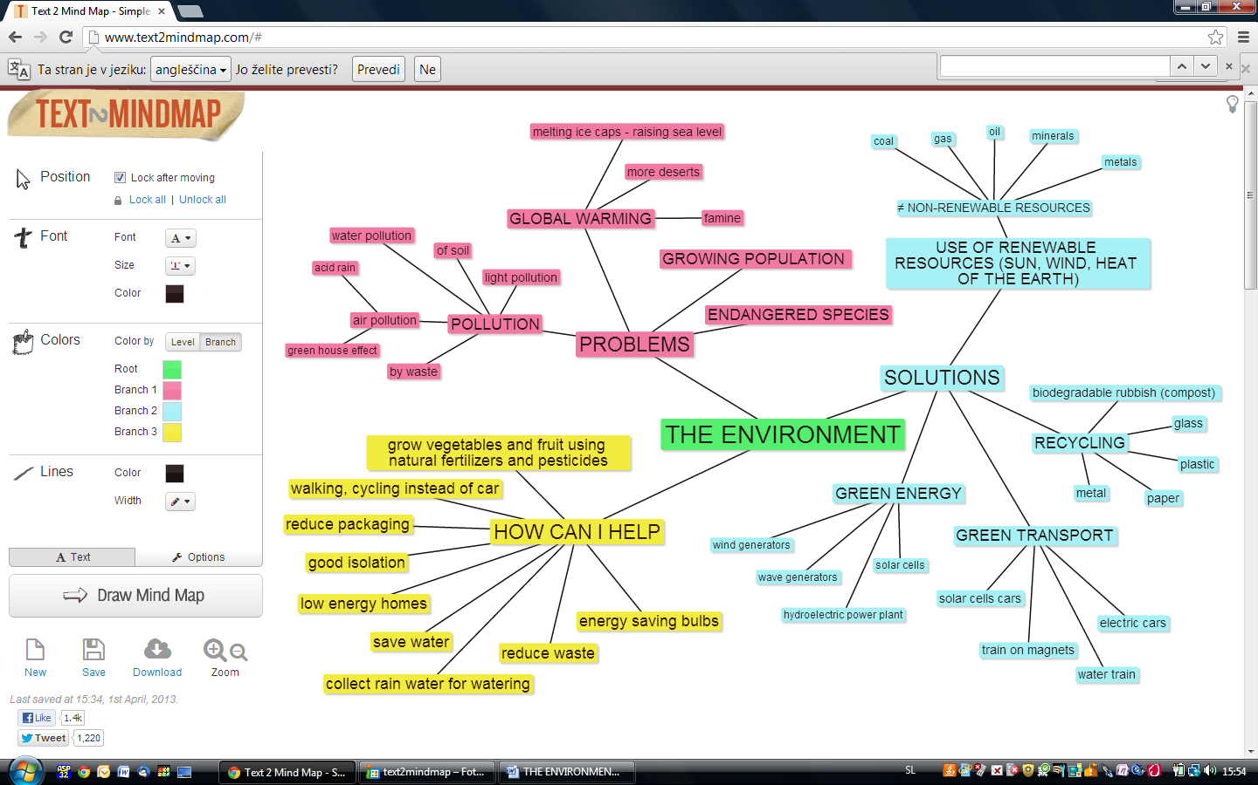
LESSON 1
GETTING STARTED
Unit
WARM-UP
THE ENVIRONMENT MINDMAP

Slide 8
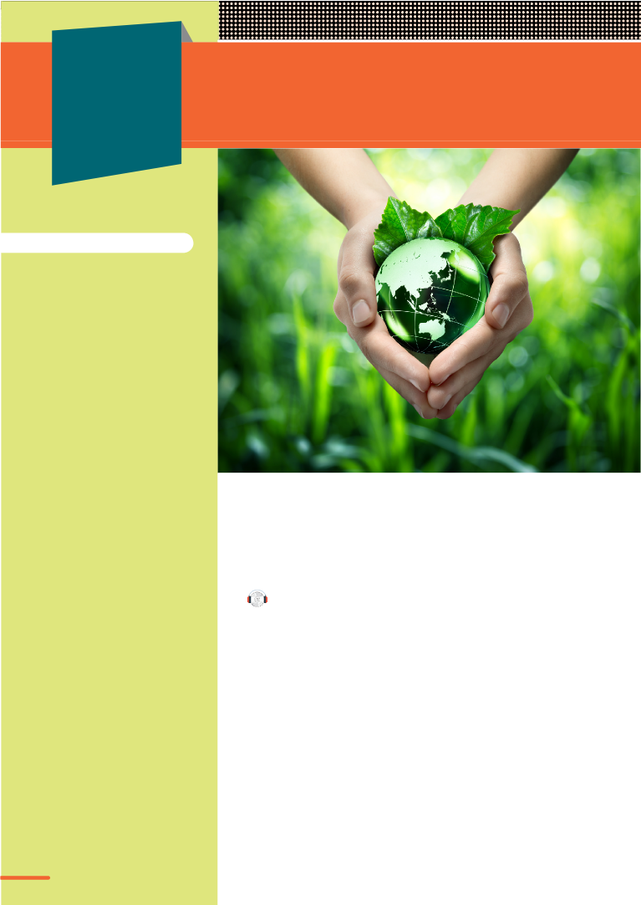
WARM-UP
Protecting the environment
A call for urgent action

Slide 9


PRESENTATION
identify (v)
/aɪˈdentɪfaɪ/
recognize a problem and show that it exists

Slide 10
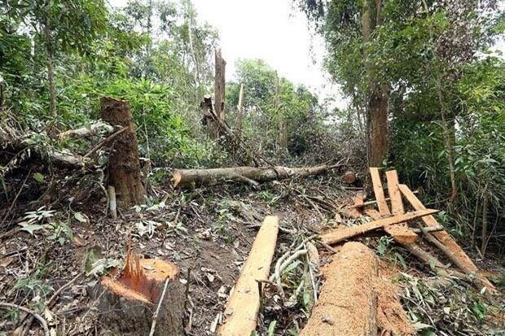
PRESENTATION
deforestation (n)
/ˌdiːˌfɒrɪˈsteɪʃn/
the cutting down of trees in a large area, or the destruction of
forests by people

Slide 11
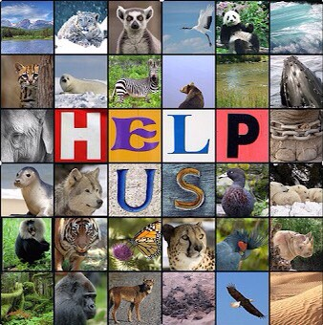
PRESENTATION
endangered (a)
/ɪnˈdeɪndʒəd/
in danger of being harmed, lost,
unsuccessful, etc.

Slide 12
PRESENTATION
New words | Pronunciation | Meaning
identify | /aɪˈdentɪfaɪ/ | recognize a problem and show that it exists
deforestation | /ˌdiːˌfɒrɪˈsteɪʃn/ | the cutting down of trees in a large area, or the destruction of forests by people
endangered | /ɪnˈdeɪndʒəd/ | in danger of being harmed, lost, unsuccessful, etc.

Slide 13
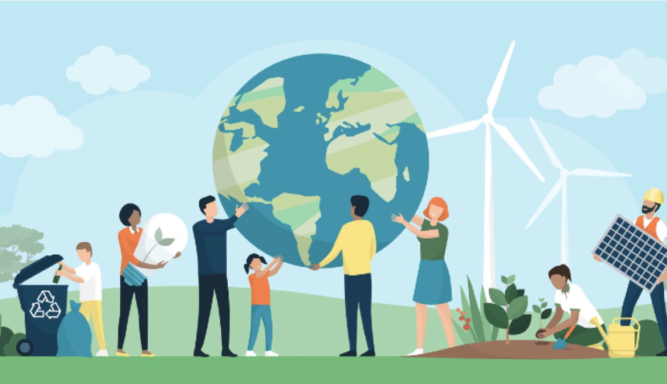
PRACTICE
1
Listen and read.
A presentation on the environment

Slide 14
PRACTICE
1
Listen and read.
A presentation on the environment
Nam’s father: What are you doing, Nam?
Nam: I’m preparing a presentation for my geography class.
Nam’s father : What’s the topic?
Nam : It’s environmental protection. My teacher asked me to do some research, but I ____________don’t know where to start.
Nam’s father : I think you should identify some environmental problems first. What have you ____________found so far?
Nam : I’ve come up with a range of environmental issues such as global warming, ____________deforestation, endangered animals and pollution, but I don’t know how to ____________organise them.

Slide 15
PRACTICE
PRACTICE
1
Listen and read.
A presentation on the environment
Nam’s father : You should focus on each problem, explain the main causes of it, and then suggest the ____________ solutions.
Nam : Thanks, Dad. But presenting all the solutions will be hard.
Nam’s father : Have you asked your teacher for advice?
Nam : Yes, I have. She advised that I should started with small, practical actions to protect ____________the environment before coming up with big ideas that need a lot of effort or money to ____________success.
Nam’s father : Sounds good. You’d better follow her advice. When did she ask you to present it?
Nam : She said I should present it the following week.
Nam’s father : You still have a lot of time. Good luck!
Nam: Thanks, Dad.

Slide 16
PRACTICE
PRACTICE
2
Read the conversation again and answer the questions.
 | Questions | Answers
1. | What did Nam’s teacher ask him to do? | She asked Nam to do some research on the environmental protection.
2. | What has Nam come up with so far? | He’s come up with a range of environmental issues.
3. | When does Nam have to deliver the presentation? | Nam has to deliver the presentation next week.

Slide 17
PRACTICE
3
Match the words in A with the words in B to form phrases in 1.
A | B | Answers
1. global | a. animals | 1-d: global warming
2. practical | b. issues | 2-c: practical actions
3. environmental | c. actions | 3-b: environmental issues
4. endangered | d. warming | 4-a: endangered animals

Slide 18
PRACTICE
4
Complete the sentences based on the conversation.
1. My teacher _____ me to do some research on the environmental problems.
2. She ______ that I should start with small, practical actions to protect the environment
3. She _____ I should deliver my presentation the following week.
asked_
advised
said_

Slide 19

PRACTICE
5
PAIRWORK

Slide 20
PRACTICE
5
PAIRWORK - Role play the following situation.
SITUATION:
- Student A: You’re Minh, a student of Thang Long High School in Hanoi. You are preparing a presentation on Environmental Protection. You meet Greta Thunberg, a famous Swedish environmental activist. Ask for her advice on your presentation.
- Student B: You’re Greta Thunberg, a famous Swedish environmental activist. Give your advice on the very presentation that Minh asks you.

Slide 21
PRACTICE
5
PAIRWORK - Role play
- CONVERSATION STEPS:
1. Greeting
2. Small talks
3. Main topic
4. Finishing off
- REQUIRED LANGUAGE: Use vocabulary in 3 and structures in 4.
1. Vocabulary: environmental issues, practical actions, endangered animals, global warming.
2. Structure: Reported speech

Slide 22

PRACTICE
5
Role play

Slide 23
CONSOLIDATION
1
Wrap-up
Gain an overview about the topic Protecting the environment
Build vocabulary on the environment and identify the reported speech with statements and questions

Slide 24
CONSOLIDATION
2
Homework
Do exercises in the Workbook
Project preparation

Slide 25


