Slide 1

Unit 10: Cities around the World
Lesson 2.3: Pronunciation & Speaking
Page 83

Slide 2
Lesson Outline
Warm-up
Pronunciation
Practice
Speaking
Consolidation
Wrap-up

Slide 3
Objectives
By the end of this lesson, students will be able to…
- know how to stress words when adding “-er”
- use them exactly in their speaking
- develop communication, collaboration, and self-study skills

Slide 4

WARM-UP

Slide 5

Work in pairs.
Choose the word whose main stress is placed
differently from the others.
1 A. attraction B. amusement C. difference D. apartment
/əˈtrækʃən/ /əˈmjuːzmənt/ /ˈdɪfərəns/ /əˈpɑːrtmənt/
2 A. expensive B. fantastic C. exciting D. terrible
/ɪkˈspensɪv/ /fænˈtæstɪk/ /ɪkˈsaɪtɪŋ/ /ˈterəbl/
3 A. correct B. modern C. noisy D. crowded
/kəˈrekt/ /ˈmɑːdərn/ /ˈnɔɪzi/ /ˈkraʊdɪd/

Slide 6
Work in pairs.
Choose the word whose underlined part is
pronounced differently from that of the other words.
A. smart B. sad C. fast D. dark
2. A. towers B. statues C. palaces D. buildings
3. A. lock B. crowd C. clock D. box
/ smɑːrt /
/sæd/
/fa:st/
/da:rk /
/ˈtaʊərz/
/ˈstætʃuːz/
/ˈpæləsiz/
/ˈbɪldɪŋz/
/ lɑːk/
/ kraʊd/
/ klɑːk /
/ bɑːks/

Slide 7


WATCH 2 VIDEOS AND DECIDE WHICH CITY YOU’D LIKE TO TRAVEL MORE. WHY?
Bali City
New York City
Notes:
Link Video Bali City: https://www.youtube.com/watch?v=qSyrF5oFXMk
Link Video New York city: https://www.youtube.com/watch?v=yD-CPM02GF0

Slide 8

Speaking

Slide 9


Pre-Speaking
Listen to the words and focus on the underlined letters.
dirtier noisier
→ Do not change the stressed positions when adding "-er."
Listen and cross out the one with the wrong word stress.
cleaner hotter
Read the words with the correct stress to a partner

Slide 10

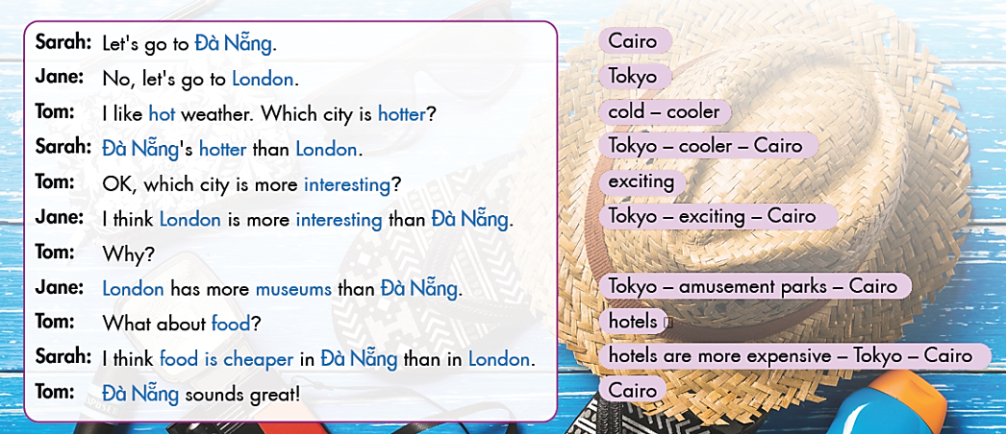
In threes, practice the conversation. Swap roles and repeat.

Slide 11
In threes, practice the conversation. Swap roles and repeat
Sarah: Let's go to Cairo.
Jane: No, let's go to Tokyo.
Tom: I like cold weather. Which city is cooler?
Sarah: Tokyo’s cooler than Cairo.
Tom: OK, which city is more exciting?
Jane: I think Tokyo is more exciting than Cairo.
Tom: Why?
Jane: Tokyo has more amusement parks than Cairo.
Tom: What about hotels?
Sarah: I think hotels are more expensive in Tokyo than in Cairo.
Tom: Cairo sounds great!

Slide 12
Practice the conversation with your own ideas.

Slide 13

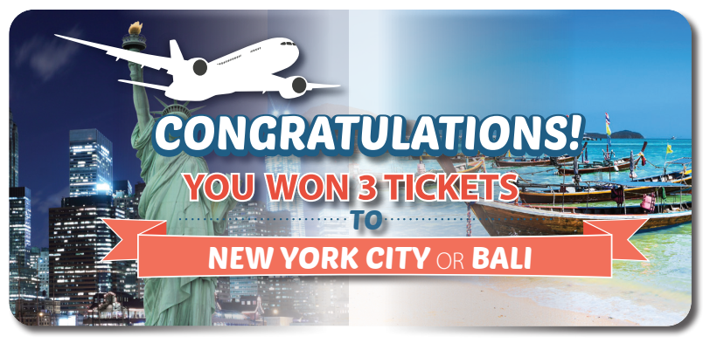
While-Speaking
A Free Vacation
You won a free vacation for three people. You can go to New York City or Bali. Work in groups of 3.
Students A and B, open page 124 file 9.
Student C, ask questions to find out more about the two places.

Slide 14
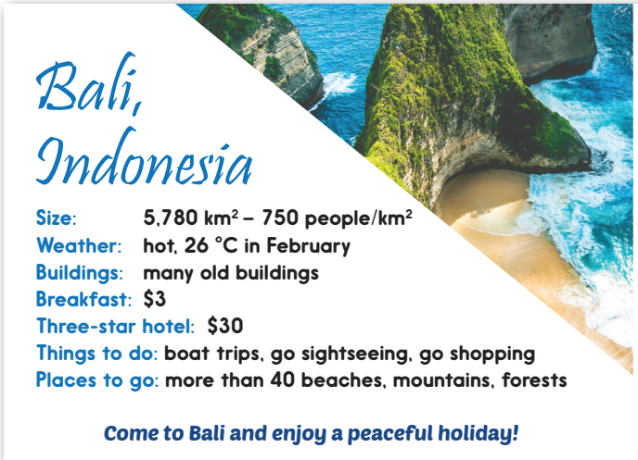
While-Speaking
Student A: You want a peaceful holiday. You like hot weather and beaches. Explain to your friends why your place is better than the other one.

Slide 15
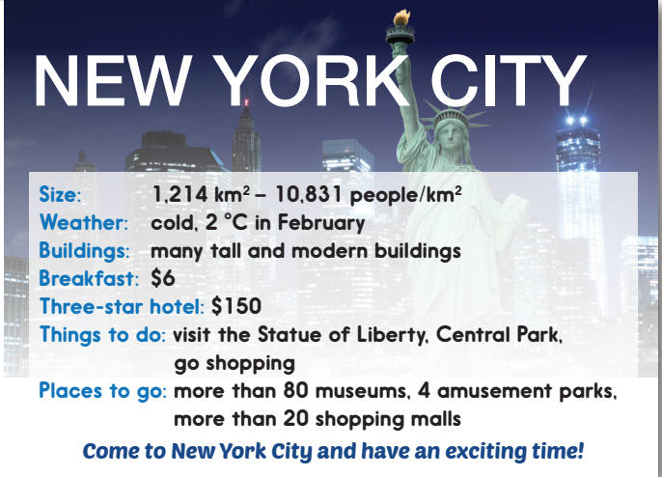
While-Speaking
Student B: You want an exciting holiday. You like cold weather, museums, and shopping. Explain to your friends why your place is better than the other one.

Slide 16
While-Speaking
Student C: Your two friends want to go to two different places. Ask them about these things.
The weather
Breakfast
Hotel prices
Things to do
Places to go

Slide 17

Post-Speaking
Compare the two places, then decide where to go.
Example

Slide 18

CONSOLIDATION

Slide 19
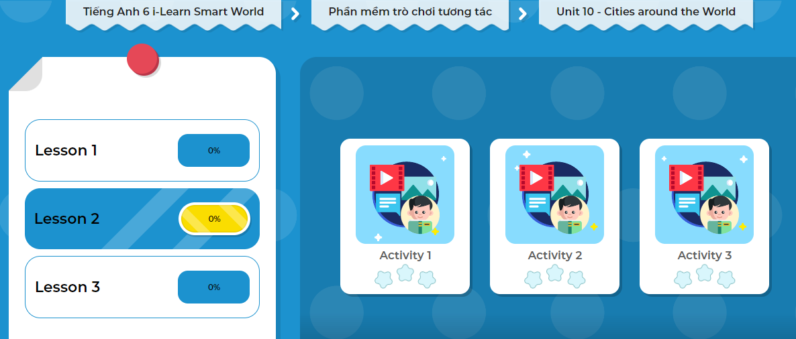
LET’S PLAY!
Click here to play the game!
Notes:
Mở Ứng dụng DHA trên Eduhome. Sách lớp 6, Unit 10, Lesson 2, Activity 3

Slide 20

WRAP-UP

Slide 21
Today’s lesson
Pronunciation
How to pronounce stress words when adding “-er”
Speaking
Comparing two cities

Slide 22
Homework
Look back on the lesson at home.
Practice comparing the cities in your country
Prepare the next lesson (page 84 SB)
Play the consolidation games in Tiếng Anh 6 i-Learn Smart World DHA App on www.eduhome.com.vn

Slide 23

Enjoy your day!

