Slide 1
Lucky Numer
A
B
1
2
3
1
2
3
4
5
1
2
3
4
5
4
5
6
7
8
9

Slide 2
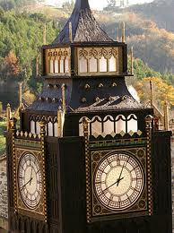
What is this ?
It’s Big Bang Tower.
Where is it ?
It’s in England.

Slide 3
Odd one out:
1
late
easy
homework
long
2
summer
holiday
spring
fall
3
review
keen
interesting
important
4
vacation
Easter
Christmas
Thanks Giving
5
typical
definitely
lazy
family
6
Christmas tree
presents
flowers
wine

Slide 4
Make Questions:
1
What did her mother give her ?
Her mother gave her a blue dress. (What?)
2
When did you go to Nha Trang ?
I went to Nha Trang last summer vacation. (When?)
3
Where did Mrs. Robinson put the poster ?
Mrs. Robinson put the poster on the wall. (Where?)

Slide 5
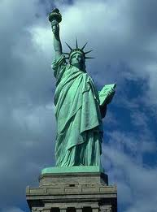
What is this ?
It’s Statue of Liberty.
Where is it ?
It’s in New York, the USA.

Slide 6
Supply the correct verb form :
Mr. Tam (be) ……... a teacher. Two years ago, he (teach) …………. math in a small shool in the country. But now he (teach) …………. at a high shool in the city.
Every day, Mr. Tam (get) ……… up at half past five. After his morning exercises, he (take) ……….. bath and (have) …….. breakfast with his wife. Then he (leave) ………... home for shool at a quarter past seven.
Yesterday was Sunday. Mr. Tam (not go) ………… to shool. He and his wife (visit) ………… his parents in the countryside. He (buy) ………… them lots of presents. Mr. Tam and his wife (spend) ……….. Their day off with their parents. They (return) …………. home at 9.30 in the evening.
is
taught
teaches
gets
takes
has
leaves
wasn’t go
visited
bought
spent
returned

Slide 7
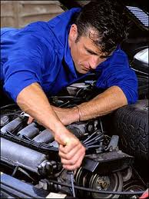
What does he do ?
He is a mechanic.

Slide 8

SƯU TẦM: ĐOÀN VĂN DOANH, NAM TRỰC, NAM ĐỊNH
LINK NHÓM DÀNH CHO GV BỘ MÔN VẬT LÝ TRAO ĐỔI TÀI LIỆU VÀ CHUYÊN MÔN CT 2018
https://www.facebook.com/groups/299257004355186

