Slide 1


Slide 2
A PROPOSAL
AGAINST CYBERBULLYING
Unit
9
SOCIAL ISSUES
Unit
FAMILY LIFE
LESSON 6
WRITING
STOP BULLYING

Slide 3
LESSON 6
WRITING
WARM-UP
Video watching
PRE-WRITING
Task 1: Discuss the questions.
WHILE-WRITING
Task 2: Write a proposal for the campaign to your head teacher.
POST-WRITING
Peer review
Wrap-up
Homework
CONSOLIDATION

Slide 4
WARM-UP
Watch the video and decide if the statements below are true or false.
1. Online and offline bullying have no connection.
2. Gossip and rumors can be considered cyberbullying.
3. It is difficult to stop the spread of cyberbullying.
4. Controlling online status and spending time with close people in real life can help us counteract cyberbullying.

Slide 5

WARM-UP
Notes:
https://www.youtube.com/watch?v=niaDJdEXk9U&t=1s

Slide 6

WARM-UP
1. Online and offline bullying have no connection.

Slide 7
WARM-UP
2. Gossip and rumors can be considered cyberbullying.

Slide 8
WARM-UP
3. It is difficult to stop the spread of cyberbullying.

Slide 9
WARM-UP
4. Controlling online status and spending time with close people in real life can help us counteract cyberbullying.

Slide 10
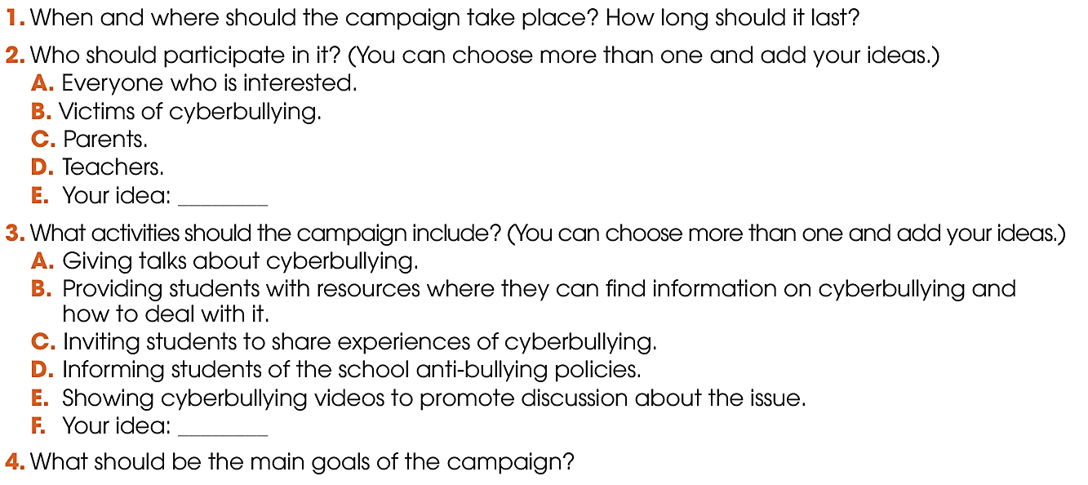
PRE-WRITING
1
You are planning a school campaign against cyberbullying. Work in groups to discuss these questions.

Slide 11



WHILE-WRITING
Time
Place
Guess/Participant
Activities
Goals

Slide 12
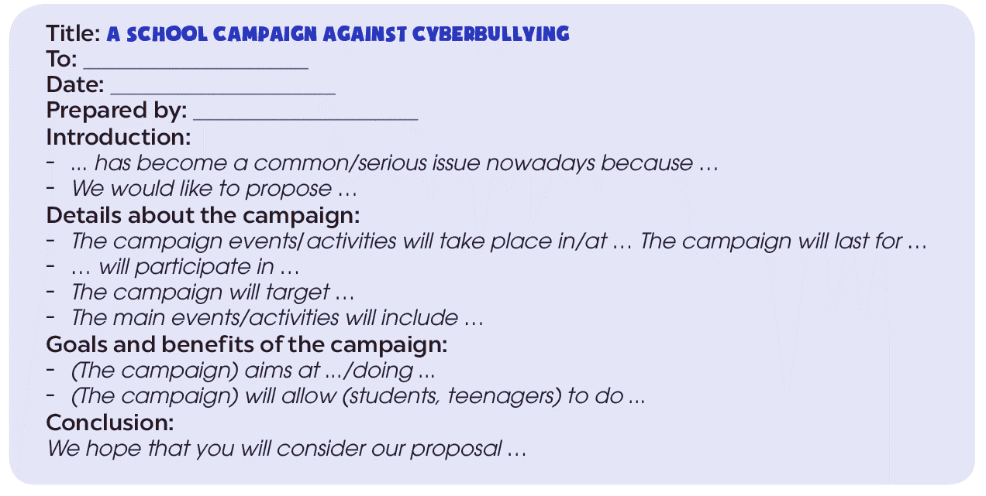
WHILE-WRITING
2
Write a proposal for the campaign (150–180 words) to your head teacher. Use the ideas in 1 and the outline with useful expressions below to help you.

Slide 13

WHILE-WRITING
Title: A proposal for a school campaign against cyberbullying
To: Ms. Le Thi Hoa
Date: February 14th, 2022
Prepared by: Vu Hoang Ha, President of the Social Awareness Club
Introduction
Cyberbullying has become a common issue nowadays because more students are using digital devices. Moreover, there have been reports of people making offensive comments about others online. Therefore, we would like to propose a school campaign against cyberbullying.
Campaign details
The campaign will include a series of activities organised by the school Social Awareness Club. They will take place in our school hall after classes. The campaign will last for a month, from the 1st of March until the 1st of April. All students who are interested will be able to participate in the activities. The main events will include several talks by cyberbullying experts and sharing sessions for students to talk about their experiences of cyberbullying.

Slide 14
WHILE-WRITING
Goals and benefits
Our goals are to raise awareness of cyberbullying, and to promote responsible and safe use of the Internet. The campaign will also help students identify cyberbullying and report it when they see it.
Conclusion
We hope that you will consider our proposal. We believe that this campaign will encourage students to make friends and promote a positive atmosphere in the school, which will ensure cyberbullying does not happen.
STOP BULLYING

Slide 15



POST-WRITING
4
Exchange your writing with your friend for peer review.
WRITING RUBRIC
Organization: …/10
Legibility: …/10
Ideas: …/10
Word choice: …/10
Grammar: …/10
TOTAL: …/50

Slide 16

CONSOLIDATION
What have you learnt today?
Write a proposal for a school campaign against cyberbullying.
Apply structures to practice

Slide 17

CONSOLIDATION
Do exercises in the workbook.
Prepare for Lesson 7 - Unit 9.

Slide 18

Website: hoclieu.vn
Fanpage: facebook.com/www.tienganhglobalsuccess.vn/

