Slide 1


Slide 2



Unit
10
ENERGY SOURCES
LESSON 2: A CLOSER LOOK 1
VOCABULARY
PRONUNCIATION
Unit
HOBBIES

Slide 3

OBJECTIVES
By the end of the lesson, students will be able to:
- Vocabulary about sources of energy.
- Pronunciation: Stress in three-syllable words

Slide 4
LESSON 2: A CLOSER LOOK 1
WARM-UP
Game: Cross words
Vocabulary
Task 1: Match the types of energy in A with the energy sources in B
Task 2: Write the phrases to label the pictures
Task 3: Complete the sentences with the words and phrases from 1 or 2.
stressed syllables in the underlined words
VOCABULARY
PRONUNCIATION
Pronunciation
Task 4: Listen and repeat. Pay attention to the stressed syllables in the words.
Task 5: Listen and repeat, paying attention to the
CONSOLIDATION
Wrap-up
Home work

Slide 5
LESSON 2: A CLOSER LOOK 1
WARM-UP
Game: Cross words
Aims of the stage:
To activate students’ prior knowledge and vocabulary related to the topic, the targeted vocabulary, and its pronunciation.

Slide 6
WARM-UP: CROSS WORDS
ENERGY
S | U | N
C | O | A | L
O | I | L
R | E | N | E | W | A | B | L | E
N | A | T | U | R | A | L | G | A | S

Slide 7

LESSON 2: A CLOSER LOOK 1
WARM-UP
Game: Cross words
Vocabulary
Task 1: Match the types of energy in A with the energy sources in B
Task 2: Write the phrases to label the pictures
Task 3: Complete the sentences with the words and phrases from 1 or 2.
stressed syllables in the underlined words
VOCABULARY
Aims of the stage:
To introduce visually some nouns related to the topic

Slide 8

PRESENTATION
Solar energy (n):
/ˈsōlər ˈenədʒi /
NĂNG LƯỢNG MẶT TRỜI

Slide 9

PRESENTATION
hydro energy (n)
/ˈhīdrō ˈenədʒi/
NĂNG LƯỢNG NƯỚC

Slide 10

PRESENTATION
nuclear (n)
/njuː.klɪər/
HẠT NHÂN

Slide 11
PRESENTATION
New words | Pronunciation | Meaning
1. Solar energy (n) | /ˈsōlər ˈenədʒi / | năng lượng mặt trời
2. Hydro energy (n) | /ˈhīdrō ˈenədʒi/ | năng lượng nước
3. nuclear (n) | /njuː.klɪər/ | hạt nhân

Slide 12
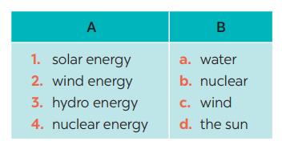
VOCABULARY
1
Match the types of energy in A with the energy sources in B
1- D
2 – C
3 – A 4 – B

Slide 13
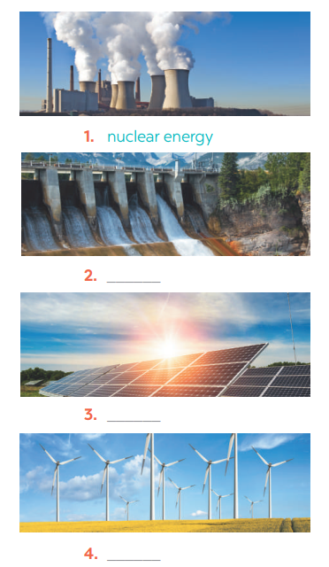
VOCABULARY
2
Write the phrases to label the pictures:
Solar energy
Hydro energy
Wind energy

Slide 14
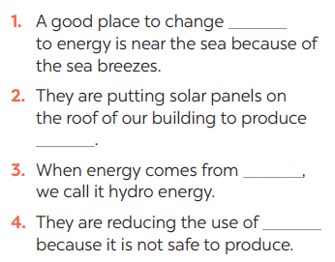
VOCABULARY
3
Complete the sentences with the words and phrases from 1 or 2.
wind
Aims of the stage:
To practise the targetted language in contexts.
solar energy
water
nuclear

Slide 15
LESSON 2: A CLOSER LOOK 1
WARM-UP
Game: Cross words
Vocabulary
Task 1: Match the types of energy in A with the energy sources in B
Task 2: Write the phrases to label the pictures
Task 3: Complete the sentences with the words and phrases from 1 or 2.
stressed syllables in the underlined words
VOCABULARY
PRONUNCIATION
Pronunciation
Task 4: Listen and repeat. Pay attention to the stressed syllables in the words.
Task 5: Listen and repeat, paying attention to the

Slide 16
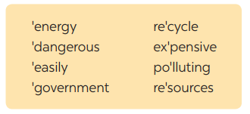
PRONUNCIATION
4
Listen and repeat. Pay attention to the sounds /aɪ/ and /eɪ/.
4
STRESS IN THREE-SYLLABLE WORDS
Aims of the stage:
To help Ss identify the and classify the words’ stress
To give students authentic practice in using pronouncing the stress correctly

Slide 17
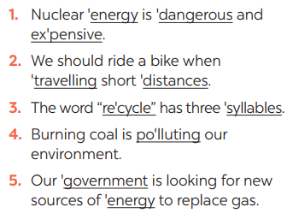
PRONUNCIATION
5
Listen and repeat, paying attention to the stressed syllables in the underlined words.

Slide 18
LESSON 2: A CLOSER LOOK 1
WARM-UP
Game: Cross words
Vocabulary
Task 1: Match the types of energy in A with the energy sources in B
Task 2: Write the phrases to label the pictures
Task 3: Complete the sentences with the words and phrases from 1 or 2.
stressed syllables in the underlined words
VOCABULARY
PRONUNCIATION
Pronunciation
Task 4: Listen and repeat. Pay attention to the stressed syllables in the words.
Task 5: Listen and repeat, paying attention to the
CONSOLIDATION
Wrap-up
Home work

Slide 19
CONSOLIDATION
1
WRAP-UP
VOCABULARY
PRONUNCIATION

Slide 20
CONSOLIDATION
2
HOMEWORK
Exercises in the workbook

Slide 21


