Slide 1



15 100,000
14 80,000
13 60,000
12 40,000
11 30,000
10 20,000
9 14,000
8 10,000
7 6,000
6 3,000
5 2,000
4 1000
3 600
2 400
1
200
Chơi

Slide 2
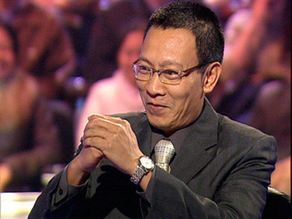


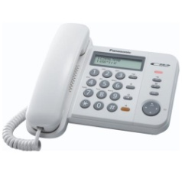

$200
1. He failed in the election just because he …….. his opponent.
A
Overestimated
B
Understated
C
Underestimated
D
Undercharged
Trả lời

Slide 3

$400
2. Which alphabet is drink?
A
A
B
H
C
O
D
T
Trả lời

Slide 4
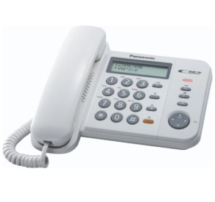
$600
3. I don’t know If…….. in my essay.
A
Is there a mistake
B
a mistake is there
C
there a mistake is
D
There is a mistake
Trả lời

Slide 5

$1000
4. “How much do you earn, Mary?” “I’d ………..”
A
Rather don’t say
B
Better not to say
C
Rather not say
D
Prefer not say
Trả lời

Slide 6

$2000
5. She’s finished the course, ………..?
A
isn’t she
B
Hasn’t she
C
Doesn’t she
D
Didn’t she
Trả lời

Slide 7
$3000
6. The teacher made a diffcult question, but at last, Joe …….. a good answer.
A
came up with
B
came up to
C
came up against
D
came up for
Trả lời

Slide 8

$6000
7. What has A hundered limbs, but cannot walk?
A
a centipede
C
a stick
B
a tree
D
a hedgehong
Trả lời

Slide 9

$10000
8. “Thanks for your help” “………………”
A
With all my heart
B
It’s my please
C
Never remind me
D
All it is for you
Trả lời

Slide 10
$14.000
9. Mr.Brown ………… in the army from 1960 to 1980.
A
had served
B
has served
C
had been serving
D
served
Trả lời

Slide 11
$20.000
10. Which alphabet is a source of salt?
A
C
B
W
C
S
D
G
Trả lời

Slide 12
$30.000
11.The woman ………… someone had stolen her purse, but althought they searched everyone in the shop, it wasn’t found.
A
accused
B
enforced
C
claimed
D
warned
Trả lời

Slide 13
$40.000
12. He isn’t go to Spain and …………….
A
so isn’t she
B
Neither is she
C
She isn’t too
D
Either she isn’t
Trả lời

Slide 14
$60.000
13. Although she is unkind, I can’t help …………. her.
A
like
B
liked
C
To like
D
liking
Trả lời

Slide 15
$80.000
14. I’m really looking for word….. To university.
A
to going
B
go
C
To go
D
going
Trả lời

Slide 16
$100.000
15. “ Never be late for an interview,….. You can’t get the job
A
If not
B
Or so
C
other wise
D
unless
Trả lời

Slide 17
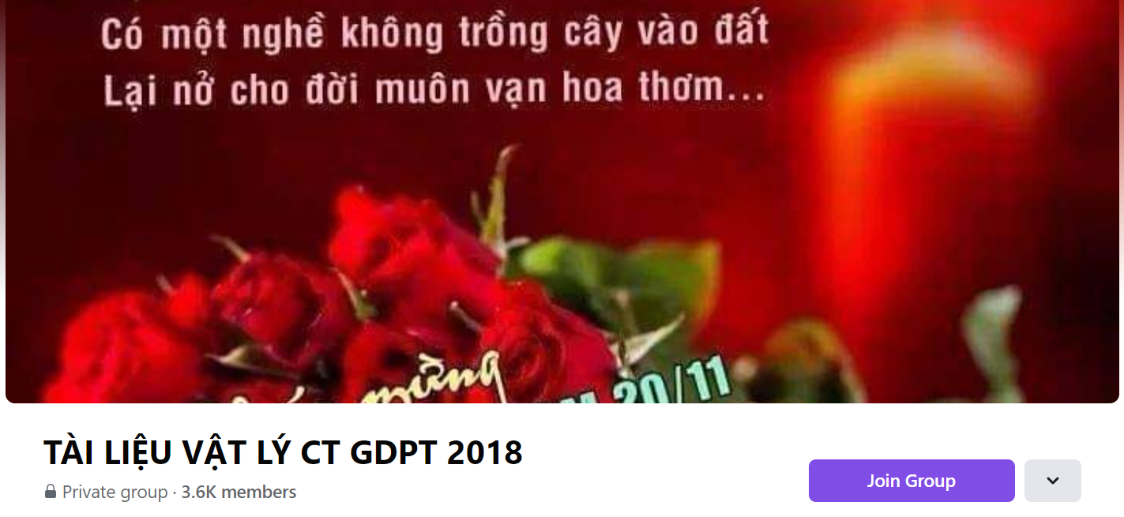
SƯU TẦM: ĐOÀN VĂN DOANH, NAM TRỰC, NAM ĐỊNH
LINK NHÓM DÀNH CHO GV BỘ MÔN VẬT LÝ TRAO ĐỔI TÀI LIỆU VÀ CHUYÊN MÔN CT 2018
https://www.facebook.com/groups/299257004355186

