Slide 1

Unit 1: My World
Lesson 1a: Reading
Page 14

Slide 2
Lesson Outline
Warm-up
Reading
Consolidation
Wrap-up

Slide 3
Objectives
By the end of this lesson, students will be able to…
- scan a text, to listen and read for gist and specific information.
- learn and use some vocabulary related to the topic.

Slide 4

WARM-UP

Slide 5
Answer the questions
- How old are you?
How is your life at thirteen?

Slide 6

It’s time to learn …

Slide 7
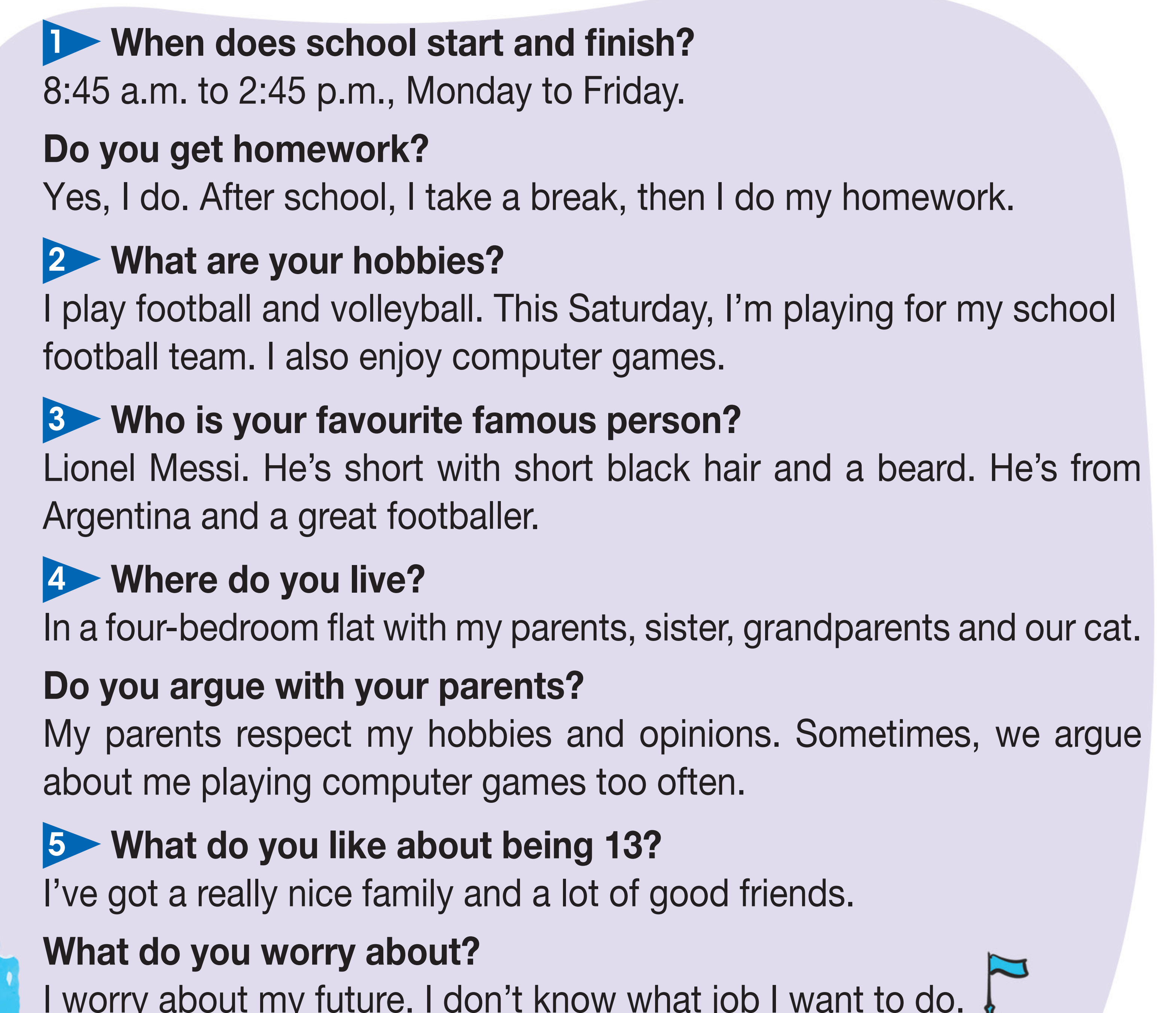
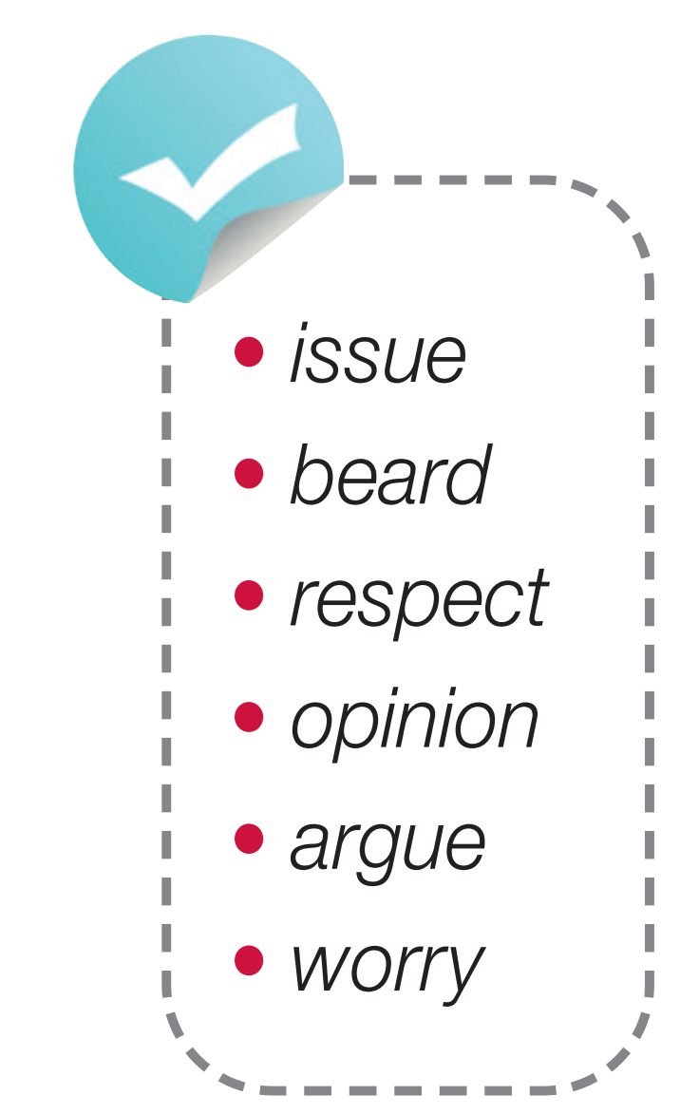
Pre-reading
Find these words in the text, try to guess what are their meanings.

Slide 8

Vocabulary
Listen and repeat.
Click on each word to hear the sound
issue /ˈɪʃuː/ (n) chủ đề bàn luận
beard /bɪəd/ (n) râu
respect /riˈspekt/ (v) tôn trọng
opinion /əˈpinjən/ (n) quan điểm, ý kiến
argue /ˈɑːɡjuː/ (v) tranh cãi, tranh luận
worry /ˈwʌri/ (v) lo lắng

Slide 9
Two sports:
=> volleyball, football
A pet:
=> cat

Slide 10









While-reading
Listen and read the interview. Then match the five sections
(1-5) to the headings in the list. One heading is extra.

Slide 11
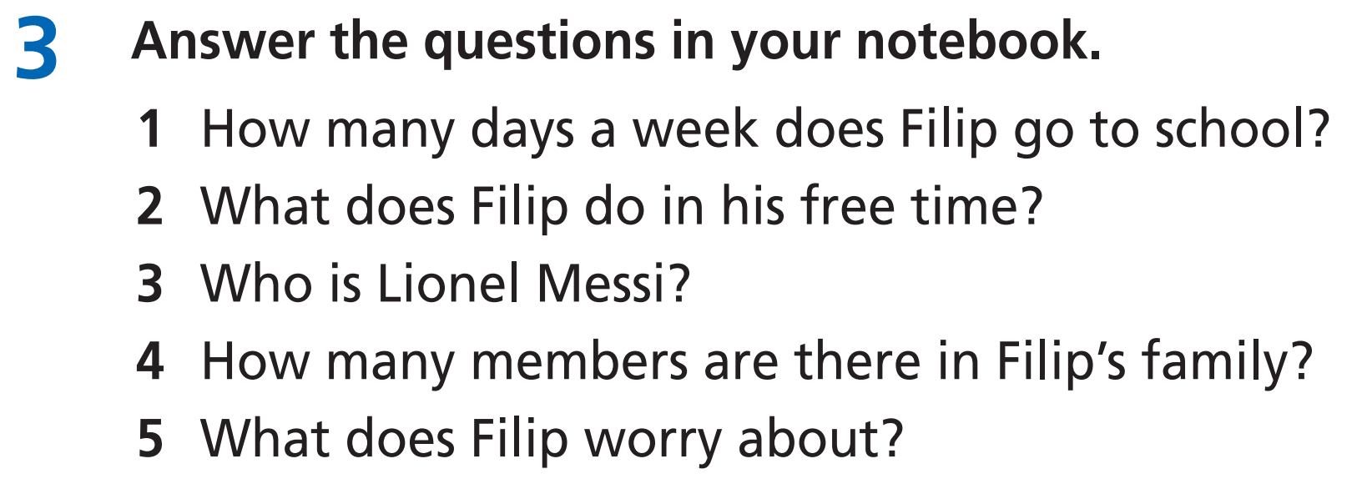
Read the task and underline the key words.

Slide 12
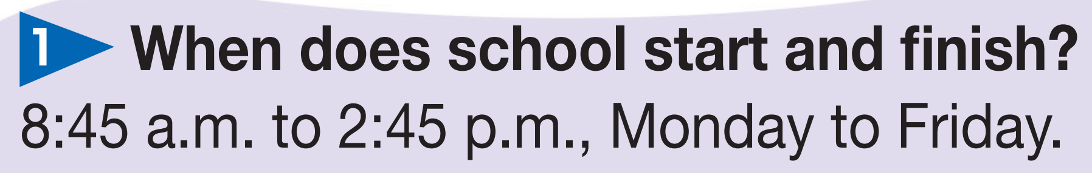
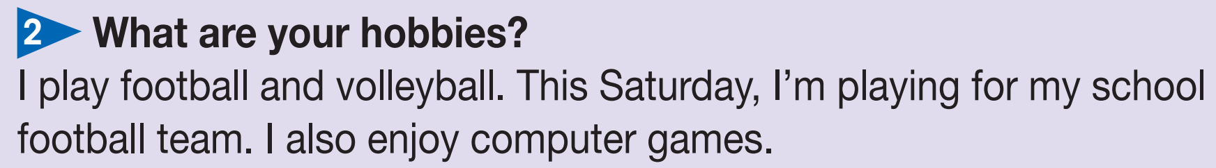
Now, read the text again and check the answers.
=> He goes to school five days a week.
=> He plays fooball, volleyball and computer games.

Slide 13
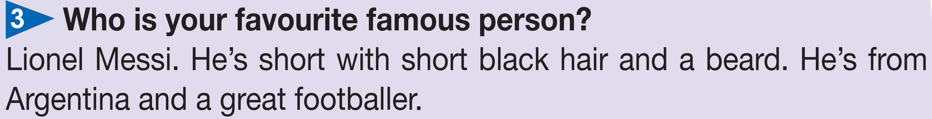
=> He’s a great footballer.
=> There are six members in his family.
=> He worries about his future. He doesn’t know what job he wants to do.

Slide 14
Extra Practice
Read the text again and choose the correct option.
First, underline the key words, then choose the correct answers.
1. How many hours a day is Filip at school?
A. 6 hours B. 8 hours C. 10 hours
2. What does Filip do after break time?
A. plays football B. plays volleyball C. does homework
3. Where’s Lionel Messi from?
A. Brazil B. Argentina C. Peru
4. How many bedrooms are there in FIlip’s flat?
A. 2 B. 3 C. 4

Slide 15
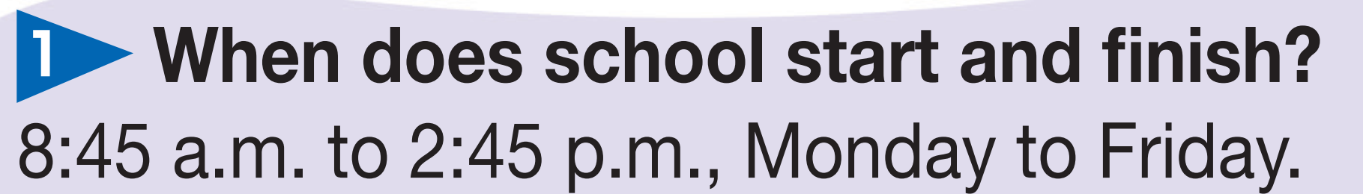
Now, read again to check the answers.
1. How many hours a day is Filip at school?
A. 6 hours B. 8 hours C. 10 hours
2. What does Filip do after breaktime?
A. plays football B. plays volleyball C. does homework

Slide 16
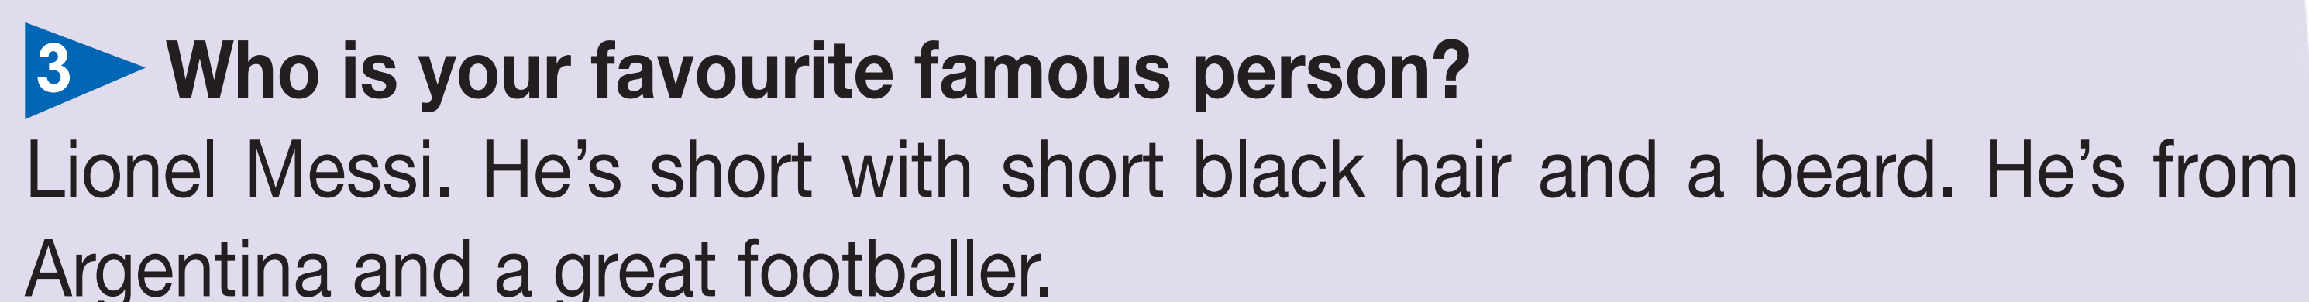
3. Where’s Lionel Messi from?
A. Brazil B. Argentina C. Peru
4. How many bedrooms are there in FIlip’s flat?
A. 2 B. 3 C. 4

Slide 17

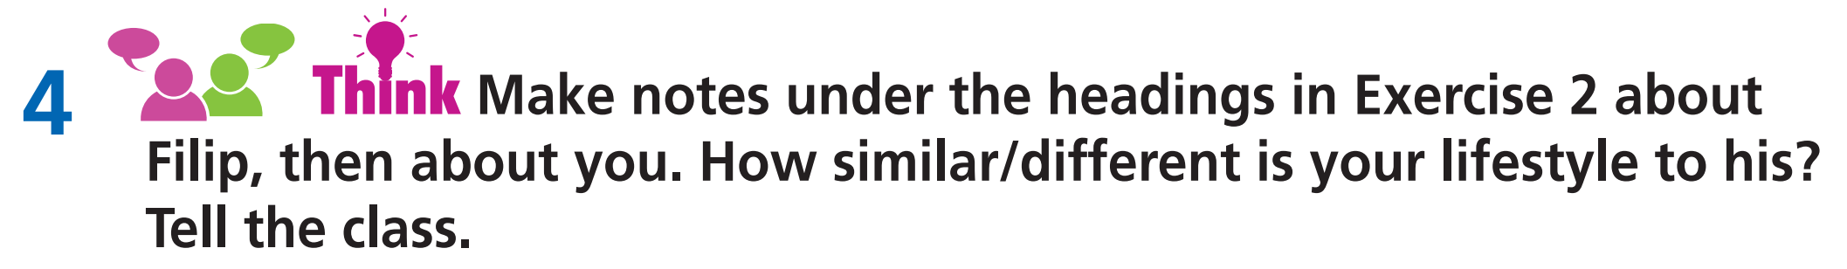
Post-reading
Example
My life is very similar to Filip’s. The only difference is that I live in a house with a garden, and I don’t like computer games. I like listening to music and going to the cinema.

Slide 18

CONSOLIDATION

Slide 19
Write a paragraph (60-80 words) about yourself by answering these questions.
When does school start and finish?
What are your hobbies?
Who is your favourite famous person?
Where do you live?
What do you like about being 13?

Slide 20

WRAP-UP

Slide 21
Today’s lesson
Vocabularies
issue
beard
respect
opinion
argue
worry
Grammar
Question words

Slide 22
Homework
Practise the vocabularies and grammar points and make sentences using them.
Do the exercises in TA 7 Right on WB (page 10)
Prepare the next lesson (page 15 SB)

Slide 23
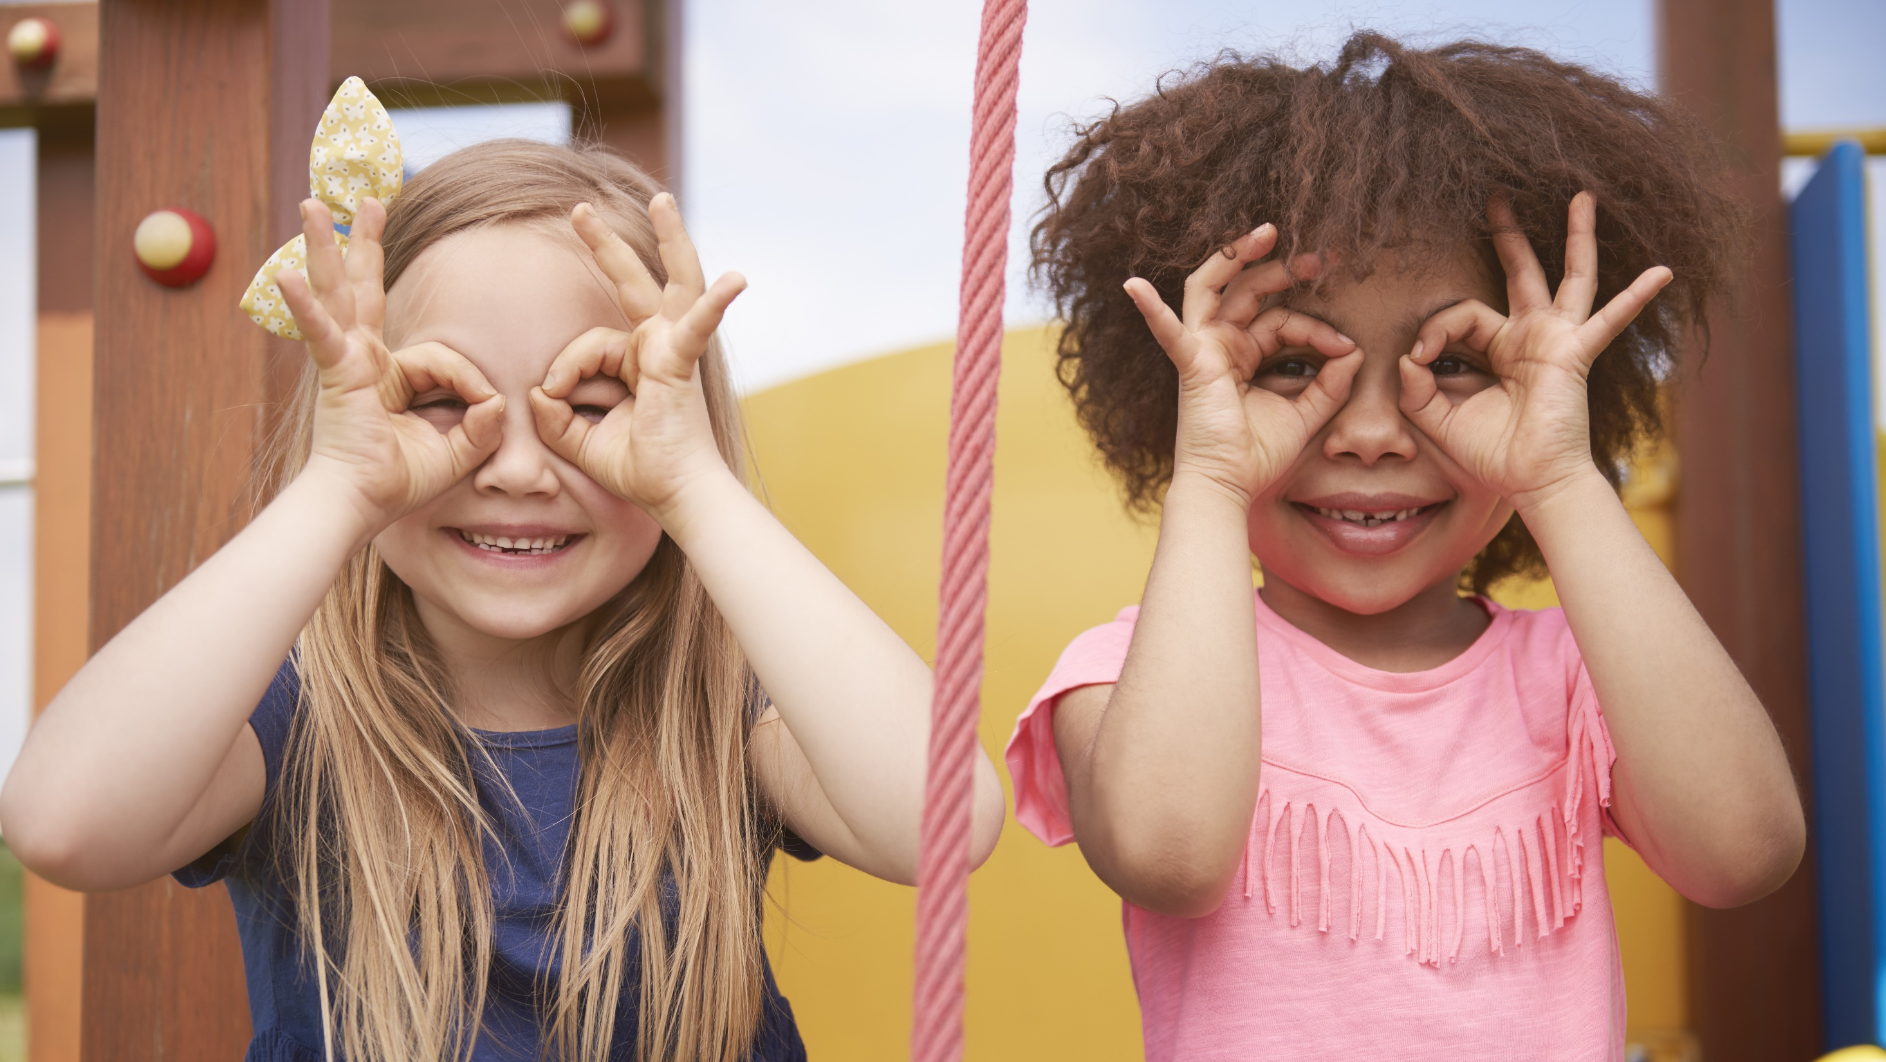
Enjoy your day!

