Slide 1
1
2
3
4
5
6
7
8
9
10
11
12
13
14
15
16
17
18
Bomb
19
20
+4
Click on the cups
+2

Slide 2
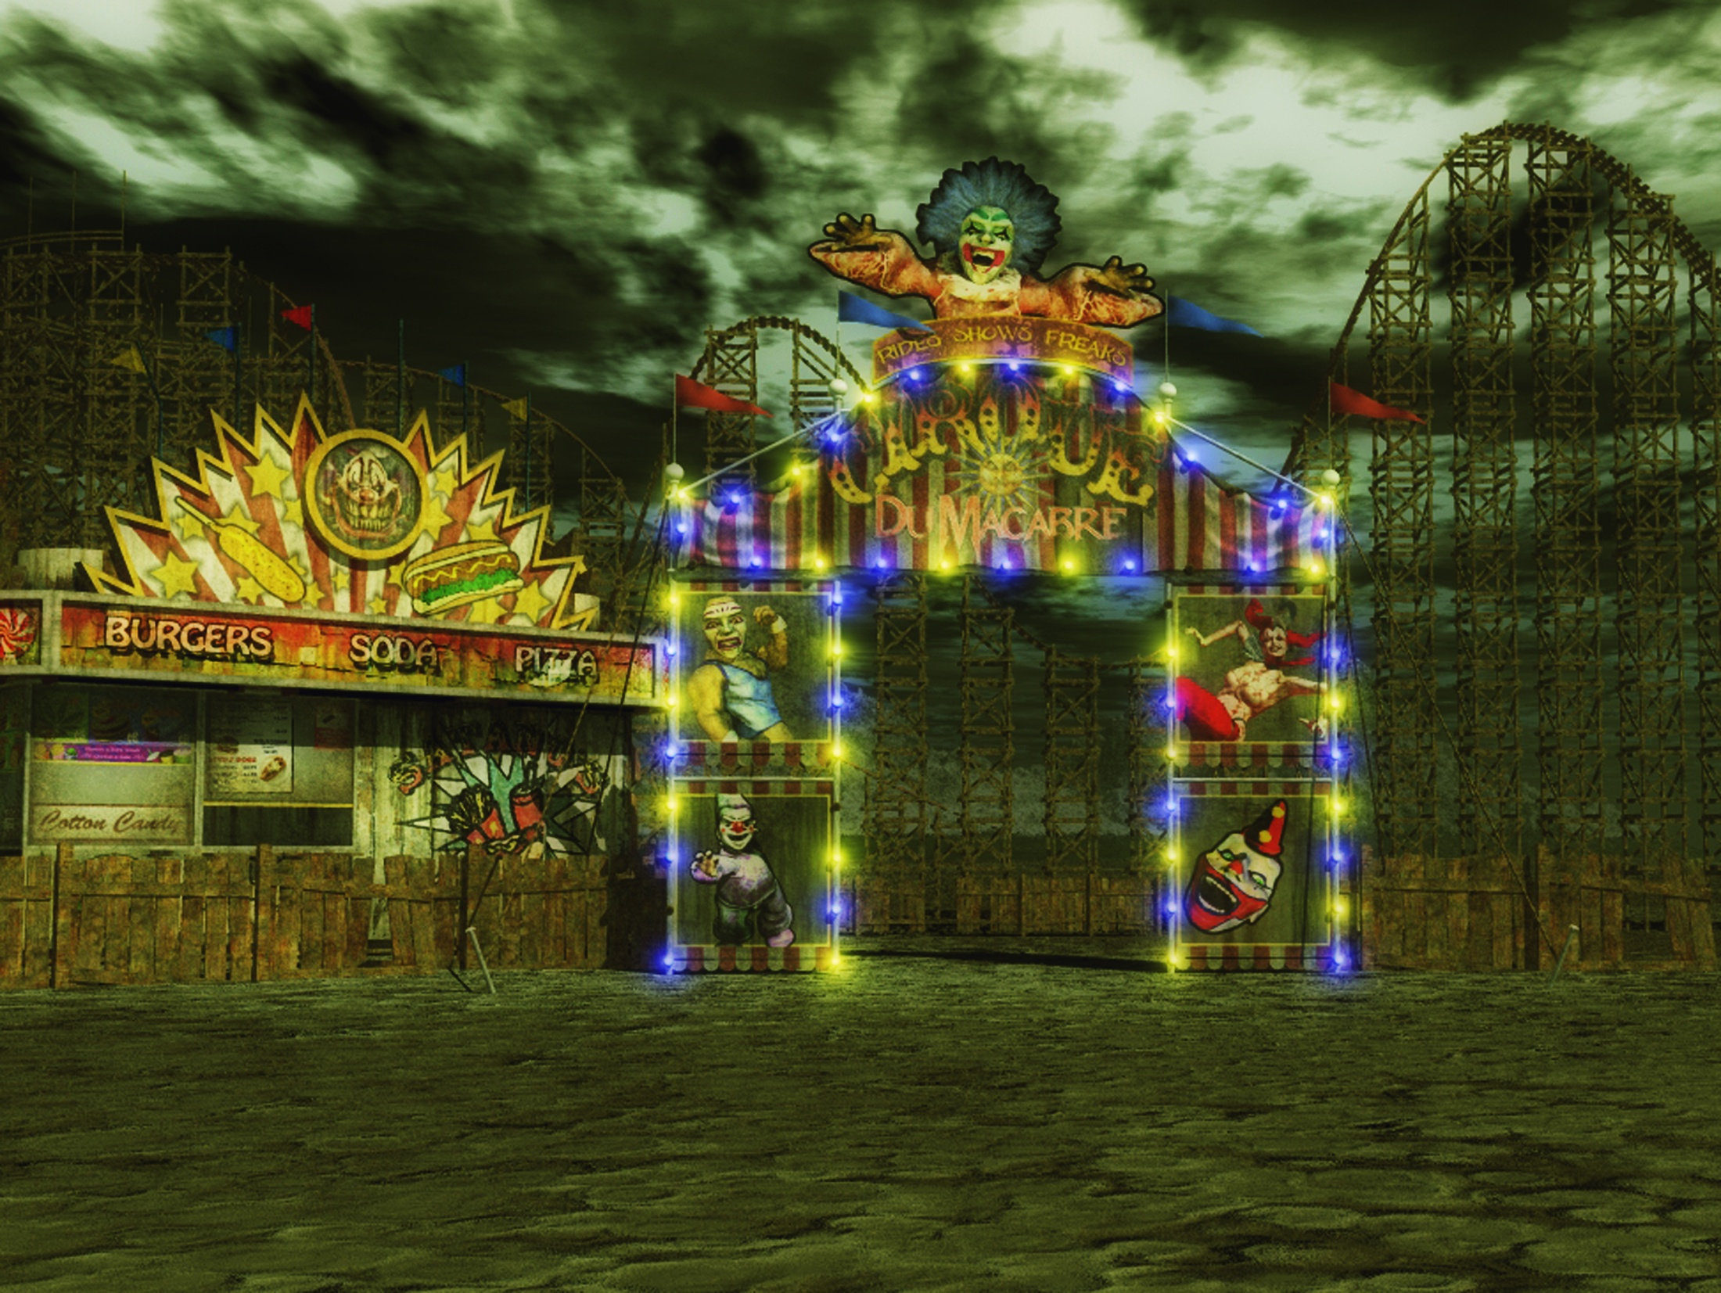
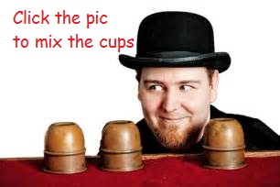
The windmill is moving _____
2
3
slowly.
Notes:
DICE ROLL GAME

Slide 3
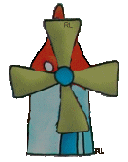
The windmill is moving _____
1
1
quickly.
Notes:
DICE ROLL GAME

Slide 4
The flower is dancing _____
1
1
softly
Notes:
DICE ROLL GAME

Slide 5
The child is flying the kite _____
1
1
happily
Notes:
DONE

Slide 6
The wind is blowing _____
strongly
Notes:
DONE

Slide 7
The wind is blowing _____
2
3
2
3
gently
Notes:
DONE

Slide 8
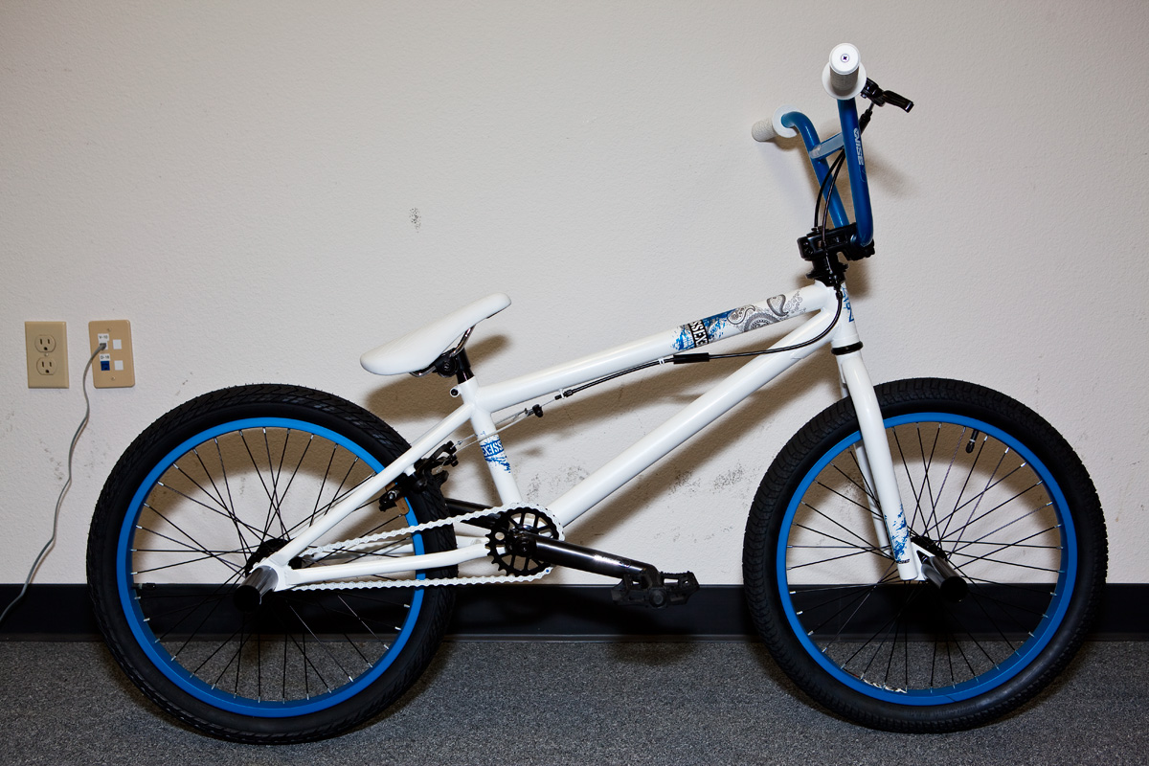
He is skating _____
2
quickly
Notes:
DONE

Slide 9
She is singing _____
happily
Notes:
DONE

Slide 10
She is walking _____
2
2
sadly
Notes:
DONE

Slide 11
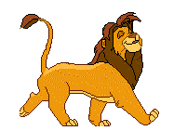
He is walking _____
happily
Notes:
DONE

Slide 12
She is running ____
slowly
Notes:
DONE

Slide 13
She is running ____
2
2
1
3
3
1
quickly
Notes:
DONE

Slide 14
He is cooking ____
badly
Notes:
DONE

Slide 15
He is cooking ____
well
Notes:
DONE

Slide 16
She is eating____
1
hungrily
Notes:
DONE

Slide 17
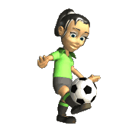
She is kicking the ball ____
3
3
gently / softly
Notes:
DONE

Slide 18
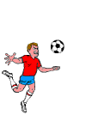
He is kicking the ball ____
strongly
Notes:
DONE

Slide 19
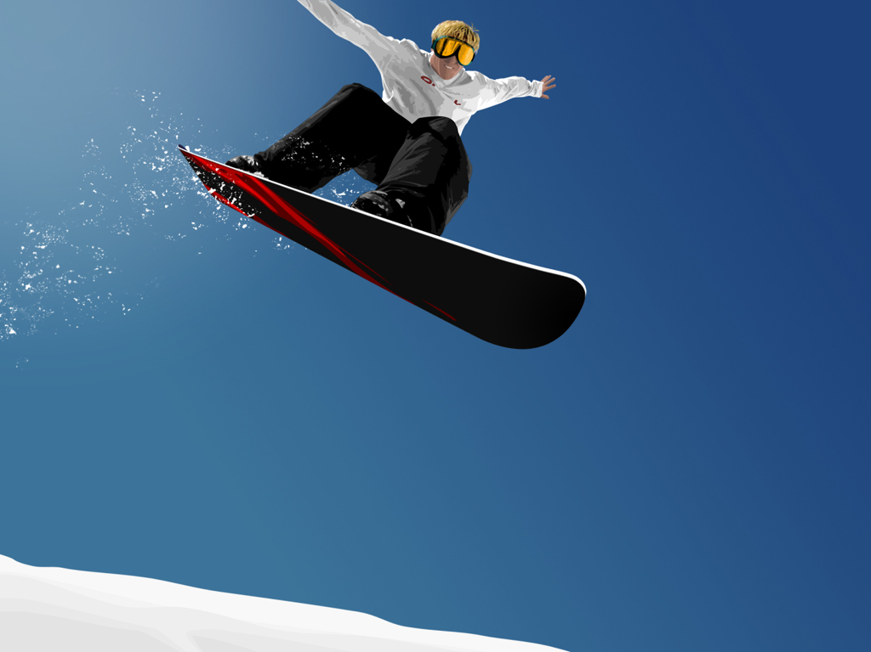
He is reading ____
2
2
quickly
Notes:
DONE

Slide 20
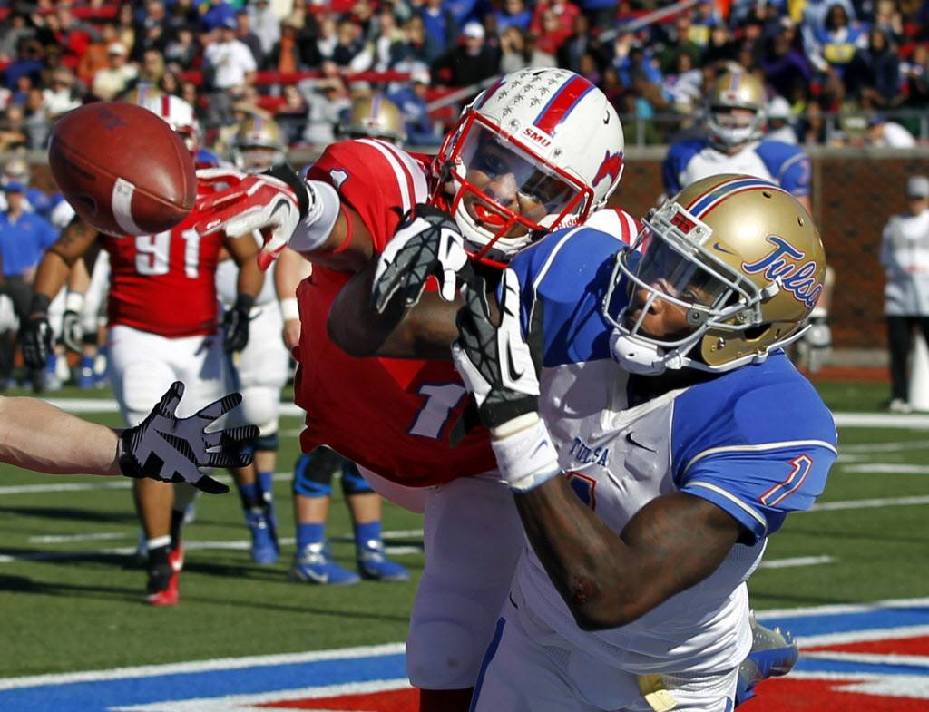
He is writing ____
quickly
Notes:
DONE

Slide 21
It is flying ____
2
slowly
Notes:
DONE

Slide 22
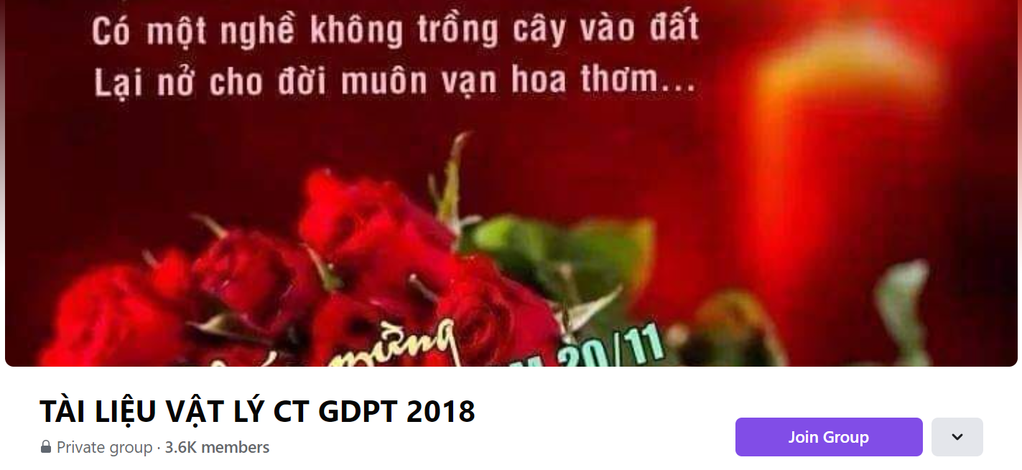
SƯU TẦM: ĐOÀN VĂN DOANH, NAM TRỰC, NAM ĐỊNH
LINK NHÓM DÀNH CHO GV BỘ MÔN VẬT LÝ TRAO ĐỔI TÀI LIỆU VÀ CHUYÊN MÔN CT 2018
https://www.facebook.com/groups/299257004355186

