Slide 1
Unit 2: Humans And
The Environment
Lesson 2: Language

Slide 2

Unit
1
1
FAMILY LIFE
Family Life
OBJECTIVES
Unit
By the end of this lesson, students will be able to:
- Pronounce the consonant blends /kl/, /pl/, /gr/, and /pr/ correctly in isolation and in sentences;
- Understand and use some lexical items about humans and the environment;
- Distinguish and use will and be going to to talk about the future;
- Use the passive voice correctly.

Slide 3
TABLE OF CONTENTS
01
02
03
04
05
Warm-up
Pronunciation
Vocabulary
Grammar
Consolidation

Slide 4
01
Warm-up
Guessing game

Slide 5
WARM-UP
Guessing game: WHAT AM I GOING TO DRAW?
A truck

Slide 6
WARM-UP
Guessing game: What am I going to draw?
A car

Slide 7
02
Pronunciation

Slide 8

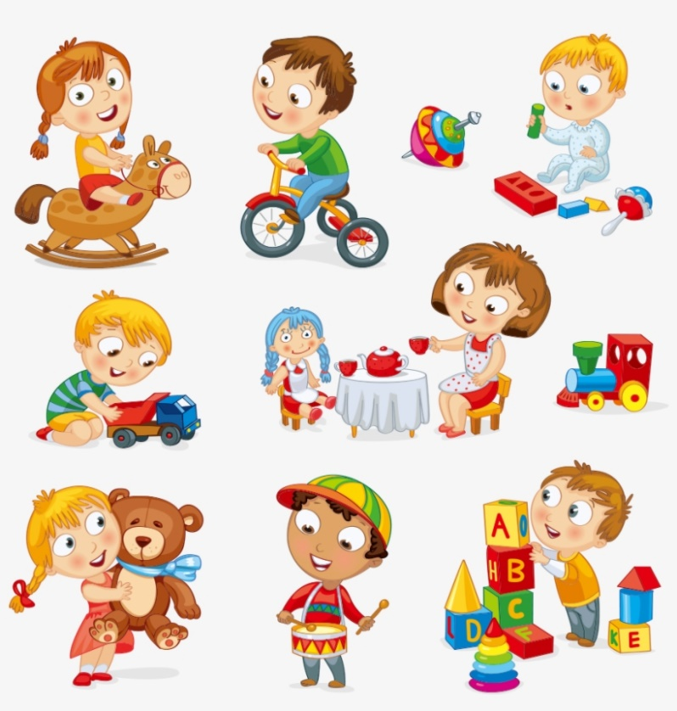
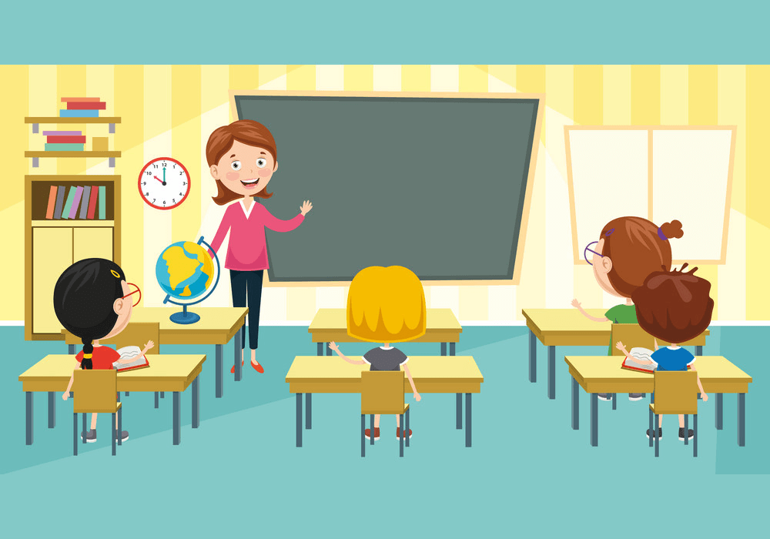
PRONUNCIATION
Describe each picture with a word.
class
ground
play

Slide 9



PRONUNCIATION
Describe each picture with a word.
present
green
clean

Slide 10


PRONUNCIATION
Describe each picture with a word.
place
protect

Slide 11


PRONUNCIATION
Put the pictures into 4 groups
present
class
ground
play
green
clean
protect
place

Slide 12


PRONUNCIATION
Group 1
Group 2
class
clean
place
play
Group 3
Group 4
present
protect
green
ground

Slide 13

PRONUNCIATION
1
Listen and read.
/kl/ | /pl/ | /gr/ | /pr/
club | please | green | practise
clean | place | group | present
class | play | ground | protect

Slide 14
PRONUNCIATION
2
Listen and practise saying the following sentences.
1. The club members will clean up all the classrooms.
2. We are pleased that we created an interesting plot for the school play.
3. Our group will make the playground green again.
4. The students are practising their presentation on environmental protection.

Slide 15
03
Vocabulary

Slide 16
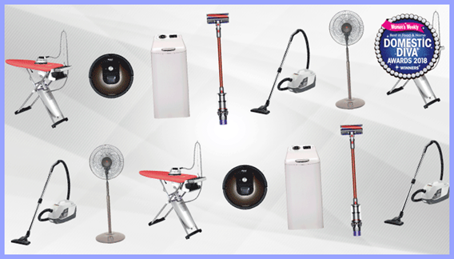



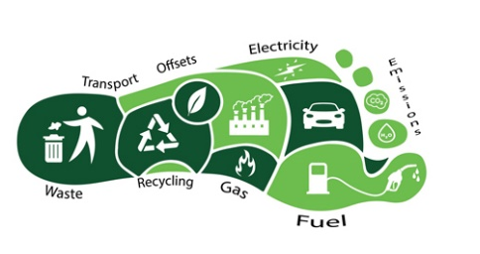
VOCABULARY
1
Match the words and phrases to their meanings.
a. the amount of carbon dioxide (CO2) produced by the activities of a person or an organisation
b. rubbish lying in an open or public place
1. household appliances
c. causing no harm to the environment
4. litter
d. devices such as fridges or TVs used in people’s homes
2. energy
e. power used for driving machines, providing heat and light, etc.
3. carbon footprint
5. eco-friendly
4. litter 5. eco-friendly

Slide 17


Slide 18
Vocabulary Game
START

Slide 19

Eco-friendly
____________ car models always attract great attention at exhibitions.
litter
household appliances
eco-friendly

Slide 20

Remember to turn off your __________________ when they are not used.
household appliances
household appliances
carbon footprint
litter

Slide 21

Small changes in your daily habits can help reduce the _______________ you produce.
carbon footprint
household appliances
energy
carbon footprint

Slide 22

One of the most important sources of _________ is the sun.
energy
energy
litter
household appliances

Slide 23
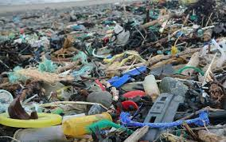
Students are reminded to pick up ______ that they see on the ground.
litter
eco-friendly
energy
litter

Slide 24
VOCABULARY
PRACTICE
3
Sentence making
household appliances
energy
carbon footprint
litter
eco-friendly
* In two minutes, make as many sentences with those words/ phrases as possible.
* Make at least one sentence with each word/ phrase.

Slide 25
04
Grammar

Slide 26
GRAMMAR - will and be going to
PRACTICE
 | Will | Be going to
1. Form | (+) Subject + will + V (-) Subject + will not/ won’t + V (?) Will + subject + V? | (+) Subject + am/is/ are going to + V (-) Subject am/is/ are + not (‘m not/ isn’t/ aren’t) + going to + V (?) Am/ Is/ Are + subject + going to+ V?
2. Uses | We use will to talk about: - plans which are made at the moment of speaking. (on-the-spot decisions) Ex: This shirt looks beautiful. I will buy it. - Predictions based on what we think or believe about the future. Ex: I think your team will win the competition. | We use be going to to talk about: - plans and intentions which are made before the moment of speaking. Ex: I have made a reservation. We are going to have dinner at the Chinese restaurant nearby. - Predictions based on what we see or know. Ex: Look at the dark clouds. It is going to rain soon.
3. Time expressions | tomorrow, next week/month/year…, in a week/month… think, believe, hope, expect, suppose, know, probably… | tomorrow, tonight, next week/month, …

Slide 27
GRAMMAR - will and be going to
PRACTICE
Complete the following sentences with will or the correct forms of be going to.
will
I don’t think she ________________ come tonight. She has to revise for her exam tomorrow.
We have already made the decision. We _________________ buy a new house next month.
I’m sure she ________________ pass her final exam.
Look at the sun. It __________________ be a beautiful day.
I forgot to phone Dad. I __________________ do it right after lunch.
are going to
will
is going to
will

Slide 28
GRAMMAR - Passive voice
PRACTICE
PASSIVE VOICE
1. Form: be + past participle (P2) Ex: + The plants are watered by Jack everyday + The report was published last week | 2. Uses: We use the passive voice when the person or thing that does the action is unknown, unimportant, obvious from the context or we don’t want to say who the doer is. We focus on the action itself. Ex: My wallet was stolen yesterday. (unknown agent) The house is cleaned twice a week. (unimportant agent) The thief was arrested (by the police-obvious agent from the context)
REMEMBER: + adverb of place + by + object + adverb of time Ex: The police found the missing painting in Jack’s house yesterday. -> The missing painting was found in Jack’s house by the police yesterday. + If the subject in the active voice is one of the following words: people, one, someone/somebody, they, he, etc. , it is not changed into the object in the passive voice. Ex: They hold the World Cup every four year. -> The World Cup is held every four year.

Slide 29
GRAMMAR - Passive voice
Rewrite the following sentences using the passive voice. Begin each sentence as shown.
1. More and more people adopt a green lifestyle.
-> A green lifestyle ________________________________.
2. The students didn’t put the rubbish in the bins after the party yesterday.
-> The rubbish
3. We will plant more trees in the neighbourhood.
-> More trees ________________________________.
4. Our club is going to organise a lot of clean-up activities this weekend.
-> A lot of clean-up activities
5. They discussed important environmental issues at the meeting.
-> Important environmental issues __________________________.
is adopted by more and more people
was not put in the bins after the party yesterday by the students
will be planted in the neighbourhood
are going to be organised by our club this weekend.
were discussed at the meeting

Slide 30
EXTRA ACTIVITY
Game: Chain Memory
Rules:
- Sit in a circle.
- Say a sentence about what you are going to or will do.
e.g. After this lesson, I’m going to play volleyball in the playground.
- The next one repeats it and adds another sentence.
e.g. After this lesson, I’m going to play volleyball in the playground and I’m going to meet some friends.
- Continue until a student can’t remember the previous sentences.
- The winner is the one that continues the chain for the longest time.

Slide 31
05
Consolidation

Slide 32
CONSOLIDATION
1
Wrap-up
WHAT HAVE YOU LEARNT TODAY?
- consonant blends /kl/, /pl/, /gr/, and /pr/
- some lexical items about humans and the environment;
- will and be going to to talk about the future;
- the passive voice .

Slide 33
CONSOLIDATION
2
Homework
*Do exercises in the workbook.
* Prepare for Lesson 3 - Unit 2.

Slide 34
SEE YOU NEXT TIME !!

