Slide 1

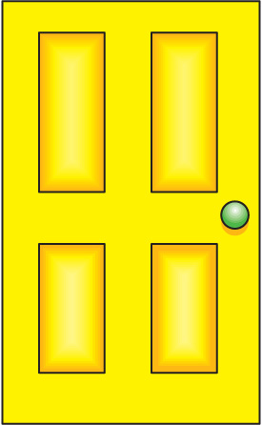



FURNITURE
AND
FITTINGS
CHOOSE A KEY
TO UNLOCK THE DOOR!

Slide 2
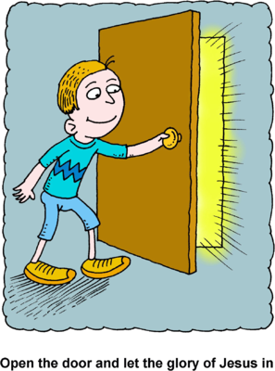




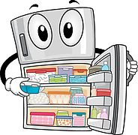
- 2p
- 1p
+3p
FRIDGE
WHAT’S THIS?
CHOOSE A KEY TO UNLOCK THE DOOR!

Slide 3

+3p
- 2p
- 1p
ARMCHA
I
R
WHAT’S THIS?
CHOOSE A KEY TO UNLOCK THE DOOR!

Slide 4

+3p
- 1p
- 2p
WARDROBE
WHAT’S THIS?
CHOOSE A KEY TO UNLOCK THE DOOR!

Slide 5

- 2p
+3p
- 1p
BOOKCASE
WHAT’S THIS?
CHOOSE A KEY TO UNLOCK THE DOOR!

Slide 6

- 1p
- 2p
+3p
RUG
WHAT’S THIS?
CHOOSE A KEY TO UNLOCK THE DOOR!

Slide 7
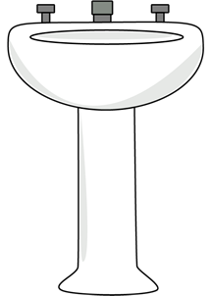
- 2p
+3p
- 1p
WASHBASIN
WHAT’S THIS?
CHOOSE A KEY TO UNLOCK THE DOOR!

Slide 8

+3p
- 1p
- 2p
MIRROR
WHAT’S THIS?
CHOOSE A KEY TO UNLOCK THE DOOR!

Slide 9

- 1p
+3p
- 2p
BEDS
I
DE
TAB
L
E
WHAT’S THIS?
CHOOSE A KEY TO UNLOCK THE DOOR!

Slide 10
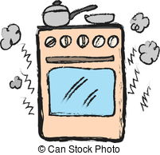
- 2p
+3p
- 1p
COOKER
WHAT’S THIS?
CHOOSE A KEY TO UNLOCK THE DOOR!

Slide 11

+3p
- 1p
- 2p
FIREPLACE
WHAT’S THIS?
CHOOSE A KEY TO UNLOCK THE DOOR!

Slide 12

- 2p
- 1p
+3p
BATHTUB
WHAT’S THIS?
CHOOSE A KEY TO UNLOCK THE DOOR!

Slide 13
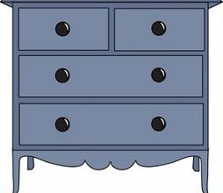
- 1p
- 2p
+3p
C
H
E
S
T
OF
DR
AWE
R
S
WHAT’S THIS?
CHOOSE A KEY TO UNLOCK THE DOOR!

Slide 14

+3p
- 2p
- 1p
KI
TCHEN
S
INK
WHAT’S THIS?
CHOOSE A KEY TO UNLOCK THE DOOR!

Slide 15

- 1p
+3p
- 2p
DOUB
L
E
BED
WHAT’S THIS?
CHOOSE A KEY TO UNLOCK THE DOOR!

Slide 16
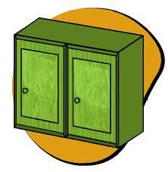
- 1p
- 2p
+3p
CUPBOARD
WHAT’S THIS?
CHOOSE A KEY TO UNLOCK THE DOOR!

Slide 17
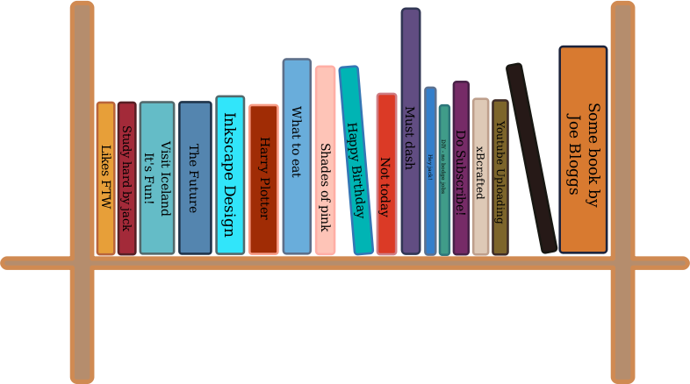
+3p
- 2p
- 1p
BOOKSHELF
WHAT’S THIS?
CHOOSE A KEY TO UNLOCK THE DOOR!

Slide 18

+3p
- 1p
- 2p
COFFEE
TABLE
WHAT’S THIS?
CHOOSE A KEY TO UNLOCK THE DOOR!

Slide 19
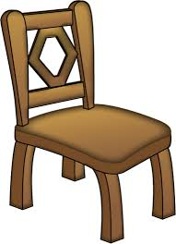
- 1p
- 2p
+3p
CHAIR
WHAT’S THIS?
CHOOSE A KEY TO UNLOCK THE DOOR!

Slide 20

- 2p
+3p
- 1p
TABLE
LAMP
WHAT’S THIS?
CHOOSE A KEY TO UNLOCK THE DOOR!

Slide 21

- 1p
+3p
- 2p
TOILET
WHAT’S THIS?
CHOOSE A KEY TO UNLOCK THE DOOR!

Slide 22

+3p
- 1p
- 2p
SOFA
WHAT’S THIS?
CHOOSE A KEY TO UNLOCK THE DOOR!

Slide 23

+3p
- 1p
- 2p
SHOWER
WHAT’S THIS?
CHOOSE A KEY TO UNLOCK THE DOOR!

Slide 24

- 2p
+3p
- 1p
DESK
WHAT’S THIS?
CHOOSE A KEY TO UNLOCK THE DOOR!

Slide 25

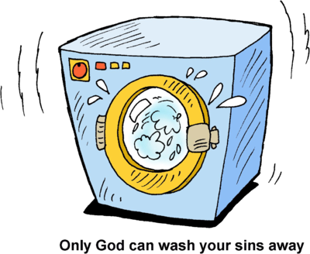
- 1p
- 2p
+3p
WA
S
H
I
NG
MA
C
H
I
N
E
WHAT’S THIS?
CHOOSE A KEY TO UNLOCK THE DOOR!

