Slide 1

Unit 10: Energy Sources
Lesson 1.3: Pronunciation & Speaking
Page 78

Slide 2
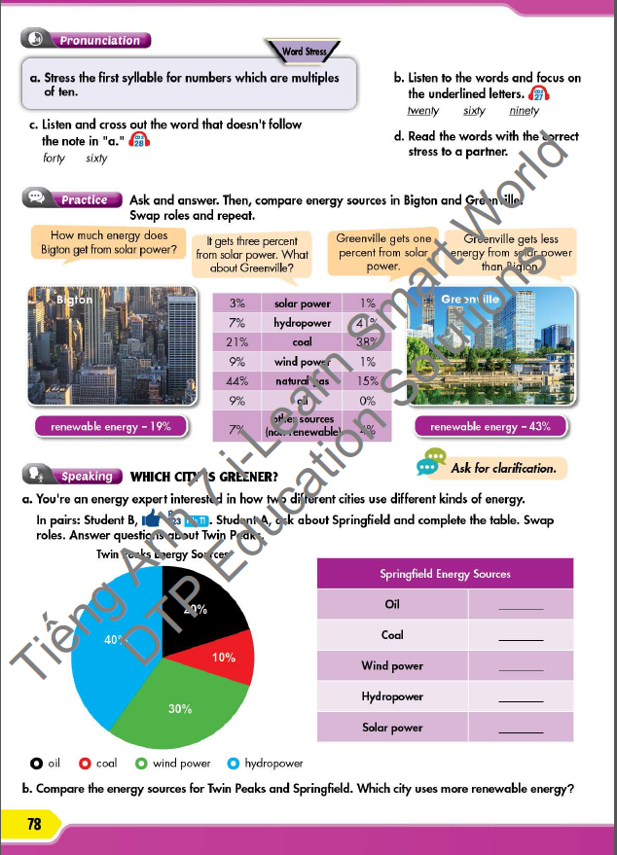



LESSON OUTLINE
Consolidation

Slide 3

By the end of this lesson, students will be able to…
- compare two cities’ use of energy sources using more/less … than …
- practice pronouncing numbers which are multiples of ten.

Slide 4

WARM-UP

Slide 5

Work in pairs.
Choose the word whose main stress is placed
differently from the others.
1. A. souvenir B. volunteer C. sightseeing D. engineer
2. A. energy B. barbecue C. traveling D. performance
3. A. situation B. hydropower C. presentation D. transportation
/ˌsu:vəˈnɪr/
/ˌvɑ:lənˈtɪr/
/ˈsaɪtsi:ɪŋ/
/ˌendʒɪˈnɪr/
/ˈenərdʒi/
/ˈbɑ:rbəkju:/
/ˈtrævəlɪŋ/
/pərˈfɔ:rməns/
/ˌsɪtʃuˈeɪʃn/
/ˈhaɪdroʊpaʊər/
/ˌpreznˈteɪʃn/
/ˌtrænspərˈteɪʃn/

Slide 6
Work in pairs.
Choose the word whose underlined part is
pronounced differently from that of the other words.
1. A. dangerous B. exciting C. delighted D. expensive
2. A. fire B. silk C. thing D. link
3. A. wrote B. sold C. stole D. wore
/ˈdeɪndʒərəs/
/ɪkˈsaɪtɪŋ/
/dɪˈlaɪtɪd/
/ɪkˈspensɪv/
/faɪər/
/sɪlk/
/θɪŋ/
/lɪŋk/
/roʊt/
/soʊld/
/stoʊl/
/wɔ:r/

Slide 7

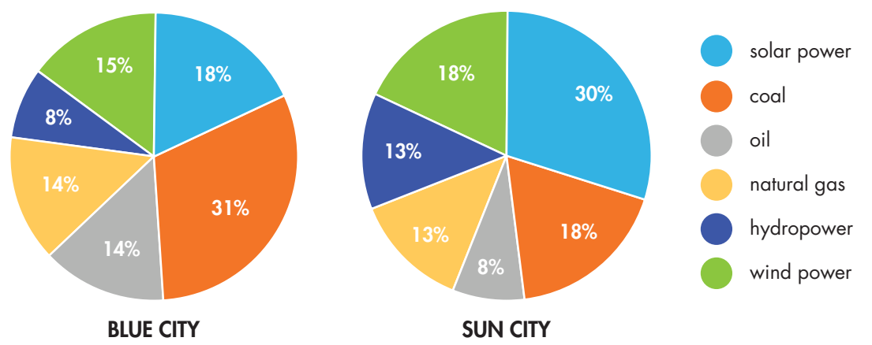
Work in pairs

Slide 8

Work in pairs
1. Which city is greener? Why?
2. How much energy does Sun City get from solar power?
1. Sun City is greener because Sun City uses more solar and wind power than Blue City.
2. (It gets) 30% (from solar power).

Slide 9



Slide 10
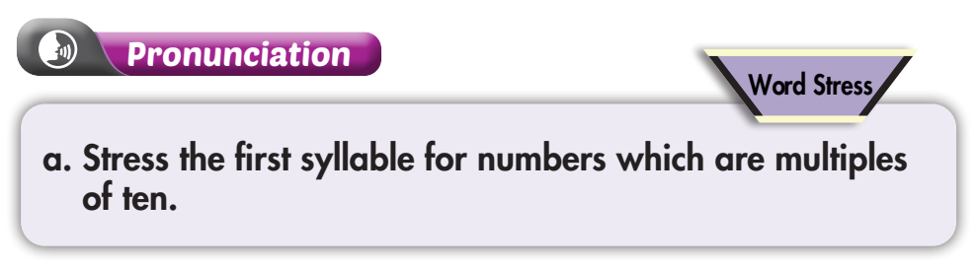
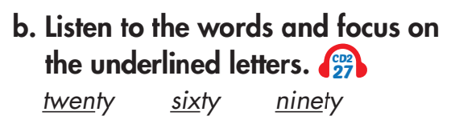

Click on the icon to hear the sound

Slide 11
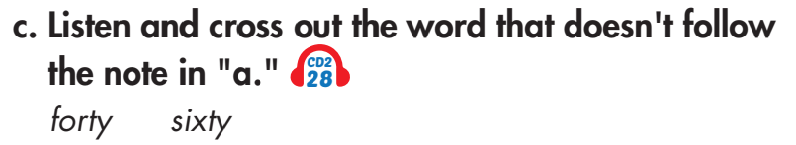

Click on the icon to hear the sound

Slide 12

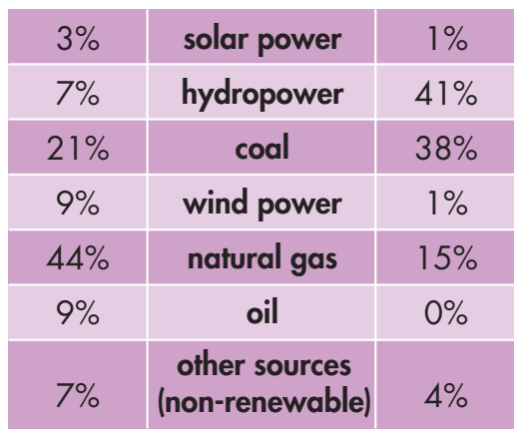

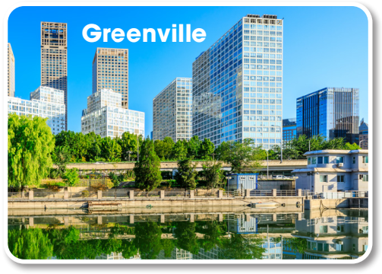
Example
B
G

Slide 13
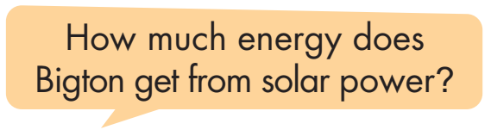
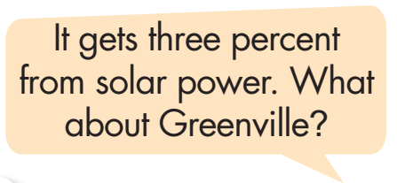
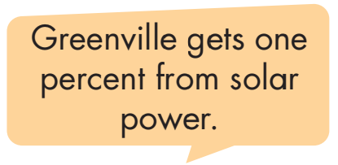
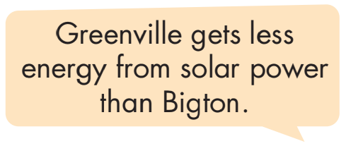

Slide 14
Do the same
How much energy does B get from hydropower?
B
G
It gets seven percent from hydropower. What about G?
G gets forty-one percent from hydropower.
G gets more energy from hydropower than B.

Slide 15
Do the same
How much energy does B get from coal?
B
G
It gets twenty-one percent from coal. What about G?
G gets thirty-eight percent from coal.
G gets more energy from coal than B.

Slide 16
Do the same
How much energy does B get from wind power?
B
G
It gets nine percent from wind power. What about G?
G gets one percent from wind power.
G gets less energy from wind power than B.

Slide 17
Do the same
How much energy does B get from natural gas?
B
G
It gets forty-four percent from natural gas. What about G?
G gets fifteen percent from natural gas.
G gets less energy from natural gas than B.

Slide 18
Do the same
How much energy does B get from oil?
B
G
It gets nine percent from oil. What about G?
G gets zero percent from oil.
G gets less energy from oil than B.

Slide 19
Do the same
How much energy does B get from other sources?
B
G
It gets seven percent from other sources. What about G?
G gets four percent from other sources.
G gets less energy from other resources than B.

Slide 20

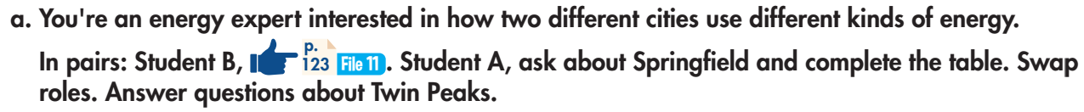
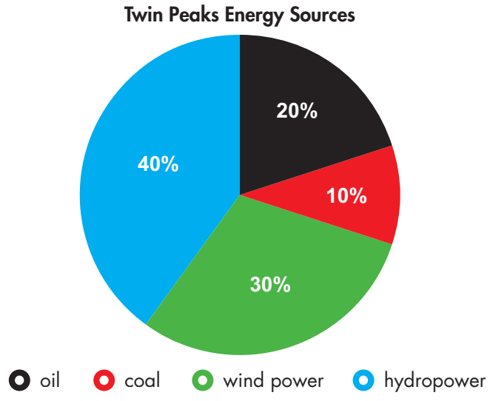
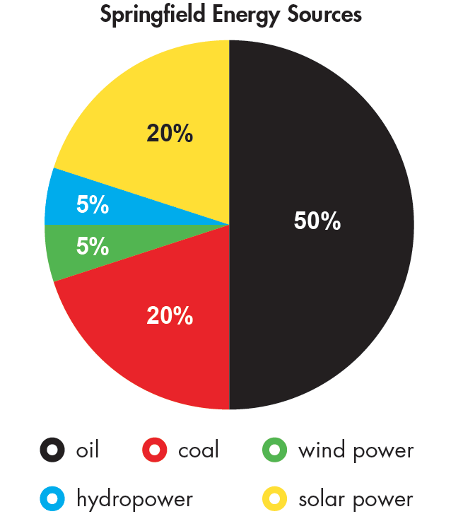

Slide 21
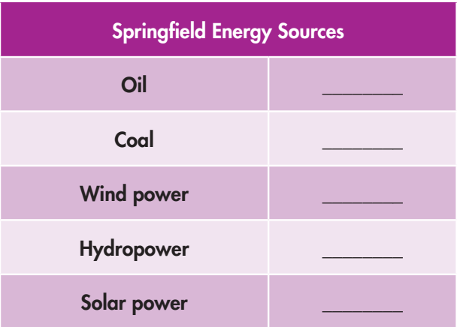
50
20
5
5
20

Slide 22
STUDENT A
STUDENT B
How much energy does Springfield get from oil?
It gets fifty percent from oil.
How much energy does Springfield get from coal?
It gets twenty percent from coal.
How much energy does Springfield get from wind power?
It gets five percent from wind power.
How much energy does Springfield get from hydropower?
It gets five percent from hydropower.
How much energy does Springfield get from solar power?
It gets twenty percent from solar power.

Slide 23
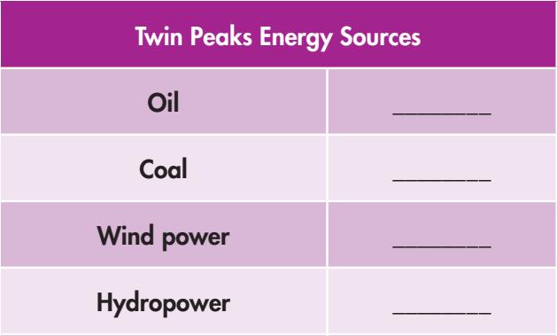
20
10
30
40

Slide 24
STUDENT A
STUDENT B
How much energy does Twin Peaks get from oil?
It gets twenty percent from oil.
How much energy does Twin Peaks get from coal?
It gets ten percent from coal.
How much energy does Twin Peaks get from wind power?
It gets thirty percent from wind power.
How much energy does Twin Peaks get from hydropower?
It gets forty percent from hydropower.

Slide 25
Twin Peaks gets less energy from oil than Springfield.
Twin Peaks gets less energy from coal than Springfield.
Twin Peaks gets more energy from wind power than Springfield.
Twin Peaks gets more energy from hydropower than Springfield.
Twin Peaks uses more renewable energy than Springfield.

Slide 26

CONSOLIDATION

Slide 27
Write a paragraph comparing two cities’ use of different kinds of energy. Which city is “greener”? Write about 70 words.

Slide 28

WRAP-UP

Slide 29
Today’s lesson
Speaking:
- Compare two cities’ use of energy sources using more/less …than…
- Practice pronouncing numbers which are multiples of ten.

Slide 30
Homework
Practice pronouncing numbers which are multiples of ten.
Redo the writing exercise in Tiếng Anh 7 i-Learn Smart World Workbook (page 57).
Review the vocabulary and grammar notes in Tiếng Anh 7 i-Learn Smart World Notebook (pages 60 & 61).
Prepare the next lesson (page 79 SB).
Play consolidation games in Tiếng Anh 7 i-Learn Smart World DHA App on www.eduhome.com.vn

Slide 31

Lesson 3
Stay positive and have a nice day!

