Slide 2


Unit
11
OUR GREENER WORLD
LESSON 2: A CLOSER LOOK 2

Slide 3
LESSON 2: A CLOSER LOOK 1
Warm up: Describing a picture
WARM-UP
Grammar 1: Articles
PRESENTATION
Task 1: Write a or an
Task 2: Write a/an or the
PRACTICE
Grammar 2: First Conditional
Task 3: Write the correct form of each verb in brackets.
Task 4: Combine each pair of sentences below to make a first conditional sentence.
PRODUCTION
CONSOLIDATION
Task 4. Game: Fun matching
Wrap-up
Homework

Slide 4
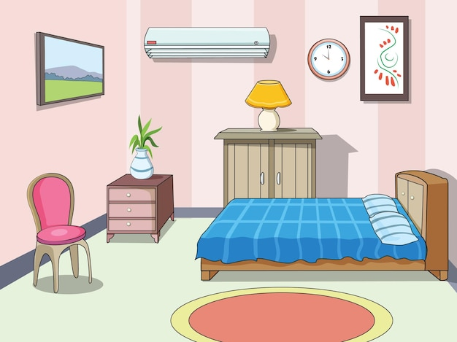
WARM-UP
GAME: DESCRIBING A PICTURE
Describe the picture using the structure “There is”
- There is a picture on the wall.
- There is an air-conditioner on the wall.
- There is a clock on the wall.
- There is a tree on the wardrobe.
- There is a chair near the wall.
- There is a bed in the room.
- There is a lamp on the table.

Slide 5
LESSON 3: A CLOSER LOOK 2
GRAMMAR

Slide 6

GRAMMAR
PRESENTATION
Articles
There are two kinds of articles in English: the indefinite article (a / an) and the definite article (the).
We use a / an
- with singular countable nouns when we are talking about them in general.
Example:
An ant is a tiny animal.
- after the verbs to be and to have.
Example:
I’m a student. / I have an eraser.

Slide 7
GRAMMAR
PRESENTATION
Articles
We use the
- with singular or plural nouns when we already know them or when they are mentioned for the second time.
Example:
The bike in front of her house is nice.
- with nouns which are unique.
Example:
The air is dirty.

Slide 8

GRAMMAR
PRACTICE
Write a or an.
____ mouth
___ egg
a mouth
1.
an egg
5.
___ friend
a friend
____ onion
2.
6.
an onion
___ sink
____ umbrella
3.
a sink
7.
an umbrella
___ arm
4.
an arm
____ classmate
8.
a classmate

Slide 9

GRAMMAR
PRACTICE
Write a / an or the.
a doctor.
1.
My father is
_______ doctor.
The Sun keeps
2.
_______ Sun keeps _______ Earth warm.
the Earth warm.
_______ intelligent animal.
3.
_______ dolphin is _______ intelligent animal.
A dolphin is
an intelligent animal.
4.
I have
an orange shirt too.
_______ orange shirt too.
5.
My brother likes
_______ blue pen, not _______ red one.
the blue pen, not
_______ red one.
the red one.

Slide 10
GRAMMAR
PRESENTATION
First Conditional
First conditional sentences describe things which are possible and likely to happen in the present or the future.
If + S + V (present simple),
If-clause
S + will / won’t + V (base form)
main clause
Example:
If you use less paper, you will save a lot of trees.

Slide 11

GRAMMAR
PRACTICE
Write the correct form of each verb in brackets.
1.
If it (be)
_______ sunny next week, we (go) _______ on a picnic.
is sunny next week, we (go)
will go on a picnic.
2.
If we (recycle)
will help the Earth.
_______ more, we (help) _______ the Earth.
recycle more, we (help)
3.
We (save)
so much paper.
_______ a lot of trees if we (not waste) _______
will save a lot of trees if we (not waste)
don’t waste
_______
use
More people (have)
less water.
will have fresh water if we (use)
4.
_______ fresh water if we (use)_______
_______ more fish.
isn’t / is not dirty, there (be)
_______ dirty, there (be) _______ more fish.
5.
If the river (not be)
will be more fish.

Slide 12

GRAMMAR
PRACTICE
Combine each pair of sentences below to make a first conditional sentence.
1.
The air isn’t fresh. People cough.
2.
The water is dirty. A lot of fish die.
3.
We cut down trees in the forest. There are more floods.
4.
There is too much noise. People don’t sleep.
5.
There is no water. Plants die.

Slide 13
GRAMMAR
PRACTICE
Combine each pair of sentences below to make a first conditional sentence.
1.
The air isn’t fresh. People cough.
If the air isn't fresh, people will cough.
2.
The water is dirty. A lot of fish die.
If the water is dirty, a lot of fish will die.
3.
We cut down trees in the forest. There are more floods.
If we cut down trees in the forest, there will be more floods.

Slide 14
GRAMMAR
PRACTICE
Combine each pair of sentences below to make a first conditional sentence.
4.
There is too much noise. People don’t sleep.
If there is too much noise, people will not / won't sleep.
5.
There is no water. Plants die.
If there is no water, plants will die.

Slide 15


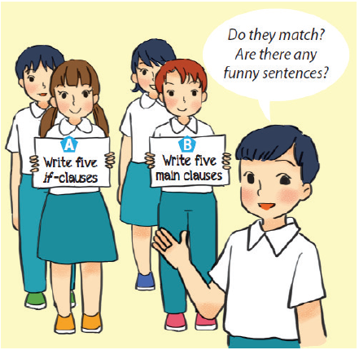
PRODUCTION
Fun matching
Work in groups, A and B.
Group A secretly writes five if-clauses on a sheet of paper.
Group B secretly writes five main clauses on another sheet of paper.
Match the if-clauses with the main clauses.
Do they match? Are there any funny sentences?

Slide 16

CONSOLIDATION
1
Wrap-up
What have we learnt in this lesson?
Grammar 1: Articles
Grammar 2: First conditional sentences

Slide 17

CONSOLIDATION
2
Homework
Do exercises in the workbook.
B3,4,5/ page 35

Slide 18







