Slide 1
Time allowed - 8-10 minutes
Normally you will do the speaking test with another candidate. The two of you will meet two examiners. One of the examiners will talk to you, the other does not particpate in the conversations.
There are two parts to the speaking test:
Speaking part 1: short questions and answers between you and the examiner
Speaking part 2: the examiner gives you some information or a card with some ideas for questions. You have to talk with the other candidate and ask or answer questions. How to prepare for KET Speaking
Speak as much as you can, with your friends
Practise asking and asnwering questions about daily life
Practise giving information about yourself

Slide 2
Part 1: Tell about your first day at primary school

Slide 3
Brain storm
when was your first day?
how did you feel at the night before?
how was your primary school?
how about your teacher and friends?
memorial events

Slide 4
Grammar
Past tenses
S + was/were + …
Ved
S + was/were + Ving …
S + had + participle

Slide 5
Useful vocabulary

Slide 6
Feelings

Slide 7
What is it like?

Slide 8
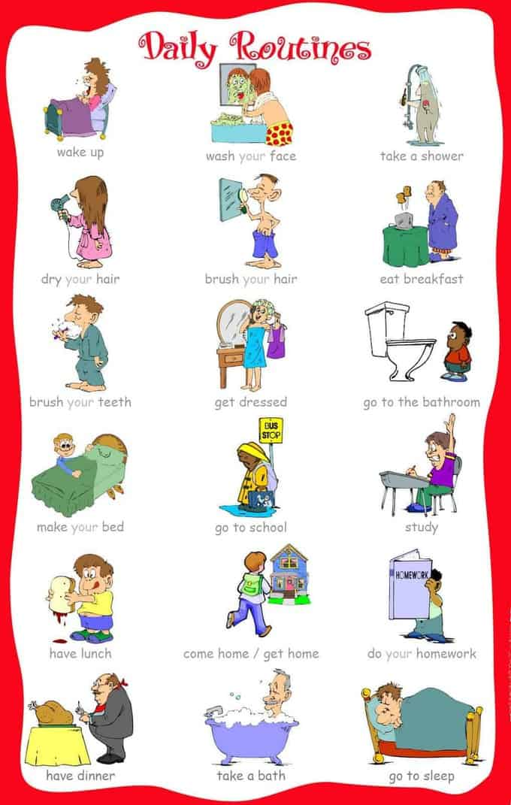

Slide 9
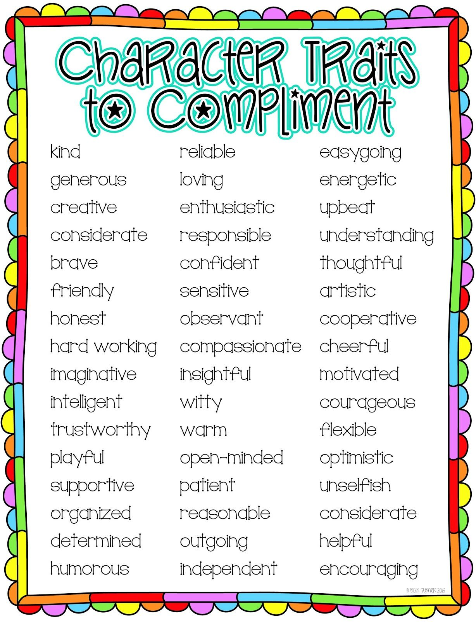
My teacher was …
My friends were …
He/she was ….
They were

Slide 10
Useful language:
My first day …
My primary school was in …
I was …
I went …
I think …

Slide 11
Tell about your first day in primary school (3 – 4 mins)

Slide 12
Speaking part 2:
Asking and answering questions using these prompt cards

Slide 13
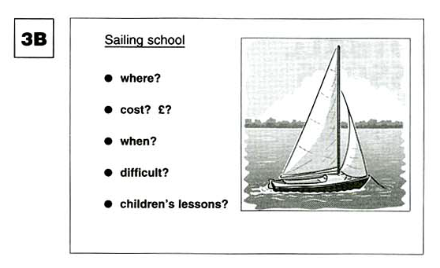
Ask and answer questions using the words given.
What are other questions and answers you can think of?

Slide 14
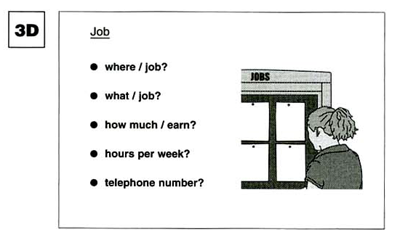
Ask and answer questions using the words given.
What are other questions and answers you can think of?

Slide 15
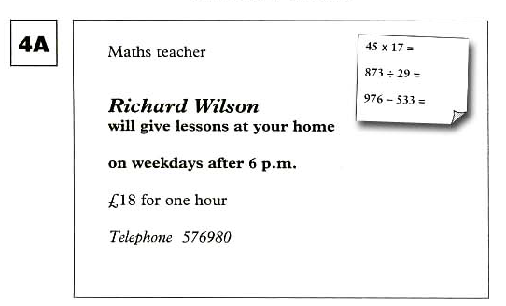
Ask and answer questions using the words given.
What are other questions and answers you can think of?

