Slide 1



Unit 1: Feelings
Lesson 1D: Grammar

Slide 2







I went to school.
I went to school.
Say what you did last night.
www.phuongnam.edu.vn

Slide 3

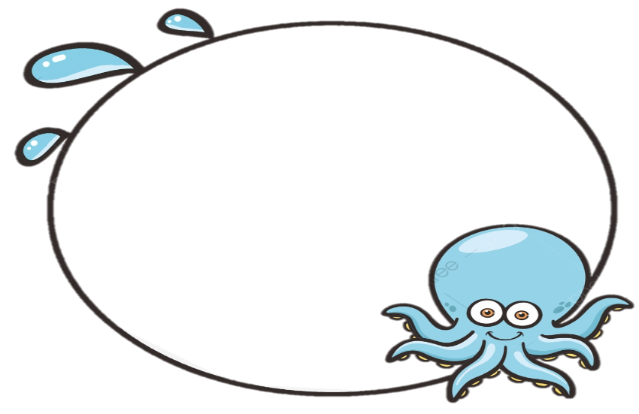
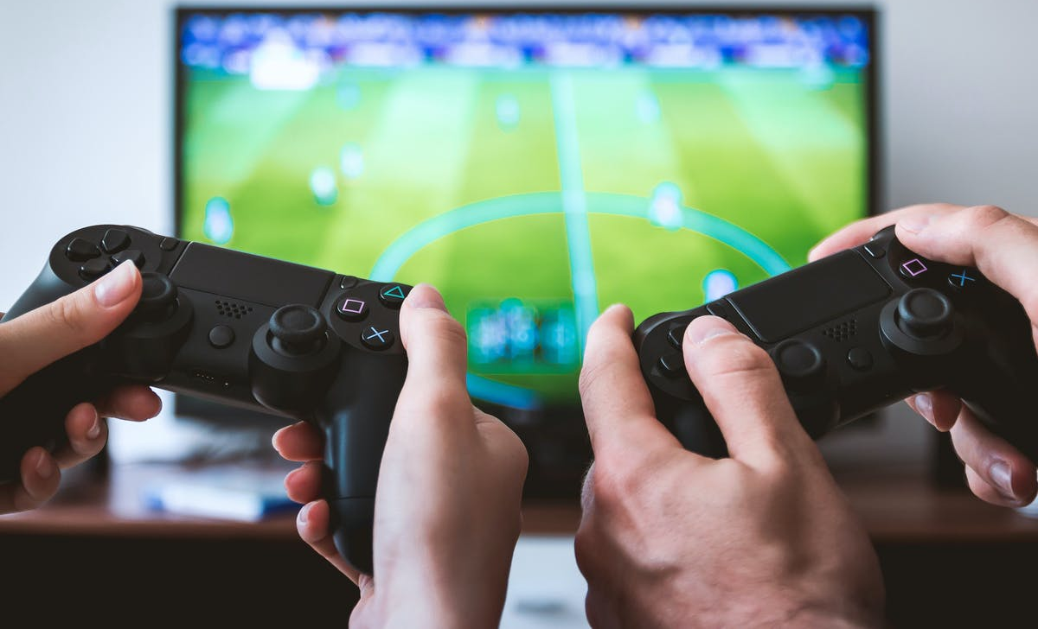


Last night I…
did my homework.
played some games.
went outside.

Slide 4

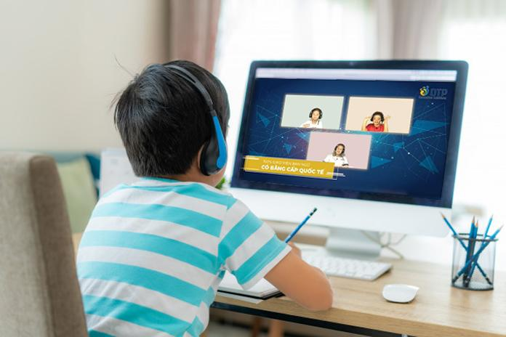
Last night I…
slept peacefully.
played boardgame.
had online lessons.

Slide 5
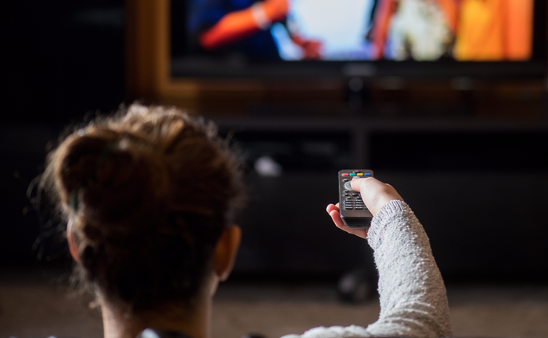

Last night I didn’t…
watched TV alone.
played with my dog.
ate some snacks.

Slide 6
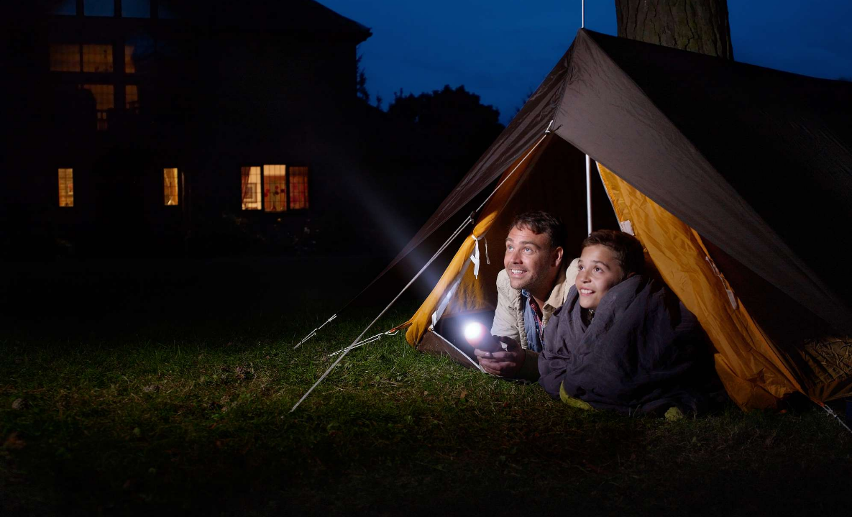
Last night I didn’t…
did some exercises.
went camping.
stayed at home.

Slide 7



Last night, did you go on a date?
No, I didn’t.
Yes, I did.

Slide 8
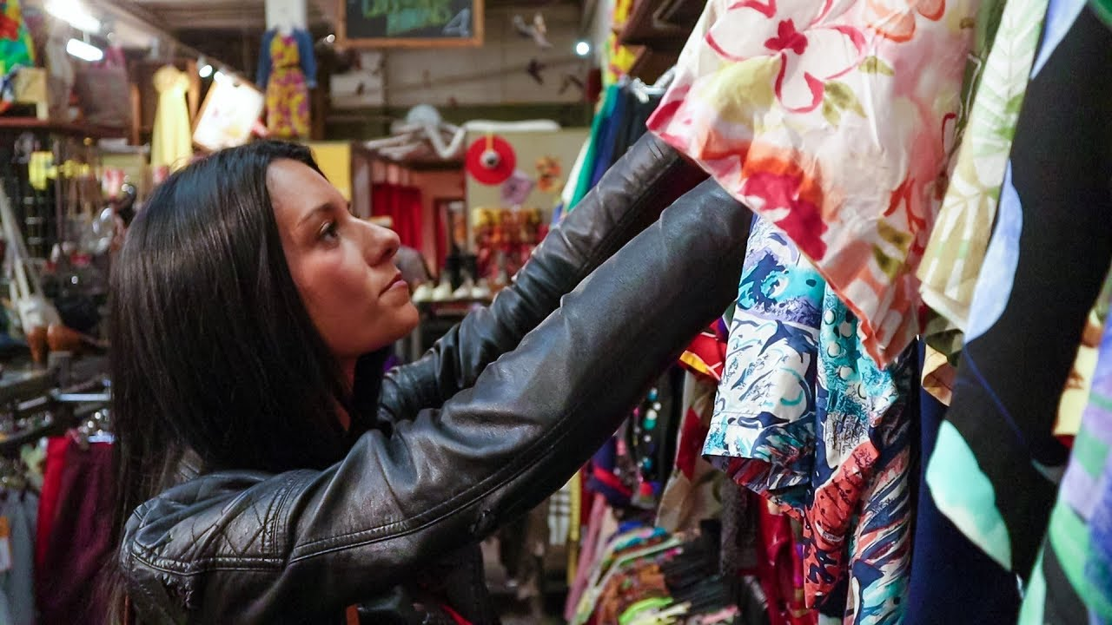
Last night, did you play with your pet?
No, I didn’t.
Yes, I did.

Slide 9

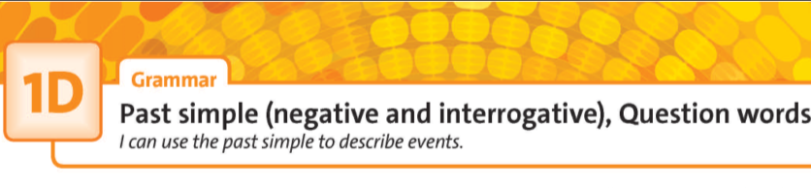

UNIT 1:
FEELINGS
www.phuongnam.edu.vn

Slide 10
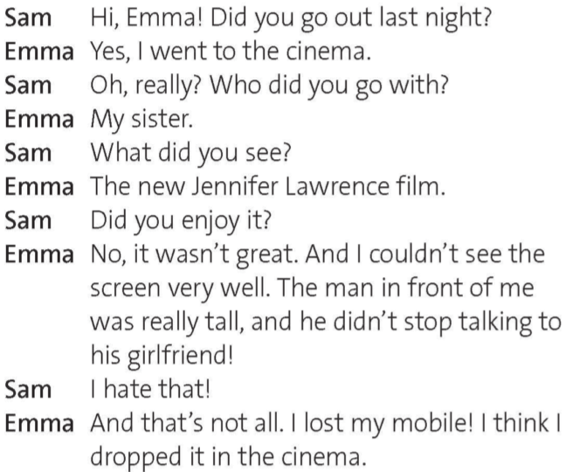
Now underline all the past simple negative & questions in the text.
www.phuongnam.edu.vn

Slide 11
2. Read & listen to the video chat. Why did Emma not enjoy her evening at the cinema?
The film wasn’t great. She couldn’t see the screen well. She also lost her mobile.
www.phuongnam.edu.vn

Slide 12

www.phuongnam.edu.vn

Slide 13
Tense reminder
Past simple (negative)
Regular + Irregular Verb | Verb be
S + did not + V₁ + V | I/He/She/It + was not + V You/We/They + were not + V
( = wasn’t)
( = didn’t)
( = weren’t)
I didn’t forget to do homework.
He didn’t eat a lot of hamburgers.
They weren’t very hungry.
I wasn’t there with my family.
www.phuongnam.edu.vn

Slide 14
Tense reminder
Past simple (questions & short answers)
Regular + Irregular Verb | Verb be
Did + S + V₁ + V? Yes, S + did. (+) No, S + didn’t. (-) | Was + I/he/she/it + V? →Yes, I was. / No, she wasn’t. Were + you/we/they + V? → Yes, we were. / No, they weren’t.
Did you drop this wallet?
Yes, I did.
No, I didn’t.
Were he angry with it?
Yes, he was.
No, he wasn’t.
www.phuongnam.edu.vn

Slide 15
Tense reminder
Past simple (with could)
Negative | Questions & short answers
S + could not + V₁ + V | Could + S + V₁ + V? →Yes, S + could. → No, S + couldn’t.
( = couldn’t)
He couldn’t raise his hand higher.
We couldn’t go out today.
Could you pass me the box?
Yes, I could.
No, I couldn’t.
www.phuongnam.edu.vn

Slide 16
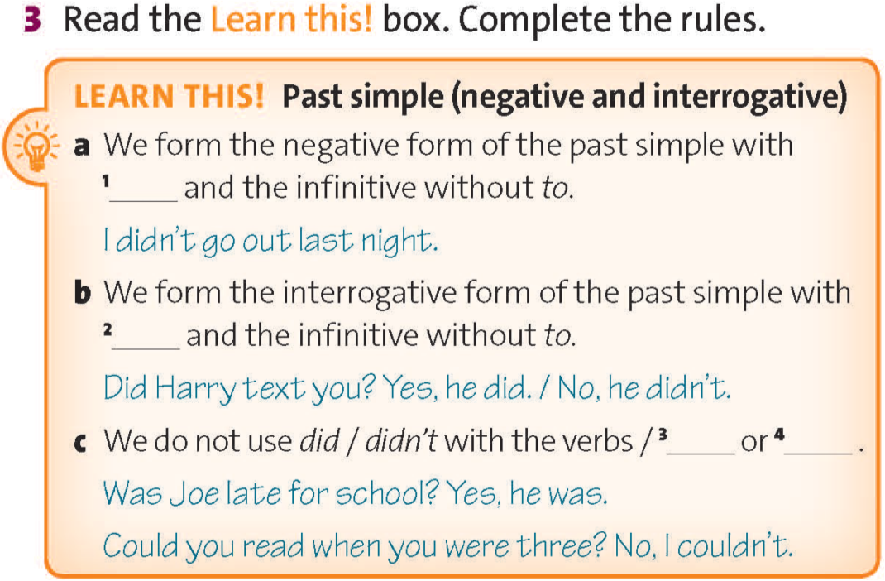
didn’t
did
was/
were
could/
couldn’t
www.phuongnam.edu.vn

Slide 17
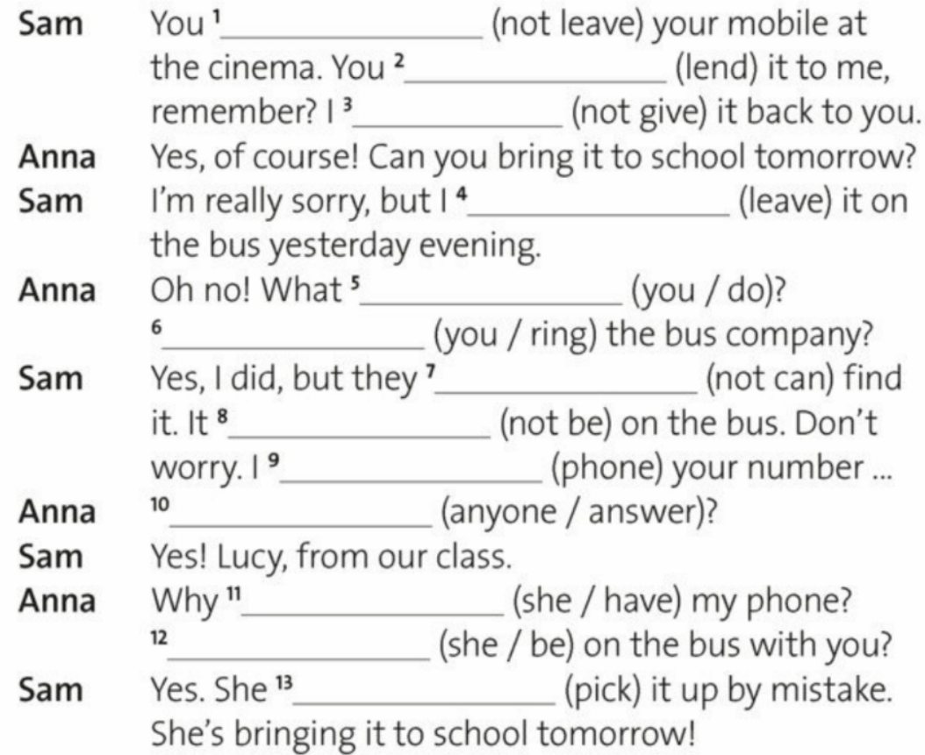
2. Complete the second part of the dialogue. Then listen & check
didn’t leave
lent
didn’t give
left
did you do
Did you ring
couldn’t
wasn’t
phoned
Did anyone answer
did she have
Was she
picked
www.phuongnam.edu.vn

Slide 18
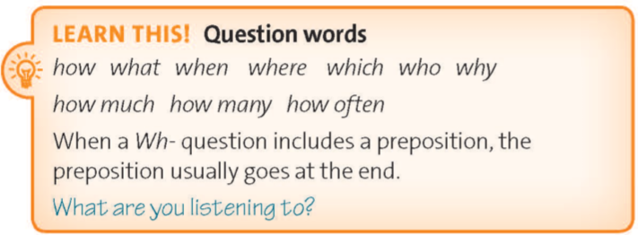
E.g.: Where did you buy that Gundam from?
➔ I bought it from a local hobby store.
How often does he play games?
➔ He usually plays games twice a week.
www.phuongnam.edu.vn

Slide 19
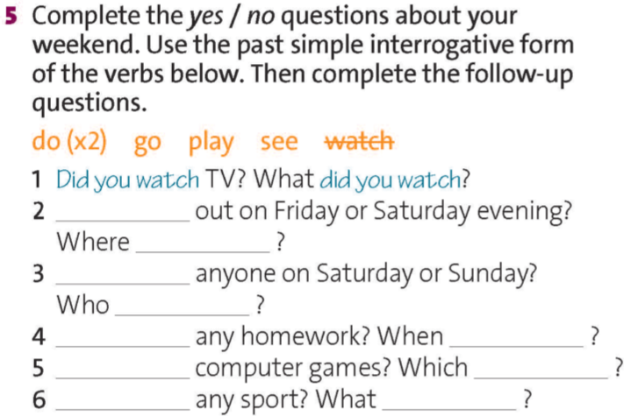
do
do
do
do
go
go
Did you
play
play
did you
see
Did you
see
did you
Did you
did you it
Check all
Did you
games did you
Did you
sport did you
www.phuongnam.edu.vn

Slide 20


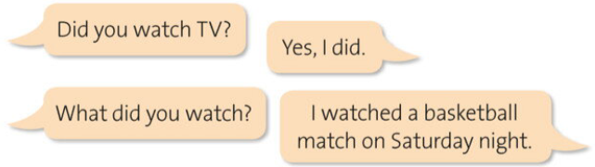
www.phuongnam.edu.vn

Slide 21

Did you go out on Friday or Saturday evening?
Yes, I did.
No, I didn’t.
www.phuongnam.edu.vn

Slide 22
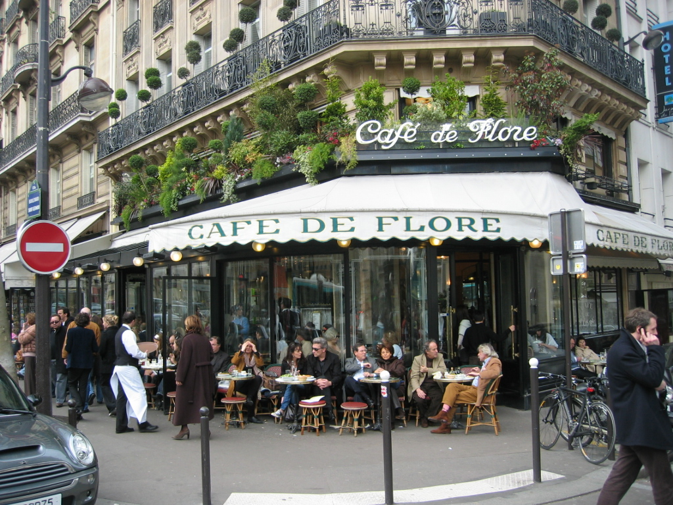
Did you go out on Friday or Saturday evening?
Where did you go?
Yes, I did.
I went to a Café on Friday evening.
www.phuongnam.edu.vn

Slide 23

Did you go out on Friday or Saturday evening?
No, I didn’t.
I stayed at home on Friday evening.
www.phuongnam.edu.vn

Slide 24
Did you see anyone on Saturday or Sunday?
Yes, I did.
No, I didn’t.
www.phuongnam.edu.vn

Slide 25

Did you see anyone on Saturday or Sunday?
Who did you see?
Yes, I did.
I saw my girlfriend / boyfriend on Sunday.
www.phuongnam.edu.vn

Slide 26

Did you see anyone on Saturday or Sunday?
No, I didn’t.
I played Free Fire all day long.
www.phuongnam.edu.vn

Slide 27
Did you do any homework?
Yes, I did.
No, I didn’t.
www.phuongnam.edu.vn

Slide 28

Did you do any homework?
When did you do it?
Yes, I did.
I did my homework in the afternoon.
www.phuongnam.edu.vn

Slide 29

Did you do any homework?
No, I didn’t.
I went shopping instead.
www.phuongnam.edu.vn

Slide 30
Did you play computer games?
Yes, I did.
No, I didn’t.
www.phuongnam.edu.vn

Slide 31

Did you play computer games?
Which games did you play?
Yes, I did.
I played Fortnite, CS:GO, League of Legends, Minecraft, and World of Warcraft.
www.phuongnam.edu.vn

Slide 32
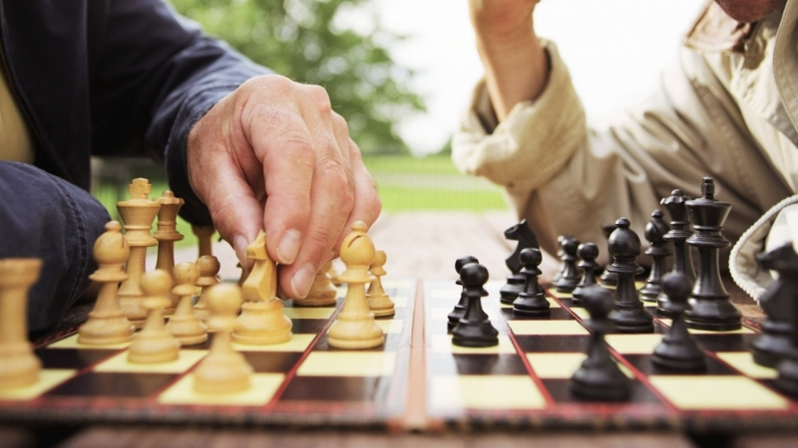
Did you play computer games?
No, I didn’t.
I played chess instead.
www.phuongnam.edu.vn

Slide 33
Did you do any sport?
Yes, I did.
No, I didn’t.
www.phuongnam.edu.vn

Slide 34

Did you do any sport?
What sport did you do?
Yes, I did.
I did badminton / tennis / soccer / basketball / volleyball / baseball.
www.phuongnam.edu.vn

Slide 35

Did you do any sport?
No, I didn’t.
I played games instead.
www.phuongnam.edu.vn

Slide 36
Did you have dinner at home today?
Yes, I did.
No, I didn’t.
www.phuongnam.edu.vn

Slide 37
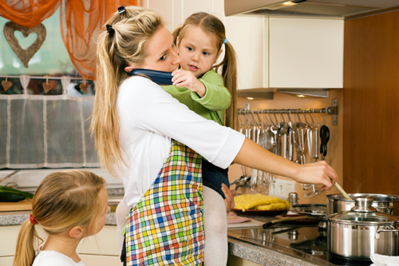
Did you have dinner at home today?
Who cooked dinner for your family?
Yes, I did.
My mother cooked dinner for my family.
www.phuongnam.edu.vn

Slide 38
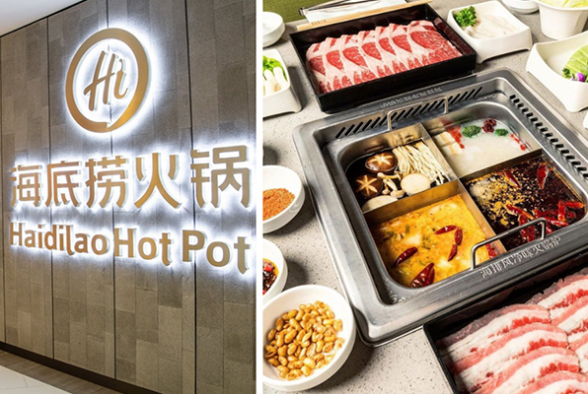
Did you have dinner at home today?
Where did you have your dinner?
No, I didn’t.
I had dinner at Haidilao Hot Pot today.
www.phuongnam.edu.vn

Slide 39

Homework
- Learn by heart all structures.
- Prepare next lesson: word skills – adjective endings.
www.phuongnam.edu.vn

Slide 40

www.phuongnam.edu.vn

Slide 41



Thank you!
CTCP ĐẦU TƯ VÀ PHÁT TRIỂN GIÁO DỤC PHƯƠNG NAM

