Slide 1
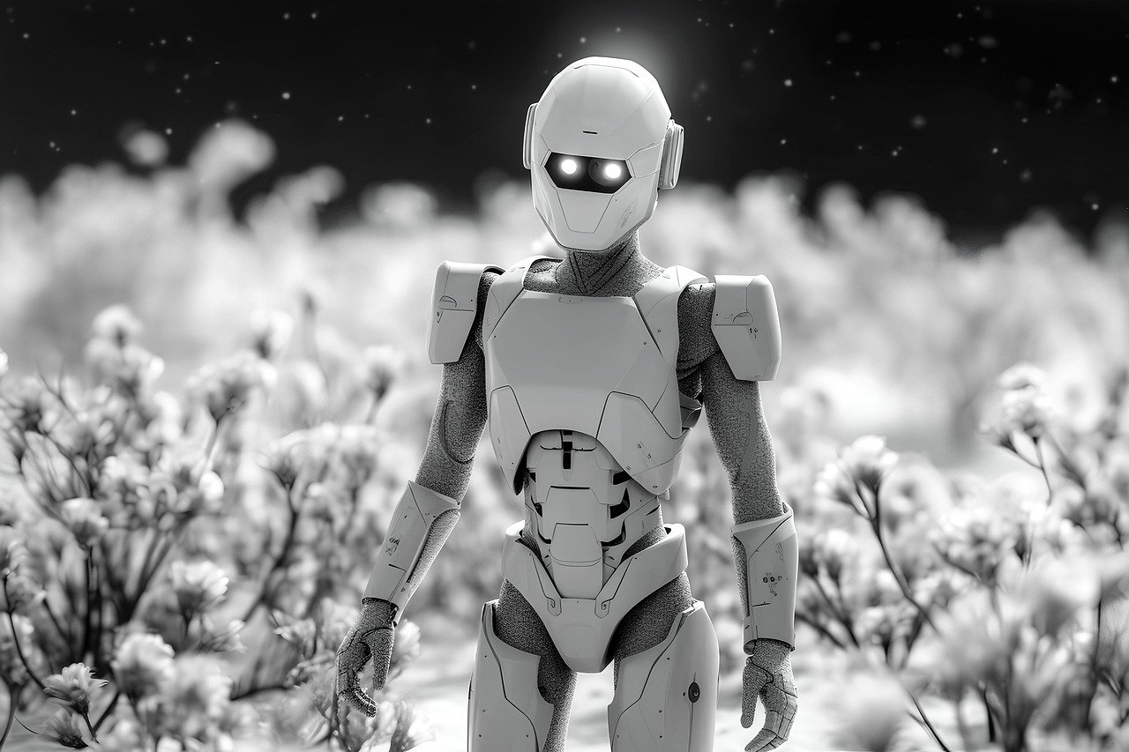


Slide 2


Unit
12
ROBOTS
LESSON 4: COMMUNICATION

Slide 3


LESSON 4: COMMUNICATION
LESSON 1: GETTING STARTED
Spider web
WARM-UP
*Expressing agreement and disagreement
Task 1: Listen and read the dialogues. Pay attention to the highlighted sentences. (p. 63)
Task 2: Work in pairs. Express your opinions about the statements. (p. 63)
EVERYDAY ENGLISH
Task 3: Listen to the radio programme from 4Teen News. Fill the blanks with the words you hear. (p. 63)
Task 4: Interview three friends about what abilities they want their robots to have. (p. 63)
MY ROBOT’S ABILITIES
CONSOLIDATION
Wrap-up
Homework

Slide 4
WARM-UP
SPIDER WEB

Slide 5

WARM-UP
I CAN

Slide 6
LESSON 4: COMMUNICATION
LESSON 1: GETTING STARTED
Spider web
WARM-UP
*Expressing agreement and disagreement
Task 1: Listen and read the dialogues. Pay attention to the highlighted sentences. (p. 63)
Task 2: Work in pairs. Express your opinions about the statements. (p. 63)
EVERYDAY ENGLISH

Slide 7


EVERYDAY ENGLISH
Listen and read the dialogues. Pay attention to the highlighted sentences.
A: I think robots can help us a lot in our daily life.
B: I agree with you.
A: Peter says robots can do everything like humans.
B: I don’t agree with him.

Slide 8
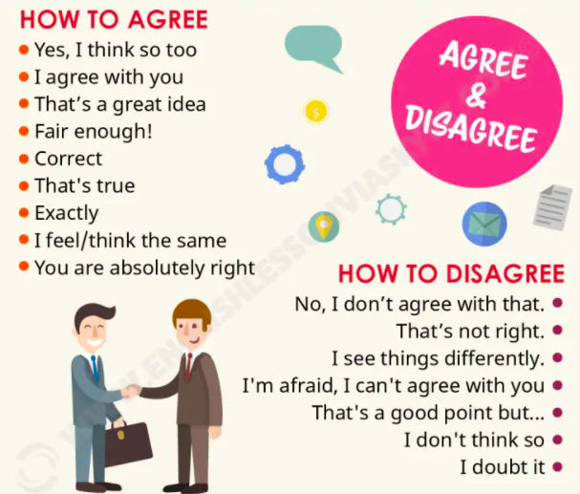
EVERYDAY ENGLISH
Agreement and disagreement expressions

Slide 9

EVERYDAY ENGLISH
Work in pairs. Express your opinions about the following statements. Use the highlighted phrases in the dialogues above.
Home robots are the most useful of all types of robots.
Some people can use robots to do bad things.
Robots will use too much electricity in the future.

Slide 10
LESSON 4: COMMUNICATION
LESSON 1: GETTING STARTED
Spider web
WARM-UP
*Expressing agreement and disagreement
Task 1: Listen and read the dialogues. Pay attention to the highlighted sentences. (p. 63)
Task 2: Work in pairs. Express your opinions about the statements. (p. 63)
EVERYDAY ENGLISH
Task 3: Listen to the radio programme from 4Teen News. Fill the blanks with the words you hear. (p. 63)
Task 4: Interview three friends about what abilities they want their robots to have. (p. 63)
MY ROBOT’S ABILITIES

Slide 11

MY ROBOT’S ABILITIES
Listen to the radio programme from 4Teen News. Fill the blanks with the words you hear.
Speaker: Today we ask our friends: Tom from Australia, Linh from Viet Nam and Nobita from Japan to tell us about their robots. Tom, would you like to start?
Tom: Well, my robot can (1) what I say. It can also understand my feelings. It’s the (2) robot.
understand
smartest

Slide 12

MY ROBOT’S ABILITIES
Listen to the radio programme from 4Teen News. Fill the blanks with the words you hear.
Speaker: Linh?
Linh: My robot is my best friend. It does a lot for me: clean the ﬂoor, (3) my toys away, and ...
Speaker: And Nobita?
Nobita: My robot is very useful. It helps me a lot. It can (4) my plants and even work as a (5)
put
water
guard

Slide 13

MY ROBOT’S ABILITIES
Interview three friends about what abilities they want their robots to have. Note their answers in the table below.
- Move around and asks three classmates what abilities they want their robots to have.
- Remember to write the names of your friends who you interview and note the answers in the table.

Slide 14
MY ROBOT’S ABILITIES
Interview three friends about what abilities they want their robots to have. Note their answers in the table below.
Friends |  | Abilities he / she wants his / her robot to have
1.
2.
3.

Slide 15

REPORT TIME
MY ROBOT’S ABILITIES

Slide 16
LESSON 4: COMMUNICATION
LESSON 1: GETTING STARTED
Spider web
WARM-UP
*Expressing agreement and disagreement
Task 1: Listen and read the dialogues. Pay attention to the highlighted sentences. (p. 63)
Task 2: Work in pairs. Express your opinions about the statements. (p. 63)
EVERYDAY ENGLISH
Task 3: Listen to the radio programme from 4Teen News. Fill the blanks with the words you hear. (p. 63)
Task 4: Interview three friends about what abilities they want their robots to have. (p. 63)
MY ROBOT’S ABILITIES
CONSOLIDATION
Wrap-up
Homework

Slide 17

CONSOLIDATION
1
Wrap-up
What have we learnt in this lesson?
Express agreement and disagreement
Talk about what a robot can do

Slide 18

CONSOLIDATION
2
Homework
- Write a paragraph about 50 words to describe a robot you want to have.
- Prepare for the next lesson (Lesson 5: Skills 1).

Slide 19






Website: hoclieu.vn
Fanpage: facebook.com/www.tienganhglobalsuccess.vn/

