Slide 1


Slide 2





Unit
8
FILMS
LESSON 5: SKILLS 1
Unit
READING
SPEAKING

Slide 3

OBJECTIVES
By the end of the lesson, students will be able to:
develop reading skill about one’s favourite film;
develop speaking skill: Talking about a film.

Slide 4
LESSON 5: SKILLS 1
WARM-UP
Game: Who is faster?
Task 1: Work in pairs. Discuss the following questions.
* Vocabulary
Task 2: Match the words or phrases with their meanings.
Task 3: Read Mark’s blog and answer the questions.
READING
Task 4: Look at the table. Work in pairs. Ask and answer questions about the film Kungfu Boy.
Task 5: Work in groups. Take turns to talk about the film Kungfu Boy.
SPEAKING
POST-READING & SPEAKING
Evaluation
CONSOLIDATION
Wrap-up
Homework

Slide 5


LESSON 5: SKILLS 1
WARM-UP
Game: Who is faster?
Aims of the stage:
To introduce the topic of reading.
To enhance students’ skills of cooperating with team mates.

Slide 6



WARM-UP
Look at the posters, say the correct types of films.
animation
horror film
science fiction film

Slide 7
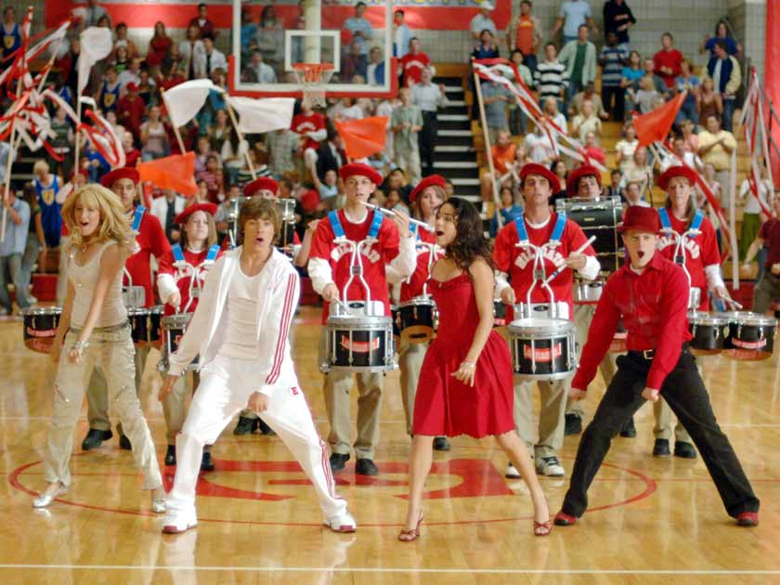

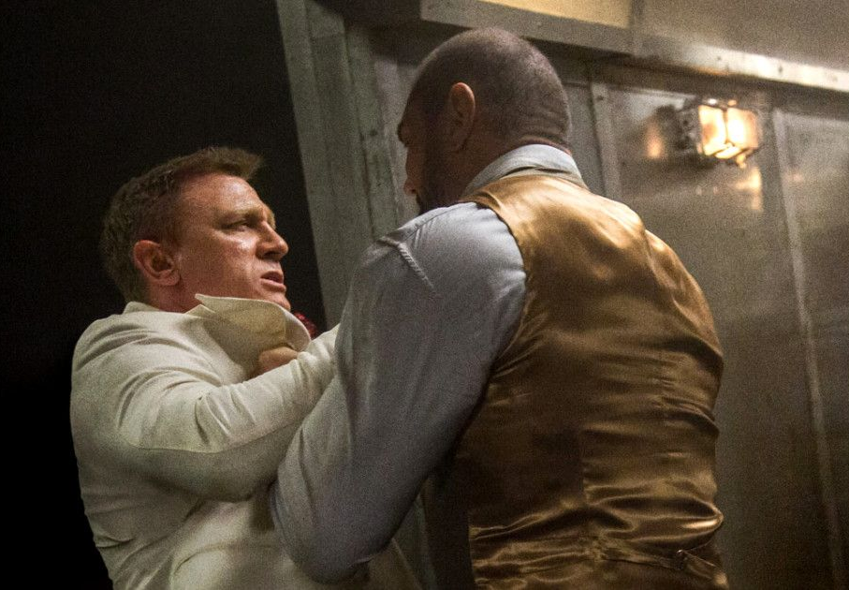
WARM-UP
Look at the posters, say the correct types of films.
action film
musical
fantasy

Slide 8

LESSON 5: SKILLS 1
WARM-UP
Game: Who is faster?
* Pre-Reading:
Vocabulary
Task 1: Work in pairs. Discuss the following questions.
Task 2: Match the words or phrases with their meanings.
READING
Aims of the stage:
To provide students with some lexical items before reading the text.

Slide 9


PRE-READING
1
Work in pairs. Discuss the following questions.
Do you like fantasies?
Why or why not?
fantasy

Slide 10

PRE-READING - VOCABULARY
series (n)
/'siəri:z/
chuỗi, loạt (phim dài tập)

Slide 11

PRE-READING - VOCABULARY
wizard (n)
/'wizəd/
phù thủy, người có tài phi thường

Slide 12

PRE-READING - VOCABULARY
must-see (n)
/ˈmʌstˈsiː/
bộ phim đáng xem, nên xem

Slide 13

PRE-READING - VOCABULARY
gripping (adj)
/'gripiη/
cuốn hút, hấp dẫn

Slide 14
PRE-READING - VOCABULARY
New words | Pronunciation | Meaning
series | /'siəri:z/ | chuỗi, loạt (phim dài tập)
wizard | /'wizəd/ | phù thủy, người có tài phi thường
must-see | /ˈmʌstˈsiː/ | bộ phim đáng xem, nên xem
gripping | /'gripiη/ | cuốn hút, hấp dẫn

Slide 15

PRE-READING - VOCABULARY
2
Match the words or phrases with their meanings.
Words | Meanings
1. series | a. something that is so good that you think others should see it
2. wizard | b. related films that tell stories about the same characters
3. must-see | c. very exciting or interesting
4. gripping | d. a man who has magical powers
1. b
2. d
3. a
4. c

Slide 16
LESSON 5: SKILLS 1
WARM-UP
Game: Who is faster?
* Pre-Reading:
Vocabulary
Task 1: Work in pairs. Discuss the following questions.
Task 2: Match the words or phrases with their meanings.
* While-Reading:
Task 3: Read Mark’s blog again and answer the questions.
READING

Slide 17
WHILE-READING
3
Read Mark’s blog and answer the questions.
Aim of the task:
To develop reading skill for specific information.

Slide 18
WHILE-READING
3
Read Mark’s blog and answer the questions.
1. What kind of film is Harry Potter and
the Sorcerer’s Stone?
Harry Potter and the Sorcerer’s Stone is a fantasy.

Slide 19
WHILE-READING
3
Read Mark’s blog and answer the questions.
2. Who is Daniel Radcliffe?
Daniel Radcliffe is one of the stars in the film.

Slide 20
WHILE-READING
3
Read Mark’s blog and answer the questions.
3. What is the film about?
The film tells the story of Harry Potter. He’s a powerful wizard. He is a student at a school for wizards and learns about himself, his family, and the bad things happening around him.

Slide 21
WHILE-READING
3
Read Mark’s blog and answer the questions.
4. What do people say about the film?
People say it’s a must-see for teens.

Slide 22
LESSON 5: SKILLS 1
LESSON 5: SKILLS 1
WARM-UP
Game: Who is faster?
* Pre-Reading:
Vocabulary
Task 1: Work in pairs. Discuss the following questions.
Task 2: Match the words or phrases with their meanings.
* While-Reading:
Task 3: Read Mark’s blog and answer the questions.
READING
Task 4: Look at the table. Work in pairs. Ask and answer questions about the film Kungfu Boy.
Task 5: Work in groups. Take turns to talk about the film Kungfu Boy.
SPEAKING

Slide 23
SPEAKING
4
Look at the table. Work in pairs. Ask and answer questions about the film Kungfu Boy.
Film’s name | Kungfu Boy
Director | John Stevenson
Type of film | Comedy
Main actor / actress | Bruce Wane
Main content | About a very big boy who saves his town and becomes a hero
Reviews | Funny and interesting
Time | 4.30 p.m and 8.30 p.m daily
Place | Ngoc Khanh Cinema
Example:
A: How about seeing a film this evening?
B: That’s a great idea. What film shall we see?
A: Kungfu Boy.
B: What kind of film is it?
A: __________________

Slide 24
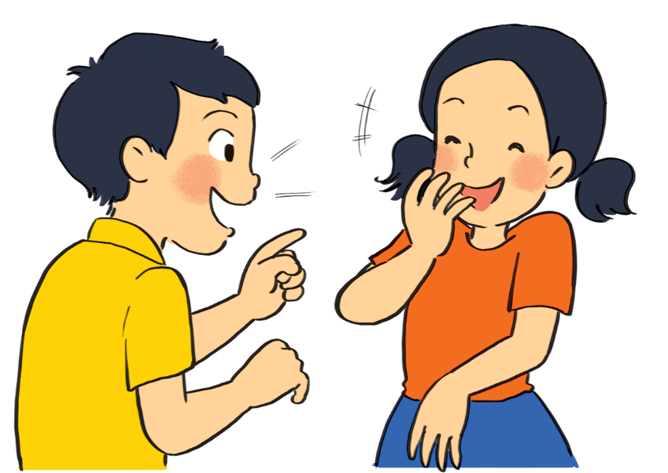
PRODUCTION (Post-Read & Speak)
5
Work in groups. Take turns to talk about the film Kungfu Boy.
Example:
Kungfu Boy is on at … at … p.m.
It’s (an) … about …
Suggestion:
Kungfu Boy is a comedy directed by John Stevenson. Bruce Wane is the main actor in this film. It's about a very big boy who saves his town and becomes a hero. People say that it's a must-see because it's very funny and interesting. It's at 4.30 p.m. and 8.30 p.m. daily at Ngoc Khanh Cinema. Let's go to see it!

Slide 25
LESSON 5: SKILLS 1
WARM-UP
Game: Who is faster?
* Pre-Reading:
Vocabulary
Task 1: Work in pairs. Discuss the following questions.
Task 2: Match the words or phrases with their meanings.
* While-Reading:
Task 3: Read Mark’s blog and answer the questions.
READING
Task 4: Look at the table. Work in pairs. Ask and answer questions about the film Kungfu Boy.
Task 5: Work in groups. Take turns to talk about the film Kungfu Boy.
SPEAKING
PRODUCTION
(Post-Read & Speak)
Evaluation
CONSOLIDATION
Wrap-up
Homework

Slide 26
CONSOLIDATION
1
Wrap-up
Unit
READING
SPEAKING

Slide 27

CONSOLIDATION
2
Homework
Prepare for the lesson: Looking back & Project
Choose one of your favourite films:
– name of the film
– type of film
– its director and main actors / actresses
– a short summary
– your overall opinion about the film
– the showtime and cinema
– pictures or photos to illustrate the film

Slide 28

Website: hoclieu.vn
Fanpage: facebook.com/www.tienganhglobalsuccess.vn/

