Slide 2
At the shopping center
Lesson 3 – Period 6

Slide 3
Table of contents
01
Warm up
02
Review
03
04
Read and complete
Let’s write
05
Project

Slide 4
01
Warm up

Slide 5
Let’s chant!

Slide 6
Table of contents
01
Warm up
02
Review
03
04
Read and complete
Let’s write
05
Project

Slide 7
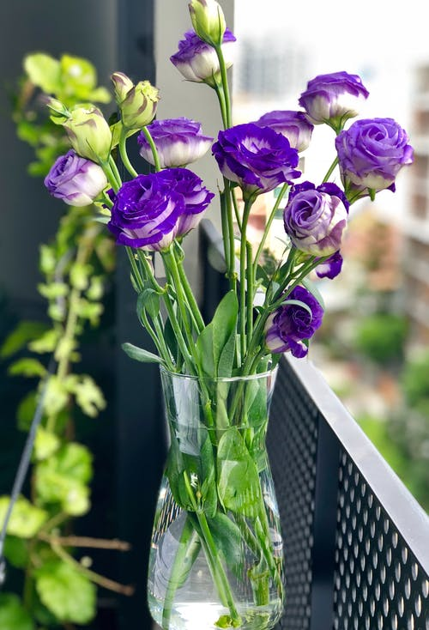
02
Review
Fun time

Slide 8
1
3
2
4
5
6
7
10
8
9
Notes:
Choose numbers to answer the questions
Click the watermelon to move to the next part.

Slide 9
= 1 point
= 10 points
= - 5 points

Slide 10
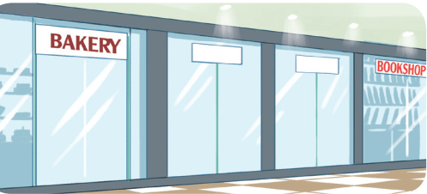
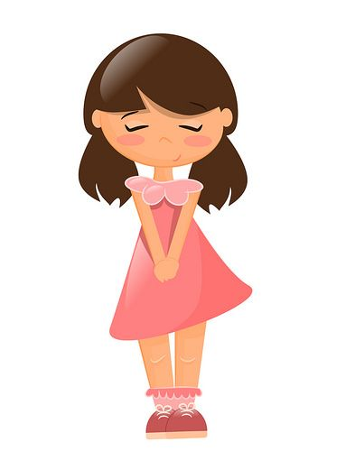
Where is the bookshop?
It’s near the bakery.
Notes:
Click the picture to come back

Slide 11
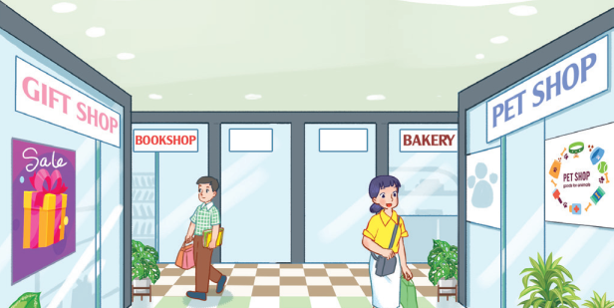
Where is the gift shop?
It’s opposite the pet shop.
Notes:
Click the picture to come back

Slide 12
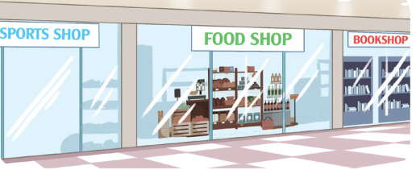
Where is the food shop?
It’s between the sports shop and the bookshop.
Notes:
Click the picture to come back

Slide 13
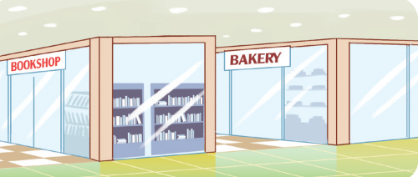
Where is the bakery?
It’s behind the bookshop.
Notes:
Click the picture to come back

Slide 14
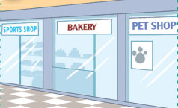
Where is the bakery?
It’s between the sports shop and the pet shop.
Notes:
Click the picture to come back

Slide 15
+ 10 points
Notes:
Click the star to come back

Slide 16
How much is the skirt?
70.000 đ
It’s seventy thousand dong.
Notes:
Click the picture to come back

Slide 17
How much is the hat?
30.000 đ
It’s thirty thousand dong.
Notes:
Click the picture to come back

Slide 18
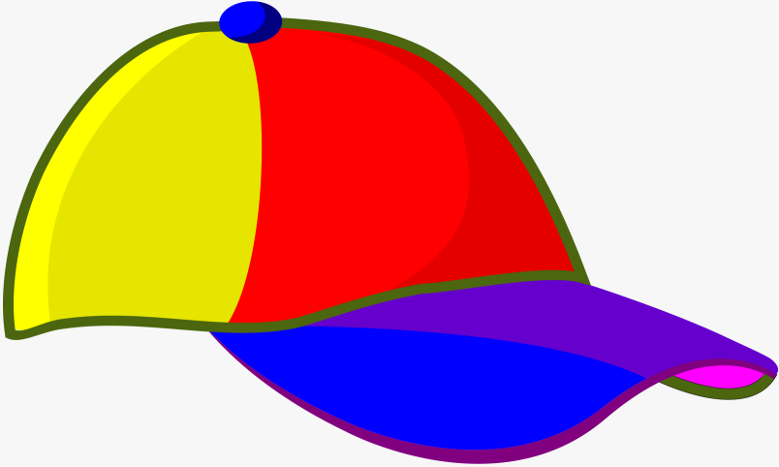
How much is the cap?
20.000 đ
It’s twenty thousand dong.
Notes:
Click the picture to come back

Slide 19
How much is the school bag?
90.000 đ
It’s ninety thousand dong.
Notes:
Click the picture to come back

Slide 20
03
Read and complete
Pupil’s book page 57

Slide 21
book
behind the pet shop
50,000
ice cream

Slide 22
Table of contents
01
Warm up
02
Review
03
04
Read and complete
Let’s write
05
Project

Slide 23
04
Let’s write

Slide 25
Table of contents
01
Warm up
02
Review
03
04
Read and complete
Let’s write
05
Project

Slide 26
05
Project

Slide 27
Where?
Where?
Shop 2
What?
What?
Shop 1
At the shopping centre
How
much?
How
much?
Notes:
Option 1: Group work: Talk about 2 shops at the shopping centre.

Slide 28
Shopping list
What? | How much?
1.
2.
3.
Notes:
Option 2: Pair work: Make the shopping list.

Slide 30
Table of contents
01
Warm up
02
Review
03
04
Read and complete
Let’s write
05
Project

Slide 31
Presentation

Slide 32
THANK YOU

