Slide 1


Slide 2
Unit
2
The generation gap
Unit
FAMILY LIFE
LESSON 5
LISTENING
Family conflicts

Slide 3
LESSON 5
LISTENING
WARM-UP
Watch a video
PRE-LISTENING
Vocabulary
Task 1. Complete the table about you.
Task 2. Listen and number.
Task 3. Listen and answer the questions using no more than TWO words.
WHILE-LISTENING
POST-LISTENING
Task 4. Work in groups. Discuss the questions.
Wrap-up
Homework
CONSOLIDATION

Slide 4

Watch a video
Notes:
https://www.youtube.com/watch?v=f1oyseKG9Y8

Slide 5
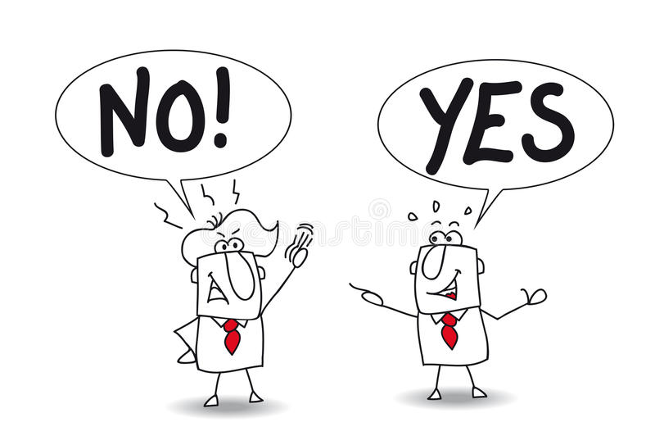

PRE-LISTENING
disagreement (n)
/ˌdɪsəˈɡriːmənt/
a situation where people have different opinions about something and often argue

Slide 6

PRE-LISTENING
upset (v)
/ˌʌpˈset/
to make somebody/yourself feel unhappy, anxious or annoyed

Slide 7
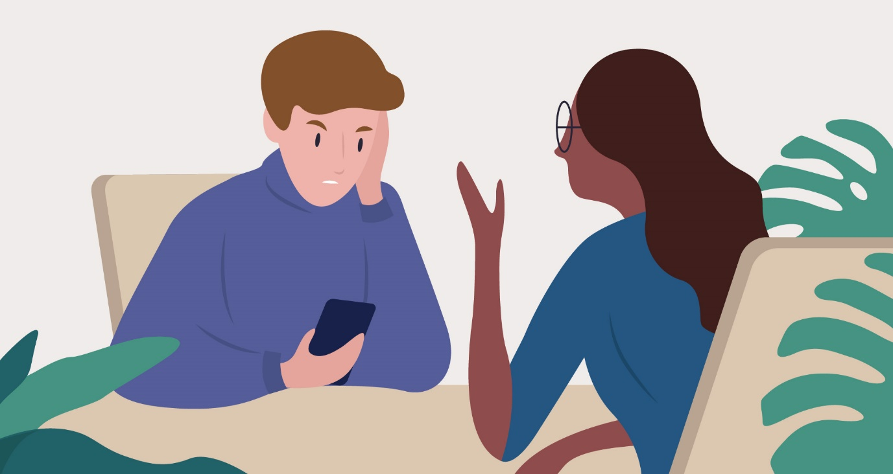
PRE-LISTENING
complain (about) (v)
/kəmˈpleɪn/
to say that you are annoyed, unhappy or not satisfied about somebody/something

Slide 8
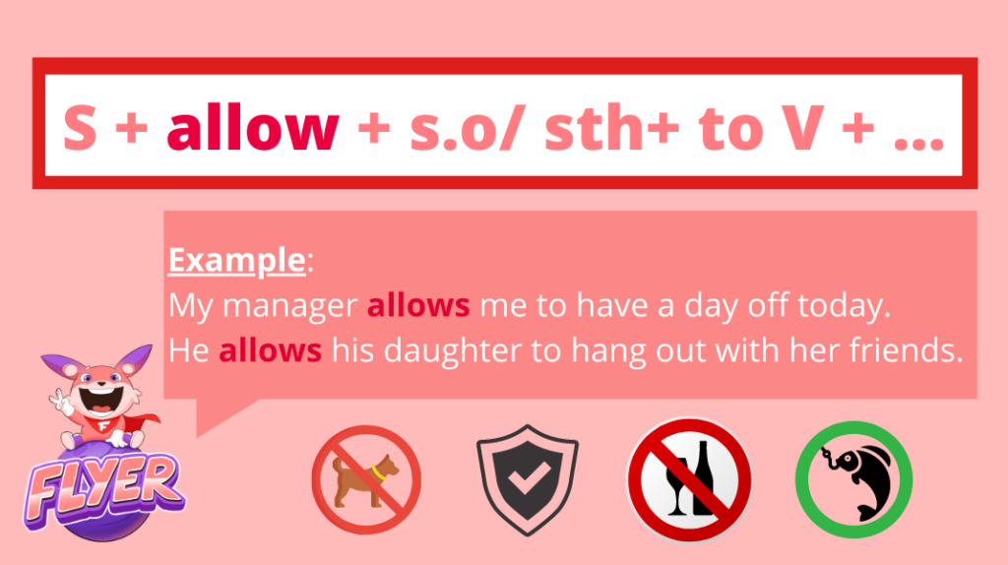
PRE-LISTENING
allow (sb to do st) (v)
/əˈlaʊ/
to let somebody/something do something; to let something happen or be done

Slide 9
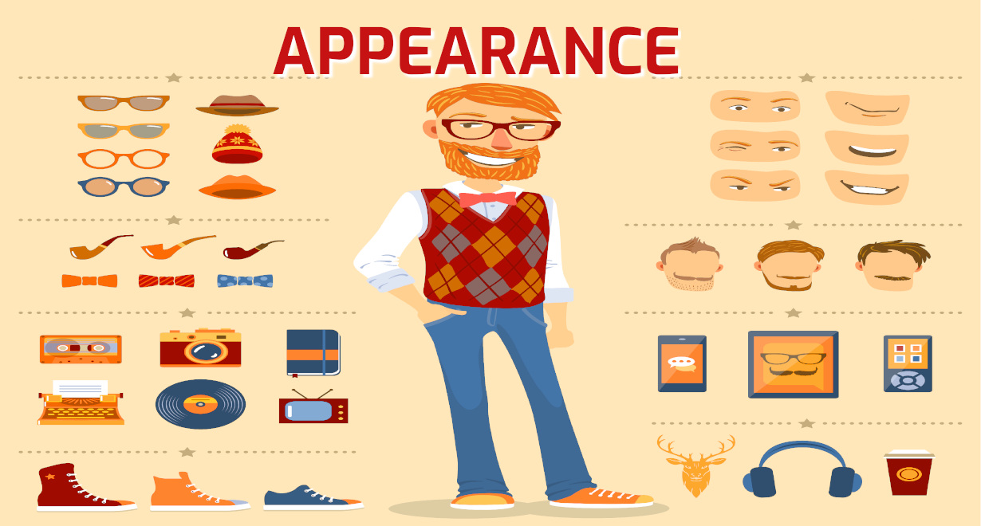
PRE-LISTENING
appearance (n)
/əˈpɪərəns/
the way that somebody/something looks on the outside; what somebody/something seems to be

Slide 10
PRE-LISTENING
Form | Pronunciation | Meaning | Vietnamese equivalent
1. disagreement (n) | /ˌdɪsəˈɡriːmənt/ | a situation where people have different opinions about something and often argue | sự bất đồng
2. upset (n) | /ˌʌpˈset/ | to make somebody/yourself feel unhappy, anxious or annoyed | gây khó chịu
3. complain (about) (v) | /kəmˈpleɪn/ | to say that you are annoyed, unhappy or not satisfied about somebody/ something | phàn nàn (về)
4. allow (sb to do st) (v) | /əˈlaʊ/ | to let somebody/something do something; to let something happen or be done | cho phép (ai làm gì)
5. appearance (n) | /əˈpɪərəns/ | ​the way that somebody/something looks on the outside; what somebody/something seems to be | ngoại hình

Slide 11
PRE-LISTENING
1
Complete the following table about you. Work in pairs and compare your answers.
 | Always | Sometimes | Never
1. My parents complain about my clothes and hairstyle.
2. My parents let me colour my hair.
3. My parents limit the time I spend on electronic devices.
4. My parents take away my electronic devices after 9 p.m.
5. My parents control everything I do.

Slide 12
WHILE-LISTENING
2
Listen and number the things they talk about in the order they are mentioned.
a. Kevin’s parents limit his screen time.
b. Mai asks Kevin if he has any disagreements with his parents.
c. Mai is not allowed to colour her hair.
d. Mai’s choice in clothes and hairstyle upsets her mother.
4
3
2
1

Slide 13
WHILE-LISTENING
3
Listen again and answer the following questions using no more than TWO words.
1. What does Mai’s mother keep complaining about?
2. Where doesn’t Mai’s mother allow her to wear tight jeans?
3. What does Kevin mainly use his smartphone and laptop for?
4. According to Mai, what might Kevin’s parents worry about?
5. What time do Kevin’s parents take away his smartphone and laptop?
Mai’s appearance.
At school.
(His) homework.
Kevin’s eyesight/ his eyesight.
10 p.m.

Slide 14

POST-LISTENING
4
Work in groups. Discuss the following questions.
Do you agree with Mai’s mother and Kevin’s parents?
Why/Why not?

Slide 15
CONSOLIDATION
1
Wrap-up
What have you learnt today?
Reasons for family conflicts
Listening for main ideas and specific information related to family conflicts

Slide 16
CONSOLIDATION
2
Homework
Do exercises in the workbook.
Prepare for Lesson 6 - Unit 2.

Slide 17

Website: hoclieu.vn
Fanpage: facebook.com/www.tienganhglobalsuccess.vn

