Slide 1

Unit 1: My World
Lesson 1b: Grammar
(Cont.)
Page 17

Slide 2
Lesson Outline
Warm-up
Grammar
Consolidation
Wrap-up

Slide 3
Objectives
By the end of this lesson, students will be able to…
- revise and practise Present Simple.
- revise and practise Adverbs of Frequency, Prepositions of time.

Slide 4

WARM-UP

Slide 5
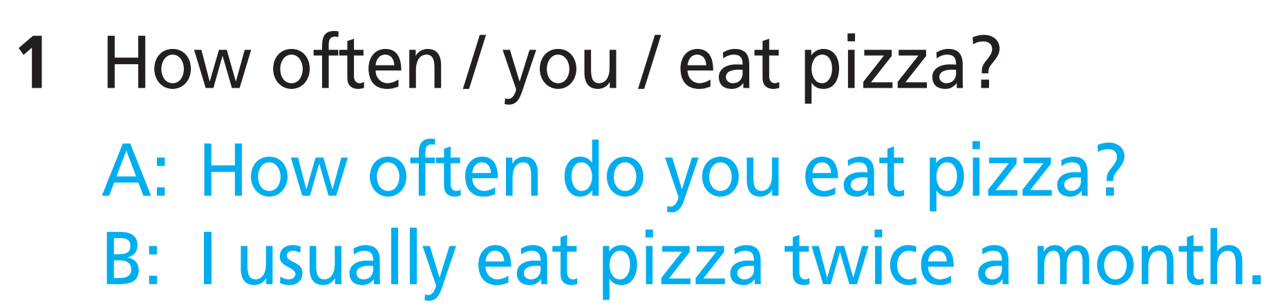
Now, work in pairs. Ask and answer these questions.
2 How often / your mum / surf the Net?
3 How often / you / go to bed late?
4 How often / you / read books?
5 How often / your dad / go shopping?
=> How often does your mum surf the Net?
=> How often do you go to bed late?
=> How often do you read books?
=> How often does your dad go shopping?

Slide 6
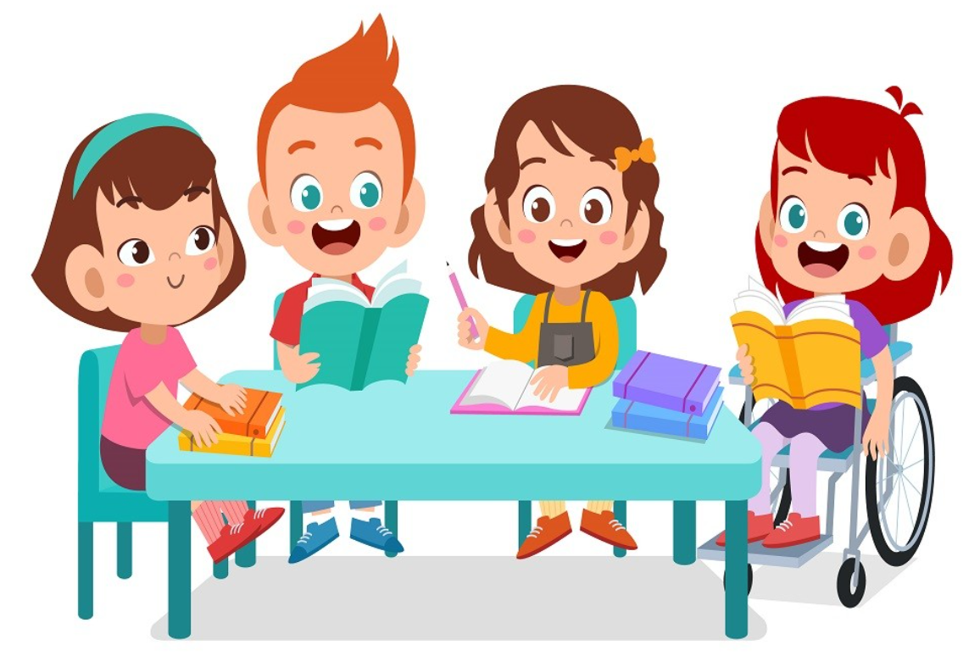
It’s time to learn …

Slide 7
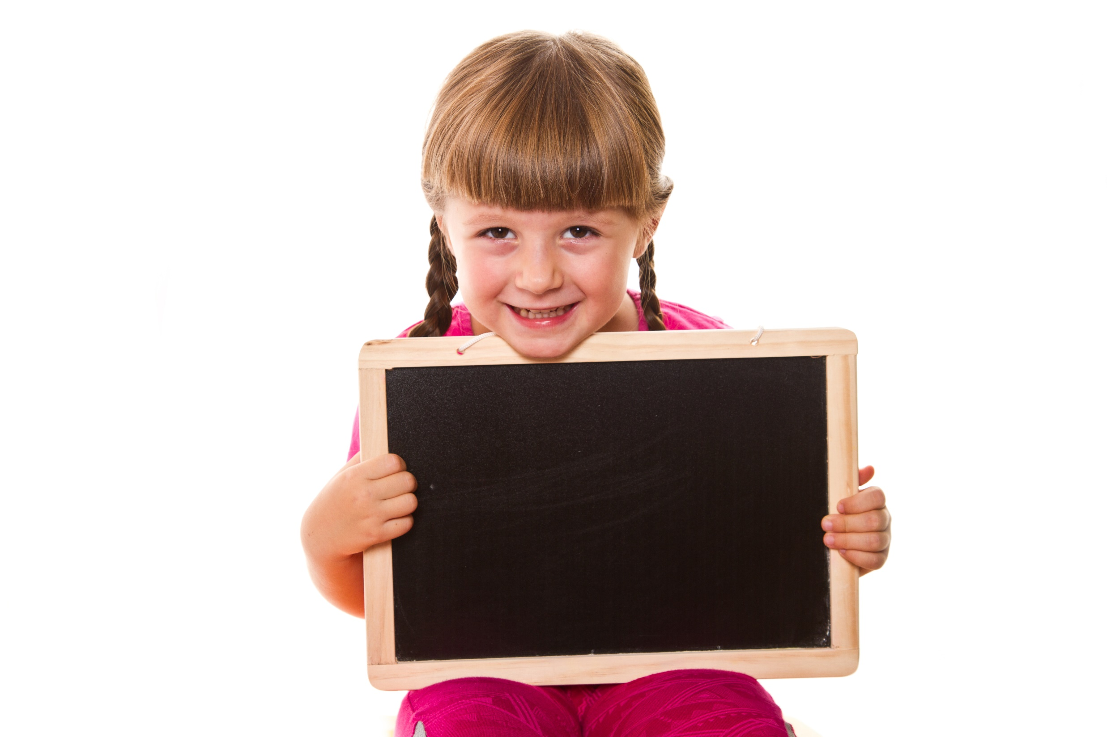
Presentation

Slide 8

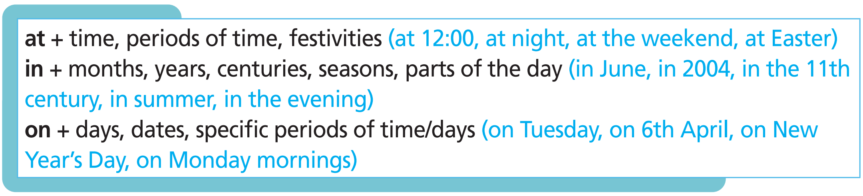

Slide 9

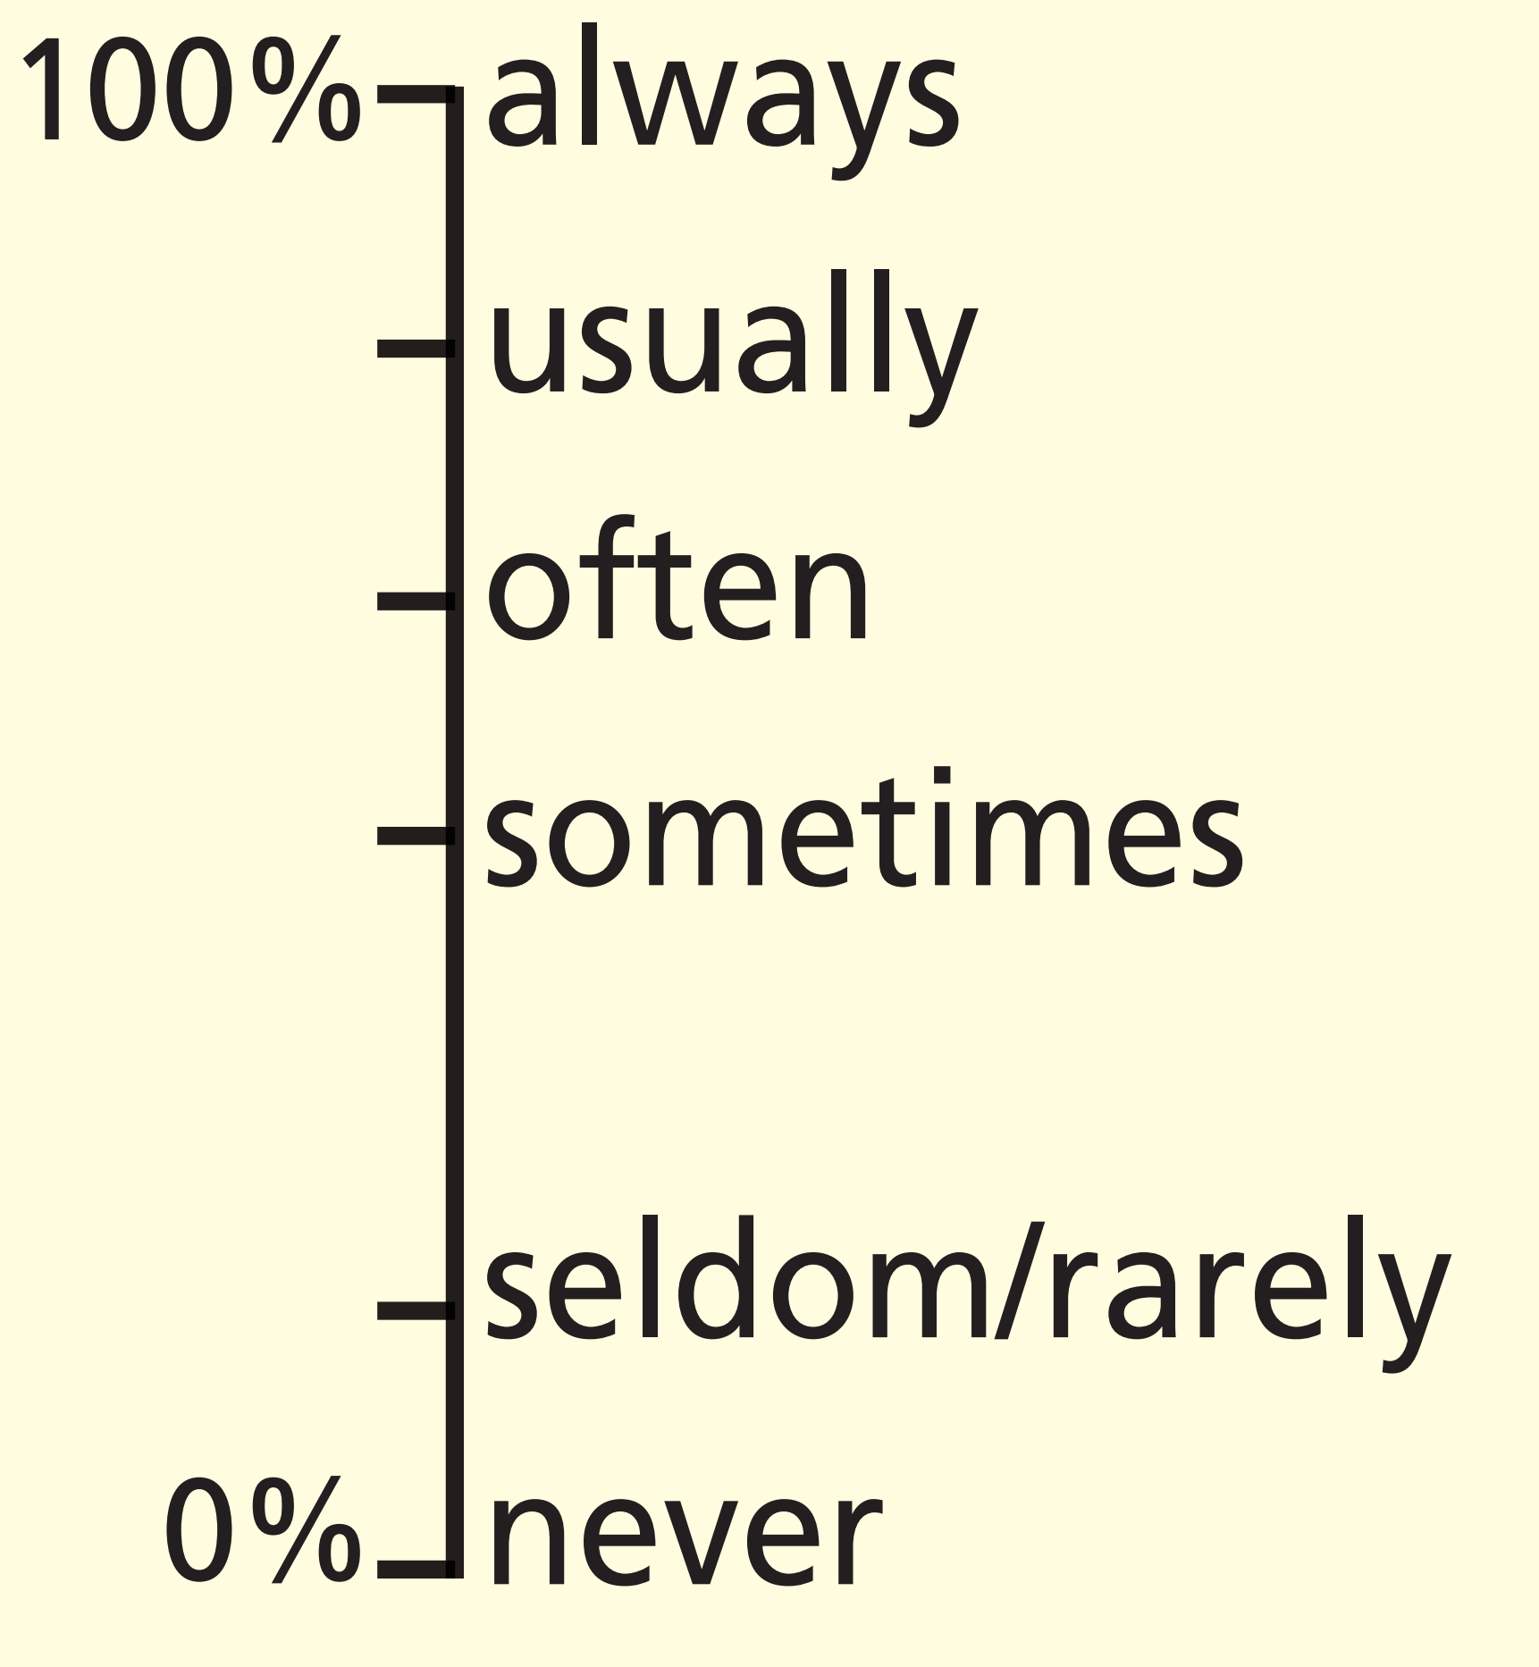
Adverbs of frequency
Adverbs of frequency tell us how often something happens.
They go before the main verb but after the verb to be

Slide 10
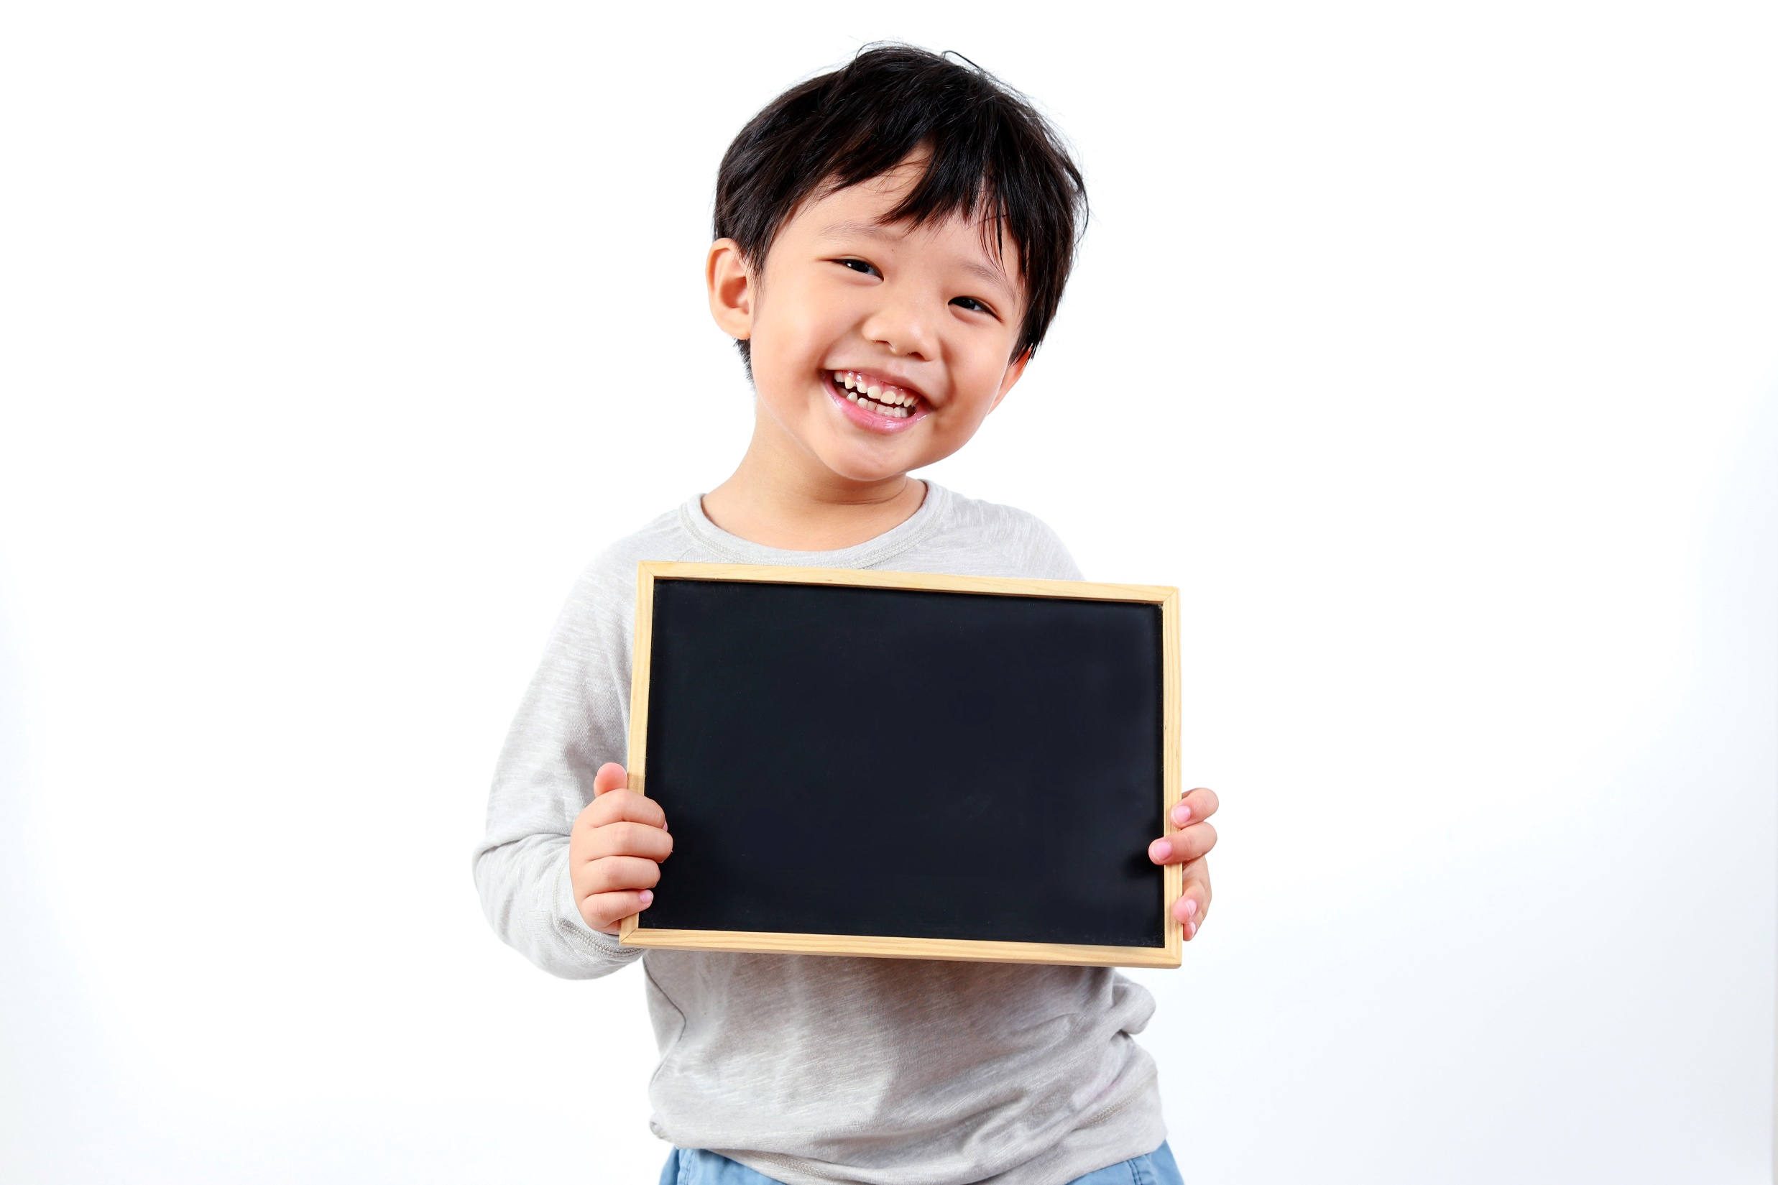
Practice

Slide 11
1 John loves (love) swimming at the beach in summer.
2 I __________________ (not/get up) ________ 7 o’clock ________ the weekend.
3 Her birthday __________ (be) ________ 2nd August.
4 Mark __________________ (not/eat) lunch at school ________ noon.
5 __________________ (you/play) football ________ Mondays?
don’t get up
at
at
is
on
doesn’t eat
at
Do you play
on

Slide 12
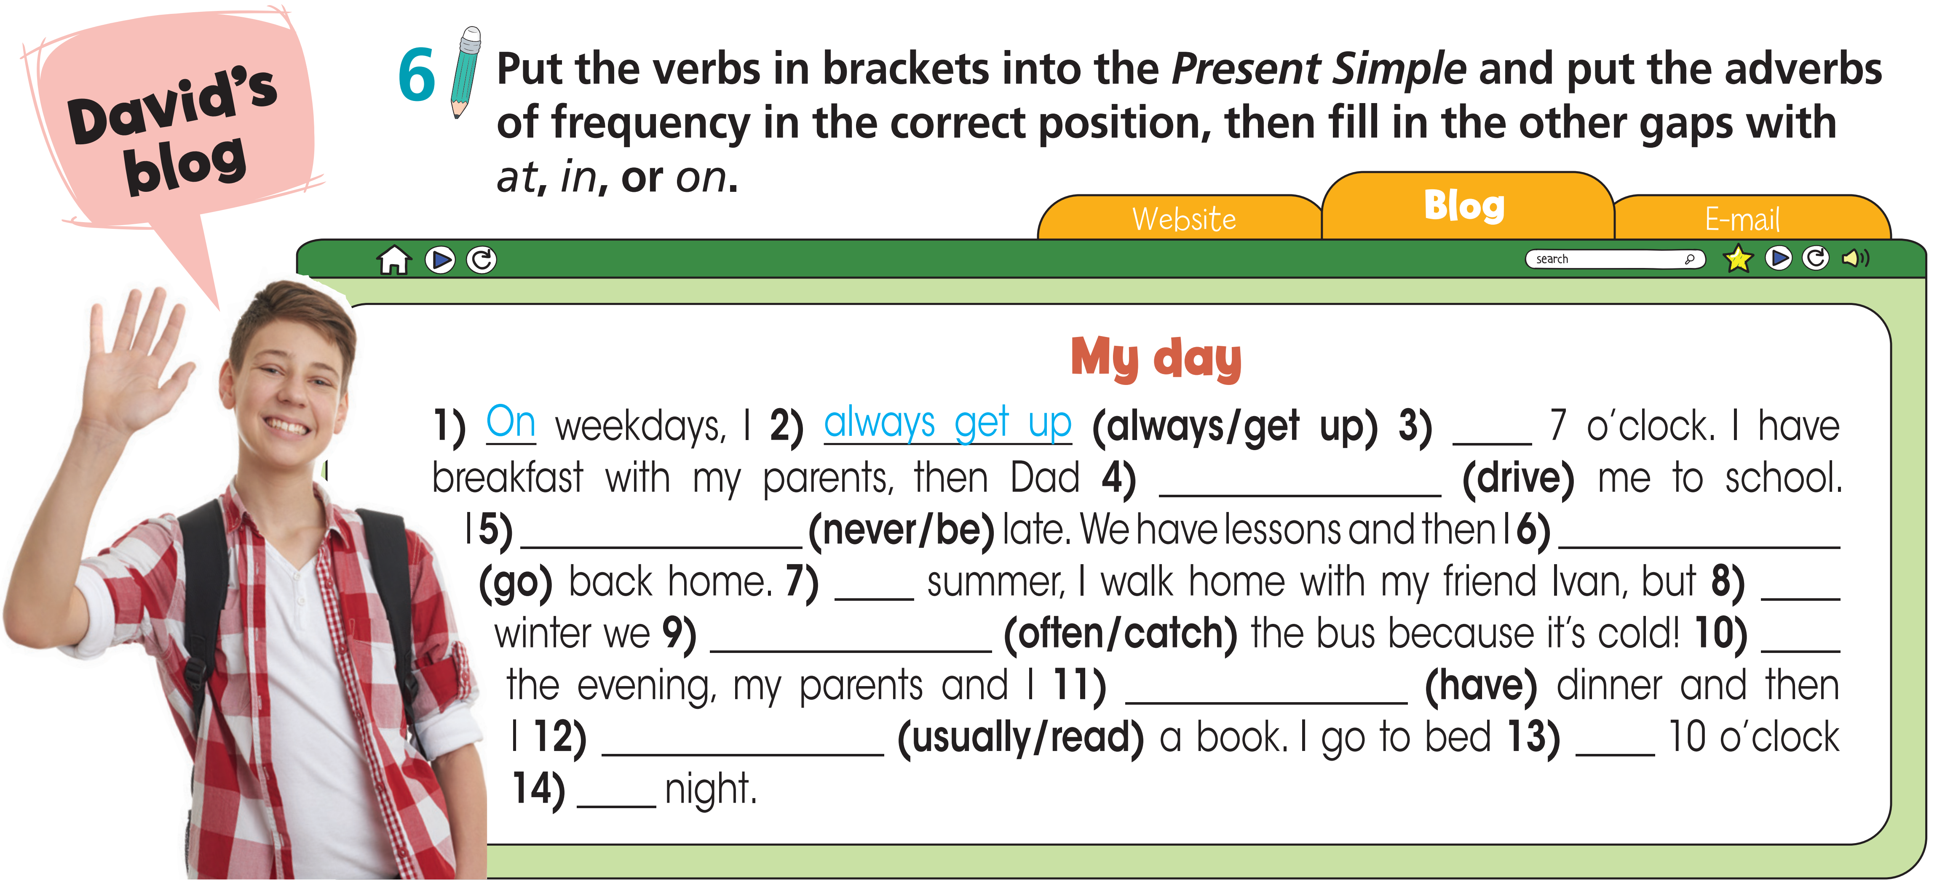
at
drives
am never
go
in
in
often catch
in
have
usually read
at
at

Slide 13
Extra Practice
WB, Page 11
Put the adverbs of frequency in the correct place (a or b).
Note! Adverbs of frequency + ordinary verbs / To be + Adverbs of frequency
usually
1 I a) ___________ do b) ___________ my homework in the evening.
2 We a) __________ meet b) __________our friends at the weekend.
3 Erica a) ___________ is b) ___________ late for her English class.
4 They a) ___________ go b) ___________to the cinema on Saturdays.
5 Jane a) ___________ is b) ___________ in bed at 10 o’clock.
6 He a) ___________ is b) ___________online after 9 o’clock.
often
never
sometimes
always
seldom

Slide 14
Extra Practice
WB, Page 11
Fill in each gap with in, at or on.
1 We usually go to the sea ____ August.
2 I go to bed ____ 10 o’clock.
3 Jamie has guitar lessons ____ Friday afternoons.
4 Is your sister’s birthday ____ 12th April?
5 He often plays sports ____ the weekend.
6 We play computer games ____ the evening.
7 We’ve got an English lesson ____ Tuesday morning.
8 My dad usually goes to bed ____ midnight
in
at
on
on
at
in
on
at

Slide 15
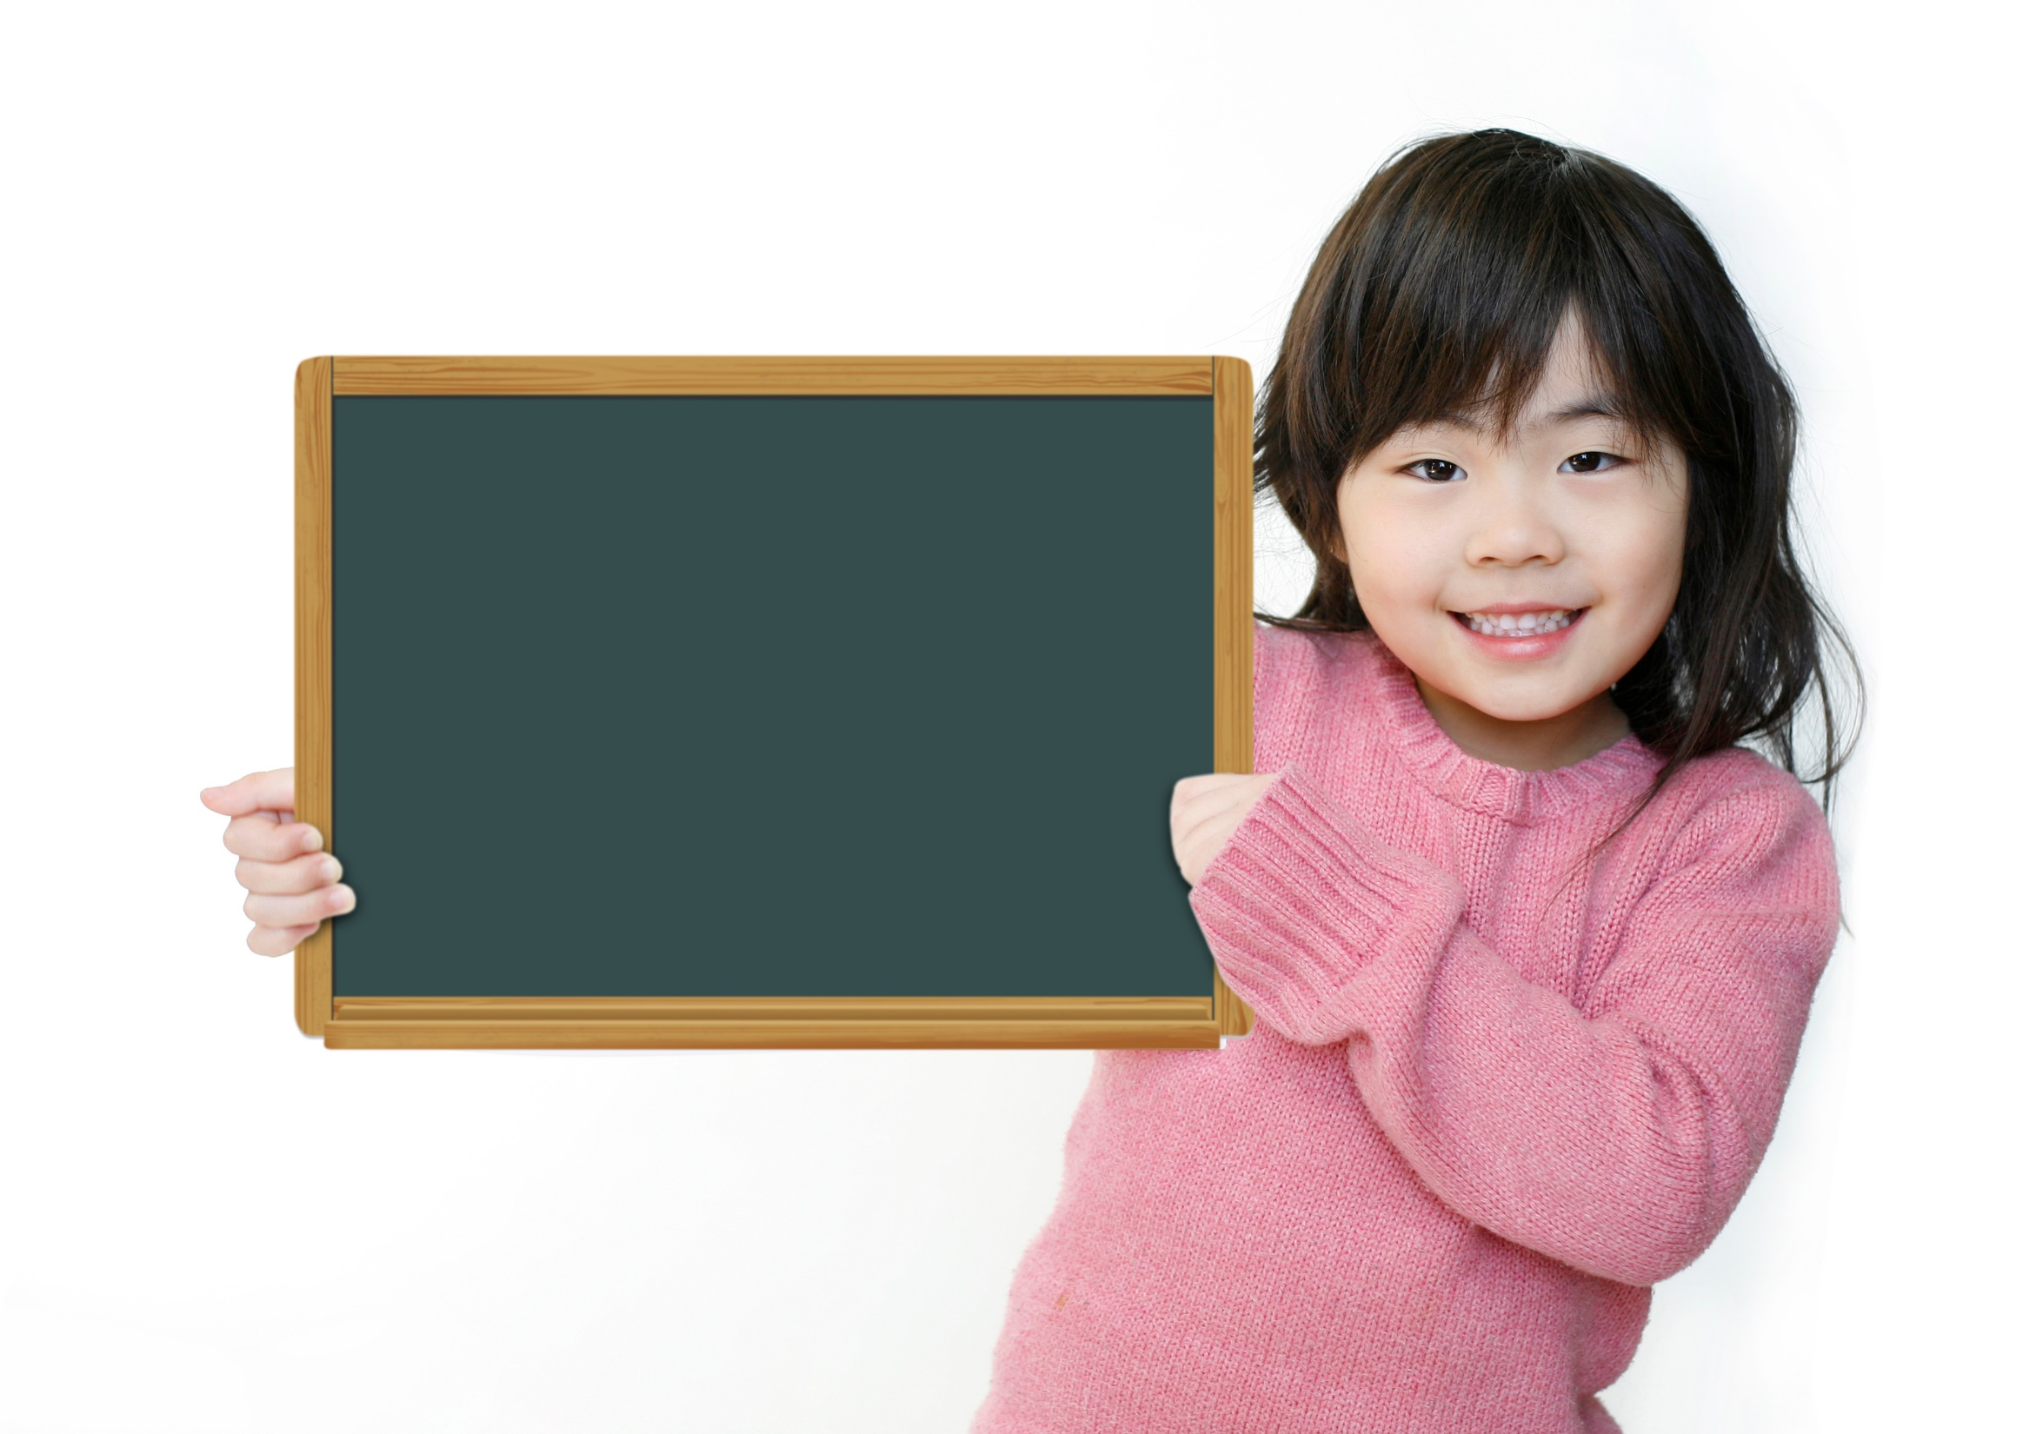
Production

Slide 16
1 what time / you / go to school?
A: What time do you go to school?
B: At 7:00 in the morning.
2 your dad / cook dinner / every evening?
3 how often / you / play / computer games?
4 your parents / exercise?
5 when / your best friend / watch TV?
Now, work in pairs. Ask and answer these questions.
=> Does your dad cook dinner every evening?
=> How often do you play computer games?
=> Do your parents exercise?
=> When does your best friend watch TV?

Slide 17

CONSOLIDATION

Slide 18
Write a paragraph (60-80 words) about what you usually do in a week. Use the Present Simple tense, Adverbs of Frequency, and Prepositions of time.

Slide 19

WRAP-UP

Slide 20
Today’s lesson
Vocabularies
Verbs to describe daily activities/routine
Grammar
Present Simple
Adverbs of Frequency
Prepositions of time

Slide 21
Homework
Practise the vocabularies and grammar and make sentences using them.
Do the exercises in TA 7 Right on WB (page 11)
Prepare the next lesson (page 18 SB)

Slide 22
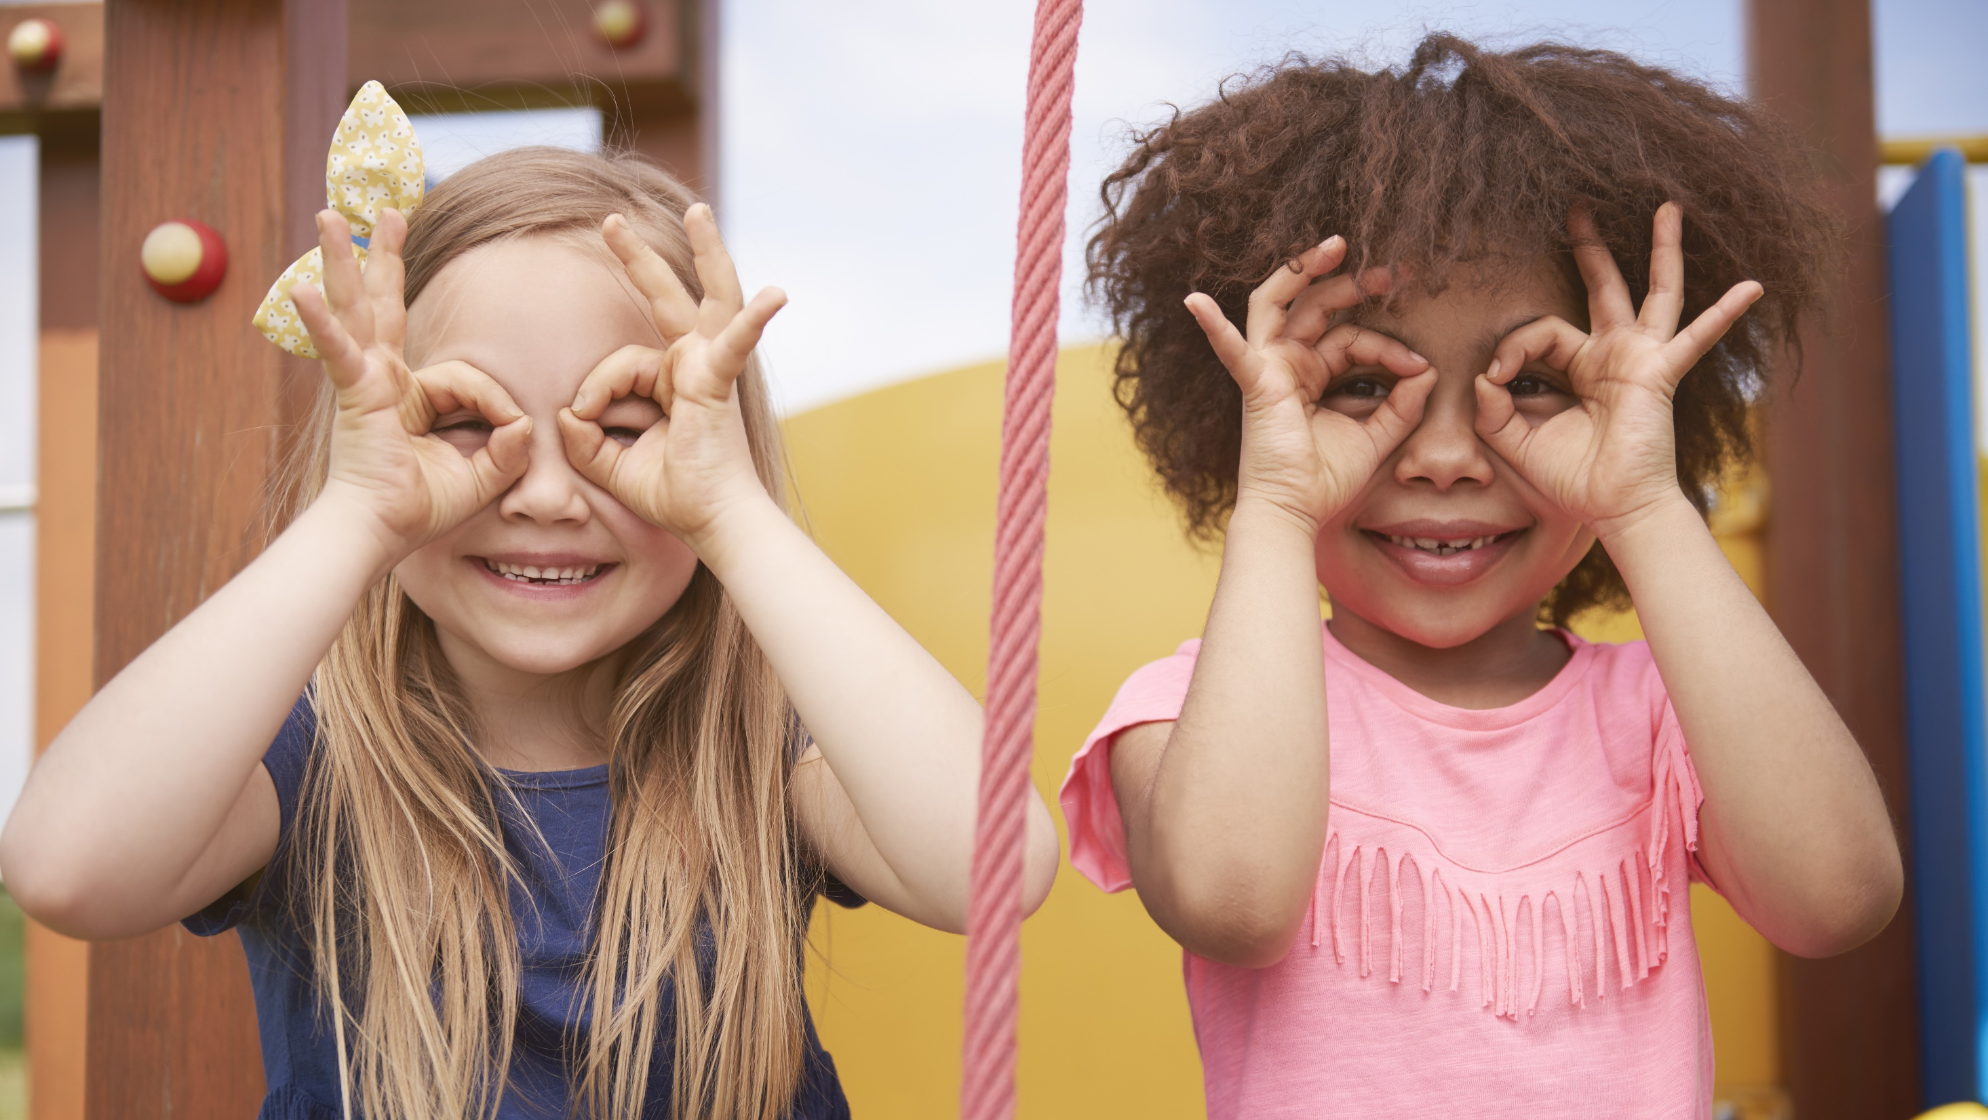
Enjoy your day!

