Slide 1
Unit 7
Traffic

Slide 2
Table of contents
01
02
03
Theory
Language
Communication Skills

Slide 3
PART 1 THEORY
I. VOCABULARY

Slide 4
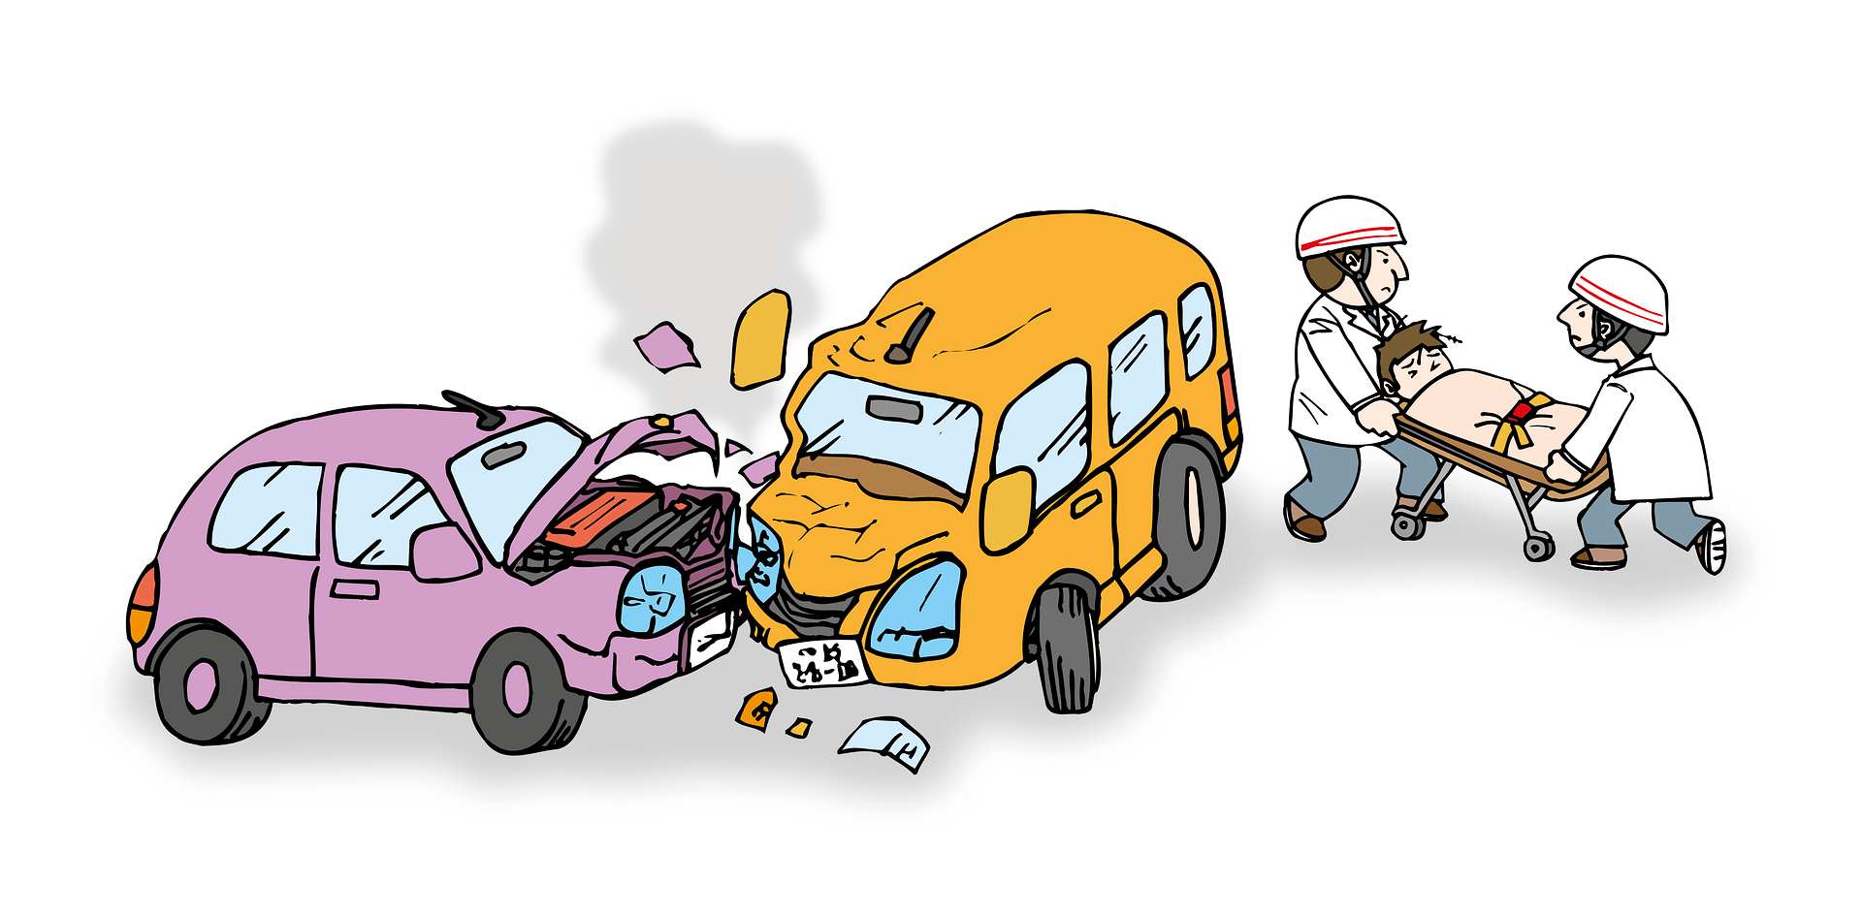
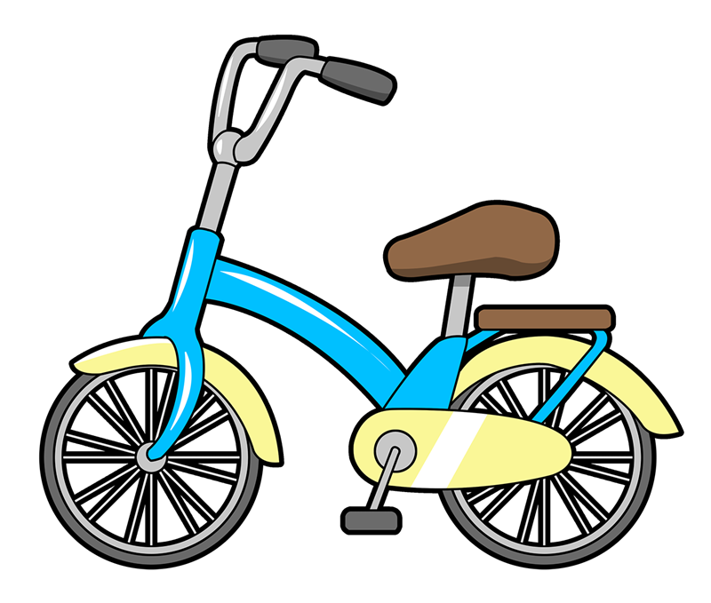


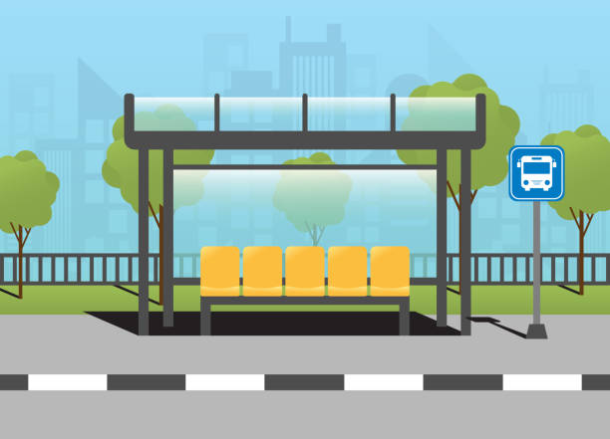
1. accident (n):
/'æksɪdənt/
tai nạn
2. bike (n):
/baɪk/
xe đạp
/bʌs/
xe buýt
3. bus (n):
4. bus stop (n):
/bʌs stɒp/
điểm dừng xe buýt

Slide 5
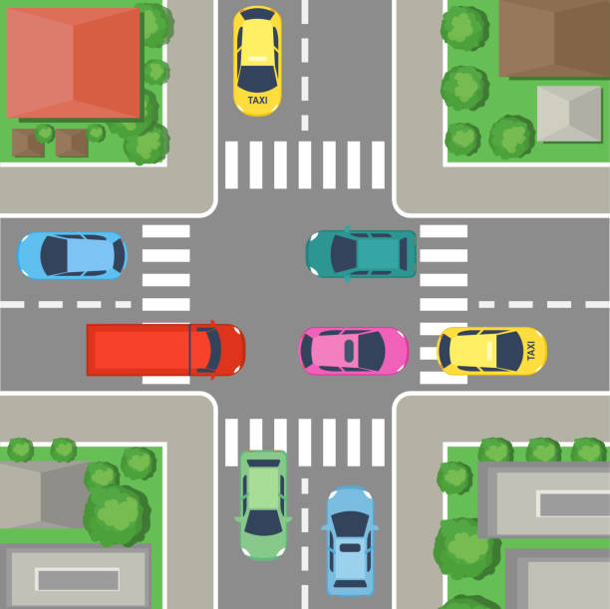
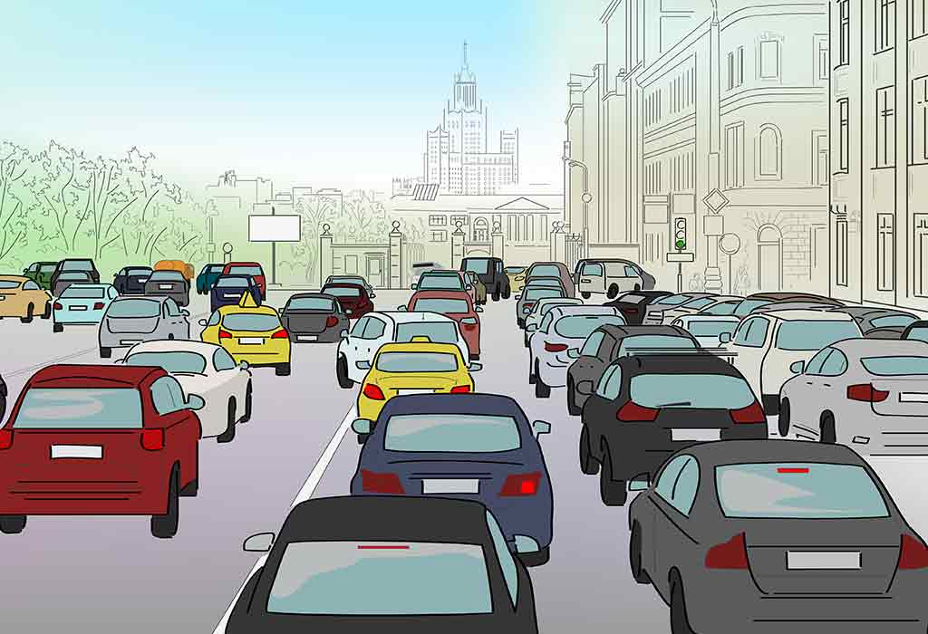
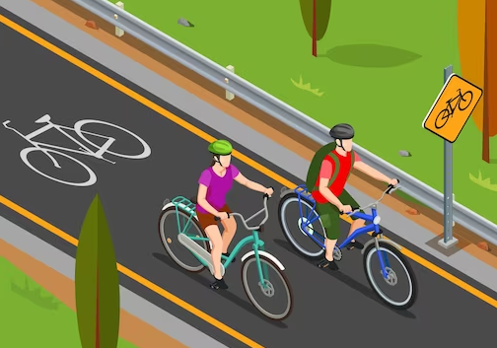
5. car (n):
/kɑː(r)/
xe ô tô
/'krɒs,rəʊd/
giao lộ
6. crossroad (n):
7. crowded (adj):
/'kraʊdəd/
đông đúc
8. cycle lane (n):
/'saɪkl leɪn/
làn đường dành cho xe đạp

Slide 6
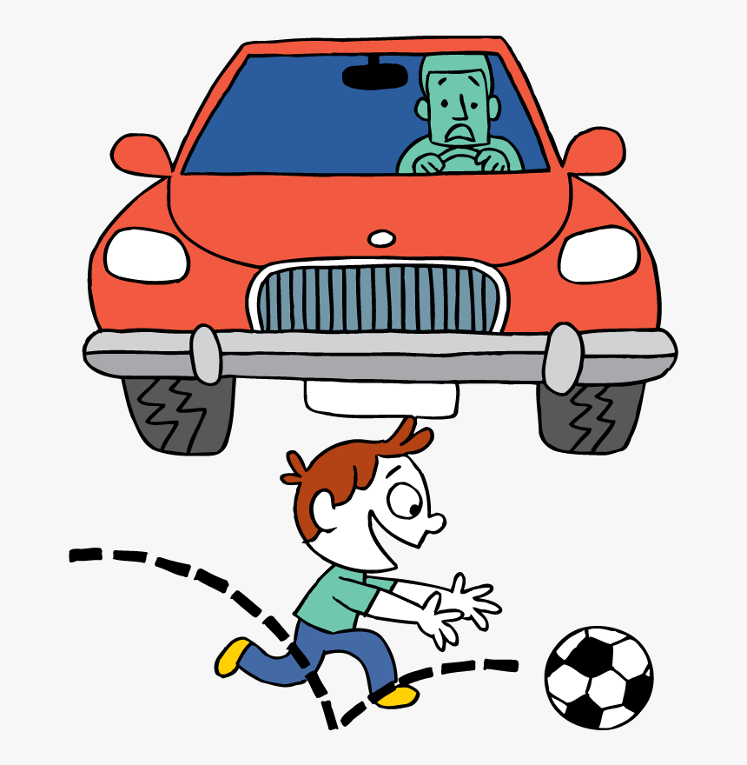
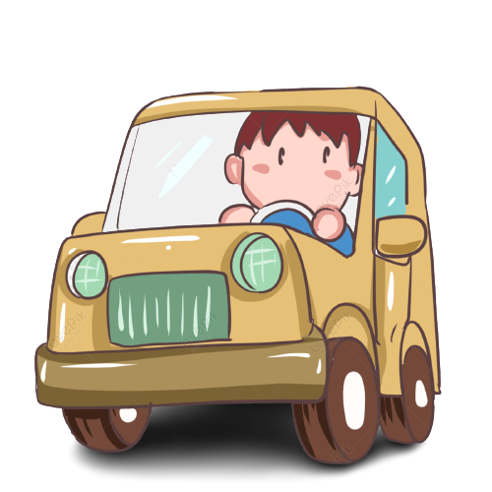
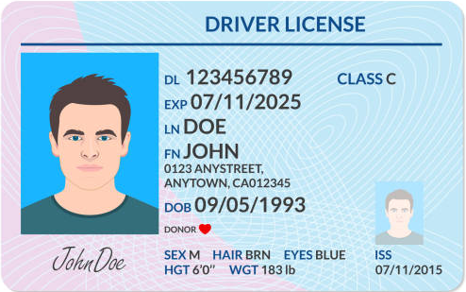
9. dangerous (adj):
/'deɪndʒərəs/
nguy hiểm
11. driving license
(n):
/draɪv/
lái xe
/'draɪvɪŋ 'laɪsns/
bằng lái xe
10. drive (v):

Slide 7
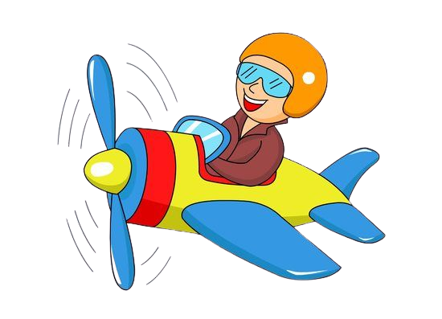

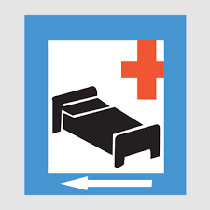
12. fly (v):
/flaɪ/
bay
13. get off (v):
/get ɒf/
xuống (xe)
14. get on (v):
/get ɒn/
lên (xe)
15. hospital ahead (phr):
/'hospɪtl ə'hed/
phía trước có bệnh viện

Slide 8
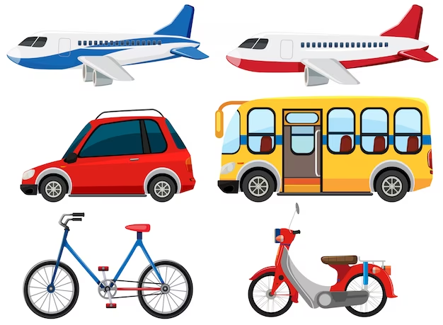

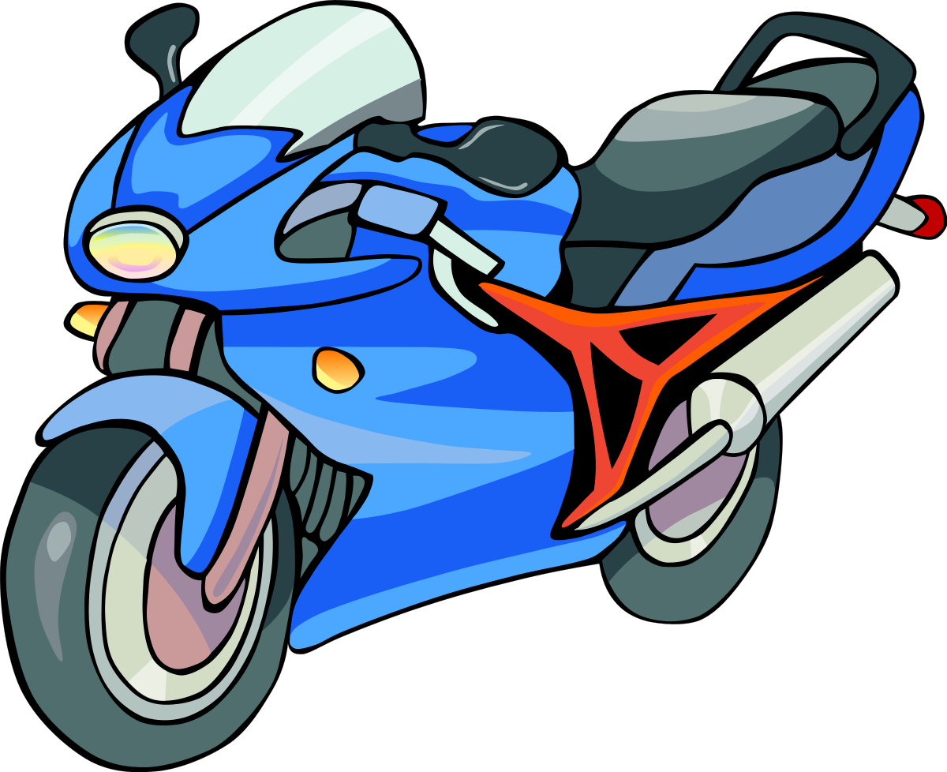
16. means of transport (v):
/mi:nz ɒf 'trænspɔ:t/
phương tiện giao thông
18. no cycling
(phr):
/nəʊ 'saɪkliŋ/
cấm xe đạp
17. motorbike (n):
/'məʊtəbaɪk/
xe máy

Slide 9


19. no parking (phr):
/nəʊ 'pɑːkɪŋ/ cấm đỗ xe
20. no right turn (phr):
/nəʊ raɪt tɜ:n/cấm rẽ phải

Slide 10


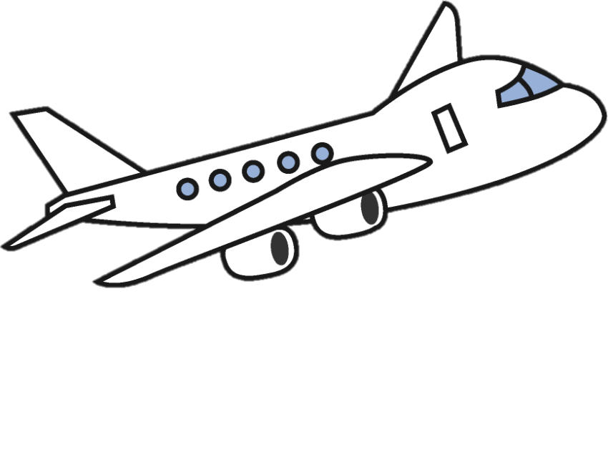
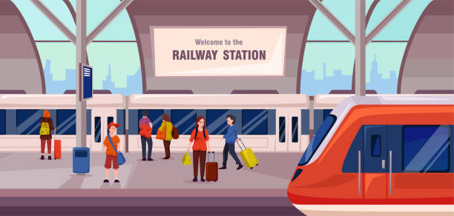
21. parking (n):
/'pɑːkɪŋ/ (biển báo) cho phép đỗ
22. pavement(n):
/'peɪvmənt/vỉa hè
/pleɪn/
máy bay
23. plane (n):
24. railway station (n):
/'reɪlweɪ 'steɪʃn/trạm xe lửa

Slide 11

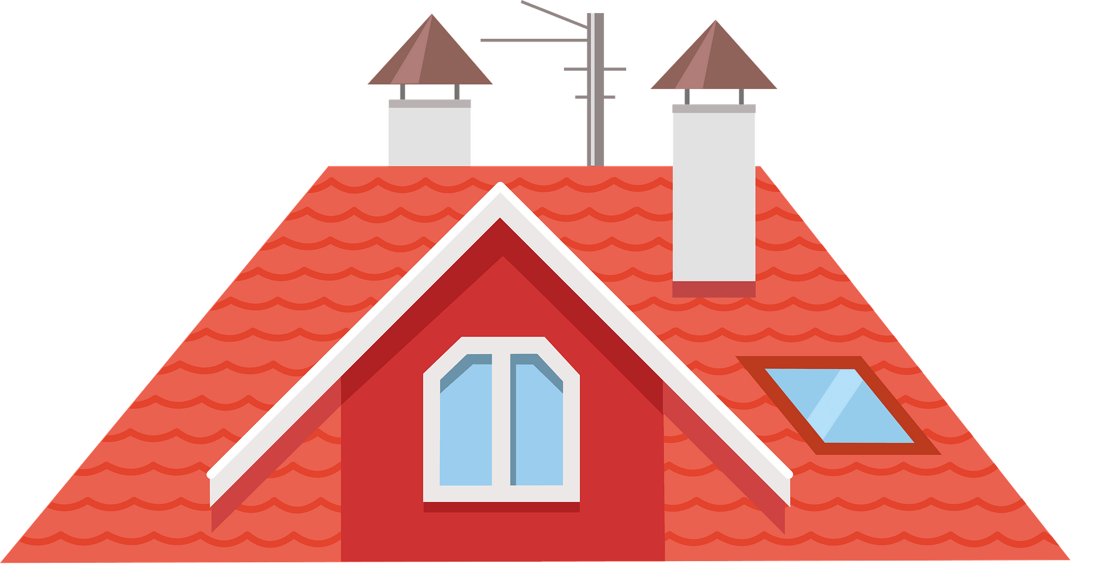
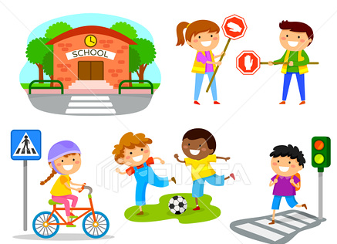
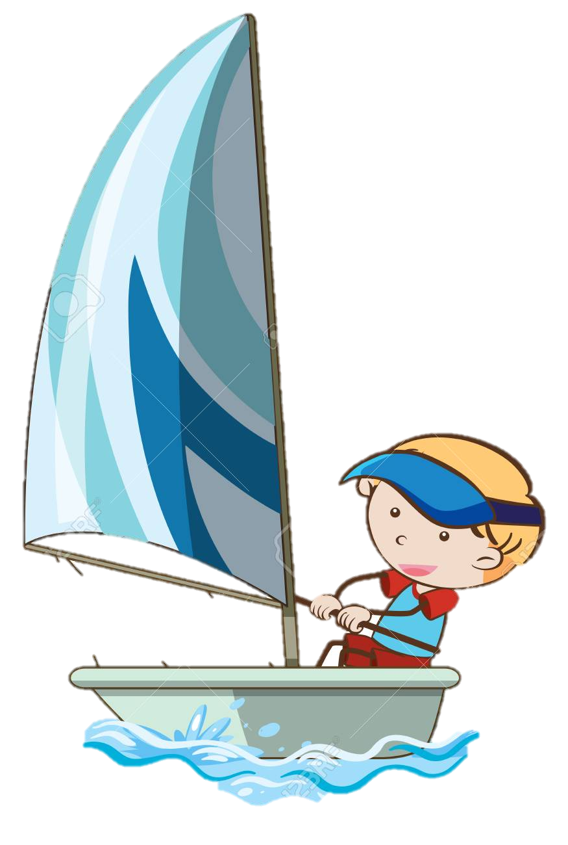
25. ride (v):
/raɪd/ cưỡi, lái (ngựa, xe 2 bánh)
/ru:f/
mái nhà
26. roof (n):
/'seɪftɪ/
sự an toàn
/seɪl/
chèo (thuyền)
27. safety (n):
28. sail (v):

Slide 12
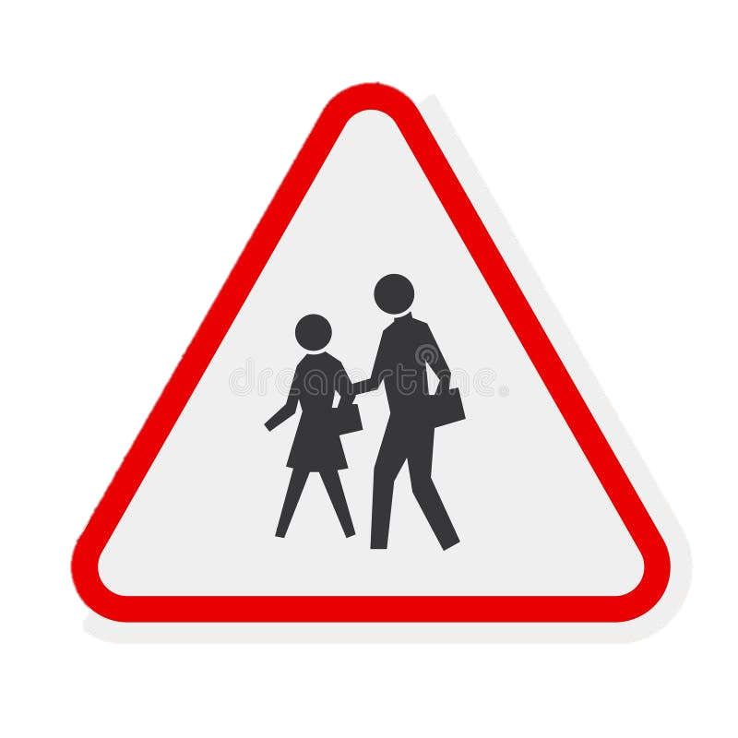
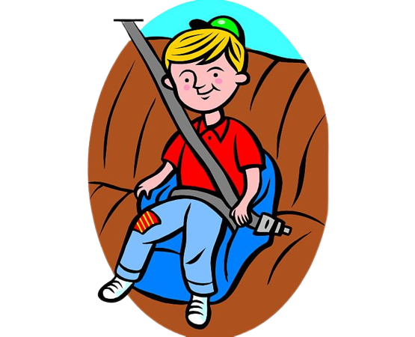
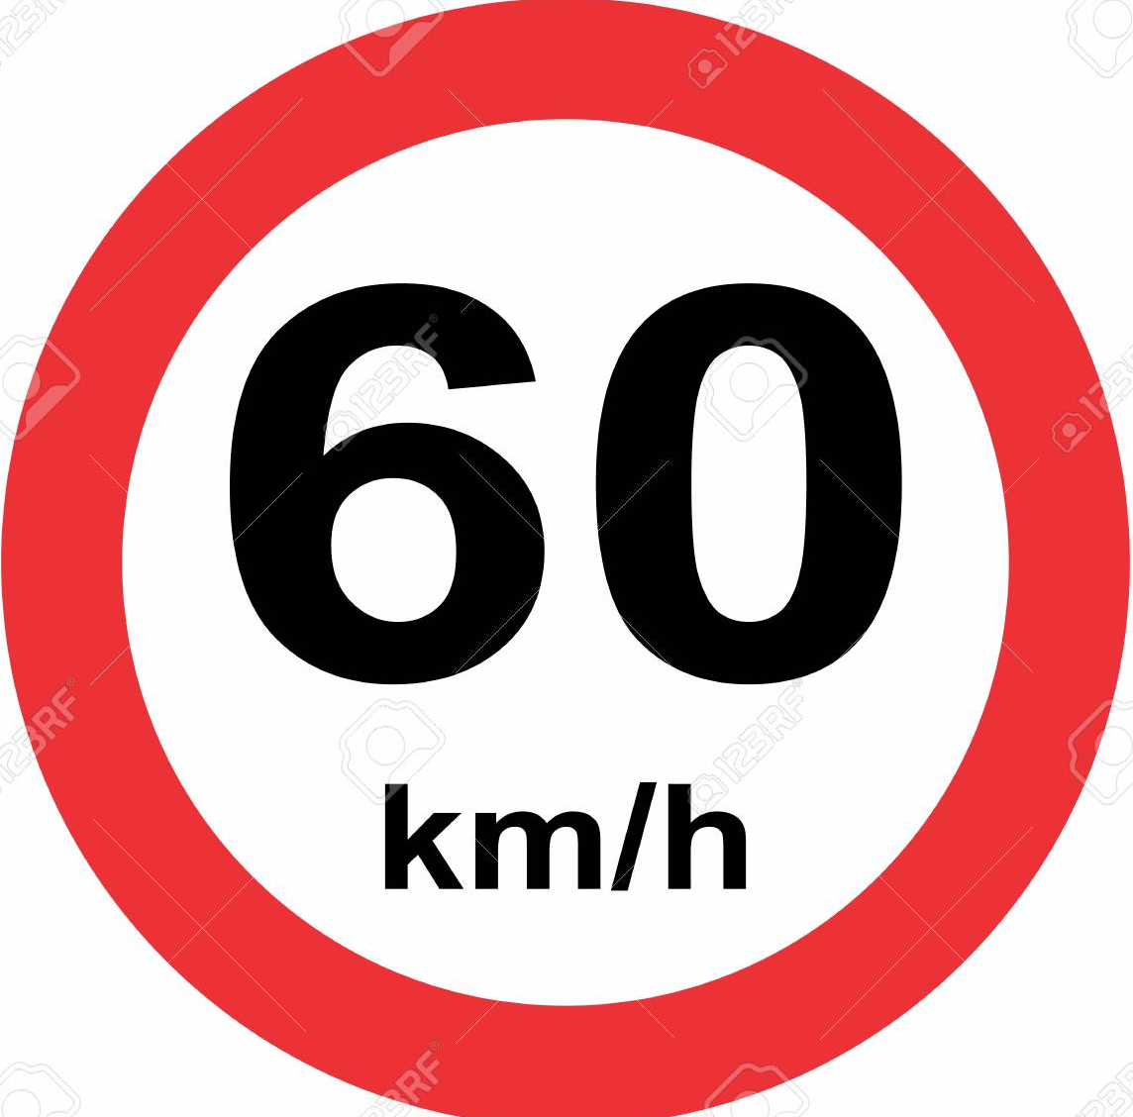
29. school ahead (phr):
/sku:l ə'hed/phía trước có trường học
30. seat belt (n):
/si:t belt/
đai an toàn
31. speed limit (n):
/spi:d 'lɪmɪt/ tốc độ giới hạn

Slide 13

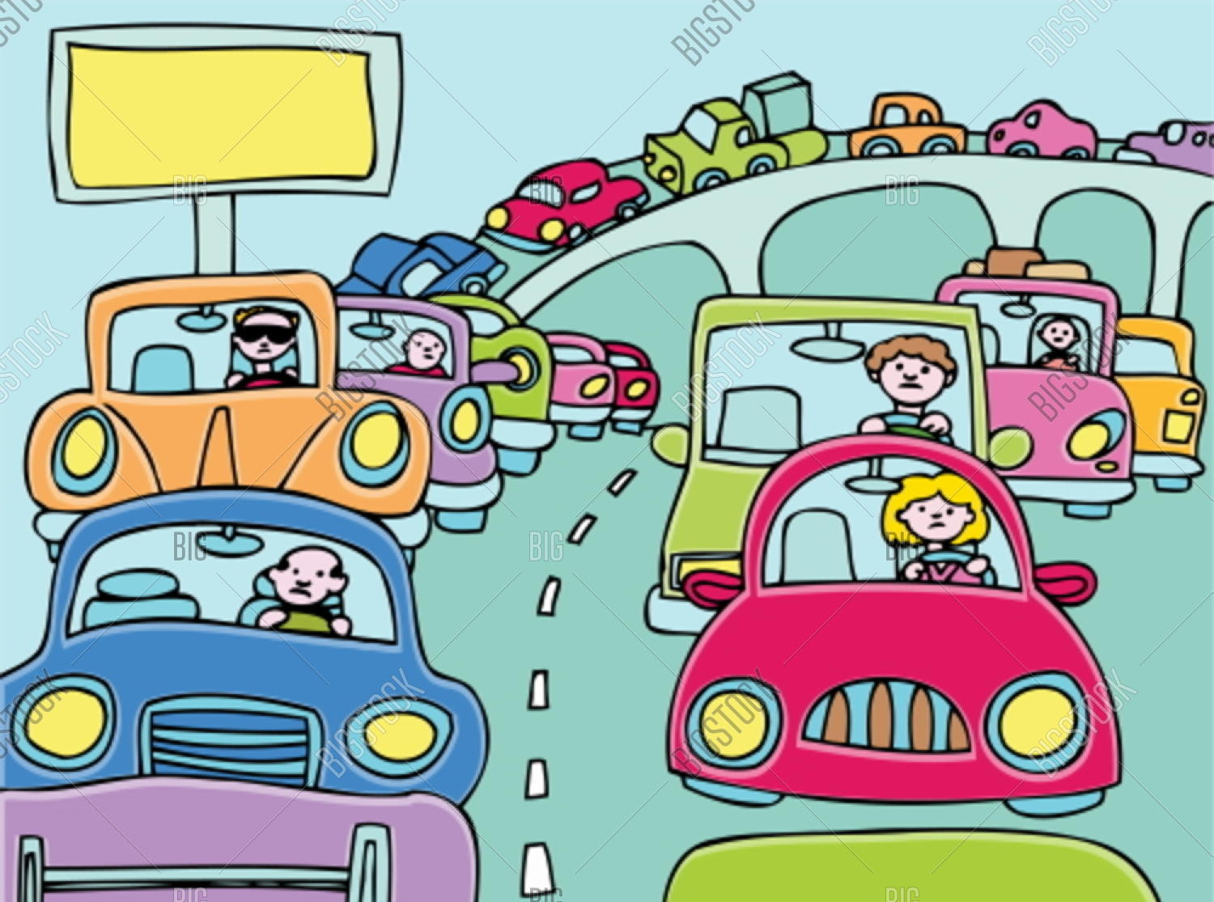
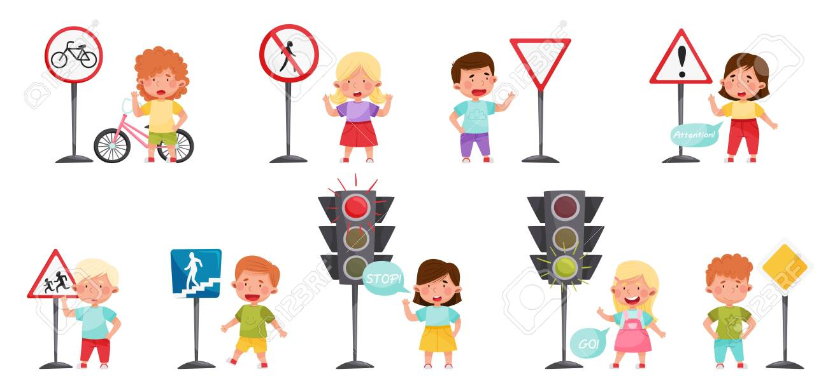
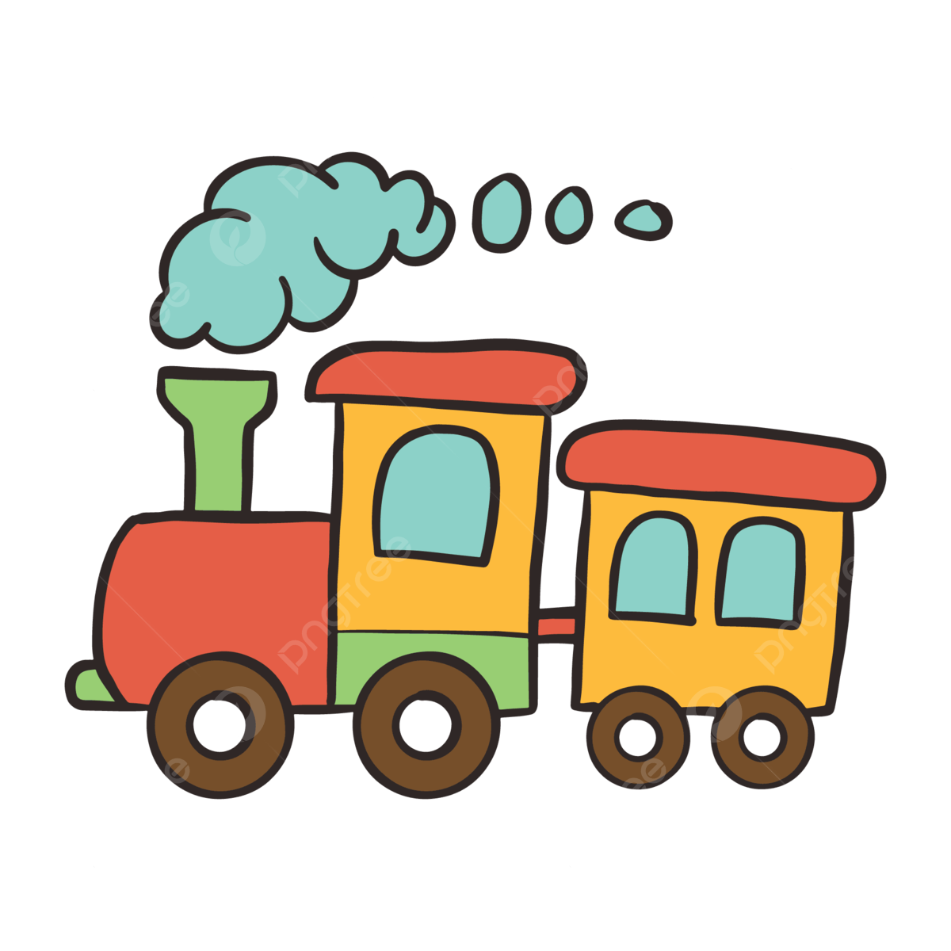
32. traffic jam (n):
33. traffic light (n):
/'træfɪk dʒæm/ tắc đường
/'træfɪk laɪt/ đèn giao thông
34. traffic rule (n):
35. train(n):
/'træfɪk ru:l/ luật lệ giao thông
/treɪn/ xe lửa

Slide 14
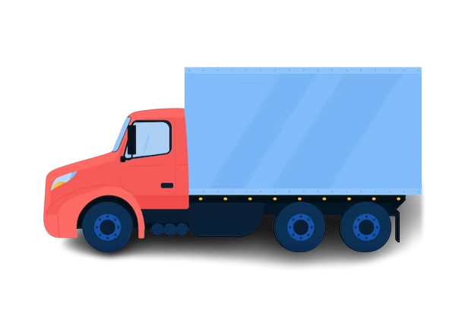

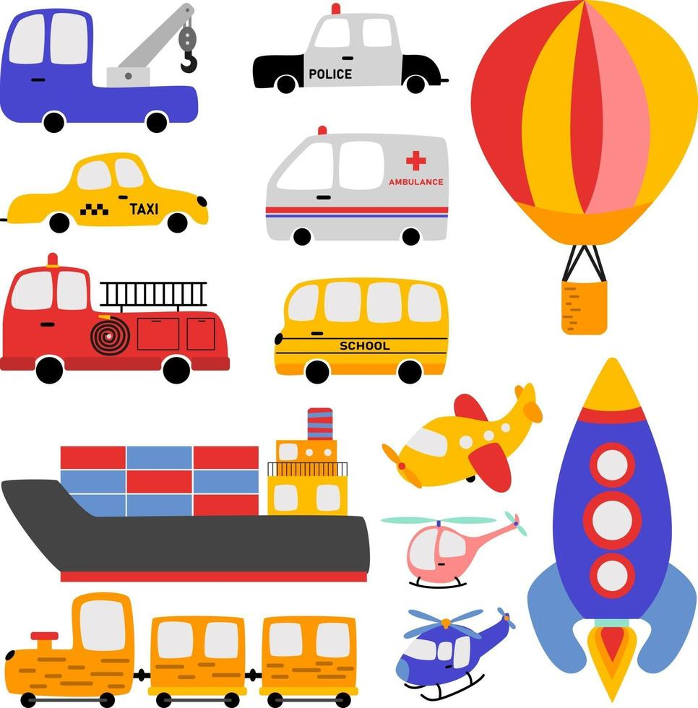
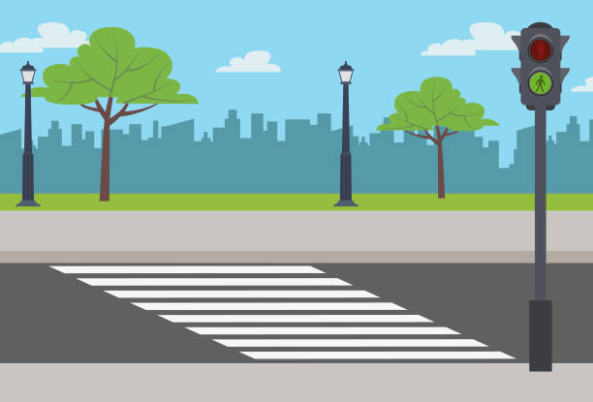
36. train ticket (n):
/treɪn 'tɪkɪt/
vé xe lửa
37. truck (n):
/trʌk/
xe tải
/trʌk/
xe tải
38. vehicle (n):
/'vi:əkl/ xe cộ
39. zebra crossing (n):
/'zebrə 'krɒsɪŋ/
vạch kẻ sọc cho người đi bộ

Slide 15
1 | accident | n
2 | bike | n
3 | bus | n
4 | bus stop | n
5 | car | n
6 | crossroad | n
7 | crowded | adj
8 | cycle lane | n
9 | dangerous | adj
10 | drive | v
11 | driving license | n
12 | fly | v
13 | get off | v
14 | get on | v
15 | hospital ahead | phr
16 | means of transport | n
17 | motorbike | n
18 | no cycling | phr
19 | no parking | phr
20 | no right turn | phr

Slide 16
21 | parking | n
22 | pavement | n
23 | plane | n
24 | railway station | n
25 | ride | V
26 | roof | n
27 | safety | n
28 | sail | V
29 | school ahead | phr
30 | seat belt | n
31 | speed limit | n
32 | traffic jam | n
33 | traffic light | n
34 | traffic rule | n
35 | train | n
36 | train ticket | n
37 | truck | n
38 | vehicle | n
39 | zebra crossing | n

Slide 17
Vocabulary checking
https://wordwall.net/resource/27633099/traffic
https://wordwall.net/resource/28037942/traffic
https://wordwall.net/resource/52148418/traffic-sign

Slide 18
PART 1 THEORY
II. GRAMMAR

Slide 19
1. "It" indicating distance ("It" dùng để nói về khoảng cách)
Chúng ta sử dụng it để chỉ khoảng cách giữa hai địa điểm/ người/ vật.
Cấu trúc:
Câu hỏi | How far is it from place A to place B?
Câu trả lời | It is (about) + khoảng cách.

Slide 20
Ex 1:
A: How far is it from your house to the nearest bank? (Khoảng cách từ nhà cậu tới ngân hàng gần nhất là bao xa?)
B: It is about 3 kilometres. (Khoảng 3km.)
Ex 2:
A: How far is it from your house to my house? (Khoảng cách từ nhà bạn đến nhà tớ bao xa?)
B: It is about 200m. (Khoảng 200m.)

Slide 21
Game
https://rutgonlink.mobi/MMRMt

Slide 22
PART 1 THEORY
III. PHONETICS

Slide 23
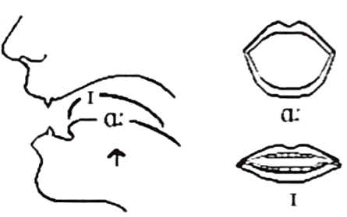
Cách phát âm âm /aɪ/ và /eɪ/
1. Cách phát âm nguyên âm đôi /aɪ/
Bước 1: Bắt đầu từ âm /a/, sau đó di chuyển về phía âm /ɪ/. Bước 2: Khi bắt đầu, miệng mở hình ô van, lưỡi hạ thấp chạm hàm răng dưới. Sau đó, môi dần kéo sang 2 bên về phía tai, hàm dưới nâng lên 1 chút. Bước 3: Kết thúc âm, môi mở hờ.
https://www.youtube.com/watch?v=RY8rMK8ZYlA

Slide 24
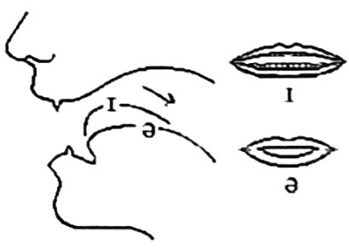
Cách phát âm âm /aɪ/ và /eɪ/
2. Cách phát âm nguyên âm đôi /eɪ/
Bước 1: Bắt đầu từ âm /e/, sau đó di chuyển về phía âm /ɪ/. Bước 2: Khi bắt đầu, miệng mở rộng thoải mái, đầu lưỡi chạm hàm răng dưới, hàm hạ. Sau đó, môi dần kéo sang hai bên về phía tai, hàm dưới nâng lên một chút. Bước 3: Kết thúc âm, môi mở hờ.
https://www.youtube.com/watch?v=yGynQ7o3_jg

Slide 25
✓ Listen and repeat these words.  Track 01
/aɪ/ | bike | buy | guide | pie
 | /baɪk/ | /baɪ/ | /gaɪd/ | /paɪ/
/eɪ/ | gate | nation | rain | clay
 | /geɪt/ | /’neɪʃn/ | /reɪn/ | /kleɪ/

Slide 26
PART 2 LANGUAGE
I. VOCABULARY

Slide 27
Exercise 1. Find the odd one out among A, B, C or D.
1. A. riding | B. driving | C. gardening | D. flying
2. A. no cycling | B. no parking | C. no right turn | D. sign
3. A. train | B. plane | C. car | D. sail
4. A. by car | B. on foot | C. by bus | D. by bicycle
5. A. rule | B. ride | C. reverse | D. drive

Slide 28
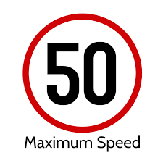

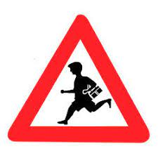

Exercise 2. Look at the pictures and put the word/phrase under each sign.
parking
no parking
school ahead
no left turn
speed limit
no cycling
hospital ahead
no right turn

Slide 29
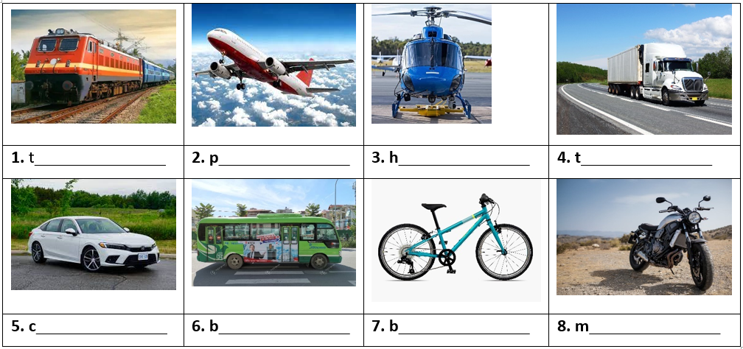
Exercise 3. Look at the pictures and complete with suitable means of transport.
rain
lane
elicopter
ruck
ar
us
ike
otorbike

Slide 30
Exercise 4. Complete each phrase below.
1. zebra ________ | 2. _______ license
3. speed _____ | 4. cycle ____
5. railway ______ | 6.______ of transport
7. traffic ____ | 8. train _____
9. ______ lights | 10. traffic _____
crossing
driving
limit
lane
station
means
jam
ticket
traffic
rules

Slide 31
Exercise 5. Fill in each blank with a word in the box.
feels
rules
it
across
did
after
vehicles
ride
accidents
break
1. What ________ you do last Sunday?
2. I stayed at home and looked ______ my younger brother yesterday.
3. Does your bike ever _________ down on the way to school?
4. We must always obey traffic _______ for our safety.
5. How far is ____ from your house to the bus stop?

Slide 32
Exercise 5. Fill in each blank with a word in the box.
feels
rules
it
across
did
ride
accidents
6. He used to ____ a tricycle when he was three years old.
7. Now there are more traffic _________ than there used to be in this city.
8. There did not use to be many _________ on the roads in my home town.
9. He lives in a small village in the mountains so he never ______ worried about traffic jams.
10. You should remember to walk ________ the streets at the zebra crossings.
vehicles
after
break

Slide 33
PART 2 LANGUAGE
II. GRAMMAR

Slide 34
Exercise 1. Choose the correct option to complete the sentence.
1. How far is it from your apartment (from/to) the zoo?
2. It is (at/ about) 2 kilometres.
3. It is not very (near/far) from my house to the bank. It is just 500 metres.
4. How far (is it/ it is) from your country to the USA?
5. How (far/ much) is it from your house to the train station?
6. My house is 2 kilometres (near/ far) from my grandparents’ house.
7. How far (is it/ are they) from here to the cinema?
8. I think it is about 400 (metres/ metre) from here to the nearest bus stop.
9. My school is not far (from/ to) my house. I can go to school on foot every day.
10. How far is it (from/ at) your office to the market?

Slide 35
1. How ____ is it from your house to the park?
2. How far is it from this restaurant to the nearest _____?
- It is about 1 kilometre from this restaurant to the nearest bank.
3. How far ____ it from Hanoi to Ho Chi Minh City?
4. It is about 5 kilometres from my house ___ yours.
5. How far is ___ from your company to your apartment?
6. It is ______ 3 kilometres.
7. How far is it from my school to yours? - ___ is about 8 kilometres.
8. How far is it _____ where you live to your company?
Exercise 2. Fill in the blank with a correct word to complete the sentence.
far
bank
is
to
it
about
It
from

Slide 36
Exercise 3. Decide the following sentences are grammatically correct or incorrect.
1. How long is it from Hanoi to Noi Bai Airport? - It is about 30 kilometers.
A. True B. False
2. It is about 300 kilometers from Ho Chi Minh City to Phu Quoc.
A. True B. False
3. How far it is from Hanoi to Lao Cai?
A. True B. False
4. I think it is about 200 metres from our school to the bus stop.
A. True B. False
5. It is not very far from my school from the bus station.
A. True B. False
6. Is it far from here to Hung Yen City? - No, it's just 10 kilometers.
A. True B. False

Slide 37
Exercise 4a. Make questions for the answers.
1. _______________________________________________?
It is about 300 metres from here to the nearest post office.
2. _______________________________________________?
It is about 3,900 kilometres from New York to California.
3. _______________________________________________?
It is about 200 metres from my house to my family store.
4. _______________________________________________?
It is about 4576.89 miles from Beijing to Berlin.
5. _______________________________________________?
It is about 1 kilometer from my hotel to the beach.
How far is it from here to the nearest post office
How far is it from New York to California
How far is it from your house to your family store
How far is it from Beljing to Berlin
How far is it from your hotel to the beach

Slide 38
Exercise 4 b. Answer the questions using the information in the brackets.
1. How far is it from here to the theatre? (about 400 metres)
____________________________________________
2. How far is it from your hometown to Ha Noi? (about 100 kilometres)
_____________________________________________
3. How far is it from the park to the zoo? (about 2 kilometres)
_____________________________________________
4. How far is it from here to the city centre? (about 50 kilometres)
_____________________________________________
5. How far is it from your house to school? (about 1 kilometre)
_____________________________________________
It is about 400 metres (from here to the theatre).
It is about 100 kilometres (from my hometown to Ha Noi).
It is about 2 kilometres (from the park to the zoo)
It is about 50 kilometres (from here to the city centre).
It is about 1 kilometre (from my house to school).

Slide 39
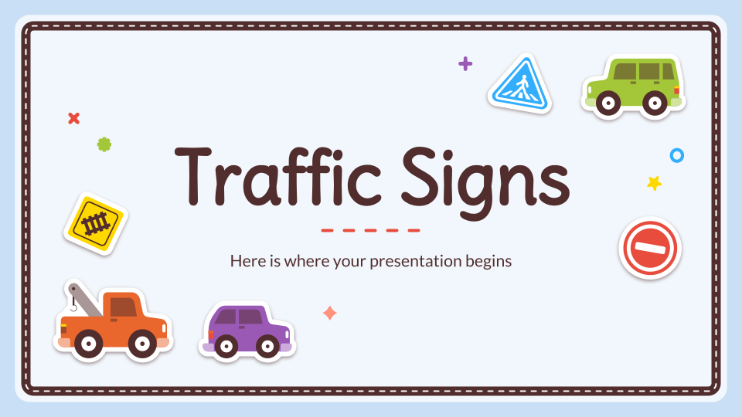
1. Young children are expected to show to their parents. (obey)
_______________________________________________________
2. When cycling on the roads, remember: first. (safe)
_______________________________________________________
3. Children should avoid foods such as hamburgers and chips. (health)
_______________________________________________________
4. Most road accidents happen because the motorists drive. (care)
_______________________________________________________
5. It is unsafe and to pass another vehicle on the left. (legal)
_______________________________________________________
Exercise 5. Give the correct form of the word given to complete the sentence.
obedience
safety
unhealthy
carelessly
illegal

Slide 40
6. My was delayed for over two hours due to bad weather. (fly)
_____________________________________________________
7. Everyone should obey traffic rules for their own safety. (strict)
_____________________________________________________
8. The policeman the car to stop with a flashlight. (sign)
_____________________________________________________
9. Signs with red circles are mostly - that means you can’t do something. (prohibit)
_____________________________________________________
10. This sign indicates that traffic lights are ahead. (warn)
_____________________________________________________
flight
strictly
signaled
prohibitive
warning

Slide 41
PART 2 LANGUAGE
III. PHONETICS

Slide 42
Divide these words into two columns as below.  TRACK 02
while | pay | rice | fine | shade | tail | behind | child
eight | nice | steak | face | kind | silent | raise | guide
amazing | guy | hate | eye | baby | my | light | paper
later | potato | sigh | gray | island | they | day | buy
/aɪ/ | /eɪ/
while guide rice guy fine eye behind my child light nice sigh kind island | pay hate shade baby tail day eight paper steak later face potato raise gray

Slide 43
PART 3. COMMUNICATION SKILLS
I. LISTENING

Slide 44
1. Mr. Hoang has no day off except Saturday._______
2. Mr. Hoang usually spends his day off in front of the TV screen.______
3. Mr. Hoang doesn't like his job. ____
4. Mr. Hoang is going to retire. ____
5. Mr. Hoang’s wife does not want him to retire. _____
☞ Listen and do the tasks followed.  Track 03
Exercise 1. Listen and decide if each statement is True (T) or False (F).
F
F
F
T
T

Slide 45
1. What does Mr. Hoang do?
______________________________________________
2. What time does he start his work?
______________________________________________
3. What is the destination of his route?
_____________________________________________
4. Why does Mr. Hoang love his job?
______________________________________________
5. How many hours does he work on Saturdays?
______________________________________________
Exercise 2. Listen again and answer the questions.
He is a bus driver.
He usually works at 5:30, sometimes 1:30.
My Dinh bus station.
Because he meets lots of people.
He works for three hours.

Slide 46
PART 3. COMMUNICATION SKILLS
II. SPEAKING

Slide 47
Write questions for the underlined parts. Then practise the dialogue with your partner.
Why did you come to class late this morning?
Mary: Hi Tony! (1) ________________________________
Tony: I came to class late this morning because I was stuck in a traffic jam.
Mary: Really? (2) _________________________________
Tony: Yes, my house is rather far from school.
Mary: (3) _______________________________________
Tony: Uhm... about 5 kilometres.
Mary: (4) _______________________________________
Tony: I go to school by bike.
Mary: (5) ________________________________________
Is your house far from school?
How far is it from your house to school?
How do you go to school?
How long does it take you to go to school?

Slide 48
Tony: It takes me about 30 minutes. And it takes longer when the traffic is jammed
Mary: (6) _________________________________________
Tony: I get stuck in a traffic jam once or twice a week.
Mary: (7)___________________________________________
Tony: I often get stuck in a traffic jam on Monday morning.
Mary: (8)_________________________________________
Tony: I usually go to school at 6.15.
Mary: So why don't you start going to school a little earlier on Monday?
Tony: Okay, I'll try.
How often do you get stuck in a traffic jam?
When do you often get stuck in a traffic jam?
What time do you usually go to school?

Slide 49
PART 3. COMMUNICATION SKILLS
III. READING

Slide 50
Exercise 1. Read the text and then choose the best answer A, B, C or D.
Yesterday, on the way home from school, I saw an accident. A boy was run over by a taxi when he was riding his bicycle. The boy's leg was broken and it was bleeding badly. Someone there tried to stop the bleeding. They put pressure on it and held it tight. A man used his mobile phone to call the emergency service. Some minutes later, an ambulance arrived and sent the boy to the hospital. Two policemen came to the scene immediately. Some people told the police that the taxi driver was driving at a very high speed when the accident happened. Some others began talking about the traffic accidents these days and blamed the increasing number of accidents on the roads for careless driving and drunk drivers.

Slide 51
1. What did the writer see yesterday?
A. A fire B. An accident C. A fighting D. A crash
2. The accident happened between a taxi and _________.
A. a bus B. a car C. a bicycle D. motorbike
3. The boy was sent to the hospital by __________.
A. a police B. a car C. an ambulance D. a passenger
4. What part of his body was hurt? – His ____________.
A. arm B. leg C. head D. shoulder
5. How was the driver driving when the accident happened?N- Very __________.
A. slowly B. fast C. carefully D. well

Slide 52
Exercise 2. Fill in the blank with a word/ phrase in the box.
discourage
pollution
expensive
example
problem
trains
transport
cities
Traffic congestion in many (1) _______ around the world is severe. One possible solution to this (2) __________ is to impose heavy taxes on car drivers and use this money to make public transport better. One of the first benefits of such a measure is that the heavy taxes would (3) ___________ car owners from using their cars because it would become very (4) _________ to drive. This would mean that they would begin to make use of public (5) _________ instead, thus reducing traffic problems and (6) ___________ as well.
Another benefit would be that much more use would be made of public transport if it was improved. It is often the case that public transport in cities is very poor. For (7) __________, we often see old buses and (8) _________ that people would rather not use. High taxes would generate enough money to make the necessary changes.

Slide 53
Exercise 3. Read the texts about model good road safety behavior at all times for parents, and then answer the questions.
Top tips for pedestrian safety
- Teach your children to hold hands with an adult whenever they go out.
- Always use a zebra crossing when one is available and teach children that these are the safest places to cross.
- Teach children that it’s still important to stop, look and listen at a zebra crossing.
- Teach children always to stop at the kerb and look and listen for traffic (a third of children injured on roads said that they didn’t stop before stepping off the kerb and many said they didn’t look).
- Never use your mobile phone while crossing roads.
- Children learn to make decisions about crossing the road and parents gradually let them take a lead when you are crossing together.
- As children get older, practise routes with them before they walk alone.

Slide 54
Exercise 3. Read the texts about model good road safety behavior at all times for parents, and then answer the questions.
Top tips for cycling
- Always encourage children to wear a cycle helmet when they are on their bikes, and set a good example by wearing one yourself.
- Children need to be able to judge speed and distance accurately before they cycle on public roads. They need to take lessons on cycling in order to travel more widely on their bikes.
- Make sure children wear bright coloured clothing and fluorescent items whenever they are cycling on the road. And if they are cycling in the dark, they will need lights on their bikes and reflective items too. And of course, make sure you do this yourself, to set a good example.

Slide 55
1. What should children do when they go out?
____________________________________________
2. Where should children cross the street?
____________________________________________
3. What should children do to cross the street?
____________________________________________
4. Where should children stop to look and listen for the traffic?
____________________________________________
5. Can they use their mobile phones while crossing roads?
____________________________________________
They should hold hands with an adult when they go out.
They should cross the street at a zebra crossing.
They should stop to look and listen at a zebra crossing.
They should stop to look and listen for the traffic at the kerb.
No, they can't.

Slide 56
6. What should parents do to help older children before they walk alone?
__________________________________________
7. What should children wear when they are on the bikes?
______________________________________________
8. What should children do before they cycle on public roads?
______________________________________________ _________________________________________________
9. Which clothes should children wear whenever they are cycling on the road?
______________________________________________
10. What should they do when they cycle in the dark?
______________________________________________
Parents should practice routes with their children before they walk alone.
They should wear a cycle helmet.
They should be able to judge speed and distance accurately before they cycle on public roads.
They should wear bright coloured clothing and fluorescent items.
They need lights on their bikes and reflective items, too.

Slide 57
PART 3. COMMUNICATION SKILLS
IV. WRITING

Slide 58
Exercise 1. Make questions for the underlined parts in the following sentences using question words in brackets.
1. Nam usually goes to school by bus. Sometimes, he rides his bicycle. (How)___________________________________________
2. My father went to the stadium yesterday. (Where)
______________________________________________________
3. There are a lot of trucks and cars on the highway in the rush hour. (When) _______________________________________ 4. The students learn about road signs when they studied in secondary school. (What) ___________________________________________
5. Hung always drives his car very carefully. (How)
_______________________________________________________
6. It is about 100 km from Ha Noi to Hai Phong. (How far)
_____________________________________________________
How does Nam usually go to school?
Where did your father go yesterday?
When are there a lot of trucks and cars on the highway?
What do the students learn about when they studied in secondary school?
How does Hung drives his car?
How far is it from Ha Noi to Hai Phong?

Slide 59
Exercise 2. Reorder the words to have correct sentences.
1. from/ the/ to/ kilometers/ house/ my/ 3/ nearest/ park./ It’s
_______________________________________________________
2. from/ far/ house I bus /the I it/ station?/ How/ is/ grandmas I your I to
_______________________________________________________
3. father I gets I rush I My I often I hour. I stuck I in
_______________________________________________________
4. can / go / You I foot. / on / far I here. I It’s I from / not
_______________________________________________________
5. bus / 700 / the / my / metres / It’s / to / from / station./ office / about
_______________________________________________________
It's 3 kilometers from my house to the nearest park.
How far is it from your grandma's house to the bus station?
My father often gets stuck in rush hour.
You can go on foot. It's not far from here.
It's about 700 metres from my office to the bus station.

Slide 60
Exercise 3. Look at the information in the box then write questions and answers.
No. | Place 1 | Place 2 | Distance | Vehicle
1. | Ha Noi | Ho Chi Minh City | 1000 kilometres | plane
2. | Ninh Binh | Da Nang | 800 kilometres | train
3. | The park | The zoo | 2 kilometres | bus
4. | The cinema | The museum | 900 metres | bike
1. How far is it from Ha Noi to Ho Chi Minh City?
It’s about 1000 kilometres.
How do you get there?
I go by plane.

Slide 61
2. How far is it from Ninh Binh to Da Nang?
It's about 800 kilometres.
How do you get there?
I go by train.
3. How far is it from the park to the zoo?
It's about 2 kilometres.
How do you get there?
I go by bus.
4. How far is it from the cinema to the museum?
It's about 900 metres
How do you get there!
I go by bike.

Slide 62
Thanks!

