Slide 1

GAME

Slide 2

volleyball
NEXT
play
go
do

Slide 3
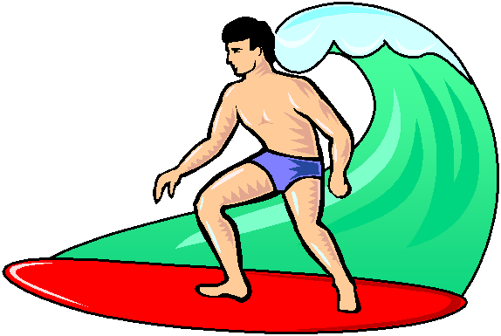
NEXT
surfing
play
go
do

Slide 4

football
NEXT
play
go
do

Slide 5

NEXT
skiing
play
go
do

Slide 6

basketball
NEXT
play
go
do

Slide 7

NEXT
athletics
play
go
do

Slide 8

handball
NEXT
play
go
do

Slide 9

NEXT
cycling
play
go
do

Slide 10

tennis
NEXT
play
go
do

Slide 11
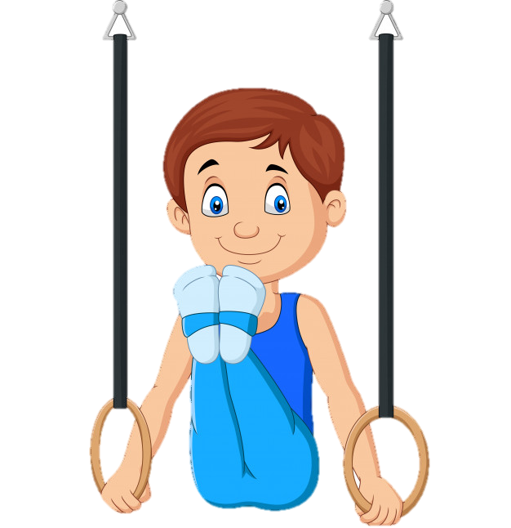
END
gymnastics
play
go
do

