Slide 1

Unit 10: Energy Sources
Lesson 3.2: Writing
Page 83

Slide 2


LESSON OUTLINE
Consolidation

Slide 3

By the end of this lesson, students will be able to…
write a formal email.
talk about how to make a town/city greener.

Slide 4

WARM-UP

Slide 5

Work in groups
What do you do to help your city (area) be better/ greener/ more eco-friendly?

Slide 6


It’s writing time….

Slide 7
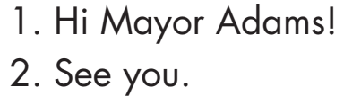
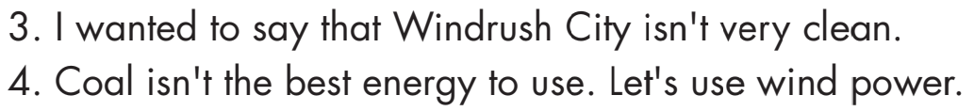
Pre - writing
a. Read the notes on writing formal emails. Use the following sentences to replace the formal parts in Elizabeth’s email on page 82.

Slide 8
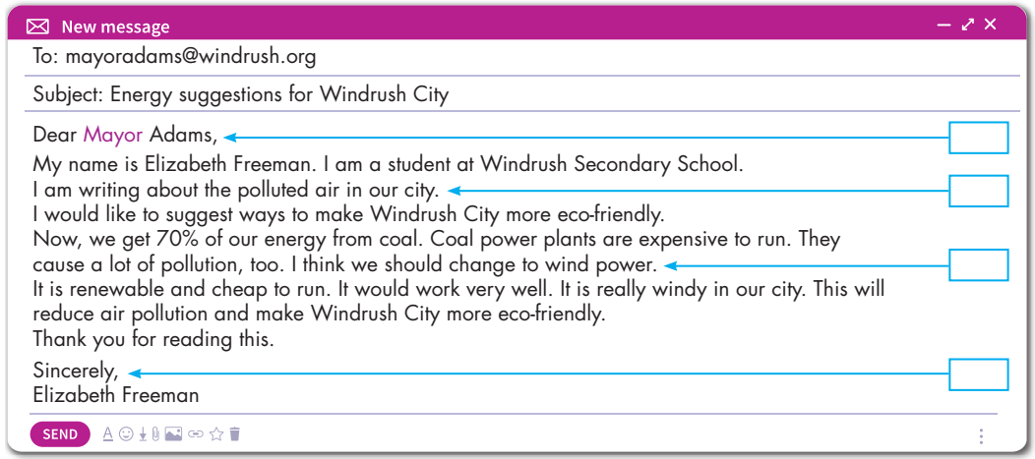
Hi Mayor Adam!
1
I wanted to say that Windrush City isn’t very clean.
3
Coal isn’t the best energy to use. Let’s use wind power.
4
See you.
2

Slide 9
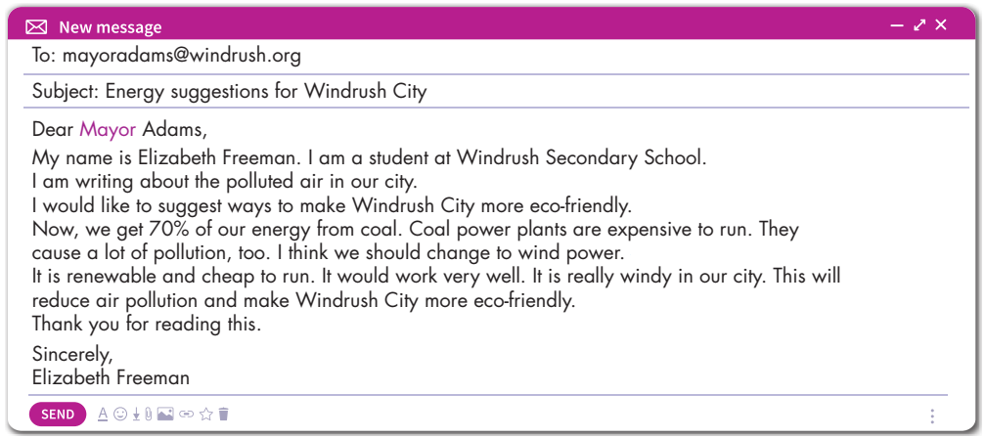
Pre - writing
Elicit important elements of an email.
Subject line: the first thing the reader sees in their inbox
Greetings: a salutation to the recipient
Intro: the purpose of the email
Body: email text
Closing: a “best wishes” type phrase and your signature

Slide 10
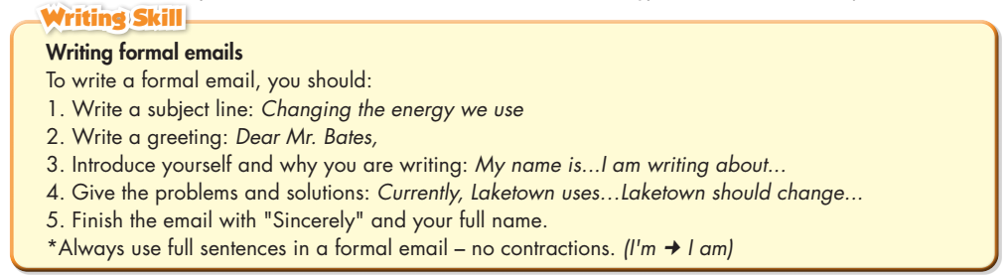
Pre - writing
Read the notes on writing a formal email again.

Slide 11
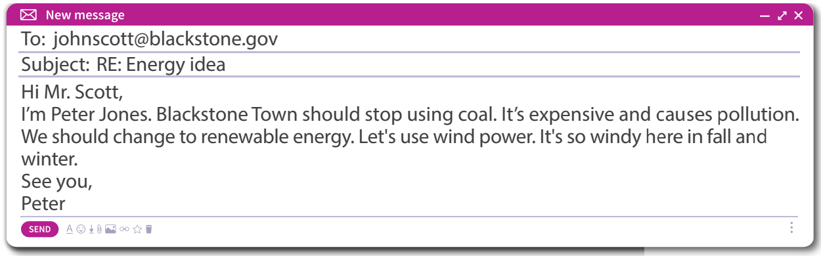
While - writing
b. Read the email below and underline the informal language. Rewrite them in the formal language in your notebook. Use the Writing Skill box to help you.

Slide 12
While - writing
Rewrite
Dear Mr. Scott,
My name is Peter Jones. Blackstone Town should stop using coal. It is expensive and causes pollution.
We should change to renewable energy. I think we should use wind power. It is so windy here in fall and winter.
Sincerely,
Peter Jones

Slide 13
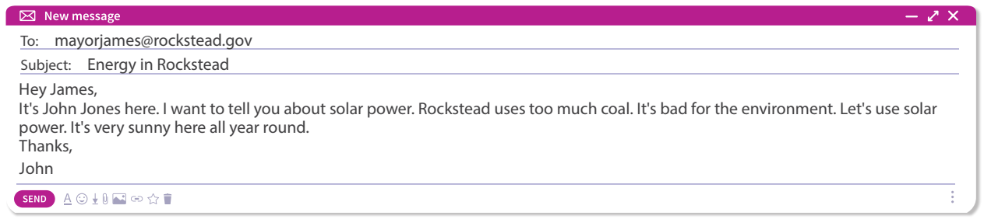
Extra Practice
WB, page 61
Underline the informal language, then rewrite it using the formal language.

Slide 14
While - writing
Let’s rewrite it.
Dear Mayor James,
My name is John Jones. I am writing to tell you about solar power. Currently, Rockstead uses too much coal. It is bad for the environment. Rockstead should change to solar power. It is sunny all year round.
Sincerely,
John Jones

Slide 15
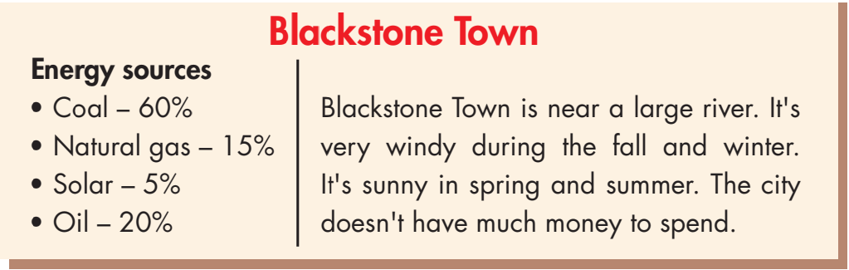
Work in pairs
a. You're talking about how to make Blackstone Town greener. In pairs: Read about Blackstone Town. Discuss which energy sources the town should use more or less.

Slide 16
I think we should use more solar power. The city is very sunny.
I think we should also use more wind power. Because it is cheap and clean.
I think we should use less coal. Because it causes a lot of pollution.
I think we should also use less oil. It causes lots of air pollution, too.

Slide 17
Post - writing
Now, write an email to the mayor of Blackstone Town to suggest changing energy sources. Write 60 to 80 words.
To: mayor@blackstone.gov
Subject: Pollution problem in Blackstone Town
Dear Mr. Mayor,
My name is Duy Nguyễn and I am writing about the pollution problem in Blackstone Town.
The city uses too much coal power. It causes a lot of pollution. It also uses a lot of oil. This causes air pollution, too.
I think we should use more solar power. The city is very sunny. We should also use wind power. It is cheap and clean.
Sincerely,
Duy Nguyễn

Slide 18

CONSOLIDATION

Slide 19
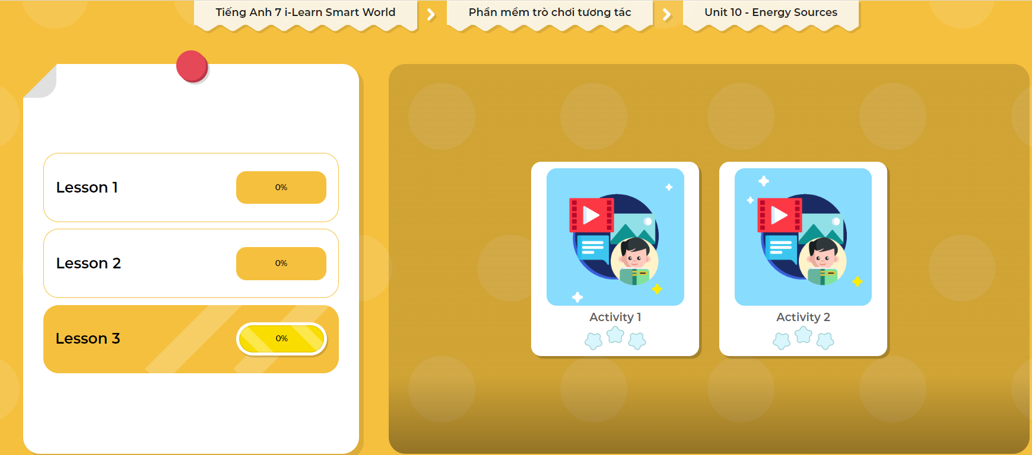
LET’S PLAY!
Click here to play the games

Slide 20

WRAP-UP

Slide 21
Today’s lesson
Writing:
- Understand the steps to write a formal email.
- Practice writing a formal email.
Speaking:
- Talk about using more good energy sources and less bad ones.

Slide 22
Homework
Do the Writing skill in Tiếng Anh 7 i-Learn Smart World Workbook on page 61.
Complete the writing notes in Tiếng Anh 7 i-Learn Smart World Notebook on page 65.
Prepare Review Unit 10 (pages 110 & 111 SB).
Play consolidation games in Tiếng Anh 7 i-Learn Smart World DHA App on www.eduhome.com.vn.

Slide 23

Lesson 3
Stay positive and have a nice day!

