Slide 2



Unit
10
HOUSES IN THE FUTURE
LESSON 5: SKILLS 1
1

Slide 3
LESSON 5: SKILLS 1
LESSON 1: GETTING STARTED
WARM-UP
Game: True or False
PRESENTATION
Vocabulary
Task 1: Lead in questions: Look at the photo, discuss in pairs and answer.
Task 2: Explicit reading skills: Scan and Skim.
Task 3: Read the passage and match.
READING
Task 4: Work in pairs and do Ex. 3.
Task 5: Students to work in groups and “build” their ideal future house.
SPEAKING
Wrap-up
Homework
CONSOLIDATION

Slide 4
WARM-UP
LOOK AT THE PICTURE
Work in pairs
Decide whether these statements are true or false
TRUE OF FALSE

Slide 5
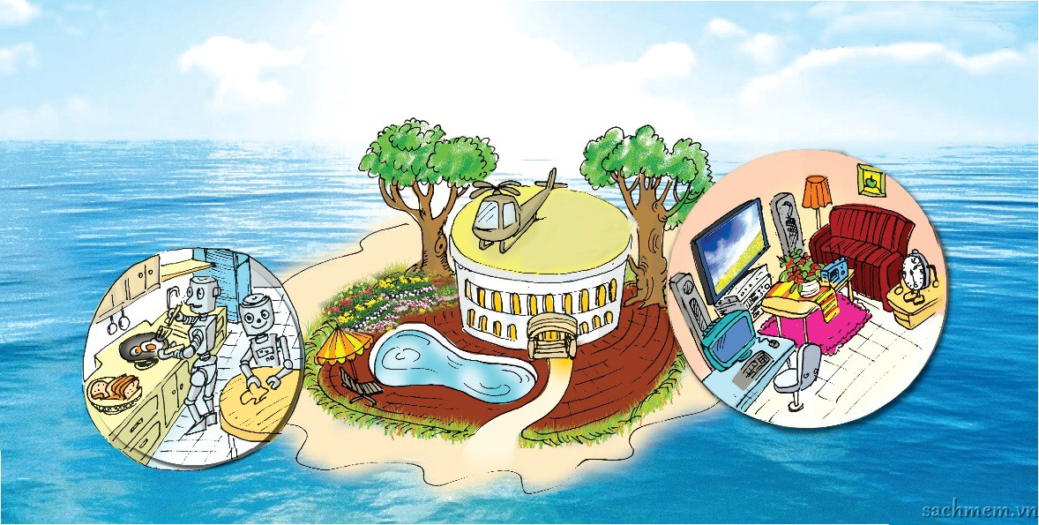
TRUE OF FALSE
WARM-UP
LOOK AT THE PICTURE
1. The house will be surrounded by a jungle.
2. Robots will help to do the housework.
3. There will be an UFO on the roof.
4. There will be a swimming pool in the house.
F
T
F
T

Slide 6

PRESENTATION
surround (v)
/ səˈraʊnd/
bao quanh

Slide 7

PRESENTATION
helicopter (n)
máy bay trực thăng
/ ˈhelɪˌkɒptə(r)/

Slide 8

PRESENTATION
feed (v)
/fiːd/
cho ăn

Slide 9
PRESENTATION
New words | Pronunciation | Meaning
1. surround (v) | / səˈraʊnd/ | bao quanh
2. helicopter (n) | / ˈhelɪˌkɒptə(r)/ | máy bay trực thăng
3. feed (v) | /fiːd/ | cho ăn

Slide 10
READING
1
Look at the picture and answer.
1. What type of house do you think it is?
It’s villa.
2. Where do you think the house is?
On the ocean.
3. What can you see around the house?
A helicopter, trees, a garden, a swimming pool, blue sea.
4. What can you see in the house?
Robots in the kitchen, a TV, a computer,… in the living room.

Slide 11
2
Read the text and match the phrases in A with the correct ones in B.
My future house will be on an island. It will be surrounded by tall trees and the blue sea. There will be a swimming pool in front of the house. There will be a helicopter on the roof. I can fly to school in it.
There will be some robots in the house. They will help me to clean the floors, cook meals, wash clothes and water the flowers. They will also help me to feed the dogs and cats.
There will be a super smart TV. It will help me to send and receive emails, and contact my friends on other planets. It will also help me to buy food from the supermarket.
a. clean the floors. b. contact my friends.
c. wash clothes.
d. buy food from the supermarket.
e. cook meals f. send and receive email
g. feed the dogs and cats. h. water the flowers.
A | B
1. The house will have robots to
2. The house will have a super smart TV to
a. clean the floors.
c. wash clothes.
e. cook meals
h. water the flowers.
g. feed the dogs and cats
f. send and receive email
b. contact my friends.
d. buy food from the supermarket.

Slide 12

Read the text again and circle the option (A, B, or C) to complete the sentences.
My future house will be on an island. It will be surrounded by tall tees and the blue sea. There will be a swimming pool in front of the house. There will be a helicopter on the roof. I can fly to school in it.
There will be some robots in the house. They will help me to clean the floors, cook meals, wash clothes and water the flowers. They will also help me to feed the dogs and cats.
There will be a super smart TV. It will help me to send and receive emails, and contact my friends on other planets. It will also help me to buy food from the supermarket.
3
1. The house will be _____
A. in the mountains
B. on an island
C. on the Moon
2. There will be a _____ in front of the house.
A. garden
B. pond
C. swimming pool
3. The house will have _____ robots.
A. many
B. some
C. a lot of
4. The _____ will help me to feed the dogs and cats.
A. helicopter
B. robot
C. super smart TV

Slide 13


SPEAKING
4
In pairs. Ask about future house.
What type of future house do you think it will be?
1. What type of future house do you think it will be?
2. Where will it be?
3. What will it look like?
4. How many rooms will it have?
5. What appliances will it have and what will they help you to do?
It'll be a palace.

Slide 14
SPEAKING
FUTURE HOUSE
5
Students to work in groups and “build” their ideal future house.
Groups of 6.
Take turns and share about your future house
The others DRAW the house you describe.

Slide 15

CONSOLIDATION
1
Wrap-up
What have we learnt in this lesson?
- Reading skill for general information and specific information
- Speaking:
+ identify different features of future house.
+ use what they have learnt to talk future house.

Slide 16

CONSOLIDATION
2
Homework
- Do Ex in WB
- Prepare: Skills 2 (Write a paraggraph about your ideal future house)

Slide 17






Website: hoclieu.vn
Fanpage: facebook.com/www.tienganhglobalsuccess.vn/

