Slide 1
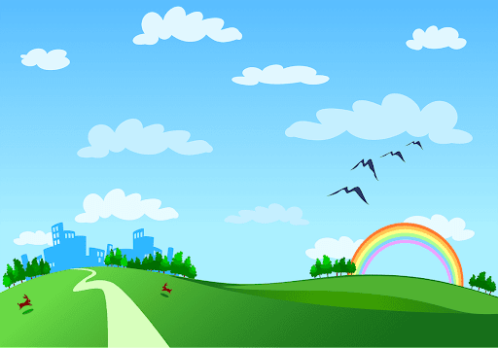
Good morning class!!!
ZALO: 0349895579

Slide 2



Unit
2
HEALTHY LIVING
LESSON 2: A CLOSER LOOK 1
VOCABULARY
PRONUNCIATION
Unit
HOBBIES

Slide 3
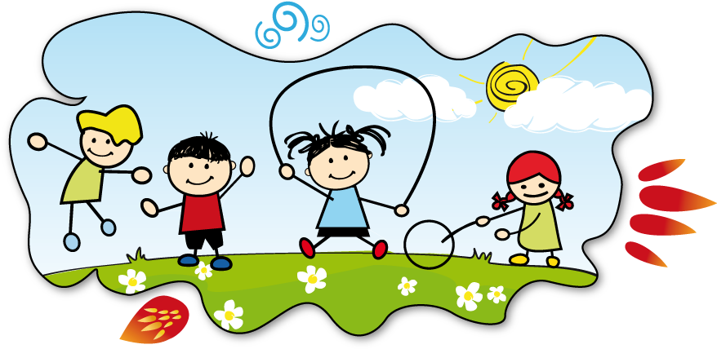
* WARM-UP: FACE TO FACE
HEALTHY ACTIVITIES
** Ss have 3 minutes to think of the topic
*** Students in each team turn by turn stand up and say 1 word or phrase related to the topic.
**** In 90 seconds, the team has more right answers will be the winner, and the team repeat the word which is mentioned already or cannot give a word will be the loser.

Slide 4
* WARM-UP: FACE TO FACE
HEALTHY ACTIVITIES
* Suggested answer:
- Going cycling/ swimming
- Walking
- Boating
- Eating breakfast
- Doing yoga/ aerobics
- Playing sports
- ….

Slide 5

* VOCABULARY
- dim light (n) :
ánh sáng lờ mờ
/dɪm lait/

Slide 6
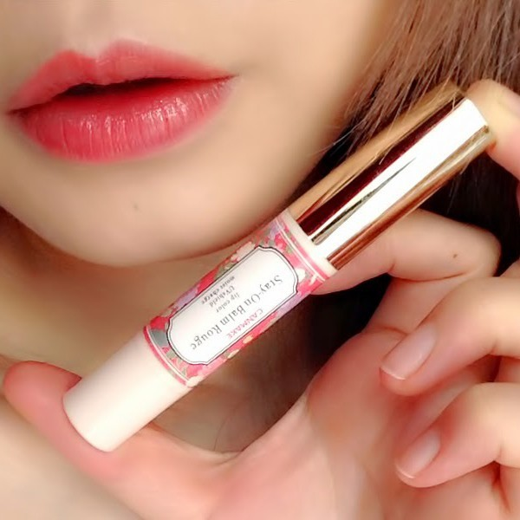
* VOCABULARY
- lip balm (n):
/ˈlɪp ˌbɑːm/
son dưỡng môi

Slide 7
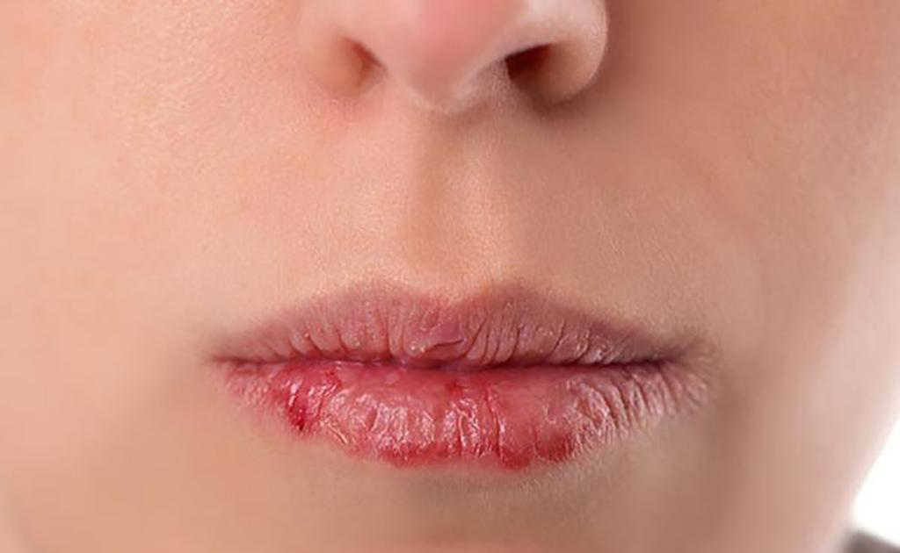
* VOCABULARY
- chapped lips (n):
/tʃæpt lɪps /
môi nứt nẻ

Slide 8
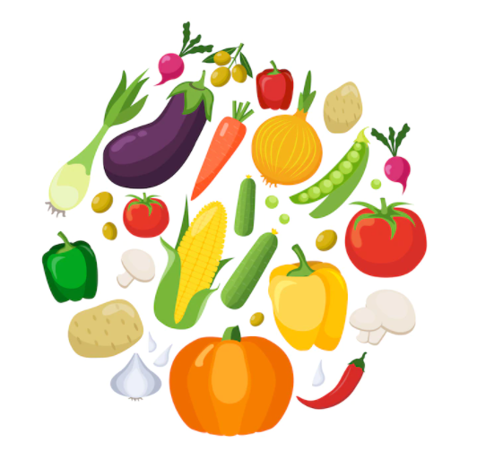
* VOCABULARY
- coloured vegetables (n):
/ ˈkʌləd ˈvedʒtəbəl/
rau có màu sắc

Slide 9
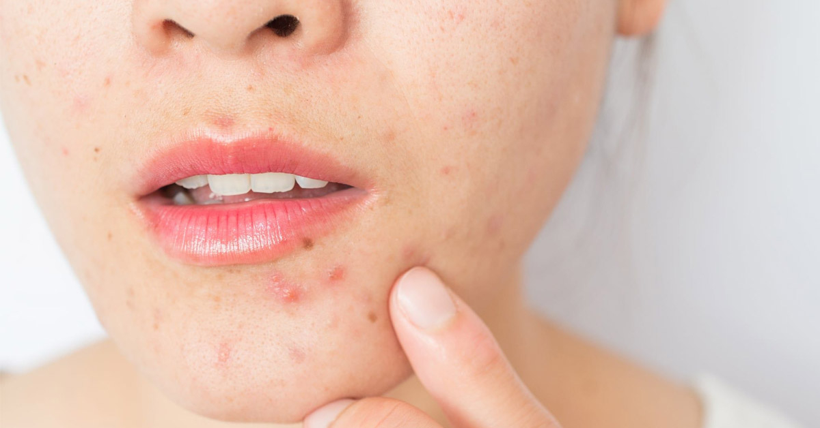
* VOCABULARY
- red spots (n):
/red spɒt/
Mụn đỏ

Slide 10
* VOCABULARY
New words | Pronunciation | Meaning
1. dim light (n) | /dɪm lait/ | ánh sáng lờ mờ
2. lip balm (n) | /ˈlɪp ˌbɑːm/ | son dưỡng môi
3. chapped lips (n) | /tʃæpt lɪps / | môi nứt nẻ
4. coloured vegetables (n) | / ˈkʌləd ˈvedʒtəbəl/ | rau có màu sắc
5. red spots (n) | /red spɒt/ | đốm đỏ, mụn đỏ

Slide 11
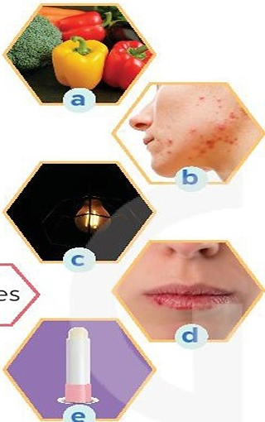
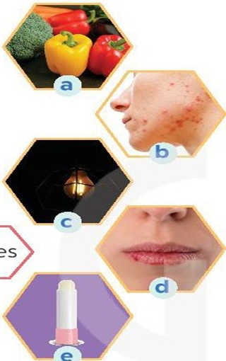
1
Match the phrase on the left with the correct pictures on the right.
1. dim light
2. lip balm
3. chapped lips
4. coloured vegetables
5. red spots

Slide 12
1
Match the phrase on the left with the correct pictures on the right.
1. dim light
2. lip balm
3. chapped lips
4. coloured vegetables
5. red spots
1. c
2. e
3. d
4. a
5. b

Slide 13
2
Complete the sentences with the correct words and phrases.
skin condition soft drinks coloured vegetables sunburn fit
coloured vegetables
1. - Please name some ________________________.
- Carrots and tomatoes.
2. ___________ are not good for your health.
3. My parents go cycling every Sunday. It keeps them _______.
4. The weather may affect our ________________.
5. - How do we get _________?
- When we spend a long time in the sun without a hat or suncream.
Soft drinks
fit
skin condition
sunburn

Slide 14


3
Discuss and tick each activity in the table as H (Healthy) or U (Unhealthy).
 | H | U
1. washing your hands often
2. reading in dim light
3. eating tofu and coloured vegetables
4. brushing your teeth twice a day
5. touching your face with dirty hands

Slide 15

* PRONUNCIATION
/f/ and /v/
Notes:
Chèn clip phát âm của HEID

Slide 16

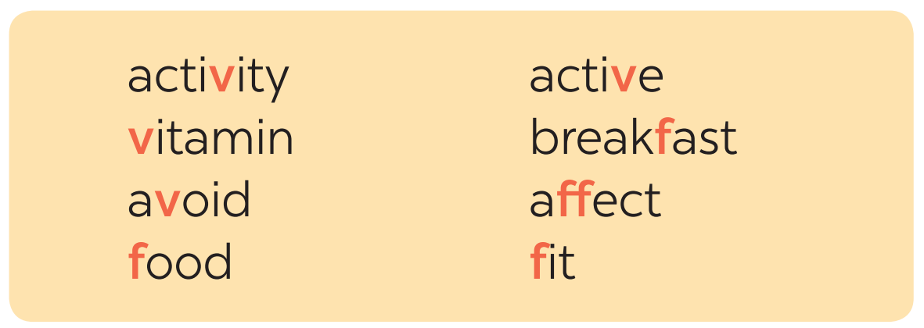
* PRONUNCIATION
4
Listen and repeat the words. Pay attention to the sounds /f/ and /v/.

Slide 17

* PRONUNCIATION
5
Listen and repeat, paying attention to the underlined words.
1. Coloured vegetables are good food.
2. My favorite outdoor activity is cycling.
3. We need vitamin A for our eyes.
4. Being active helps keep you fit.
5. Jack never eats fish.
/f/ and /v/

Slide 18
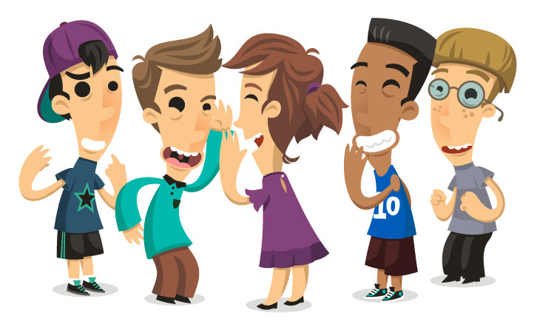
* PRODUCTION
Game: Tongue twister
Victoria fried some fresh fish.
2. Van fried the fish in half a vat of fat.

Slide 19
CONSOLIDATION
1
WRAP-UP
VOCABULARY
PRONUNCIATION

Slide 20
* CONSOLIDATION
2
HOMEWORK
Find 5 more words with the sound /f/ and 5 more words with the sound /v/. Write them down and practice pronouncing the words.

Slide 21
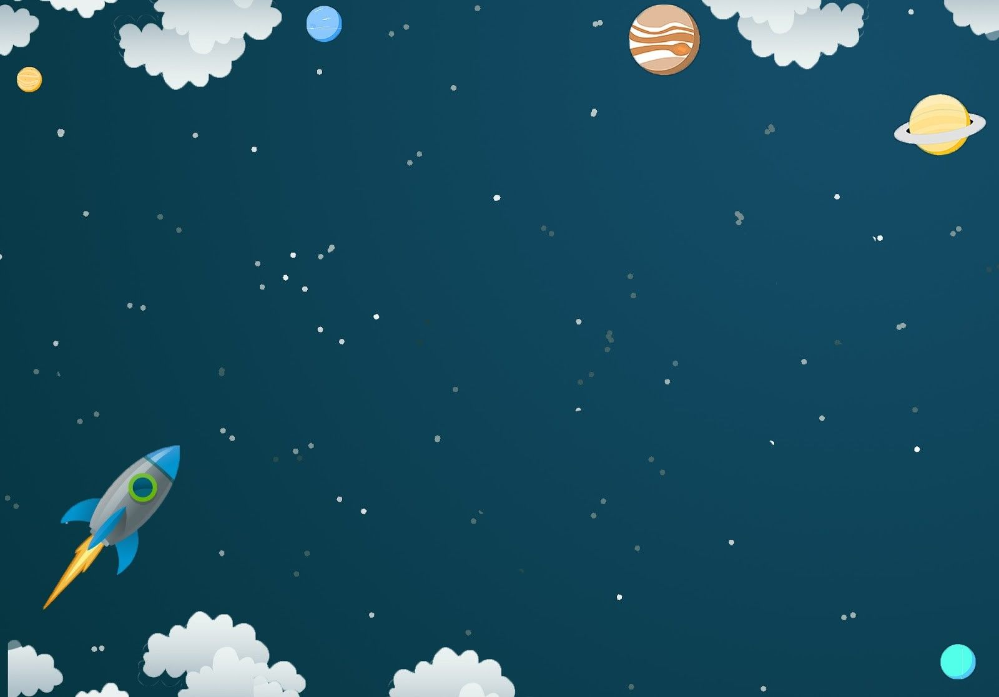
Goodbye.
See you again.

