Slide 1

UNIT 7: INVENTIONS
Lesson 1.3 – Pronunciation & Speaking
Page 61

Slide 2




Lesson 2.3
LESSON OUTLINE
Consolidation

Slide 3

By the end of this lesson,
students will be able to …
- practice intonation for relative clauses.
- talk about weird inventions.

Slide 4



Slide 5

Choose the word whose main stress is placed
differently from the others.
Work in pairs.
A. idea B. distance C. software D. feedback
2. A. internet B.resident C. pharmacy D. computer
3. A. allow B. explain C. defeat D. enter
/aɪˈdi:ə/
/ˈdɪstəns/
/ˈsɑ:ftwer/
/ˈfi:dbæk/
/ˈɪntənet/
/ˈrezədənt/
/ˈfɑ:rməsi/
/kəmˈpju:tə/
/əˈlaʊ/
/ɪkˈspleɪn/
/dɪˈfi:t/
/ˈentə/

Slide 6
Work in pairs.
Choose the word whose underlined part is
pronounced differently from that of the other words.
A. eat B. wear C.heat D. lead
2. A. who B. which C. what D. where
3. A. attach B. fasten C. damage D. restart
/i:t/
/wer/
/hi:t/
/li:d/
/hu:/
/wɪtʃ/
/wɑ:t/
/ˈwer/
/əˈtætʃ/
/ˈfæsn/
/ˈdæmɪdʒ/
/ˌri:ˈstɑ:rt/

Slide 7
Read aloud the sentences below.
This is the thing that you use to get information.
What do you use to get information?
Do you use a computer to get information?
Statements: falling
WH-questions: falling
Yes/No questions: rising
Lead-in: Intonation

Slide 8



Slide 9
Intonation
a. Sentences with defining relative clauses follow the same intonation pattern as statements.
The crawling mop has a mop that is attached to baby clothes.
It's for people who like to read.

Slide 10

b. Listen to the sentence and notice how the intonation falls.
The umbrella tie is an umbrella that looks like a tie.
Listen and repeat.

Slide 11
c. Listen and cross out the sentence with the wrong intonation.
The Privacy Scarf is a scarf that you pull over your head and laptop.
People who want to save time when they cook can use this invention.
d. Read the sentences with the correct intonation to a partner.

Slide 12

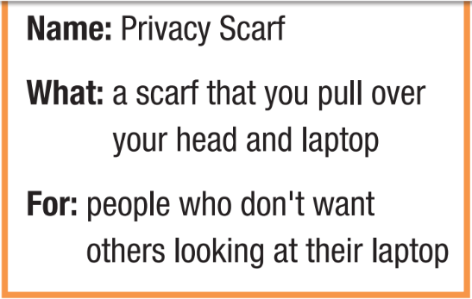
Ask and answer
What is a Privacy Scarf?
It’s a scarf that you pull over your head and laptop.
Who is it for?
It’s for people who don’t want others looing at their laptop.

Slide 13
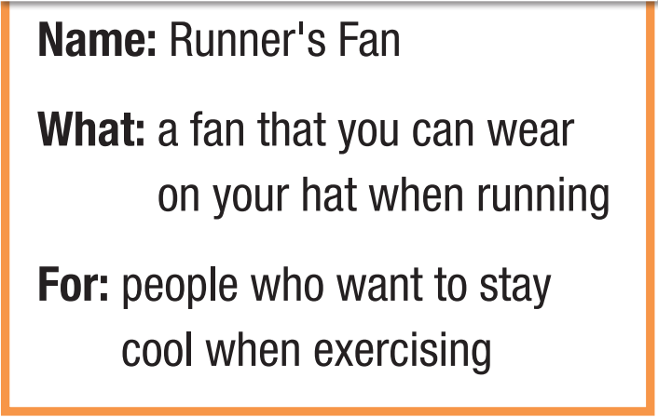
Ask and answer
What is a Runner’s Fan?
It’s a fan that you can wear on your hat when running.
Who is it for?
It’s for people who want to stay cool when exercising.

Slide 14
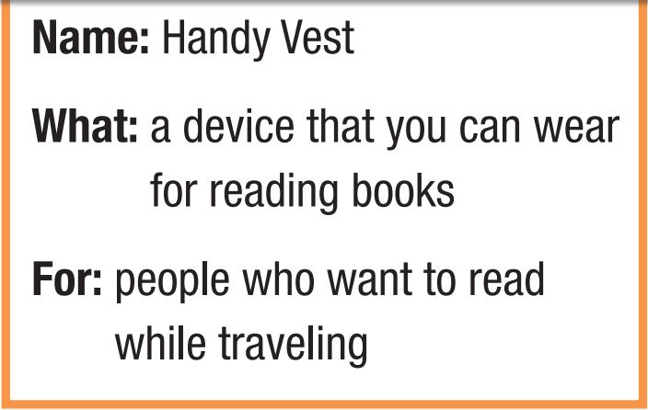
Ask and answer
What is a Handy Vest?
It’s a device that you can wear for reading books.
Who is it for?
It’s for people who want to read while traveling.

Slide 15
More practice with your own ideas.

Slide 16
You're participating in a science fair.
Work in pairs: Look at the problems these people have. Choose two problems and invent something to help solve them.

Slide 17
Problems
1. My feet always get hot when I wear shoes.
2. I don't want to hold an umbrella. I need both hands to message my friends.
3. I often make a mess when I eat. I don't want to clean the table every time I eat.
4. Sometimes food is too hot, and I burn my tongue when I eat.

Slide 18
Sample solutions
I think we should invent shoes that have mini fans.
I think we should invent umbrellas which can be attached on our shoulders.
I think we should invent tables which clean up after meals.
I think we should invent mini fans that can be attached on bowls.

Slide 19

Consolidation

Slide 20

Work in pairs.
b. Join two other pairs and share your inventions.
Explain what problems your inventions solve and how they work. Who has the best inventions?
I think the smart table that can clean up after meals is the best invention…

Slide 21

WRAP-UP

Slide 22
Today’s lesson
Pronunciation: practice intonation for relative clauses
Speaking: talk about weird inventions

Slide 23
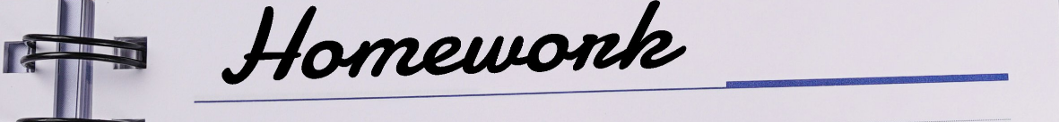
Practice talking about weird inventions with defining relative clause.
Practice intonation.
Prepare the next lesson – Lesson 3 on page 62 in SB.
Review all vocabularies and grammar in the unit.
Play the consolidation games in Tiếng Anh 10 i-Learn Smart World DHA App on www.eduhome.com.vn

